Slide 1
Growth Hormone Disorders: Importance of Correct Diagnosis and Timely Treatment
Hala Tfayli, MD
Associate Professor of Clinical Pediatrics
Head, Division of Pediatric Endocrinology & Diabetes
American University of Beirut
Lebanese Pediatric Society Annual Meeting
Sep 14, 2019

Slide 2
Growth Hormone History: A Tale of Ups and Downs
1956: First patient to receive GH (3 ½ yo, Bovine GH)
1958: Extraction of Human GH (356 pituitaries to treat one patient!)
1961: National Pituitary Agency (NIH supported)
1963: Immunoassay for GH and IGF-1
Use was on research basis and supply limited
1970’s-80’s: Gene splicing and recombinant human GH
1985: 2 Major events:
CJD cases from hGH
FDA Approval of rhGH for GH Deficiency:
unlimited supply for treatment and investigation
1958-1985: 27 years of human GH
1985-2019: Expanded use, New indications, Abuse (athletes, anti-aging)
2005: IGF-1 for primary IGF-1 Deficiency
Current : ongoing clinical trials for the weekly GH
Robert Blizzard
1924-2018
hGH: human growth hormone
rhGH: recombinant human growth hormone
Blizzard R. 2012

Slide 3
Approved Indications for Growth hormone: NICE Guidelines
Growth failure in:
Children with growth hormone deficiency/insufficiency:
Idiopathic isolated GHD
Congenital hypopituitarism (e.g. septo-optic dysplasia)
Acquired hypopituitarism (e.g. craniopharyngioma, post cranial irradiation, neuro-surgery or traumatic brain injury)
Girls with Turner syndrome
Children with chronic renal failure
Poor growth and body composition in children with Prader Willi Syndrome
Children born SGA, who fail to show catch up growth by 4 years of age (current height SDS < -2.5 and parental adjusted height SDS < -1)
SHOX deficiency
FDA: all of the above and
Noonan syndrome
Idiopathic short stature
(final height < 160 cm men, < 150 cm women)

Slide 4
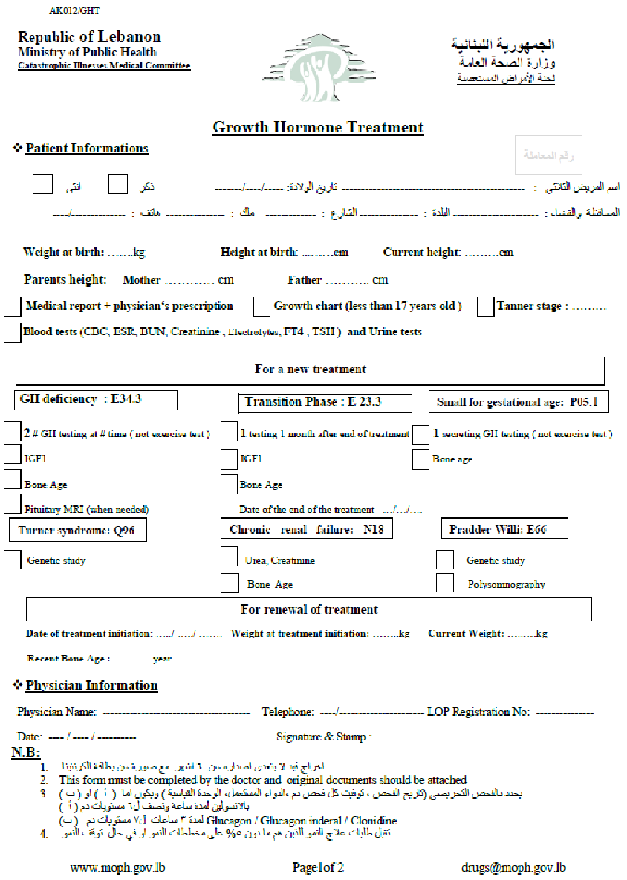
Approved Indications for GH treatment in children in Lebanon
Doses approved in Lebanon are similar to NICE

Slide 5
Short Stature/ Poor Growth: A Common Cause of Referral to Pediatric Endocrinology Clinics
Approximately 40% of new patient referrals to the pediatric endocrine clinics are for short stature¹
Many families present with the explicit question of whether growth hormone (GH) therapy should be administered to their child²
Growth hormone deficiency (GHD) is a rare disorder with a prevalence of approximately 1 in 4000 to 1 in 10000 during childhood³
Lee JM. J Ped Endocrinol Metab 2007
Stein MT. J Dev Behav Pediatr 2004
NICE, 2010. http://www.nice.org.uk/guidance/TA188

Slide 6
Causes of Short Stature/ Poor Growth
Non Pathologic
Intrauterine Growth Restriction
Systemic Disorders
Endocrine
Chromosomal & Genetic
Familial Short Stature
Syndromic
Cardiovascular disease
Growth Hormone related
GH deficiency: isolated/combined
GH resistance
Turner’s
SHOX
Russell- Silver
Noonan
Prader- Willi
Down
Seckel
Other
Renal
Non-Syndromic
Respiratory
Constitutional Delay of growth and Puberty
Hypothyroidism
Gastrointestinal disease
Glucocorticoid excess
Cushing
CAH
Exogenous
Nutritional
Neurological
Psychological
Skeletal dysplasias

Slide 7
Etiology of Short Stature Different depending on Study Population
Cincinnati Children's Hospital: Retrospective chart review of 1373 (2008-2011)
235 patients with a height of <3rd percentile, negative history and review of systems, and normal physical examination were identified:
23% with familial short stature
41% with constitutional delay of growth
36% with idiopathic short stature
The incidence of newly diagnosed pathology was 1.3%
Sisley S. J Pediatr 2013
64%
Organic disease found in:
7.3% of correctly referred short-statured patients¹
25% of new short stature referrals in a pediatric endocrine clinic²
40% of patients at a specialized growth center³
1. Grote. BMC Pediatr 2008
2. Grinberg A. J Pediatr 2005
3. Green AA. Arch Dis Child 1983

Slide 8
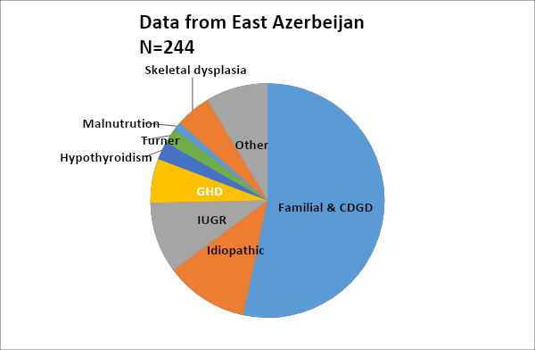
Etiology of Short Stature in Pediatric Endocrinology Clinics
GHD 6.1%
*Other: Iron deficiency anemia, Fanconi aplastic anemia, Celiac disease, Rickets, Congenital heart disease, Morquio syndrome
Shiva S. Iran J Pediatr 2009

Slide 9
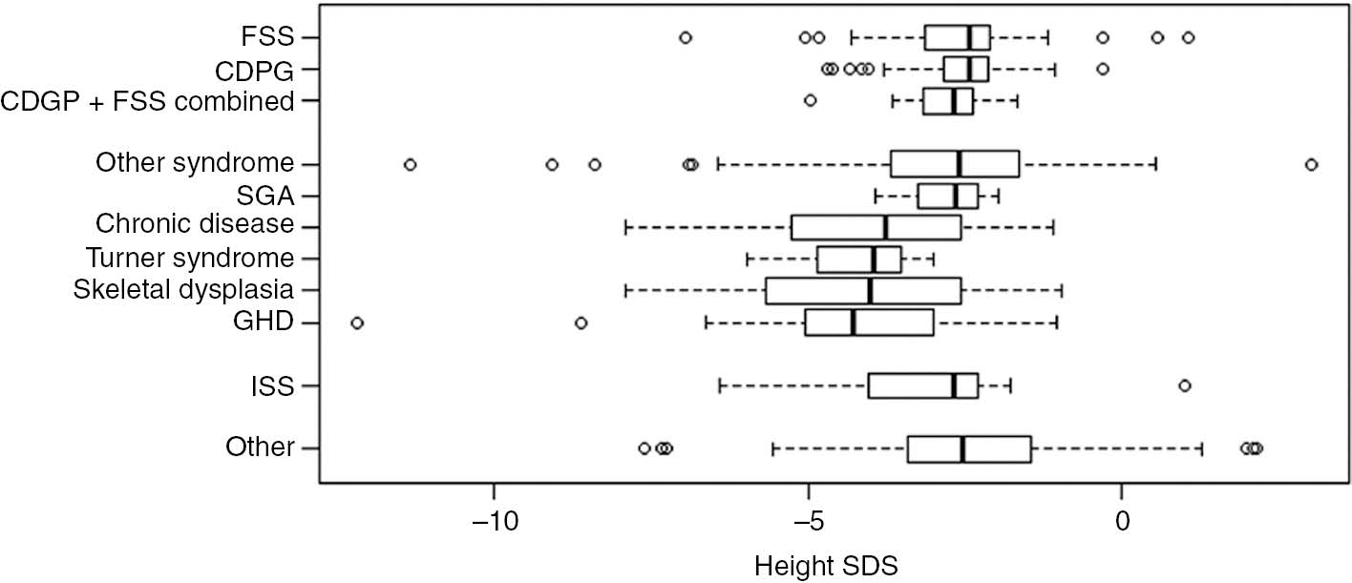
Etiology of Short Stature in Pediatric Endocrinology Clinics
N= 521
Short stature <-2 SDS. Thai children
45%
7.5%
J Pediatr Endocrinol Metabol 2017

Slide 10
Approved Indications for Growth Hormone Treatment
Growth hormone deficiency
Turner syndrome
SGA with poor catch-up growth
Chronic renal failure
Prader Willi Syndrome
SHOX deficiency
? Noonan
? ISS
For approved indications of GH use data indicates that earlier age at initiation of treatment is linked to better outcomes

Slide 11
Growth Hormone Deficiency Diagnosis: Striking the Right Balance
Missed or delayed diagnosis
Overdiagnosis or Misdiagnosis
Poor outcome
Linear growth
Bone health
Visceral adiposity
?Quality of life
Years of daily unnecessary subcutaneous injections
Significant wasted expenditure
Unnecessary exposure to potential adverse effects

Slide 12
What is Considered Short Stature? What is Considered Abnormal Growth?
Importance of the correct diagnosis

Slide 13
What is considered abnormal growth?
Is the child short?
Is the child short compared to genetic potential?
Does the child have a normal growth velocity/pattern?
Pattern of growth (height, weight, head circumference)
Birth history
Does the child have systemic problems?
Are they proportionate/disproportionate? Syndromic features?
Neurodevelopment?
What is their pubertal status?
Family history?

Slide 14
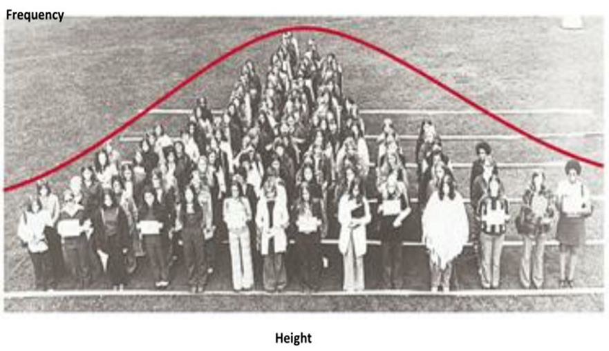
What is Considered Short Stature?
Height follows a normal distribution
SD
–3
–2
–1
Mean
+1
+2
+3
Percentile:
1
3
10
25
50
75
90
97
99
Short stature can be defined as:
height <-2 SD for age and sex in a population Below 3rd percentile (not 5th)
height more than 2SD below the mid-parental target height
Percentile talk: 5th: -1.6 SD, 3rd: -1.9 SD

Slide 15
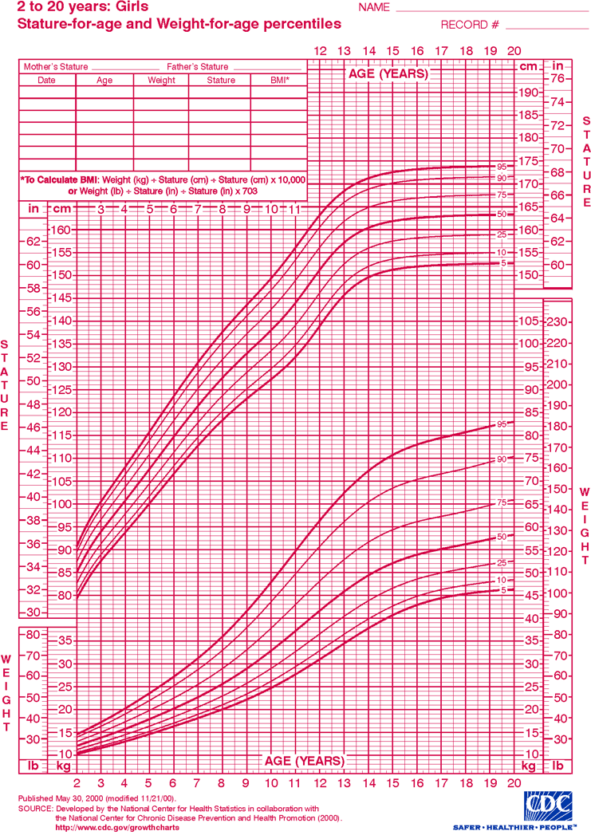
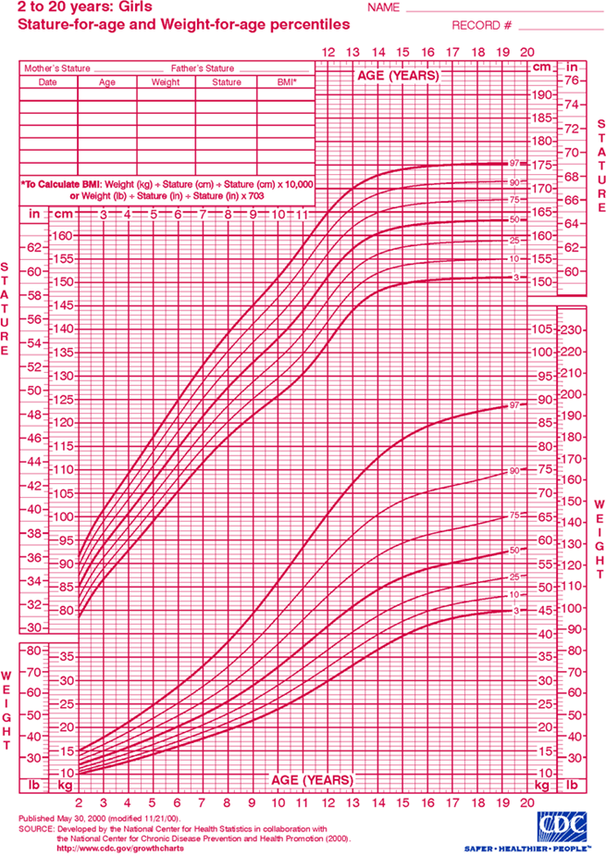
12 years old girl, 140 cm
+2SD
mean
.
.
-2SD
OK135S058

Slide 16
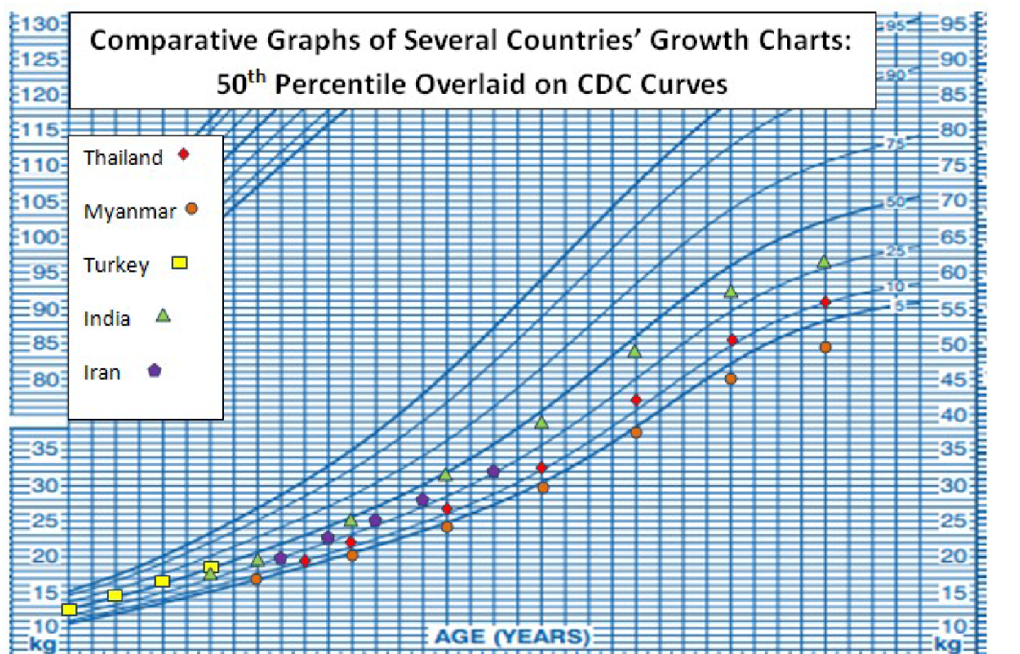
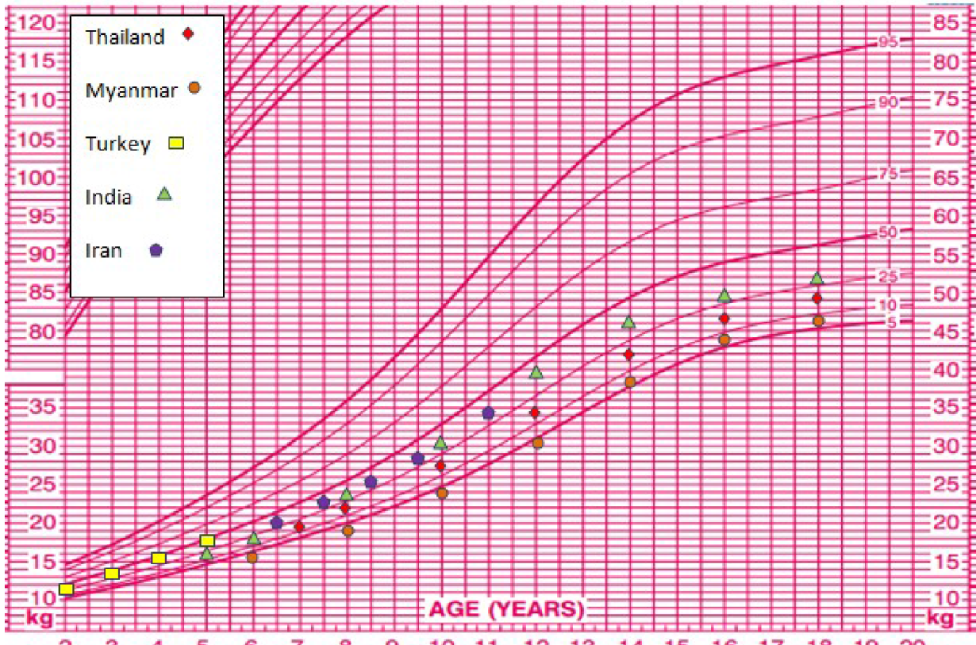
Williams 2016

Slide 17
Target height is calculated based on mid-parental height
Target height takes into account a child’s genetic potential for growth using parental heights¹
There are different formulas for calculation of target height, this is one commonly used²
Target mid-parental height (boys) = (father’s height + mother’s height + 13) ± 6.5 cm
2
Target mid-parental height (girls) = (father’s height + mother’s height - 13) ± 6.5 cm
2
Luo et al. Pediatr Res 1998
Tanner et al. Arch Dis Child 1970
Notes:
Speaker Notes
Target height calculates the expected height of an individual given their parents' heights.
The target height is commonly determined by corrected midparental height method (adding or subtracting 6.5 cm for boys and girls, respectively) which was introduced by Tanner et al. in 1970.
The first stage is to take a mean of the parental heights (father’s height plus mother’s height and then divided by 2); the second step is to add 6.5 cm for boys or subtract 6.5 cm for girls.

Slide 18
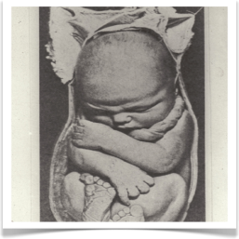
Phases of Growth
Intrauterine
Infancy
Childhood
Puberty
Fastest growth rate
Changing growth rates
Stable
growth rates
Acceleration in growth rates
Maternal factors
IGF-I and IGF-II
FGF, TGF, EGF
Insulin
Growth hormone (small role)
Nutrition
Endocrine
Thyroid
GH-IGF1
(after 1 yr)
Endocrine
Thyroid
GH-IGF1
Nutrition
Sex-steroids
GH-IGF1
Thyroid
Nutrition
Rose S. Pediatr Rev. 2005; Dattani. Lancet 2004

Slide 19
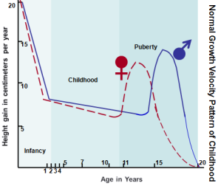
Annual Growth velocity
Birth to 12 mo: 18 -25 cm
12 to 24 mo: 10 -13 cm
24 mo to 36 mo: 7.5 – 10 cm
3 yrs -puberty onset: 5-6 cm
Development of long bones
Epiphyses formed at 1–2 years of age, stimulated by GH–IGF-I system
Epiphyses fuse:
end of growth

Slide 20
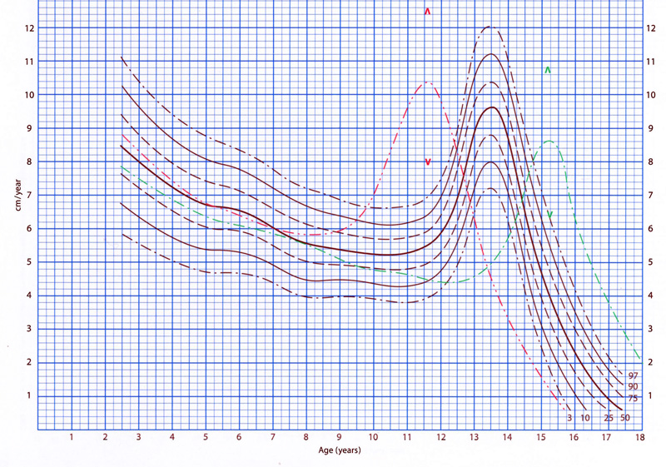

Slide 21
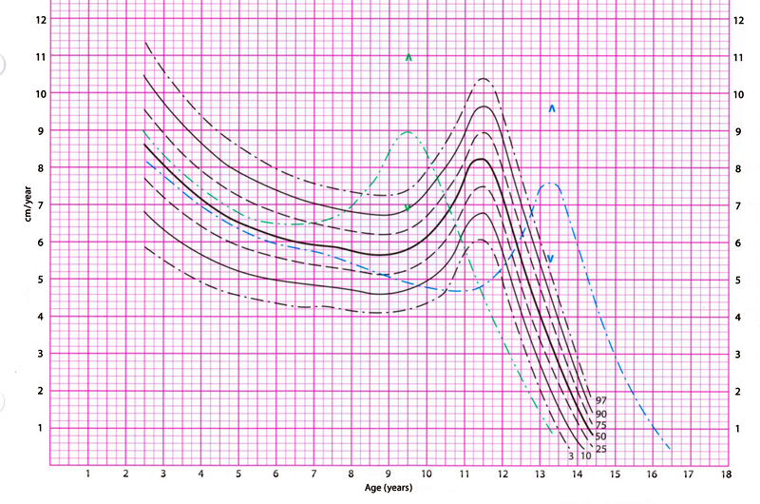

Slide 22
Diagnosing GHD: Not a Single Test
Multifaceted diagnosis
assessment of patient's auxology
biochemical assessment of the GH-IGF-I axis
imaging of the hypothalamo-pituitary axis

Slide 23
Diagnosing GHD: Challenges
Laboratory assays
IGF-1 assays accuracy
Confounding factors for IGF-1 concentration
Stimulation tests
Which ones to use: Insulin, glucagon, clonidine, L-DOPA, arginine?
Which cut-off: ?10 ng/ml or 7 or 8?
Special consideration: priming or no priming with sex steroids?
Blunted response in obese individuals
Respecting the correct order in testing
Make sure full pituitary axis is assessed in case of GHD

Slide 24
Consensus guidelines on the diagnosis and treatment of GH deficiency in childhood and adolescence (GH Research Society)
When to consider investigation for GH deficiency
Severe short stature, defined as a height > 3 SD below the mean (height < 1st percentile)
Height >1.5 SD below the mid-parental height
Height >2 SD below the mean (height < 1st percentile) and a height velocity over 1 year >1 SD below the mean for chronological age
or
Height >2 SD below the mean and a decrease in height SD of > 0.5 SD over 1 year in children over 2 years of age
In the absence of short stature, a height velocity >2 SD below the mean over 1 year or >1.5 SD sustained over 2 years; this may occur in growth hormone deficiency (GHD), presenting in infancy, or in organic acquired GHD.
Signs indicative of an intracranial lesion
Signs of MPHD (multiple pituitary hormone deficiencies)
Neonatal symptoms and signs of GHD
J Clin Endocrinol Metab. 2000

Slide 25
Guidelines for GH treatment in Children and Adolescents with GHD, ISS, primary IGF-1 deficiency
Use of GH to normalize AH and avoid extreme shortness in children and adolescents with GHD is strongly recommended
Stimulation testing may not be needed in patients with all the following :
auxological criteria
hypothalamic-pituitary defect (i.e.major congenital malformation [ectopic posterior pituitary and pituitary hypoplasia with abnormal stalk], tumor or irradiation)
deficiency of at least one additional pituitary hormone
“We recommend against reliance on GH provocative test results as the sole diagnostic criterion of GHD. (Strong recommendation)”
Horm Res Paediatr 2016

Slide 26
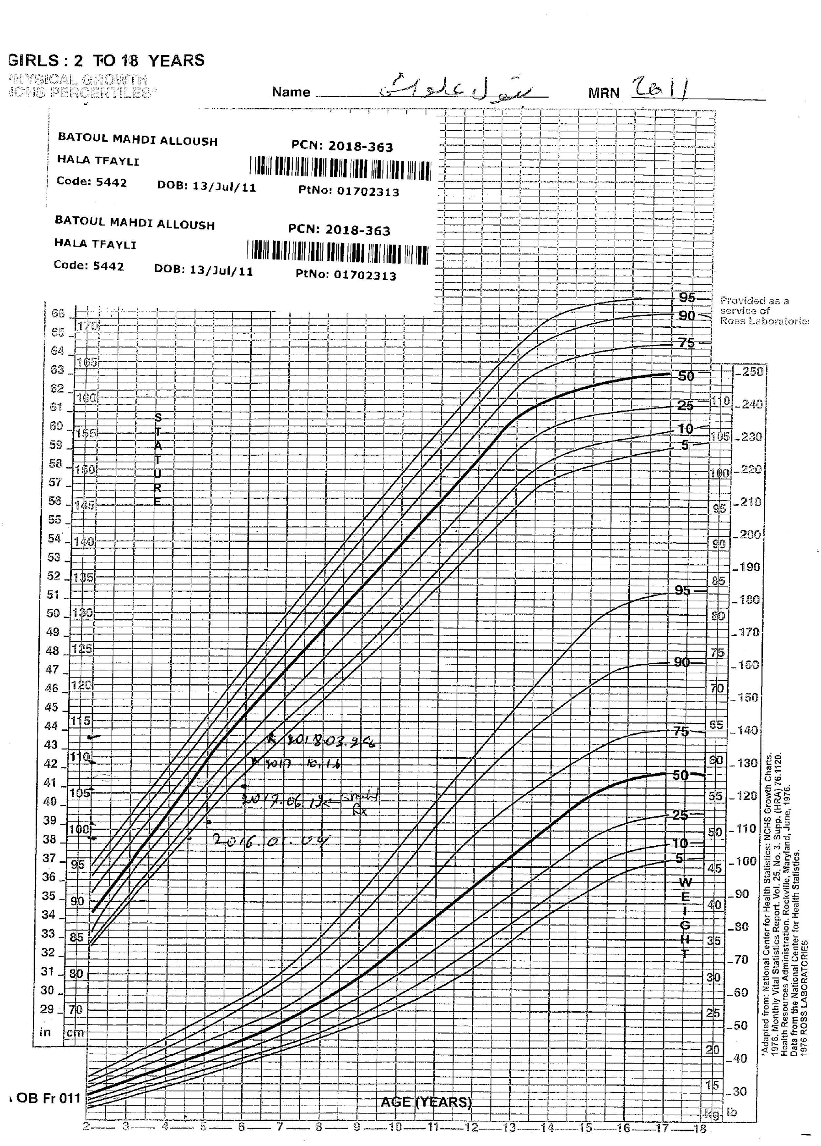
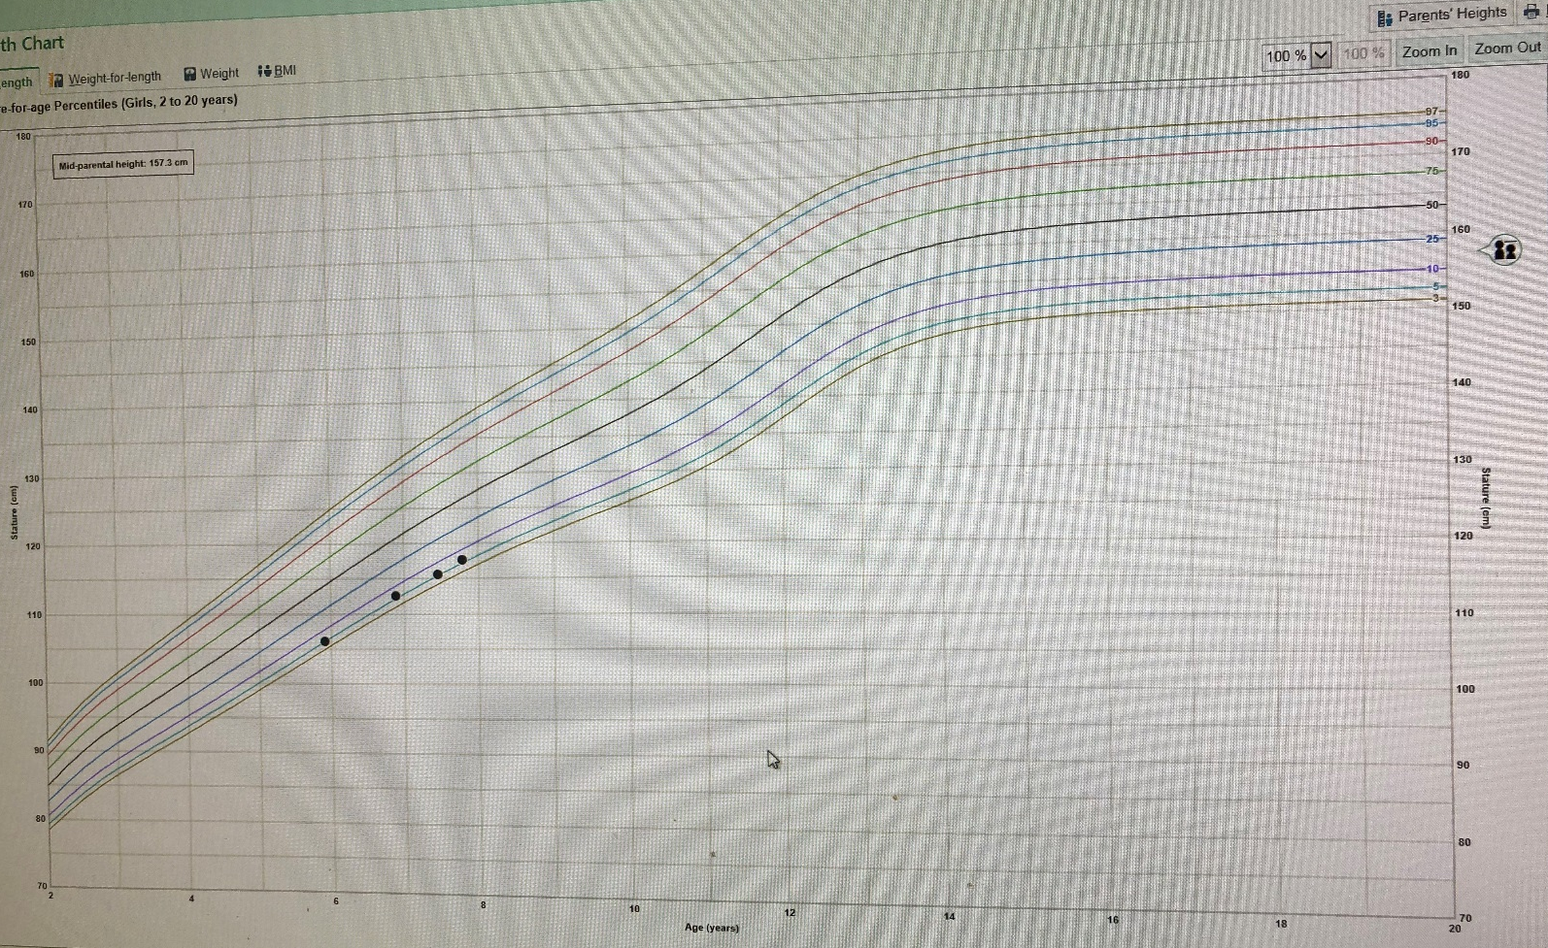
7 y
No chronic medical issues
Mom 159 cm
Dad 168.5 cm
MPH 157.3 cm
Bone age normal, TFTs normal, IGF-1 normal
7 yrs 5 mo Female
Diagnosed GHD (Peak GH 8.5 ng/ml)
Receiving treatment
Parents presented for a second opinion
First visit
Stop Rx
GH initiated

Slide 27
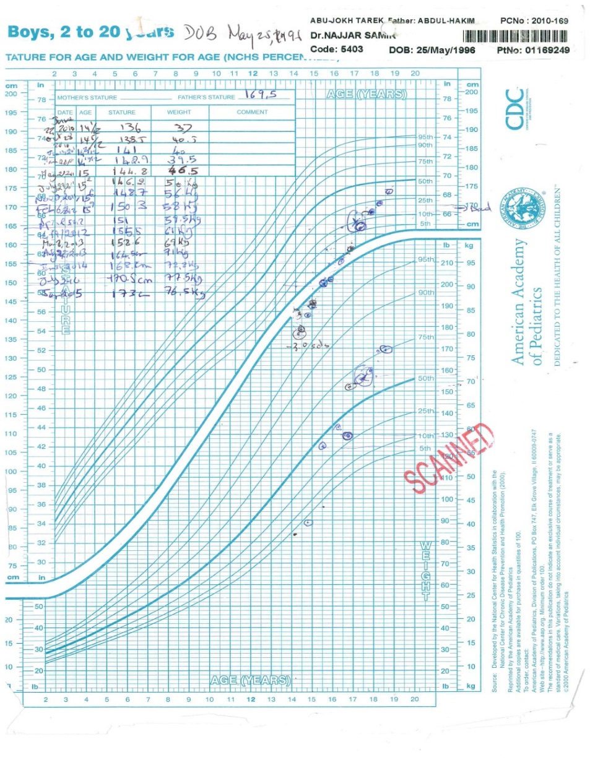
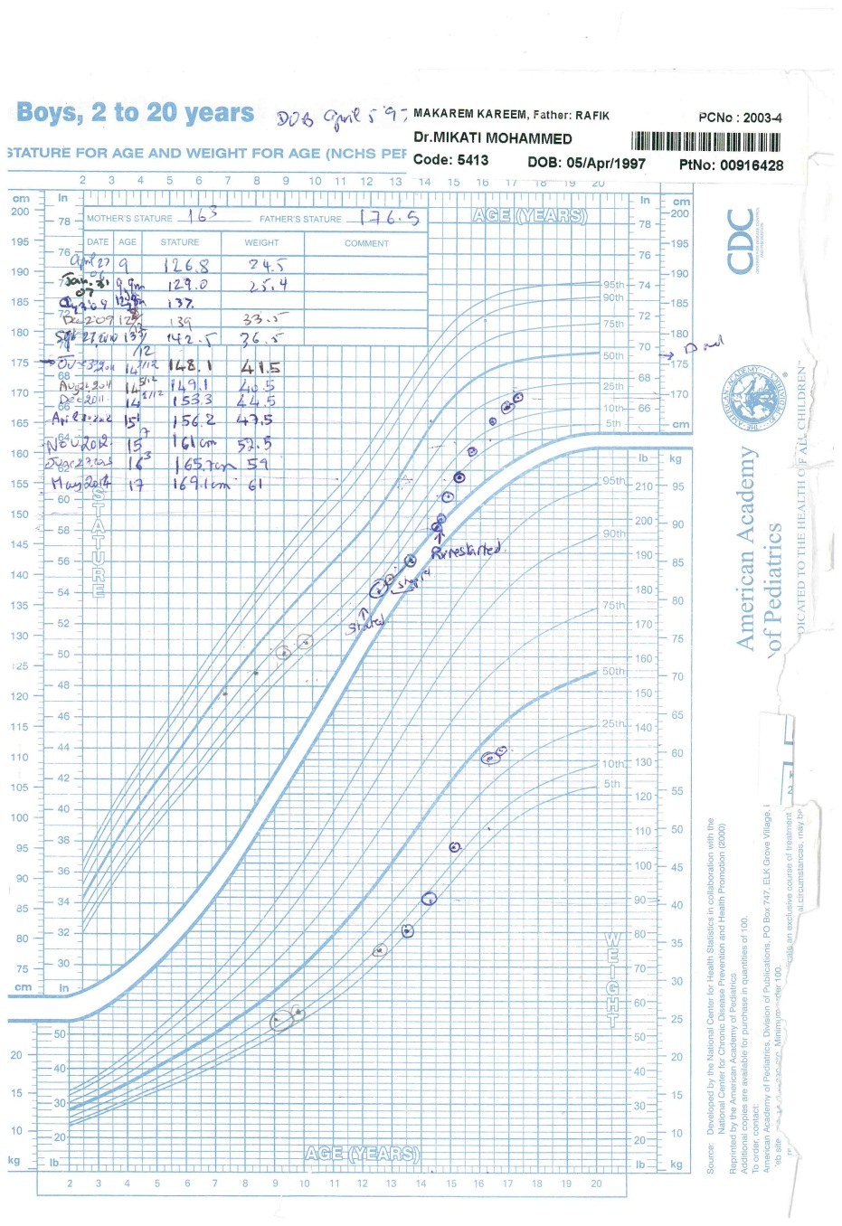
Severe acquired GH deficiency
Treated for several years
Height at 17 yrs 1 mo: 171 cm
176.5±6.5cm
Pineal Germinoma
s/p surgery, chemotherapy, cranial radiation
GH deficiency
Diabetes Insipidus
Hypogonadotropic hypogonadism

Slide 28
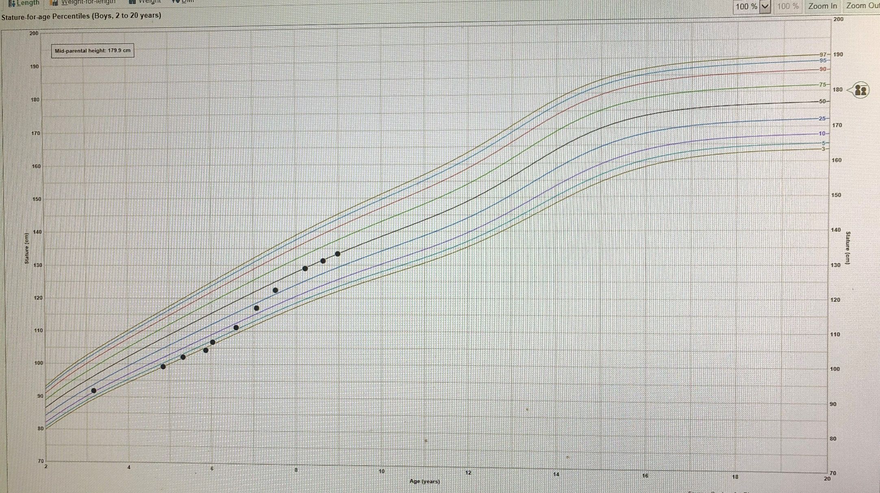
Presented at age 5 yr and a half
Height= 102 cm, 3.1%, -1.9 SDS
MPH; 180 cm
Craniopharyngioma
IGF-1: very low

Slide 29
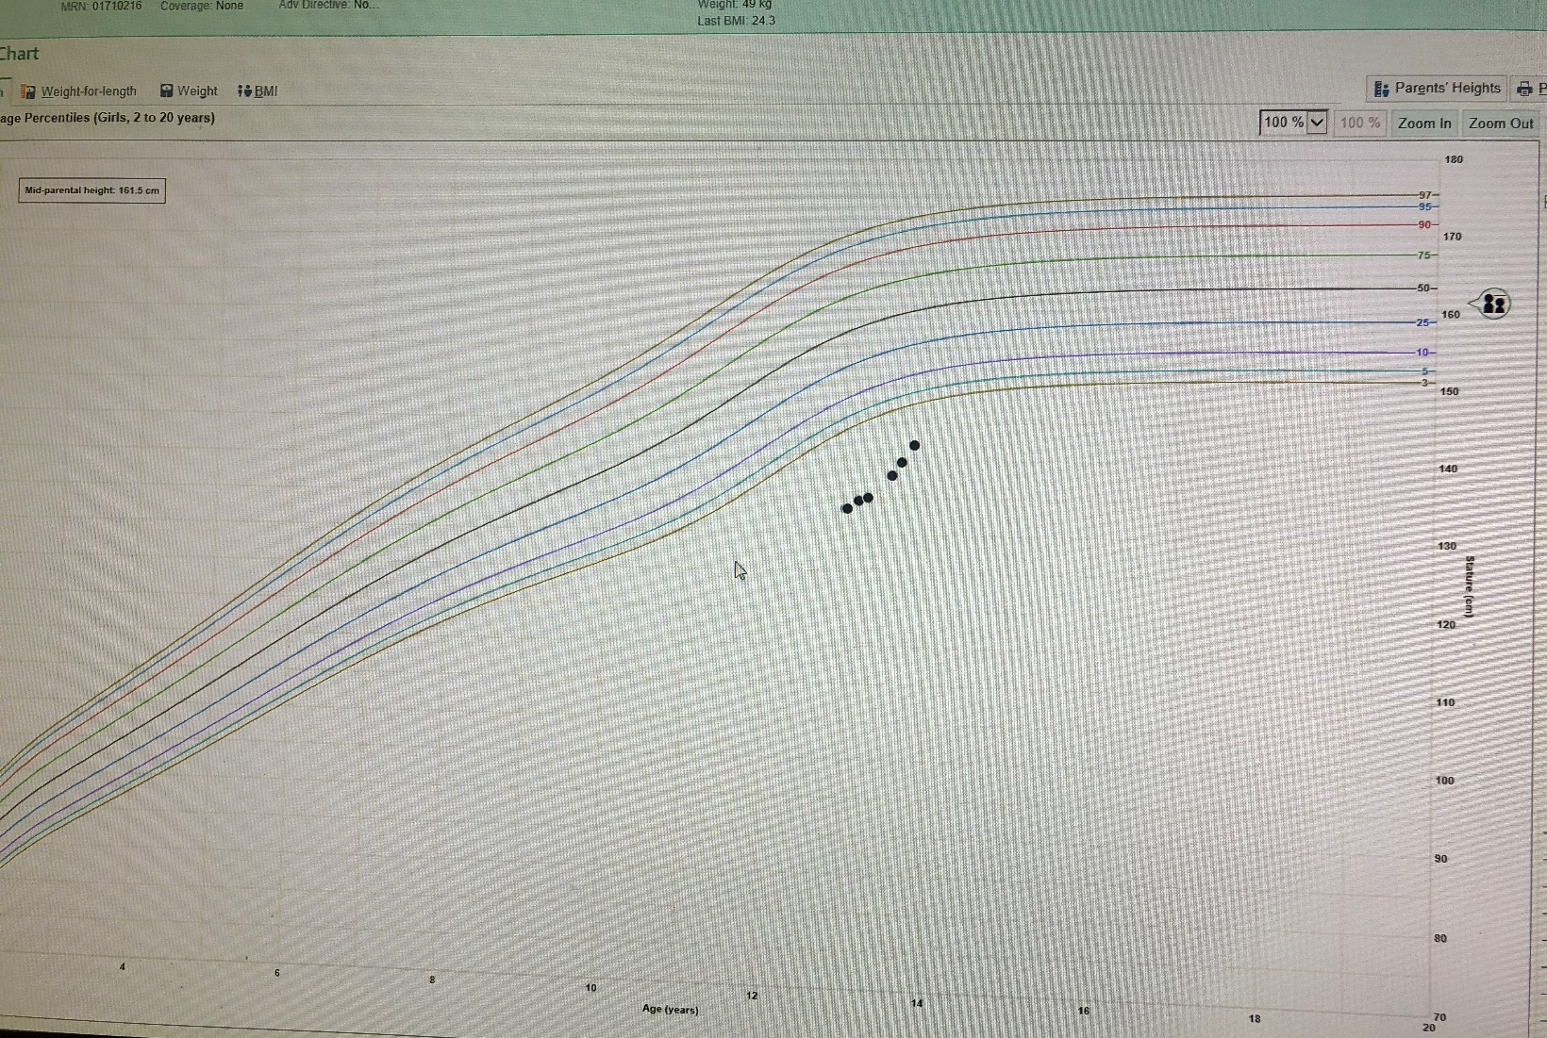
Patient presented age 13 yrs
Height 133.5 cm, at -3.39 SDS, 0.03%
MPH= 161.5 cm
Obese
No pubertal signs
History of stunted growth
Craniopharyngioma
IGF-1: 25 ng/ml, VERY LOW
FreeT4 low with normal TSH
Cortisol normal
MRI: Craniopharyngioma

Slide 30
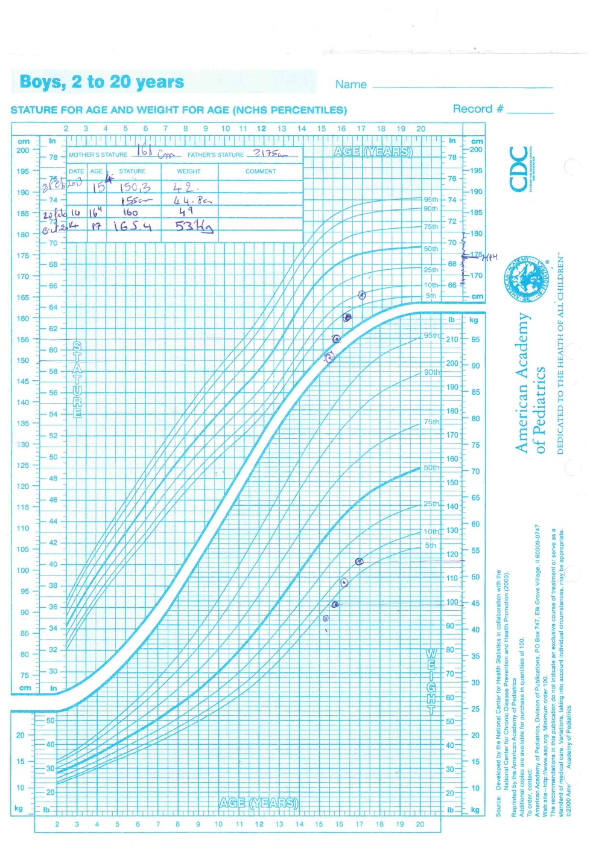
Patient presented at 15 yrs 4 mo
Height: 150.3 cm
Weight: 42 kg
MPH: 174 cm
Tanner II PH, II Testicles
Normal general exam
Puberty induction done
On follow-up grew 10 cm in 1 year
IGF-1: increased appropriately
Most recent report by mom as tall as dad
Bone age: 12 yrs 6 mo
CBC, Electrolytes, Cr: normal
TSH, Free T4: normal
IGF-1: 110 ng/ml (low for age)
LH: 0.9 mIU/ml
FSH:1.9 mIU/ml
Testosterone:11.1 ng/dl
Constitutional Delay of Growth and Puberty

Slide 31
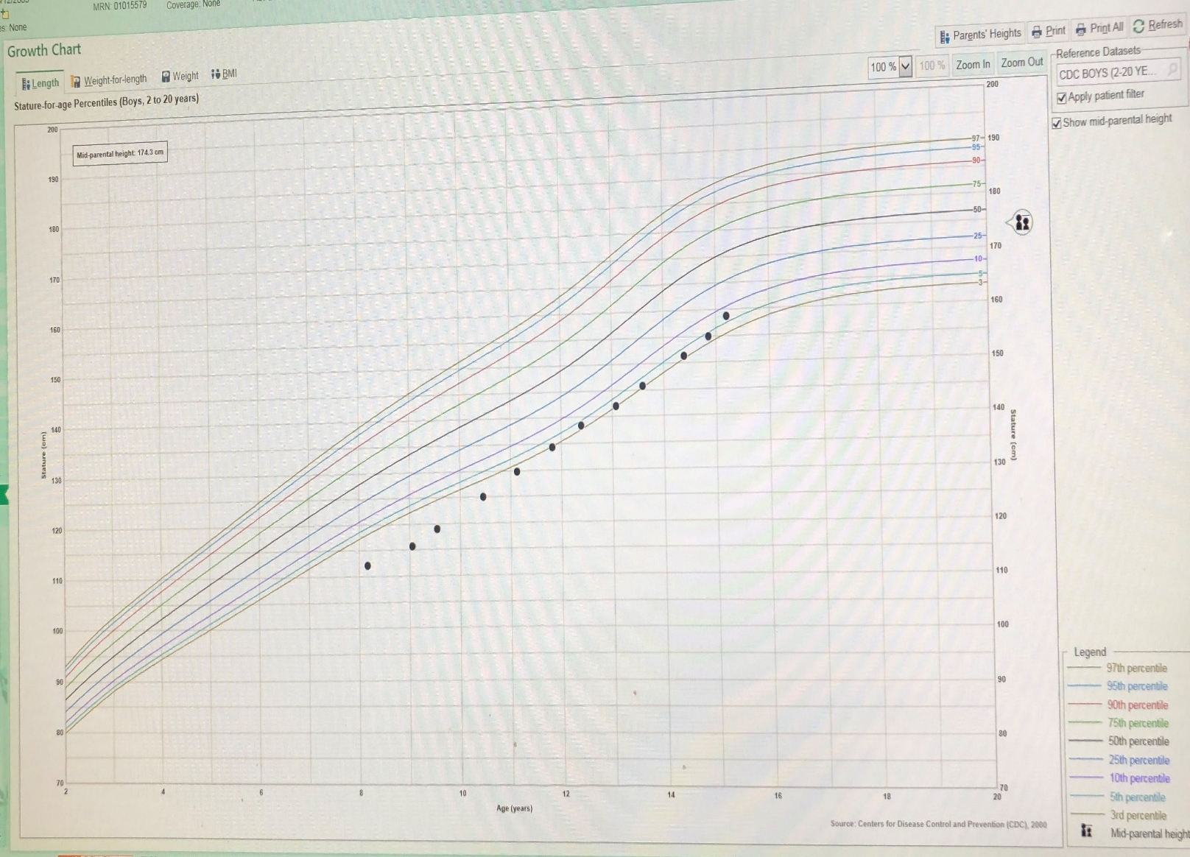
Patient presented age 8 yrs
Height 112.2 cm, at -2.97 SDS, 0.15%
MPH= 174.3 cm
(Dad 177 cm, Mom 158.5 cm)
Healthy, normal birth weight
Normal screening tests

Slide 32
Benefits of early GH treatment

Slide 33
Greater height velocity in younger GHD, TS and SGA patients during 1-year of GH treatment
18
Severe GHD
18
Turner syndrome
16
16
Study design:
Observational database (KIGS)
GH dose:
0.22 mg/kg/wk in GHD
0.30 mg/kg/wk in TS
0.31 mg/kg/wk in SGA
14
P97
14
12
12
Height velocity (cm/year)
P90
10
Height velocity (cm/year)
P75
10
P97
8
P50
8
P90
P25
P75
6
6
P50
P10
P25
4
P3
4
P10
Before
P3
2
2
Before
2
4
6
8
10
12
2
4
6
8
10
12
Age (years)
Age (years)
18
Less-severe GHD
18
SGA
16
16
14
14
12
Height velocity (cm/year)
12
10
Height velocity (cm/year)
P97
10
P97
P90
P90
8
P75
8
P75
6
P50
P50
P25
6
P25
4
P10
P10
P3
4
P3
2
Before
2
Before
2
4
6
8
10
12
2
4
6
8
10
12
Age (years)
Age (years)
Height velocity patterns during the first year of GH treatment
relative to age at onset of treatment
GH, growth hormone; GHD, growth hormone deficiency; P, percentile lines; SGA, small for gestational age; TS, Turner syndrome
Ranke et al. J Clin Endocrinol Metab 2010
Notes:
Speaker Notes
This figure shows height velocity (HV) patterns during the first year of GH therapy related to age at treatment onset in children with severe GHD, less-severe GHD, Turner syndrome, or in children who were born SGA.
In all groups, HV showed a downward trend with increasing age.
Dotted lines represent mean height velocity before GH therapy, other lines are percentile lines.
Background
Growth data from the KIGS (Pfizer International Growth Database) on prepubertal children aged 1–13 years with severe GHD (max GH <5 µg/L; n=2129), with less-severe GHD (max GH of 5–10.5 µg/L; n=3075) and with Turner syndrome (n=2350), and short children born SGA (n=993) were analysed before and during 2 years of GH treatment. During first year of treatment, HV was higher in patients with severe GHD than in other patients groups (all p<0.001).
Figure reproduced with permission from Ranke M et al. Observed and predicted growth responses in prepubertal children with growth disorders: guidance of growth hormone treatment by empirical variables. J Clin Endocrinol Metab 2010;95(3):1229–37. Copyright 2010, The Endocrine Society.

Slide 34
Early age at treatment start improves final height in GHD patients
Prepubertal height gain was significantly correlated with the total height gain (r=0.57; p<0.001). It is therefore important to start treatment before puberty
Study design:
Observational database (KIGS)
8
6
4
Age at treatment start was negatively correlated with total height gain (p<0.0001)
2
Total delta height (SDS)
0
–2
n=245
–4
–2
0
2
4
6
Prepubertal delta height (SDS)
GH, growth hormone; GHD, GH deficiency; r, correlation coefficient; SDS, standard deviation score
Reiter et al. J Clin Endocrinol Metab 2006
Notes:
Speaker Notes
Data are coming from the observational KIGS database. The figure shows that prepubertal height gain was significantly correlated with the total height gain in patients with isolated GHD. This implicates importance of treatment start well before puberty to allow for sufficient time for optimal GH treatment outcome.
1st click – This study also showed significant negative correlation between age at treatment start and total height gain in GH-treated patients with GHD. It means that earlier the GH treatment starts, better final height gain.
Study concludes that it is possible to achieve final height within the normal range in patients with idiopathic GHD treated from an early age with GH.
Background
The objective of this study was to analyse near-final height (NFH) data from a cohort of GH-treated children with idiopathic GHD.
Of 1258 evaluable patients in the Pfizer International Growth Database (KIGS) with GHD, 980 were of Caucasian origin, and 278 were of Japanese origin; 747 had isolated GHD (IGHD), and 511 had multiple pituitary hormone deficiencies (MPHD).
Mean GH dose: 0.17–0.22 mg/kg/wk for different groups (gender-specific Caucasian and Japanese for IGHD and MPHD).
It was concluded that it is possible to achieve final height within the normal range in patients with idiopathic GHD treated from an early age with GH.
Figure reproduced with permission from Reiter E et al. Effect of growth hormone (GH) treatment on the near-final height of 1258 patients with idiopathic GH deficiency: analysis of a large international database. J Clin Endocrinol Metab 2006;91(6):2047–54. Copyright 2006, The Endocrine Society.
‹#›

Slide 35
98% of children born SGA reached an adult height within their target height range after long-term GH treatment
In the GH 0.033 mg/kg/day group, mean height gain of 1.8 SDS from start of treatment until adult height; an improvement of ≅ 11 cm in girls and 12 cm in boys
Study design:
Double-blind, randomised,
dose–response study
GH 0.033 mg/kg/day
Mean (SD) age, 7.9 (1.9) years
n=28
GH 0.067 mg/kg/day
Mean (SD) age, 8.2 (1.9) years
n=26
1.0
Target height SDS
Baseline
2 years
Adult
height^{Ɨ}
0.0
–1.0
Height SDS
–2.0
*
*
Data are mean±SD
–3.0
*p<0.0001 vs. baseline
^{Ɨ}Adult height was reached after ~7.8 years of GH treatment
–4.0
Age at treatment start was negatively correlated with the height gain
from treatment start until adult height (p<0.01)
GH, growth hormone; SDS, standard deviation score; SGA, small for gestational age
Van Pareren . J Clin Endocrinol Metab 2003
Notes:
Speaker Notes
This was a double-blind, randomised, dose-response study (0.033 mg/kg/day and 0.067 mg/kg/day) in short children born SGA.
The figure shows height SDS at baseline, after 2 years of GH treatment and at adult height in relation to the target height (TH) range.
GH treatment resulted in an adult height within the target height range in 98% of SGA children.
1st click – Mean gain in height SDS from the start of GH treatment until adult height was 1.8 SDS in the low dose group (0.033 mg/kg/day), corresponding to the improvement of 11 cm for boys and 12 cm for boys.
2nd click – A significant negative correlation between the age at treatment start and the gain in height SDS from the start of GH treatment until adult height. It means that earlier the GH treatment starts, greater height gain until adult height.
Please refer to local GH product labelling, when treating patients with SGA.
Background
A total of 54 children included in a Dutch study reached adult height following a mean (±SD) GH treatment period of 7.9 (1.7) years in the 0.033 mg/kg/day group and 7.5 (1.7) years in the 0.067 mg/kg/day group (calculate for both groups together, the corresponding value is approximately 7.8 years).
GH resulted in a mean (SD) adult height SDS of –1.1 (0.7) for children receiving GH at a dose of 0.033 mg/kg/day and –0.9 (0.8) for children receiving 0.067 mg/kg/day. In both groups there was a significant improvement in height SDS from baseline (p<0.0001). The between-group difference was not statistically significant (mean difference 0.3 SDS; 95% confidence interval, –0.2 to 0.6; p=0.3).
TH was adapted from Dutch reference data (Roede 1985) and TH range was defined as mean TH ±2 SD.
It was concluded that long-term GH treatment in short children born SGA leads to normalisation of AH (98% achieved adult height within their target range).
Figure reproduced with permission from van Pareren Y et al. Adult height after long-term, continuous growth hormone (GH) treatment in short children born small for gestational age: results of a randomized, double-blind, dose-response GH trial. J Clin Endocrinol Metab 2003;88(8):3584–90. Copyright 2003, The Endocrine Society.

Slide 36
83% of Turner syndrome girls reached a normal final height after long-term GH treatment
Mean gain in final height was 12 cm and 16 cm in
the 0.045 mg/kg/day and 0.067 mg/kg/day groups, respectively
Duration of GH treatment
Study design:
Open, randomised, dose-escalation study
n=60
Start
2 years
4 years
7 years
Adult height
0
–1
Height SD score
Age at treatment start was negatively correlated with final height (p<0.05)
–2
–3
p<0.01 vs. start
Group A, 0.045 mg/kg/day, mean age 6.5 years
Group B, 0.067 mg/kg/day, mean age 6.9 years
–4
Group C, 0.090 mg/kg/day, mean age 6.5 years
Height SD score (reference group healthy Dutch girls)
GH, growth hormone; SD, standard deviation
Van Pareren et al. J Clin Endocrinol Metab 2003
Notes:
Speaker Notes
This was an open, randomised, dose-escalation study (three dose groups: 0.045, 0.067 and 0.090 mg/kg/day) in TS girls.
The slide shows height SDS at start, after 2, 4 and 7 years of GH treatment and at adult height (mean duration of GH treatment was 8.6 years).
83% of TS girls reached final height within the normal range.
1st click – Mean gain in final height in the low dose group (0.045 mg/kg/day) was 12 cm; mean gain in final height was 16 cm in the 0.067 mg/kg/day group.
2nd click – The study showed significant negative correlation between age at treatment start and final height in GH-treated TS patients. This means younger age at treatment start, better final height.
Please refer to local GH product labelling when treating patients with TS.
Background
This study shows final height (FH) in 60 girls with Turner syndrome treated in a randomised dose-response trial, combining GH treatment with low dose estrogens at a relatively young age. Girls were randomly assigned to group A (0.045 mg/kg/day), group B (first year, 0.045 mg/kg/day; thereafter 0.067 mg/kg/day), or group C (first year, 0.045 mg/kg/day; second year, 0.067 mg/kg/day; thereafter, thereafter 0.090 mg/kg/day). After a minimum of 4 years of GH treatment low dose micronized 17beta-oestradiol was given orally.
After a mean duration of GH treatment of 8.6 ± 1.9 years when FH was reached.
FH SDS, was –1.6 (1.0) in group A, –0.7 (1.0) in group B, and –0.6 (1.0) in group C. The difference in FH in cm, corrected for height SD score and age at start of treatment, was significant between groups A and B (p<0.01], and groups A and C (p<0.001), but not between groups B and C.
83% of TS girls reached a normal FH.
After starting oestrogen treatment, the decrease in height velocity (HV) changed significantly to a stable HV, without affecting bone maturation.
Chronological age at start of treatment contributed significantly to predicting FH SD score.
Study concluded that GH treatment leads to normalisation of final height in most TS girls, even when puberty is induced at a normal pubertal age.
Figure reproduced with permission from van Pareren Y et al. Final height in girls with Turner syndrome after long-term growth hormone treatment in three dosages and low dose estrogens. J Clin Endocrinol Metab 2003;88(3):1119–25. Copyright 2003, The Endocrine Society.

Slide 37
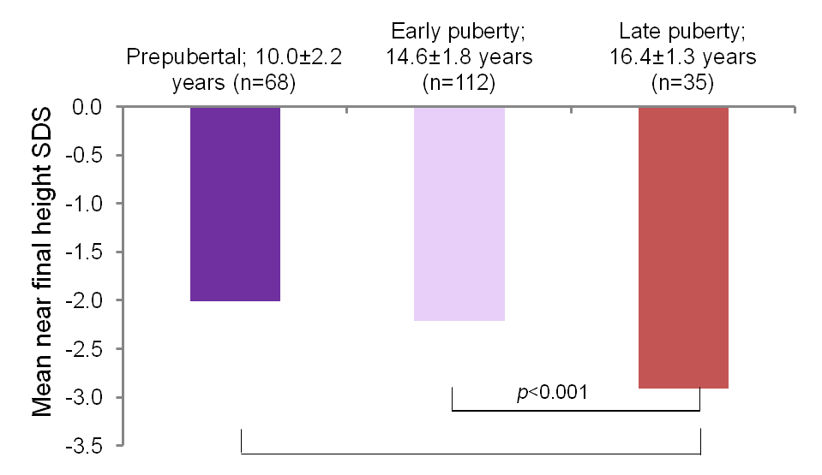
Near final height is improved with earlier GH treatment start in children with CRD
Study design:
Observational database (KIGS)
Mean GH dose:
Boys: 0.30 mg/kg/day
Girls: 0.32 mg/kg/day
Pubertal status (mean [SD] age) at treatment start
Age at treatment start was negatively correlated with near final height, (p=0.012)
p<0.001
CRD, chronic renal disease; GH, growth hormone; SD, standard deviation; SDS, standard deviation score
Nissel et al. J Clin Endocrinol Metab 2008
Notes:
Speaker Notes
This study analysed near final height (FH) in a cohort of 240 patients with CRD treated with GH of whom 39% were prepubertal and 61% were pubertal at baseline.
As shown on the figure, mean near FH SDS was significantly better in patients who started treatment prepubertally than during late puberty.
1st click – Age at start of treatment was significantly negatively correlated with near FH.
Please refer to local GH product labelling when treating CRD patients with growth failure.
Background
This study set out to analyse near-FH in a cohort of GH-treated Chronic kidney disease (CKD) patients.
Of 240 evaluable patients in the Pfizer International Growth Database (KIGS) with CKD, 39% were prepubertal and 61% were pubertal at baseline; 45% were on conservative treatment for CKD, 28% were on dialysis, and 27% were in the period after renal transplantation.
Mean height SD scores increased continuously during GH treatment until near FH by 1.2 and 1.6 in boys and girls, respectively.
Age at start of GH treatment was among significant predictors of growth response to GH therapy.
It was concluded that long-term GH therapy of CKD patients in prepubertal and pubertal age results in an increased adult height, but response is diminished in patients on dialysis and/or with severely delayed puberty.
‹#›

Slide 38
Closing Remarks
Linear growth is an essential part of a child’s normal development. Abnormal growth can be a sign of underlying pathology
Distinction between abnormal growth and normal short stature is important
Diagnosis of GHD is multifaceted and relies on a comprehensive approach
Timely referral, diagnosis and treatment initiation is important for better outcomes

Slide 39
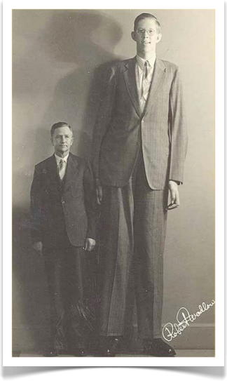
Shortest Man in History
Age: 72 yrs
Height: 54.6 cm
Tallest Man in History
Age: 22 yrs
Height: 272 cm

