Slide 1
Bronchiolitis What’s New in 2019
Katia El Taoum, MD
Salman Mroueh, MD
Pediatric Pulmonary
AUBMC

Slide 2
Objectives
AAP Guidelines
Current practice
Pros and Cons
Future expectations from AAP

Slide 3
Introduction
Controversial subject
Treat or not to treat
AAP Bronchiolitis Diagnosis & Management Guidelines 2006 – 2014

Slide 5
AAP bronchiolitis diagnosis and management Guidelines 2014
The guideline applies to children from 1-23 months of age who are 1st time wheezing
Diagnosis
Treatment
Prevention

Slide 6
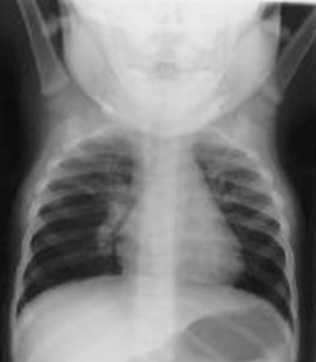
Diagnosis
History and Physical Exam
Risk factors:
age <12 wks
History of prematurity
Cardiopulmonary disease
Immunodeficiency
NO Radiographic or laboratory studies routinely

Slide 7
Management: Supportive
Test/Treatment | Recommendations based on the AAP 2014 Guidelines
Nasal Suctioning | Often helpful
Deep Nasopharyngeal suctioning | Insufficient evidence but unlikely to be beneficial
Chest physiotherapy | Not recommended
Albuterol/Epinephrine | Not recommended
Hypertonic saline | Not recommended in ER
Corticosteroids | Not recommended
Support for patients who cannot maintain oral hydration | Provide NGT or IV hydration
Supplemental O2 | Not to administer if saturation exceeds 90%
Continuous Pulse Oximetry | Use only intermittent monitoring
Antibiotics | Only if concomitant bacterial infection, or a strong suspicion of one

Slide 8
Prevention
Disinfect hands before and after patient contact using alcohol-based rubs or soap and water
Encourage breast-feeding
Assess for and counsel against environmental smoke exposure
Administer palivizumab during RSV season to infants who qualify

Slide 9
What About Other Treatments?
Heated Humidified High Flow Nasal Cannula
Macrolides
Montelukast
Complementary and Alternative Medicine

Slide 11
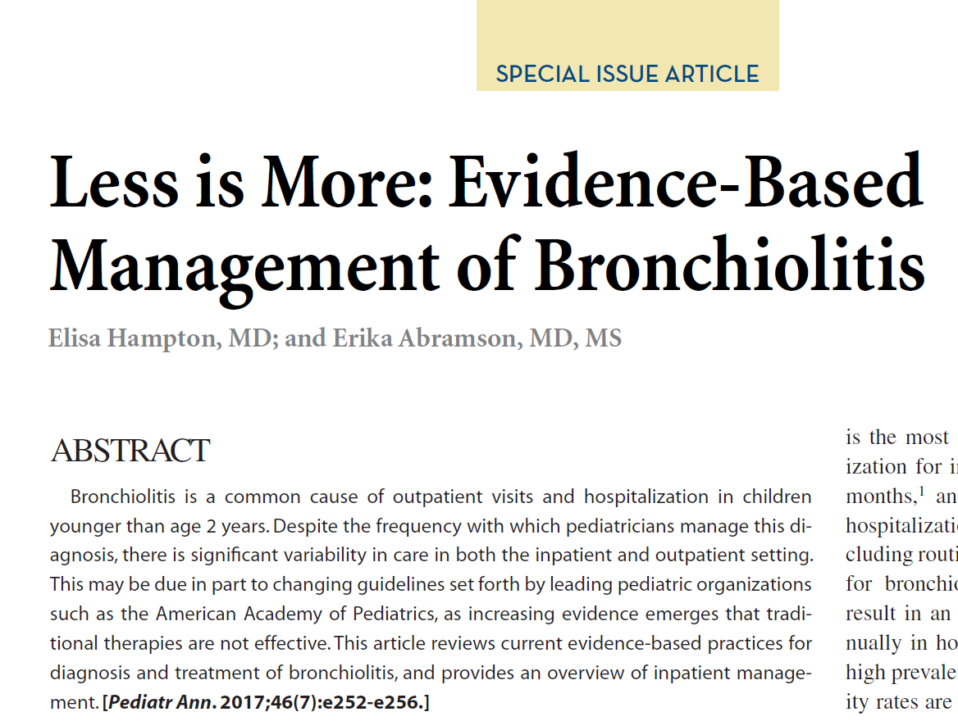

Slide 12
Bronchodilators such as albuterol or salbutamol do not improve oxygen saturation, do not reduce hospital admission after outpatient treatment, do not shorten the duration of hospitalization and do not reduce the time to resolution of illness at home. Given the adverse side effects and the expense associated with these treatments, bronchodilators are not effective in the routine management of bronchiolitis.
Cochrane Database of Systematic Reviews 2014, Issue 6.

Slide 13
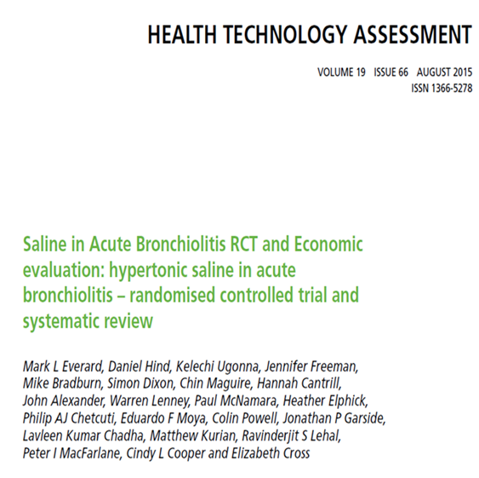
The results from this large pragmatic study indicate that the addition of nebulized HS to good supportive care when treating infants admitted to hospital with acute bronchiolitis does not appear to cause any harm but confers no benefit.

Slide 14
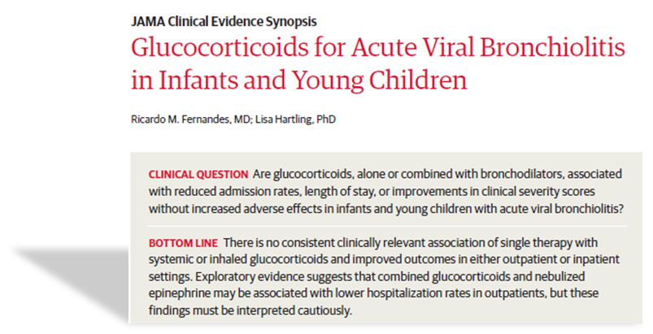
JAMA. 2014 Jan 1;311(1):87-8.

Slide 15
CONCLUSIONS AND RELEVANCE Prior analyses were driven by an outlier population and unbalanced treatment groups in positive trials. Once heterogeneity was accounted for, the data did not support the use of HS to decrease LOS in infants hospitalized with bronchiolitis.
JAMA Pediatr. 2016;170(6):577-584.

Slide 18
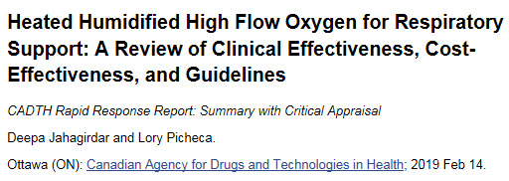
Though it is promising and increasingly being used, there are currently no set recommendations for practical application. It is unclear whether greater patient tolerance translates into clinical benefit.

Slide 19
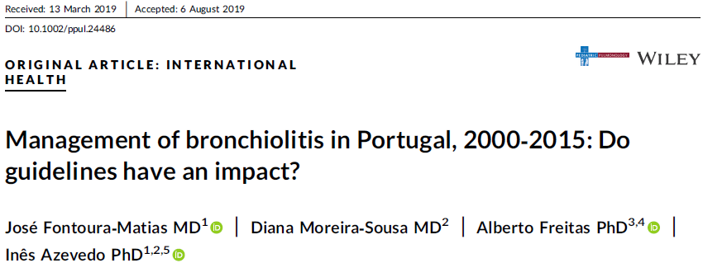

Slide 21
