Slide 1
Where We Are Now and How We Can Do Better
Pneumococcal disease vaccination
Mansour R Khalaf, Bsc Pharm, MPH
Group Medical Manager, Vaccines
September 2019
GlaxoSmithKline Biologicals SA., Rixensart, Belgium.
©2018 GSK group of companies or its licensor.
Zinc Approval code : NE/SYN/0018/18
Date : 13 September 2019
The 16th Annual Meeting of the Lebanese Paediatric Societies | 13 - 14 September, 2019 | Beirut - Lebanon

Slide 2
Conflict of Interest Statement
I am a full-time GSK employee
The 16th Annual Meeting of the Lebanese Paediatric Societies | 13 - 14 September, 2019 | Beirut - Lebanon

Slide 3
Speaker biography
Mansour Khalaf, Group Medical Manager, Saudi Arabia
Graduated as a Pharmacist.
Obtained Diploma in Business Administration from International Academy of Business Administration.
Obtained Master Degree in Public Health in Denmark.
Member of the Canadian Public Health Association.
Have more than 21 years of experience in immunization policies & management.
Currently, Leading Saudi Vaccines Medical.
Consulted in developing vaccination policies, with an objective to improve the health in Saudi Arabia, continuously delivering better vaccines and protecting more people.
Have 2 published papers.
The 16th Annual Meeting of the Lebanese Paediatric Societies | 13 - 14 September, 2019 | Beirut - Lebanon

Slide 4
3
The use of Synflorix is supported by recommendations of trusted, independent international bodies (e.g. the WHO and PAHO TAG) and an increasing number of national and local public health authorities
1
We recognize your responsibility to your community to reduce the overall burden of pneumococcal disease with vaccination
2
Synflorix effectively helps prevent pneumococcal disease as demonstrated by real-world evidence
PAHO, Pan American Health Organization; TAG, Technical Advisory Group; WHO, World Health Organization.

Slide 5
We recognize your responsibility to your community to reduce the overall burden of pneumococcal disease with vaccination
1
Clinical objectives of pneumococcal vaccination programs
Reducing the overall disease burden
Focus on overall disease protection, not individual serotypes
The 16th Annual Meeting of the Lebanese Paediatric Societies | 13 - 14 September, 2019 | Beirut - Lebanon

Slide 6
Clinical objectives of pneumococcal vaccination programs
1
Well-tolerated vaccine¹
Effective prevention of pneumococcal diseases in target group²
Young children <5 years¹
Most serious disease
Most frequent disease
Reduction in invasive pneumococcal disease (IPD)²
Reduction in pneumonia (non-invasive)²
Reduction in acute otitis media (AOM)²
1. GlaxoSmithKline. Synflorix European public assessment report, Annex I: Summary of product characteristics: EMA; November 2018. Available at: https://www.ema.europa.eu/en/documents/product-information/synflorix-epar-product-information_en.pdf [last accessed July 2019]. 2. World Health Organization (WHO). Wkly Epidemiol Rec. 2012;87:129-144.
The 16th Annual Meeting of the Lebanese Paediatric Societies | 13 - 14 September, 2019 | Beirut - Lebanon

Slide 7
Overall effectiveness of PCVs: determined by the net reduction of pneumococcal disease
1
Overall effectiveness¹
Vaccine-type effectiveness
Net reduction
Total pneumococcal disease incidence
Replacement disease
Cross-protection
Before PCV implementation
After PCV implementation
“The overall impact of a given PCV formulation on IPD, AOM or pneumonia cannot be predicted solely on the basis of its serotype content”¹
The chart has been independently created by GSK from original data. It is illustrative and not representative of actual values from clinical studies. AOM, acute otitis media; IPD, invasive pneumococcal disease; PCV, pneumococcal conjugate vaccine.
1. Hausdorff, et al. Expert Rev Vaccines. 2015;14(3):413-428.
The 16th Annual Meeting of the Lebanese Paediatric Societies | 13 - 14 September, 2019 | Beirut - Lebanon
Notes:
The overall effectiveness of PCVs depends on reductions in vaccine serotype and vaccine-related serotype disease and changes in non-vaccine serotype disease (replacement disease).^{1,2}
The effects (effectiveness) of PCVs on vaccine serotypes and vaccine-related serotypes are dependent on:¹
Conjugation chemistry
Dosage level of each serotype
Carrier proteins
Reference:
1. Castiglia P, et al. Hum Vaccin Immunother. 2017;13(10):2307-2315.
2. Hausdorff WP, et al. Expert Rev Vaccines. 2015;14(3):413-428.

Slide 8
Synflorix effectively helps prevent pneumoccocal disease as demonstrated by real-world evidence
2
2.1 Rigorous evidence of overall disease protection
2.2 Consistent evidence of comparability with PCV13
PCV, pneumococcal conjugate vaccine.
The 16th Annual Meeting of the Lebanese Paediatric Societies | 13 - 14 September, 2019 | Beirut - Lebanon

Slide 9
Synflorix effectively helps prevent pneumoccocal disease as demonstrated by real-world evidence
2
2.1 Rigorous evidence of overall disease protection
2.2 Consistent evidence of comparability with PCV13
PCV, pneumococcal conjugate vaccine.
The 16th Annual Meeting of the Lebanese Paediatric Societies | 13 - 14 September, 2019 | Beirut - Lebanon

Slide 10
Synflorix: establishing the full impact on public health¹
2.1
Vaccine probe study based on FinIP (>30,000 vaccinated infants)¹
 | Pneumococcal disease syndrome | Study outcome designation
 | IPD irrespective of serotype | Laboratory-confirmed IPD
 | Community-acquired pneumonia diagnosed in hospital | Hospital-diagnosed pneumonia
 | Recurrent AOM/prolonged OME, complicated AOM | Tympanostomy tube surgery
 | URTI, mostly AOM requiring antimicrobial treatment | Antimicrobial treatment
Finland
This vaccine probe study is the first of its kind to evaluate the vaccine-preventable disease incidences (VPDIs) for a full range of pneumococcal disease outcomes using vaccine efficacy values derived from FinIP¹
The same results were first published in Palmu AA, et al. Vaccine. 2018. The table has been independently created by GSK from the original data. AOM, acute otitis media; FinIP, Finnish Invasive Pneumococcal disease study; IPD, invasive pneumococcal disease; OME, otitis media with effusion; URTI, upper respiratory tract infection.
1. Palmu AA, et al. Vaccine. 2018;36:1816-1822.
The 16th Annual Meeting of the Lebanese Paediatric Societies | 13 - 14 September, 2019 | Beirut - Lebanon
Notes:
The FinIP vaccine trial was a nationwide phase III/IV cluster randomized, double-blind field trial conducted in 2009–2012 by the National Institute for Health and Welfare (THL) in Finland.¹
Children were also enrolled in a parallel acute otitis media (AOM) and carriage trial.
These trials included over 47,000 vaccinated children, with over 30,000 eligible for the infant schedule analyses.¹
While the efficacy results of this trial have been reported previously, this vaccine probe design also provides the opportunity to assess the true reduction in disease burden due specifically to vaccination.
Vaccines of known efficacy against a pathogen can be used to assess proportion of the disease caused by that pathogen.¹
Where incidence of a disease is known, vaccine probe data add evidence to potential public health impact for a vaccine program.¹
“Vaccine probe studies are unique methods to reveal the biological role of a pathogen and the public health importance of a vaccine”.²
References:
1. Palmu AA, et al. Vaccine. 2018;36:1816-1822.
2. Feikin DR, et al. Lancet. 2014;383(9930):1762-1770.

Slide 11
Overall pneumococcal disease: proven protection with Synflorix¹
2.1
Vaccine probe study based on FinIP (>30,000 vaccinated infants)¹
 | Study outcome | Vaccine effectiveness 3+1 and 2+1 combined (95% CI)
 | Laboratory-confirmed overall IPD | 94% (77–99)
 | Hospital-diagnosed pneumonia | 23% (3–39)
 | Tympanostomy tube surgery | 13% (-2 to 26)
 | Antimicrobial treatment (for URTI, mostly AOM) | 7% (0–14)
Finland
Synflorix dramatically reduced overall IPD and
also had a major impact on pneumonia¹
The same results were first published in Palmu AA, et al. Vaccine. 2018. The table has been independently created by GSK from the original data. AOM, acute otitis media; CI, confidence interval; FinIP, Finnish Invasive Pneumococcal disease study; IPD, invasive pneumococcal disease; URTI, upper respiratory tract infection.
1. Palmu AA, et al. Vaccine. 2018;36:1816-1822.
The 16th Annual Meeting of the Lebanese Paediatric Societies | 13 - 14 September, 2019 | Beirut - Lebanon
Notes:
Based on the observed vaccine efficacy in the FinIP study in over 30,000 vaccinated infants, Synflorix prevented:¹
94% of cases of overall IPD (laboratory-confirmed)
23% of hospital-diagnosed pneumonia
13% of tube placements for otitis (non-significant trend for reduction)
And 7% of antimicrobial prescriptions
Note on antimicrobial treatment:
‘Purchase of antimicrobials recommended for AOM including amoxicillin without (ATC-code J01CA04) and with enzyme inhibitor clavulanic acid (J01CR02), phenoxymethylpenicillin (J01CE02), cefuroxime (J01DC02), cefaclor (J01DC04), sulfadiazine and trimethoprim (J01EE02), clarithromycin (J01FA09), and azithromycin (J01FA10)’.¹
Reference:
1. Palmu AA, et al. Vaccine. 2018;36:1816-1822.

Slide 12
Synflorix: helps to prevent a large number of pneumococcal-related events¹
2.1
Vaccine probe study based on FinIP (>30,000 vaccinated infants)¹
Number of cases prevented
per 1000 babies vaccinated^{*1}
Finland
1
5
22
200
IPD
Cases of pneumonia
Cases of serious AOM†
Antimicrobial prescriptions‡
The same results were first published in Palmu AA, et al. Vaccine. 2018. The figure has been independently created by GSK from the original data. * Based on number needed to vaccinate (NNV) data: 671 for IPD; 185 for pneumonia; 44 for serious AOM; 5 for antimicrobial purchases. † Requiring tympanostomy tube surgery.
‡ For upper respiratory tract infection, mostly AOM. AOM, acute otitis media; FinIP, Finnish Invasive Pneumococcal disease study; IPD, invasive pneumococcal disease.
1. Palmu AA, et al. Vaccine. 2018;36:1816-1822.
The 16th Annual Meeting of the Lebanese Paediatric Societies | 13 - 14 September, 2019 | Beirut - Lebanon
Notes:
Calculating the difference in the absolute incidence of disease between control and Synflorix clusters yields an estimate for the vaccine-preventable disease incidence (VPDI) from which the number needed to vaccinate (NNV) to prevent each clinical outcome can be calculated.
Absolute incidences per 100,000 in control clusters versus Synflorix vaccinated clusters were 80 vs 5 for lab-confirmed IPD, 1234 vs 960 for hospital diagnosed pneumonia, 7980 vs 6776 for tympanostomy tube surgery (serious AOM) and 154,700 vs 142,100 for antimicrobial prescriptions (for URTI, mostly AOM)
VPDIs per 1000,000 person-years were 75 for lab-confirmed IPD, 271 for hospital diagnosed pneumonia, 1143 for tympanostomy tube surgery (serious AOM) and 11,381 for antimicrobial prescriptions (for URTI, mostly AOM)
The NNV is calculated as the reciprocal of the VPDI (1/VPDI) and further divided by 2 to account for the average two-year follow-up period per subject
The number of children needed to be vaccinated (NNV) with Synflorix to prevent one episode for the different outcomes during 24 months after administration of the first dose (2+1 and 3+1 vaccination schedules combined) were: 671 for IPD; 185 for pneumonia; 44 for serious AOM; 5 for antimicrobial purchases.¹
Therefore, for every 1000 babies vaccinated the number of cases prevented with Synflorix vaccination were (rounded down to the nearest whole number):¹
1 IPD [1000 / 671 = 1.49]
5 cases of pneumonia [1000 / 185 = 5.41]
22 cases of serious AOM [1000 / 44 = 22.73]
200 antimicrobial prescriptions [1000 / 5 = 200]
Note on antimicrobial treatment:
‘Purchase of antimicrobials recommended for AOM including amoxicillin without (ATC-code J01CA04) and with enzyme inhibitor clavulanic acid (J01CR02), phenoxymethylpenicillin (J01CE02), cefuroxime (J01DC02), cefaclor (J01DC04), sulfadiazine and trimethoprim (J01EE02), clarithromycin (J01FA09), and azithromycin (J01FA10)’.¹
Reference:
1. Palmu AA, et al. Vaccine. 2018;36:1816-1822.

Slide 13
Synflorix: helps to prevent a large number of pneumococcal-related events¹
ALTERNATIVE SLIDE
2.1
Vaccine probe study based on FinIP (>30,000 vaccinated infants)¹
Number needed to vaccinate with
Synflorix to prevent one episode¹
Finland
671
185
44
5
4
IPD
Pneumonia
Serious AOM*
Antimicrobial prescriptions†
Any episode
The same results were first published in Palmu AA, et al. Vaccine. 2018. The figure has been independently created by GSK from the original data. * Requiring tympanostomy tube surgery.
† For upper respiratory infection, mostly AOM. AOM, acute otitis media; FinIP, Finnish Invasive Pneumococcal disease study; IPD, invasive pneumococcal disease.
1. Palmu AA, et al. Vaccine. 2018;36:1816-1822.
The 16th Annual Meeting of the Lebanese Paediatric Societies | 13 - 14 September, 2019 | Beirut - Lebanon
Notes:
Calculating the difference in the absolute incidence of disease between control and Synflorix clusters yields an estimate for the vaccine-preventable disease incidence (VPDI) from which the number needed to vaccinate (NNV) to prevent each clinical outcome can be calculated.¹
Absolute incidences per 100,000 in control clusters versus Synflorix vaccinated clusters were 80 vs 5 for lab-confirmed IPD, 1234 vs 960 for hospital diagnosed pneumonia, 7980 vs 6776 for tympanostomy tube surgery (serious AOM) and 154,700 vs 142,100 for antimicrobial prescriptions (for URTI, mostly AOM)
VPDIs per 1000,000 person-years were 75 for lab-confirmed IPD, 271 for hospital diagnosed pneumonia, 1143 for tympanostomy tube surgery (serious AOM) and 11,381 for antimicrobial prescriptions (for URTI, mostly AOM)
The NNV is calculated as the reciprocal of the VPDI (1/VPDI) and further divided by 2 to account for the average two-year follow-up period per subject
The number of children needed to be vaccinated (NNV) with Synflorix to prevent one episode for the different outcomes during 24 months after administration of the first dose (2+1 and 3+1 vaccination schedules combined) were: 671 for IPD; 185 for pneumonia; 44 for serious AOM; 5 for antimicrobial purchases.¹
Note on antimicrobial treatment:
‘Purchase of antimicrobials recommended for AOM including amoxicillin without (ATC-code J01CA04) and with enzyme inhibitor clavulanic acid (J01CR02), phenoxymethylpenicillin (J01CE02), cefuroxime (J01DC02), cefaclor (J01DC04), sulfadiazine and trimethoprim (J01EE02), clarithromycin (J01FA09), and azithromycin (J01FA10)’.¹
Reference:
1. Palmu AA, et al. Vaccine. 2018;36:1816-1822.

Slide 14
Synflorix: significant efficacy demonstrated in Latin America
2.1
COMPAS double-blind, randomized controlled study (n=~24,000)¹
Panama
 |  | Vaccine efficacy (95% CI)
 | Overall IPD | 65% (11.1–86.2)
 | Bacterial CAP | 22% (7.7–34.2)
Colombia
Argentina
Mendoza
San Juan
Santiago del Estero
The same results were first published in Tregnaghi MW, et al. PLoS Med. 2014. The table has been independently created by GSK from the original data. CAP, community-acquired pneumonia; CI, confidence interval; COMPAS, Clinical Otitis Media and Pneumonia Study; IPD, invasive pneumococcal disease.
1. Tregnaghi MW, et al. PLoS Med. 2014;11(6):e1001657.
The 16th Annual Meeting of the Lebanese Paediatric Societies | 13 - 14 September, 2019 | Beirut - Lebanon
Notes:
In the randomized, controlled COMPAS study, conducted between 28 June 2007 and 28 July 2011 in Latin American infants (n=~24,000), Synflorix was proven to significantly reduce overall IPD and bacterial CAP (B-CAP).¹
Reference:
1. Tregnaghi MW, et al. PLoS Med. 2014;11(6):e1001657.

Slide 15
Synflorix effectively helps prevent pneumoccocal disease as demonstrated by real-world evidence
2
2.2 Consistent evidence of comparability with PCV13
2.1 Rigorous evidence of overall disease protection
PCV, pneumococcal conjugate vaccine.
The 16th Annual Meeting of the Lebanese Paediatric Societies | 13 - 14 September, 2019 | Beirut - Lebanon

Slide 16
Pneumococcal Conjugate Vaccines (PCVs)
Synflorix
vaccine¹
4
6B
9V
14
18C
19F
23F
1
5
7F
19A
PD
PD
PD
PD
TT
DT
PD
PD
PD
PD
CRM
Cross-protection conferred by Synflorix vaccine¹
4
6B
9V
14
18C
19F
23F
1
5
7F
6A
19A
3
PCV13²
CRM
CRM
CRM
CRM
CRM
CRM
CRM
CRM
CRM
CRM
CRM
CRM
CRM
“The overall impact of a given PCV formulation on IPD, AOM or pneumonia cannot be predicted solely on the basis of its serotype content”³
Antigen conjugates: CRM, Corynebacterium diphtheriae cross-reactive material 197; DT, diphtheria toxoid; PCV13, 13-valent pneumococcal conjugate vaccine; PD, non-typeable Haemophilus influenzae protein D; TT, tetanus toxoid 1. GlaxoSmithKline. Synflorix vaccine summary of product characteristics. July 2017. Available from http://www.ema.europa.eu/docs/en_GB/document_library/EPAR_-_Product_Information/human/000973/WC500054346.pdf [accessed December 2017]; 2. Pfizer. Prevenar 13 SmPC March 2017. Available from http://www.ema.europa.eu/docs/en_GB/document_library/EPAR_-_Product_Information/human/001104/WC500057247.pdf [accessed December 2017]. 3. . Hausdorff, et al . Expert Rev Vaccines 2015;14(3):413-28
The 16th Annual Meeting of the Lebanese Paediatric Societies | 13 - 14 September, 2019 | Beirut - Lebanon

Slide 17
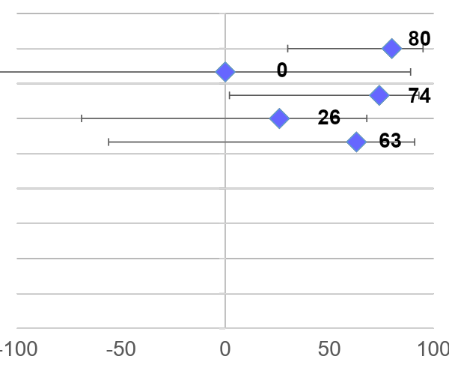
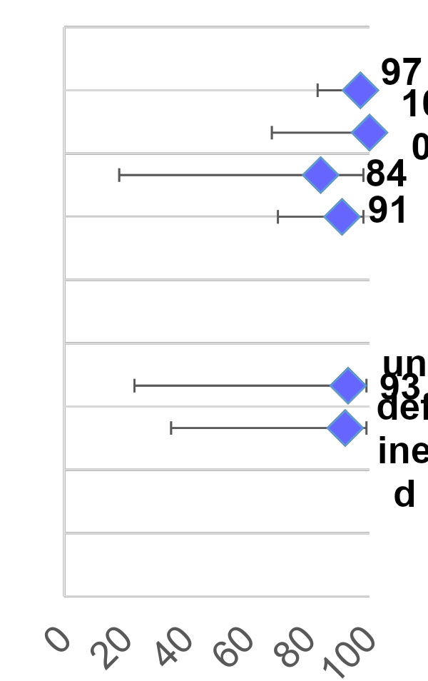
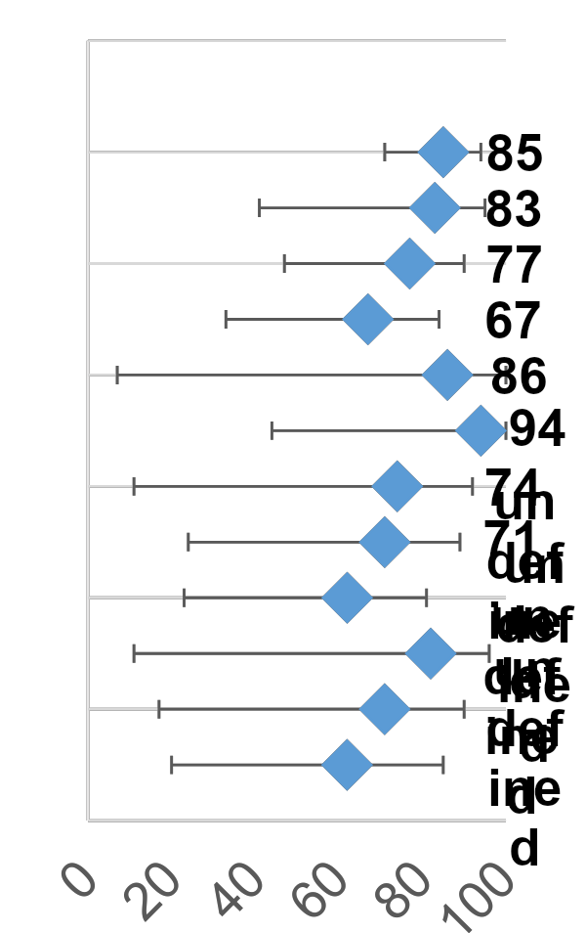
Vaccine effectiveness can differ for different vaccine serotypes and for vaccine-related serotypes
PHiD-CV
PCV13
 | Serotype 3 | Serotype 19A | Serotype 19A
US CDC, matched case control¹
Germany, indirect cohort²
Germany, indirect cohort³
UK, indirect cohort⁴
Spain, matched case control⁵
South Africa, matched case control⁶
Quebec, unmatched case control⁷
Quebec, unmatched case control⁷
The Netherlands, laboratory based surveillance⁸
Brazil, matched case control⁹
Brazil, indirect cohort¹⁰
Finland, population based surveillance¹¹
Vaccine effectiveness (VE, %)
1. Moore et al. Lancet Respir Med 2016; 2. Weinberger et al. Vaccine 2016; 3. van der Linden et al. PLoS One 2016; 4. Andrews et al. Lancet Infect Dis 2014; 5. Dominguez A, et al. PLoSONE 2017, 12(8): e0183191; 6. Cohen, C. et al. Lancet Glob Health 2017; 7. Deceuninck et al. Vaccine 2015; 8. Knol et al. ISPPD-10 2016; 9. Domingues et al. Lancet Resp Med 2014; 10. Verani J, et al. Vaccine 2015; 33(46): 6145–8; 11. Jokinen J, et al. PLoS ONE 2015; 10(3): e0120290.

Slide 18
Real-world data: high effectiveness against overall IPD, irrespective of differences in PCV programs¹
2.2
Overall IPD incidence and case counts across analyzed countries or regions by PCV era in children <5 years old¹
Pre-PCV
PCV7
Synflorix or PCV13
110
100
90
80
PCV13
70
Irrespective of vaccines used and vaccination setting differences, the post-PCV incidence is in a similar range in the countries analyzed
60
Incidence/100,000
50
40
30
20
10
Synflorix
0
= 50 cases
Denmark
USA
Quebec
England & Wales
Finland
France
Israel
New Zealand
Australia
Netherlands
The chart is reproduced with the permission of Taylor & Francis Group. It was first published in Izurieta P, et al. Expert Rev Vaccines. 2018. Rectangles illustrate the mean incidence across analyzed countries (center of rectangle) ± 1 standard deviation (height of rectangle, calculated based on IPD incidences without considering the absolute numbers of cases). IPD, invasive pneumococcal disease; PCV, pneumococcal conjugate vaccine.
1. Izurieta P, et al. Expert Rev Vaccines. 2018;17(6):479-493.
The 16th Annual Meeting of the Lebanese Paediatric Societies | 13 - 14 September, 2019 | Beirut - Lebanon
Notes:
Izurieta et al. recently conducted an analysis of the impact of PCV programs on the incidence of overall IPD, and on the distribution of vaccine-preventable serotypes (VT) and non-vaccine-preventable serotypes (NVT) in children <5 years old and adults ≥65 years old.
Datasets were retrieved from observational post-marketing studies and surveillance reports from countries with high-quality surveillance data available for at least 2 years before PCV program initiation and 3 years after higher-valent PCV implementation.
After the introduction of pediatric PCV programs, the residual overall IPD burden in children was low and in a narrow range across countries with high vaccination coverage, irrespective of differences in PCV programs and pneumococcal epidemiology.¹
Reference:
1. Izurieta P, et al. Expert Rev Vaccines. 2018;17(6):479-493.

Slide 19
Real-world impact of Synflorix vs PCV13 on IPD in equivalent populations in Sweden¹
2.2
Population-based cohort study¹
Yearly incidences (2005–2016) of IPD calculated for age groups 0–4, 5–64 and ≥65 years
Counties using either Synflorix or PCV13 in the Swedish childhood immunization schedule were compared
Sweden
January 2009
PCV7 introduced* (2+1 schedule)
From October 2009
All 21 counties switched to either Synflorix or PCV13
Synflorix
PCV13
Mixed
Simultaneous use of Synflorix and PCV13 in Sweden has provided
a unique opportunity to compare the two vaccines¹
Comparative data should be interpreted with caution due to the inherent bias of observational studies. * Some counties started vaccinating with PCV7 in 2007–2008. IPD, invasive pneumococcal disease; PCV, pneumococcal conjugate vaccine.
1. Naucler P, et al. Clin Infect Dis. 2017;65(11):1780-1790.
The 16th Annual Meeting of the Lebanese Paediatric Societies | 13 - 14 September, 2019 | Beirut - Lebanon

Slide 20
Real-world impact on overall IPD: no notable difference between higher-valent PCVs¹⁻³
2.2
IPD incidence in children aged <2 years: Synflorix vs PCV13¹
Sweden
Rate ratio (95% CI):
0.27 (0.12–0.58)†
Rate ratio (95% CI):
0.30 (0.16–0.56)†
30
30
25
25
20
-73%
20
-70%
15
15
IPD Incidence*
IPD Incidence*
10
10
5
5
0
0
Pre-PCV7
2007 (N=12)
Post-Synflorix
2013–2016 (N=14)
Pre-PCV7
2007 (N=17)
Post-PCV13
2013–2016 (N=22)
No statistically significant difference between vaccines on overall IPD impact despite some differences in IPD serotype distribution¹
Comparative data should be interpreted with caution due to the inherent bias of observational studies.
The same results were first published in Naucler P, et al. Clin Infect Dis. 2017. The graph has been independently created by GSK from the original data. * Incidence per 100,000 population in a year. † Significant change. CI, confidence interval; IPD, invasive pneumococcal disease; PCV, pneumococcal conjugate vaccine.
1. Naucler P, et al. Clin Infect Dis. 2017;65(11):1780-1790 and supplementary material. 2. Deceuninck G, et al. Vaccine. 2015;33:2684-2689. 3. Institute of Environmental Science and Research Limited (ESR). Invasive Pneumococcal Disease Quarterly Reports. Available at: https://surv.esr.cri.nz/PDF_surveillance/IPD [last accessed July 2019].
Notes:
Reductions of -73% and -70% are based on respective rate ratios in slide

Slide 21
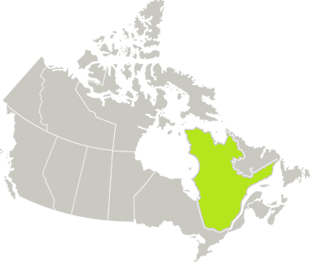
Real-world impact on overall IPD: no notable difference between higher-valent PCVs¹⁻³
2.2
Vaccine effectiveness (≥1 dose) against all IPD according to PCV era in children aged <5 years¹
 | PCV7 (n=305) | Synflorix (n=34) | PCV13 (n=44)
All serotypes, VE, % (95% CI) | 50 (29–64) | 72 (46–85) | 66 (29–83)
Quebec
2018
Synflorix
reinstated in Quebec⁴
Jan 2005
Jun 2009
Jan 2011
Dec 2013
No substantial differences in overall effectiveness were seen between Synflorix and PCV13¹
The same results were first published in Deceuninck G, et al. Vaccine. 2015. The table has been independently created by GSK from the original data. Comparative data should be interpreted with caution due to the inherent bias of observational studies. VE computed by logistic regression model weighted for sampling fraction of controls and adjusted for age, year, season and underlying medical conditions (including asthma and severe prematurity). CI, confidence interval; IPD, invasive pneumococcal disease; PCV, pneumococcal conjugate vaccine; VE, vaccine effectiveness.
1. Deceuninck G, et al. Vaccine. 2015;33:2684-2689. 2. Naucler P, et al. Clin Infect Dis. 2017;65(11):1780-1790 and supplementary material. 3. Institute of Environmental Science and Research Limited (ESR). Invasive Pneumococcal Disease Quarterly Reports. Available at: https://surv.esr.cri.nz/PDF_surveillance/IPD [last accessed July 2019]. 4. Gouvernement du Québec. Pneumococcal Conjugate Vaccine. Available at: https://www.quebec.ca/en/health/advice-and-prevention/vaccination/pneumococcal-conjugate-vaccine/ [last accessed July 2019].
Notes:
A population-based case-control study was conducted in Quebec, Canada to evaluate vaccine effectiveness of each PCV used: PCV7 was replaced with Synflorix in June 2009, which was replaced with PCV13 in January 2011 (no catch-up in both instances).¹
IPD cases in children 2–59 months during the years 2005–2013 were eligible.
Controls were randomly identified in the provincial health insurance registry.
Vaccine effectiveness (VE) was computed using multivariate logistic regression models.
Effectiveness against overall IPD, PCV13 only serotypes and serotype 19A was not substantially different between children vaccinated with Synflorix or PCV13.
Reference:
1. Deceuninck G, et al. Vaccine. 2015;33:2684-2689.

Slide 22
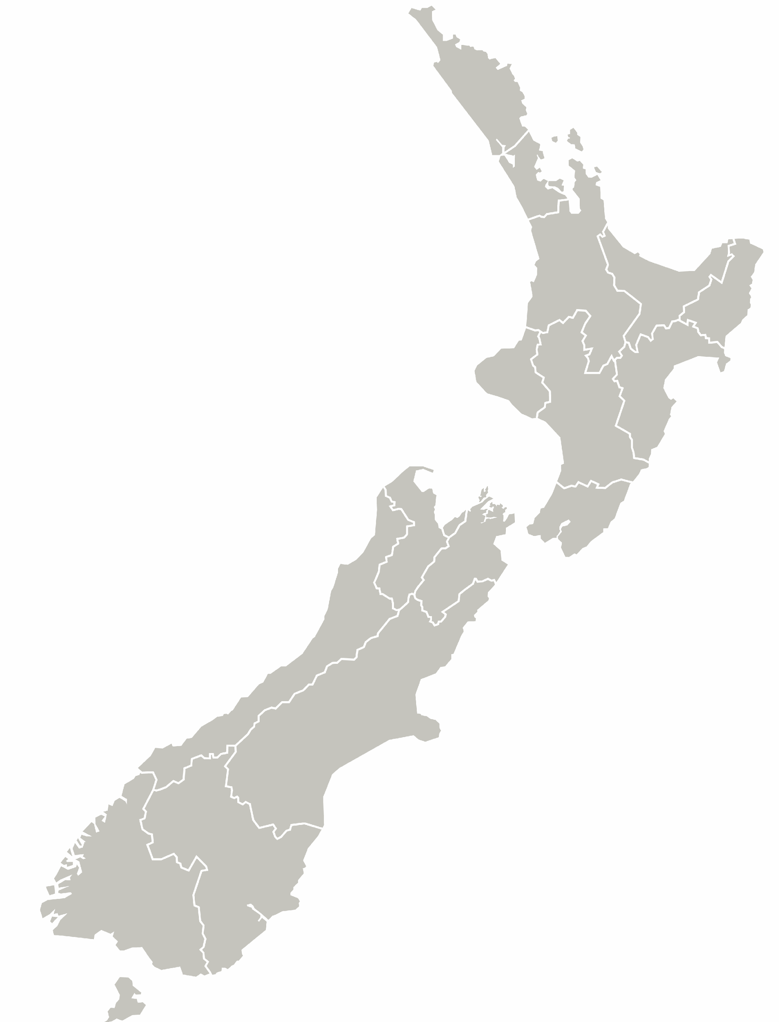
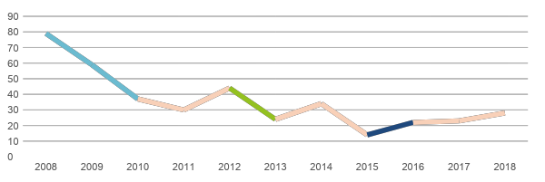
Real-world impact on overall IPD: no notable difference between higher-valent PCVs¹⁻³
2.2
Number of notified cases of IPD in children aged <2 years¹
New Zealand
Following a clinical data update review,
New Zealand will move to a 2+1 schedule for Synflorix in July 2020⁴
Number of IPD cases
PCV7
Synflorix
PCV13
Synflorix
No substantial differences in the number of overall IPD cases were observed with Synflorix and PCV13^{1,2}
The same results were first published online at: https://surv.esr.cri.nz/PDF_surveillance/IPD. The charts have been independently created by GSK from the original data. IPD, invasive pneumococcal disease; PCV, pneumococcal conjugate vaccine.
1. Institute of Environmental Science and Research Limited (ESR). Invasive Pneumococcal Disease Quarterly Reports. Available at: https://surv.esr.cri.nz/PDF_surveillance/IPD [last accessed July 2019]. 2. Naucler P, et al. Clin Infect Dis. 2017;65(11):1780-1790 and supplementary material. 3. Deceuninck G, et al. Vaccine. 2015;33:2684-2689. 4. Pharmaceutical Management Agency (PHARMAC). Changes to funded vaccines in the National Immunisation Schedule: PHARMAC, Wellington, New Zealand; July, 2019. Available at: https://www.pharmac.govt.nz/news/notification-2019-07-30-immunisation#PCV10 [last accessed July 2019].
Notes:
Analysis of data from the national notifiable disease surveillance system, New Zealand: PCV7 was replaced with Synflorix in July 2011, which was replaced with PCV13 in July 2014, which was then replaced with Synflorix in July 2017
The graph shows the serotype distribution in New Zealand in children less than 2 yoa
In young children directly receiving PCVs: the incidence of IPD is higher in this population but due to the small birth cohort in New Zealand, actual case numbers are small, resulting in substantial variation from year to year.

Slide 23
Real-world impact on overall IPD: no notable difference between higher-valent PCVs¹⁻³
ALTERNATIVE SLIDE
2.2
Number of notified cases of IPD in children aged <5 years¹
New Zealand
Following a clinical data update review,
New Zealand will move to a 2+1 schedule for Synflorix in July 2020⁴
Number of IPD cases
PCV7
Synflorix
PCV13
Synflorix
No substantial differences in the number of overall IPD cases were observed with Synflorix and PCV13^{1,2}
The same results were first published online at: https://surv.esr.cri.nz/PDF_surveillance/IPD. The charts have been independently created by GSK from the original data. IPD, invasive pneumococcal disease; PCV, pneumococcal conjugate vaccine.
1. Institute of Environmental Science and Research Limited (ESR). Invasive Pneumococcal Disease Quarterly Reports. Available at: https://surv.esr.cri.nz/PDF_surveillance/IPD [last accessed July 2019]. 2. Naucler P, et al. Clin Infect Dis. 2017;65(11):1780-1790 and supplementary material. 3. Deceuninck G, et al. Vaccine. 2015;33:2684-2689. 4. Pharmaceutical Management Agency (PHARMAC). Changes to funded vaccines in the National Immunisation Schedule: PHARMAC, Wellington, New Zealand; July, 2019. Available at: https://www.pharmac.govt.nz/news/notification-2019-07-30-immunisation#PCV10 [last accessed July 2019].
Notes:
Analysis of data from the national notifiable disease surveillance system, New Zealand: PCV7 was replaced with Synflorix in July 2011, which was replaced with PCV13 in July 2014, which was then replaced with Synflorix in July 2017.¹
The graph shows the number of notified cases of IPD in New Zealand by each annual to give a seasonal view of the fluctuation in IPD cases reported.
In contrast, after a switch from Synflorix to PCV13 in July 2014 there appears to be a steady increase in total number of IPD cases although no statistical analysis is given in the report to compare Synflorix with PCV13.
Therefore, it can at least be concluded that there have been no substantial differences in the seasonal pattern of overall IPD cases were seen before vs after a switch from Synflorix to PCV13.
Reference:
1. Institute of Environmental Science and Research Limited (ESR). Invasive Pneumococcal Disease Quarterly Reports. Available at: https://surv.esr.cri.nz/PDF_surveillance/IPD [last accessed July 2019].

Slide 24
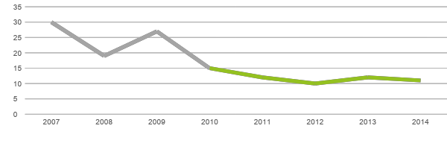
Switching to Synflorix: reduction in overall IPD sustained¹
2.2
Number of cases of IPD in children aged <5 years¹
Morocco
Oct 2010:
PCV13
July 2012:
Synflorix
Number of IPD cases
Pre-implementation
PCV13
Synflorix
High-valent PCVs have dramatically reduced incidence of overall IPD in children ≤5 years¹
No serotype 19A was observed in the evaluated period of time¹
The same results were first published in Diawara I, et al. Int J Infect Dis. 2015. The chart has been independently created by GSK from the original data. IPD, invasive pneumococcal disease; PCV, pneumococcal conjugate vaccine.
1. Diawara I, et al. Int J Infect Dis. 2015;40:95-101 and supplementary material.
The 16th Annual Meeting of the Lebanese Paediatric Societies | 13 - 14 September, 2019 | Beirut - Lebanon
Notes:
Laboratory-based surveillance of IPD among hospitalized children before and after the introduction of PCV in the NIP in Casablanca, Morocco:
PCV13 was introduced in October 2010 (2+1 schedule) and replaced with Synflorix in July 2012.¹
IPD has continued to decline in Morocco with the switch from PCV13 to Synflorix without significant replacement disease.¹
Reference:
1. Diawara I, et al. Int J Infect Dis. 2015;40:95-101.

Slide 25
The use of Synflorix is supported by recommendations of trusted, independent international bodies (e.g. the WHO and PAHO TAG) and an increasing number of national and local public health authorities¹⁻⁸
3
PAHO, Pan American Health Organization; TAG, Technical Advisory Group; WHO, World Health Organization.
Please see slide notes for reference list.
The 16th Annual Meeting of the Lebanese Paediatric Societies | 13 - 14 September, 2019 | Beirut - Lebanon
Notes:
References:
World Health Organization (WHO). Wkly Epidemiol Rec. 2019;94(8):85-104.
Pan American Health Organization. Technical Advisory Group on Vaccine-Preventable Diseases, editor. Final report of the 19th TAG Meeting; July 6–8 2011; Buenos Aires, Argentina. Available at: http://www.paho.org/hq/index.php?option=com_docman&task=doc_download&gid=14164&Itemid=&lang=f [last accessed July 2019].
Pharmacology and Therapeutics Advisory Committee (PTAC). Immunisation Subcommittee of PTAC. Meeting held 28 October 2015 (minutes for web publishing): Pharmaceutical Management Agency (PHARMAC), Wellington, New Zealand; March 2016. Available at: https://www.pharmac.govt.nz/assets/ptac-immunisation-subcommittee-minutes-2015-10.pdf [last accessed July 2019].
Health Council of the Netherlands. Executive summary. Vaccination of infants against pneumococcal infections: Health Council of the Netherlands, the Hague, The Netherlands; 2013. Available at: https://www.healthcouncil.nl/documents/advisory-reports/2013/11/27/vaccination-of-infants-against-pneumococcal-infections-3 [last accessed July 2019].
National Institute for Health and Welfare (Terveyden ja hyvinvoinnin laitos; THL). Tendering process for pneumococcal conjugate vaccine: THL, Helsinki, Finland; last updated March 2016. Available at: http://en.opasnet.org/w/Tendering_process_for_pneumococcal_conjugate_vaccine [last accessed July 2019].
Polskiego Towarzystwa Wakcynologii. Stanowisko Zarządu Polskiego Towarzystwa Wakcynologii z dnia 30.01.2017 r. w sprawie wyboru szczepionki do powszechnego, bezpłatnego szczepienia dzieci przeciwko pneumokokom w Polsce w ramach Programu Szczepień Ochronnych: Polskiego Towarzystwa Wakcynologii, Warsaw, Poland; January 31, 2017. Available at: http://ptwakc.org.pl/wytyczne-i-stanowiska/stanowisko-zarzadu-polskiego-towarzystwa-wakcynologii-z-dnia-30-01-2017-r-w-sprawie-wyboru-szczepionki-do-powszechnego-bezplatnego-szczepienia-dzieci-przeciwko-pneumokokom-w-polsce-w-ramach-programu/ [last accessed July 2019].
Ministerio de Salud [El Salvador]. Comunicado de prensa el minsal continuara vacunando gratuitamente contra los neumococis usando las vacunas recomendadas por la oms y ops: Twitter; March 17, 2018. Available at: https://twitter.com/minsalud/status/974762737795588096/photo/1?ref_src=twsrc%5Etfw&ref_url=http%3A%2F%2Felmundo.sv%2Fminsal-confirma-cambio-de-vacuna-contra-el-neumococo%2F [last accessed July 2019].
Comité sur l’immunisation du Québec. Avis sur le calendrier optimal de vaccination des enfants contre les infections à pneumocoque au Québec: Institut national de santé publique du Québec, Québec City, Québec, Canada; September 2017. Available at: https://www.inspq.qc.ca/sites/default/files/publications/2334_calendrier_vaccination_enfants_infections_pneumocoque.pdf [last accessed July 2019].

Slide 26
International recognition of Synflorix based on rigorous evidence reviews
3
World Health Organization (WHO)
2019 PCV Position Paper: Recommendations based on a systematic literature review¹
Pan American Health Organization (PAHO)
2016: Systematic review of the evidence of the impact and effectiveness of PCVs²
Hierarchy of evidence – Level 1³
A systematic review, using either meta-analytic analysis or narrative synthesis, is the primary methodology in secondary research. A systematic review summarizes the results of available carefully designed studies in response to a research question and is considered to be the most reliable source of evidence to guide clinical practice.
PCV, pneumococcal conjugate vaccine.
1. World Health Organization (WHO). Wkly Epidemiol Rec. 2019;94(8):85-104. 2. de Oliveira LH, et al. PLoS ONE. 2016;11(12):e0166736. 3. International Center for Allied Health Evidence. UNiSA. Available at: http://www.unisa.edu.au/Research/Sansom-Institute-for-Health-Research/Research/Allied-Health-Evidence/Resources/Evidence-based-Practice-Online/EBP-online-Step-2/#Hierarchy [last accessed June 2019].

Slide 27
International recognition of Synflorix based on rigorous evidence reviews
3
“PCV10 and PCV13 have comparable immu­nogenicity and impact on IPD, pneumonia and NP carriage due to shared vaccine serotypes.
While differ­ences were found in their immunogenicity and impact on the 3 serotypes included in PCV13 and not PCV10 and on serotype 6C, there is currently insufficient evidence that the 2 vaccines differ in their impact on overall pneumococcal disease burden.”¹
World Health Organization (WHO)
^{PRODUCT CHOICE-SUMMARY}
“Available evidence to date indicates significant impact of both [Synflorix] and PCV13 in the outcomes studied, with no evidence of the superiority of one vaccine over the other on pneumonia, IPD or meningitis hospitalization reduction in children under 5 years old.”²
Pan American Health Organization (PAHO)
No demonstrable differences between higher-valent PCVs on overall disease burden^{1,2}
IPD, invasive pneumococcal disease; PCV, pneumococcal conjugate vaccine. 1. World Health Organization (WHO). Wkly Epidemiol Rec. 2019;94(8):85-104. 2. de Oliveira LH, et al. PLoS ONE. 2016;11(12):e0166736.
Notes:
WHO statement on product choice:
For shared serotypes: Both vaccines have comparable impact on IPD, pneumonia and carriage
Overall, no evidence that the 2 vaccines differ on their impact on pneumococcal disease burden

Slide 28
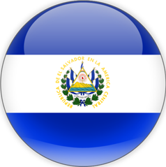
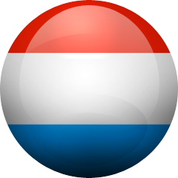
Synflorix UMV: recommended by national and local Public Health Authorities
3
Canada (Quebec)¹
El Salvador²
Luxembourg³
“Available data indicate that direct protection against invasive pneumococcal infection caused by serotypes in PCV13 is not very different between a schedule containing only PCV10 or PCV13”
“PAHO recommends that the decision to change one vaccine to another be made based on the availability of vaccines in the countries, epidemiological profile of the country and the cost of the vaccine. @minsalud has decided to acquire the PCV10 vaccine, based on quality and lower price”
“…the two conjugate vaccines against pneumococcus (PCV10 and PCV13) can be considered for universal vaccination of infants*”
New Zealand⁴
Poland⁵
The Netherlands⁶
“…both (…) are suitable for inclusion on the National Immunization Schedule”
“Numerous published clinical studies and reviews conducted in many countries around the world have shown great and comparable efficacy and safety of both of the currently available conjugate vaccines (PCV10 and PCV13)”
“…both vaccines are suitable for use in public programs”
* With a slight advantage for PCV13 due to its activity on additional serotypes circulating in Luxembourg, particularly serotype 19A, very aggressive.
@minsalud, El Salvador Ministry of Health [Twitter account]; PAHO, Pan American Health Organization; PCV, pneumococcal conjugate vaccine; UMV, universal mass vaccination.
Please see slide notes for reference list.
The 16th Annual Meeting of the Lebanese Paediatric Societies | 13 - 14 September, 2019 | Beirut - Lebanon
Notes:
References
Comité sur l’immunisation du Québec. Avis sur le calendrier optimal de vaccination des enfants contre les infections à pneumocoque au Québec: Institut national de santé publique du Québec, Québec City, Québec, Canada; September 2017. Available at: https://www.inspq.qc.ca/sites/default/files/publications/2334_calendrier_vaccination_enfants_infections_pneumocoque.pdf [last accessed July 2019].
Ministerio de Salud [El Salvador]. Comunicado de prensa el minsal continuara vacunando gratuitamente contra los neumococis usando las vacunas recomendadas por la oms y ops: Twitter; March 17, 2018. Available at: https://twitter.com/minsalud/status/974762737795588096/photo/1?ref_src=twsrc%5Etfw&ref_url=http%3A%2F%2Felmundo.sv%2Fminsal-confirma-cambio-de-vacuna-contra-el-neumococo%2F [last accessed July 2019].
Conseil Supérieur des Maladies Infectieuses (CSMI). Avis du CSMI pour la vaccination universelle contre le pneumocoque: vaccin 10 ou 13-valent?: Ministère de la Santé, Luxembourg, Luxembourg; September, 2016. Available at: http://www.sante.public.lu/fr/espace-professionnel/recommandations/conseil-maladies-infectieuses/infection-pneumocoques/2016-09-20-vaccination-pneumocoque.pdf [last accessed July 2019].
Pharmacology and Therapeutics Advisory Committee (PTAC). Immunisation Subcommittee of PTAC. Meeting held 28 October 2015 (minutes for web publishing): Pharmaceutical Management Agency (PHARMAC), Wellington, New Zealand; March 2016. Available at: https://www.pharmac.govt.nz/assets/ptac-immunisation-subcommittee-minutes-2015-10.pdf [last accessed July 2019].
Polskiego Towarzystwa Wakcynologii. Stanowisko Zarządu Polskiego Towarzystwa Wakcynologii z dnia 30.01.2017 r. w sprawie wyboru szczepionki do powszechnego, bezpłatnego szczepienia dzieci przeciwko pneumokokom w Polsce w ramach Programu Szczepień Ochronnych: Polskiego Towarzystwa Wakcynologii, Warsaw, Poland; January 31, 2017. Available at: http://ptwakc.org.pl/wytyczne-i-stanowiska/stanowisko-zarzadu-polskiego-towarzystwa-wakcynologii-z-dnia-30-01-2017-r-w-sprawie-wyboru-szczepionki-do-powszechnego-bezplatnego-szczepienia-dzieci-przeciwko-pneumokokom-w-polsce-w-ramach-programu/ [last accessed July 2019].
Health Council of the Netherlands. Executive summary. Vaccination of infants against pneumococcal infections: Health Council of the Netherlands, the Hague, The Netherlands; 2013. Available at: https://www.healthcouncil.nl/documents/advisory-reports/2013/11/27/vaccination-of-infants-against-pneumococcal-infections-3 [last accessed 2019 July].

Slide 29
Switching from PCV13 to Synflorix: the choice of various countries and regions¹⁻⁸
3
Sweden
(different
counties)
2009–2019
Synflorix
2009–2017
PCV13
2019
Synflorix
2009–2010
2011–2017
Canada
(Quebec)
Synflorix
PCV13
2018
Synflorix
+
19A data
El Salvador
2010–2017
PCV13
2018
Synflorix
Italy
(Piedmont)
2010–2017
PCV13
2017
Synflorix
New Zealand
2008–2011
PCV7
2011–2014
Synflorix
2014–2017
PCV13
2017
Synflorix
+
19A data
Morocco
2010–2012
PCV13
2012
Synflorix
+
19A data
+
19A data
The latest recommendations or program changes may not be captured in the figure. PCV, pneumococcal conjugate vaccine.
Please see slide notes for reference list.
The 16th Annual Meeting of the Lebanese Paediatric Societies | 13 - 14 September, 2019 | Beirut - Lebanon
Notes:
19A data accessible via the ‘+’ links are to be used on reactive basis and are not to be used as part of the core story flow.
GlaxoSmithKline. Synflorix NIP/UMV status worldwide & in EU as of September 2019. Data on File. 2019N416383_00; August 2019.
Institute of Environmental Science and Research Limited (ESR). Invasive Pneumococcal Disease Quarterly Reports. Available at: https://surv.esr.cri.nz/PDF_surveillance/IPD [last accessed July 2019].
Pharmaceutical Management Agency (PHARMAC). Changes to the National Immunisation Schedule: PHARMAC, Wellington, New Zealand; July, 2016. Available at: https://www.pharmac.govt.nz/news/notification-2016-07-28-immunisation-schedule/ [last accessed July 2019].
Naucler P, et al. Clin Infect Dis 2017;65(11):1780-1790.
SKL Kommentus Inköpscentral. Avtalsnytt. Available at: http://www.anpdm.com/newsletterweb/45455F4174424B584477494359/42455E427746455C4679434B5C4771 [last accessed July 2019].
Gouvernement du Québec. Pneumococcal Conjugate Vaccine. Available at: https://www.quebec.ca/en/health/advice-and-prevention/vaccination/pneumococcal-conjugate-vaccine/ [last accessed July 2019].
Deceuninck G, et al. Vaccine. 2015;33:2684-2689.
Diawara I, et al. Int J Infect Dis. 2015;40:95-101.

Slide 30
Synflorix helps you transform your policy into possibilities
Synflorix is proven to provide a high level of protection against overall pneumococcal disease^{1,2}
Real-world data show comparability of Synflorix and PCV13³⁻⁵
Synflorix is internationally recognized and increasingly recommended for use in NIPs⁶⁻¹³
Various countries and regions are switching from PCV13 to Synflorix^{5,14-18}
Competitive PCV tendering helps to reduce costs, freeing up resources to support other vaccination programs¹⁸⁻²⁰
NIP, National Immunization Program; PCV, pneumococcal conjugate vaccine.
Please see slide notes for reference list.
The 16th Annual Meeting of the Lebanese Paediatric Societies | 13 - 14 September, 2019 | Beirut - Lebanon
Notes:
Palmu AA, et al. Vaccine. 2018;36:1816-1822.
Tregnaghi MW, et al. PLoS Med. 2014;11(6):e1001657
Naucler P, et al. Clin Infect Dis. 2017;65(11):1780-1790 and supplementary material.
Deceuninck G, et al. Vaccine. 2015;33:2684-2689.
Institute of Environmental Science and Research Limited (ESR). Invasive Pneumococcal Disease Quarterly Reports. Available at: https://surv.esr.cri.nz/PDF_surveillance/IPD [last accessed July 2019].
World Health Organization (WHO). Wkly Epidemiol Rec. 2019;94(8):85-104.
de Oliveira LH, et al. PLoS ONE. 2016;11(12):e0166736.
Pharmacology and Therapeutics Advisory Committee (PTAC). Immunisation Subcommittee of PTAC. Meeting held 28 October 2015 (minutes for web publishing): Pharmaceutical Management Agency (PHARMAC), Wellington, New Zealand; March 2016. Available at: https://www.pharmac.govt.nz/assets/ptac-immunisation-subcommittee-minutes-2015-10.pdf [last accessed July 2019].
Health Council of the Netherlands. Executive summary. Vaccination of infants against pneumococcal infections: Health Council of the Netherlands, the Hague, The Netherlands; 2013. Available at: https://www.healthcouncil.nl/documents/advisory-reports/2013/11/27/vaccination-of-infants-against-pneumococcal-infections-3 [last accessed July 2019].
National Institute for Health and Welfare (Terveyden ja hyvinvoinnin laitos; THL). Tendering process for pneumococcal conjugate vaccine: THL, Helsinki, Finland; last updated March 2016. Available at: http://en.opasnet.org/w/Tendering_process_for_pneumococcal_conjugate_vaccine [last accessed July 2019].
Polskiego Towarzystwa Wakcynologii. Stanowisko Zarządu Polskiego Towarzystwa Wakcynologii z dnia 30.01.2017 r. w sprawie wyboru szczepionki do powszechnego, bezpłatnego szczepienia dzieci przeciwko pneumokokom w Polsce w ramach Programu Szczepień Ochronnych: Polskiego Towarzystwa Wakcynologii, Warsaw, Poland; January 31, 2017. Available at: http://ptwakc.org.pl/wytyczne-i-stanowiska/stanowisko-zarzadu-polskiego-towarzystwa-wakcynologii-z-dnia-30-01-2017-r-w-sprawie-wyboru-szczepionki-do-powszechnego-bezplatnego-szczepienia-dzieci-przeciwko-pneumokokom-w-polsce-w-ramach-programu/ [last accessed July 2019] .
Ministerio de Salud [El Salvador]. Comunicado de prensa el minsal continuara vacunando gratuitamente contra los neumococis usando las vacunas recomendadas por la oms y ops: Twitter; March 17, 2018. Available at: https://twitter.com/minsalud/status/974762737795588096/photo/1?ref_src=twsrc%5Etfw&ref_url=http%3A%2F%2Felmundo.sv%2Fminsal-confirma-cambio-de-vacuna-contra-el-neumococo%2F [last accessed July 2019].
Comité sur l’immunisation du Québec. Avis sur le calendrier optimal de vaccination des enfants contre les infections à pneumocoque au Québec: Institut national de santé publique du Québec, Québec City, Québec, Canada; September 2017. Available at: https://www.inspq.qc.ca/sites/default/files/publications/2334_calendrier_vaccination_enfants_infections_pneumocoque.pdf [last accessed July 2019].
GlaxoSmithKline. Synflorix NIP/UMV status worldwide & in EU as of September 2019. Data on File. 2019N416383_00; August 2019.
Diawara I, et al. Int J Infect Dis. 2015;40:95-101.
Gouvernement du Québec. Pneumococcal Conjugate Vaccine. Available at: https://www.quebec.ca/en/health/advice-and-prevention/vaccination/pneumococcal-conjugate-vaccine/ [last accessed July 2019].
SKL Kommentus Inköpscentral. Avtalsnytt. Available at: http://www.anpdm.com/newsletterweb/45455F4174424B584477494359/42455E427746455C4679434B5C4771 [last accessed July 2019].
Pharmaceutical Management Agency (PHARMAC). Changes to the National Immunisation Schedule: PHARMAC, Wellington, New Zealand; July, 2016. Available at: https://www.pharmac.govt.nz/news/notification-2016-07-28-immunisation-schedule/ [last accessed July 2019].
Garattini L, et al. Pharmacoeconomics. 2012;30(3):213-217.
Garattini L, et al. J R SocMed. 2014;107(1):4-5.

Slide 31
Safety, Prescribing Information, Adverse Event Reporting Procedure
NAME OF THE MEDICINAL PRODUCT
Synflorix suspension for injection in pre-filled syringe
Pneumococcal polysaccharide conjugate vaccine (adsorbed)
QUALITATIVE AND QUANTITATIVE COMPOSITION
1 dose (0.5 ml) contains:
Pneumococcal polysaccharide serotype 1 1 microgram
Pneumococcal polysaccharide serotype 4 3 micrograms
Pneumococcal polysaccharide serotype 5 1 microgram
Pneumococcal polysaccharide serotype 6B 1 microgram
Pneumococcal polysaccharide serotype 7F 1 microgram
Pneumococcal polysaccharide serotype 9V 1 microgram
Pneumococcal polysaccharide serotype 14 1 microgram
Pneumococcal polysaccharide serotype 18C 3 micrograms
Pneumococcal polysaccharide serotype 19F 3 micrograms
Pneumococcal polysaccharide serotype 23F 1 microgram
adsorbed on aluminium phosphate 0.5 milligram Al³⁺
conjugated to protein D (derived from non-typeable Haemophilus influenzae) carrier protein 9-16 micrograms
conjugated to tetanus toxoid carrier protein 5-10 micrograms
conjugated to diphtheria toxoid carrier protein 3-6 micrograms
PHARMACEUTICAL FORM
Suspension for injection (injection).
The vaccine is a turbid white suspension.
Therapeutic indications
Active immunisation against invasive disease, pneumonia and acute otitis media caused by Streptococcus pneumoniae in infants and children from 6 weeks up to 5 years of age.
The use of Synflorix should be determined on the basis of official recommendations taking into consideration the impact on pneumococcal diseases in different age groups as well
as the variability of the epidemiology in different geographical areas.
Posology and method of administration
The immunisation schedules for Synflorix should be based on official recommendations.
Infants from 6 weeks to 6 months of age
The 16th Annual Meeting of the Lebanese Paediatric Societies | 13 - 14 September, 2019 | Beirut - Lebanon

Slide 32
Safety, Prescribing Information, Adverse Event Reporting Procedure
Three-dose primary series
The recommended immunisation series to ensure optimal protection consists of four doses, each of 0.5 ml. The primary infant series consists of three doses with the first dose usually given at 2 months of age and with an interval of at least 1 month between doses.
The first dose may be given as early as six weeks of age. A booster (fourth) dose is recommended at least 6 months after the last priming dose and preferably
between 12 and 15 months of age.
Two-dose primary series
Alternatively, when Synflorix is given as part of a routine infant immunisation programme, a series consisting of three doses, each of 0.5 ml may be given.
The first dose may be administered from the age of 2 months, with a second dose 2 months later. A booster (third) dose is recommended at least 6 months after the last primary dose.
Preterm newborn infants (born between 27-36 weeks gestation)
In preterm infants born after at least 27 weeks of gestational age, the recommended immunisation series consists of four doses, each of 0.5ml.
The primary infant series consists of three doses with the first dose given at 2 months of age and with an interval of at least 1 month between doses.
A booster (fourth) dose is recommended at least 6 months after the last primary dose.
Unvaccinated infants and children ≥ 7 months of age
Infants aged 7-11 months: The vaccination schedule consists of two primary doses of 0.5 ml with an interval of at least 1 month between doses.
A booster (third) dose is recommended in the second year of life with an interval of at least 2 months after the last primary dose.
- Children aged 12 months - 5 years: The vaccination schedule consists of two doses of 0.5 ml with an interval of at least 2 months between doses.
It is recommended that subjects who receive a first dose of Synflorix complete the full vaccination course with Synflorix.
Paediatric population
The safety and efficacy of Synflorix in children over 5 years of age have not been established.
Method of administration
The vaccine should be given by intramuscular injection. The preferred sites are anterolateral aspect of the thigh in infants or the deltoid muscle of the upper arm in young children.
Contraindications
Hypersensitivity to the active substances or to any of the excipients, or to any of the carrier proteins.
As with other vaccines, the administration of Synflorix should be postponed in subjects suffering from acute severe febrile illness.
However, the presence of a minor infection, such as a cold, should not result in the deferral of vaccination.
Special warnings and precautions for use
The potential risk of apnoea and the need for respiratory monitoring for 48-72h should be considered when administering the primary immunisation series to very premature infants
(born ≤ 28 weeks of gestation) and particularly for those with a previous history of respiratory immaturity. As the benefit of vaccination is high in this group of infants,
vaccination should not be withheld or delayed.
Synflorix should under no circumstances be administered intravascularly or intradermally. No data are available on subcutaneous administration of Synflorix.
In children as of 2 years of age, syncope (fainting) can occur following, or even before, any vaccination as a psychogenic response to the needle injection.
It is important that procedures are in place to avoid injury from faints.

Slide 33
Safety, Prescribing Information, Adverse Event Reporting Procedure
As for other vaccines administered intramuscularly, Synflorix should be given with caution to individuals with thrombocytopenia or any coagulation disorder since bleeding
may occur following an intramuscular administration to these subjects.
As with any vaccine, Synflorix may not protect all vaccinated individuals against invasive pneumococcal disease, pneumonia or Otitis Media caused by the serotypes in the vaccine
and the cross-reactive serotype 19A.
The functional immune response to serotypes 1 and 5 was lower in magnitude than the response against all other vaccine serotypes.
Synflorix is indicated for use in children aged from 6 weeks up to 5 years. Children should receive the dose regimen of Synflorix that is appropriate to their age at the time of
commencing the vaccination series. Safety and immunogenicity data are not yet available in children above 5 years of age.
Children with impaired immune responsiveness, whether due to the use of immunosuppressive therapy, a genetic defect, HIV infection, or other causes, may have
reduced antibody response to vaccination.
Safety and immunogenicity data in children with increased risk for pneumococcal infections (e.g. sickle cell disease, congenital and acquired splenic dysfunction, HIV-infected,
malignancy,
nephritic syndrome) are not yet available for Synflorix. Vaccination in high-risk groups should be considered on an individual basis.
Children younger than 2 years old should receive the appropriate-for-age Synflorix vaccination series. The use of pneumococcal conjugate vaccine does not replace the use of
23-valent pneumococcal polysaccharide vaccines in children ≥ 2 years of age with conditions (such as sickle cell disease, asplenia, HIV infection, chronic illness, or those who are immunocompromised)
placing them at higher
risk for invasive disease due to Streptococcus pneumoniae. Whenever recommended, children at risk who are ≥ 24 months of age and already primed with Synflorix should receive 23-valent
pneumococcal polysaccharide vaccine. The interval between the pneumococcal conjugate vaccine (Synflorix) and the 23-valent pneumococcal polysaccharide vaccine should not be less than 8 weeks.
Prophylactic administration of antipyretics before or immediately after vaccine administration can reduce the incidence and intensity of post-vaccination febrile reactions, according to local treatment guidelines.
Interaction with other medicinal products and other forms of interaction
Use with other vaccines
Synflorix can be given concomitantly with any of the following monovalent or combination vaccines [including DTPa-HBV-IPV/Hib and DTPw-HBV/Hib]: diphtheria-tetanus-acellular pertussis vaccine (DTPa),
hepatitis B vaccine (HBV), inactivated polio vaccine (IPV), Haemophilus influenzae type b vaccine (Hib), diphtheria-tetanus-whole cell pertussis vaccine (DTPw), measles-mumps-rubella vaccine (MMR),
varicella vaccine (V), meningococcal serogroup C conjugate vaccine (CRM₁₉₇ and TT conjugates), meningococcal serogroups A, C, W-135 and Y conjugate vaccine (TT conjugate), oral polio vaccine (OPV)
and oral rotavirus vaccine. Different injectable vaccines should always be given at different injection sites.
Immune responses and the safety profiles of the co-administered vaccines were unaffected, with the exception of the inactivated poliovirus type 2 response (seroprotection ranging from 78% to 100%).
In addition when the meningococcal serogroups A, C, W-135 and Y vaccine (TT conjugate) was co-administered with a booster dose of Synflorix during the second year of life in children primed
with 3 doses of Synflorix, lower antibody geometric mean concentration (GMC) and opsonophagocytic assay geometric mean titre (OPA GMT) were observed for one pneumococcal serotype (18 C).
Enhancement of antibody response to Hib-TT conjugate, diphtheria and tetanus antigens was observed. Use with systemic immunosuppressive medicinal products
It may be expected that an adequate response may not be elicited.
The 16th Annual Meeting of the Lebanese Paediatric Societies | 13 - 14 September, 2019 | Beirut - Lebanon

Slide 34
Safety, Prescribing Information, Adverse Event Reporting Procedure
Undesirable effects
Very common: Appetite lost, Irritability, Drowsiness, Pain, redness, swelling at the injection site, fever 38°C rectally (age < 2 years)
Very rare: Angioedema, Kawasaki disease, Anaphylaxis
Common: Injection site reactions like injection site induration, fever >39°C rectally (age < 2 years), Fever ≥38°C rectally (age 2 to 5 years)
Uncommon: Crying abnormal, Apnoea in very premature infants (≤28 weeks of gestation), Diarrhoea, vomiting, Rash, Injection site reactions like injection site haematoma,
haemorrhage and nodule, Headache (age 2 to 5 years), Nausea (age 2 to 5 years), Injection site reactions like pruritus, fever > 40°C rectally (age < 2 years), fever >39°C rectally
(age 2 to 5 years), diffuse swelling of the injected limb, sometimes involving the adjacent joint
Rare: Allergic reactions (such as allergic dermatitis, atopic dermatitis, eczema), Convulsions (including febrile convulsions)
Urticaria, Hypotonic-hyporesponsive episode
Overdose
No case of overdose has been reported.
Pharmacodynamic properties
Epidemiological data
The 10 pneumococcal serotypes included in this vaccine represent the major disease-causing serotypes in Europe covering approximately 56% to 90% of invasive pneumococcal disease
(IPD) in children <5 years of age. In this age group, serotypes 1, 5 and 7F account for 3.3% to 24.1% of IPD depending on the country and time period studied.
Pneumonia of different aetiologies is a leading cause of childhood morbidity and mortality globally. In prospective studies, Streptococcus pneumoniae was estimated to be responsible for 30-50% of
pneumonia cases.
Acute otitis media (AOM) is a common childhood disease with different aetiologies. Bacteria can be responsible for 60-70% of clinical episodes of AOM. Streptococcus pneumoniae and Non-Typeable
Haemophilus influenzae (NTHi) are the most common causes of bacterial AOM worldwide.
Impact on nasopharyngeal carriage (NPC)
The effect of Synflorix on nasopharyngeal carriage significantly decrease of individual serotypes 6B and 19F. In the nested Finnish study, a significant reduction was also observed for individual
serotypes 14, 23F and, in the 3 dose primary schedule, for the cross-reactive serotype 19A.
Effectiveness in post-marketing surveillance
Table 4: Summary of effectiveness of Synflorix for IPD in Brazil
Types of IPD | Adjusted Effectiveness % (95% CI)
Any vaccine serotype IPD Invasive pneumonia or bacteraemia Meningitis | 83.8% (65.9;92.3) 81.3% (46.9;93.4) 87.7% (61.4;96.1)
IPD due to individual serotypes 6B 14 19A | 82.8% (23.8;96.1) 87.7% (60.8;96.1) 82.2% (10.7;96.4)

Slide 35
Safety, Prescribing Information, Adverse Event Reporting Procedure
Table 5: Rates of IPD and the corresponding rate reductions in Finland
Immune memory
In the follow-up of the study evaluating the 2-dose and 3-dose primary vaccination schedules, the persistence of antibodies at 36-46 months of age was demonstrated in subjects
that had received a 2-dose primary series followed by a booster dose with at least 83.7% of subjects remaining seropositive for vaccine serotypes and the cross-reactive serotype 19A.
In subjects that had received a 3-dose primary series followed by a booster dose, at least 96.5% of the subjects remained seropositive for vaccine serotypes and 86.4% for serotype 19A.
After a single dose of Synflorix, administered during the 4th year of life, as a challenge dose, the fold increase in ELISA antibody GMCs and OPA GMTs, pre to post vaccination, was similar
in 2-dose primed subjects to that in 3-dose primed subjects. These results are indicative of immunological memory in primed subjects for all vaccine serotypes and the cross-reactive serotype 19A.
Immunogenicity data in preterm infants
Immunogenicity of Synflorix in very preterm (gestation period of 27-30 weeks), preterm (gestation period of 31-36 weeks) and full term (gestation period > 36 weeks) infants was
evaluated following a 3 dose primary vaccination course at 2, 4, 6 months of age. Immunogenicity following a fourth dose (booster dose) at 15 to 18 months of age was evaluated
in 44 very preterm, 69 preterm and 127 full term infants.
One month after primary vaccination (i.e. after the third dose), for each vaccine serotype at least 92.7% of subjects achieved ELISA antibody concentrations ≥ 0.2 μg/ml and at least 81.7%
achieved OPA titres ≥ 8 except serotype 1 (at least 58.8% with OPA titres ≥ 8). Similar antibody GMCs and OPA GMTs were observed for all infants except lower antibody GMCs for serotypes 4, 5, 9V and the
cross-reactive serotype 19A in very preterms and serotype 9V in preterms and lower OPA GMT for serotype 5 in very preterms. The clinical relevance of these differences is not known.
One month after the booster dose increases of ELISA antibody GMCs and OPA GMTs were seen for each vaccine serotype and the cross-reactive serotype 19A, indicative of immunological memory.
Similar antibody GMCs and OPA GMTs were observed for all infants except a lower OPA GMT for serotype 5 in very preterm infants. Overall, for each vaccine serotype at least 97.6% of subjects achieved
ELISA antibody concentrations ≥ 0.2μg/ml and at least 91.9% achieved OPA titres ≥ 8.
List of excipients
Sodium chloride, Water for injections
Shelf life 4 years
IPD | Incidence per 100,000 person years |  | Relative rate reduction % (95% CI)
 | Before NIP | After NIP
Any culture confirmed | 62.9 | 12.9 | 80% (72;85)
Any vaccine serotype | 49.1 | 4.2 | 92% (86;95)
Serotype 19A | 5.5 | 2.1 | 62% (20;85)
The 16th Annual Meeting of the Lebanese Paediatric Societies | 13 - 14 September, 2019 | Beirut - Lebanon

Slide 36
Safety, Prescribing Information, Adverse Event Reporting Procedure
Special precautions for storage
Store in a refrigerator (2°C – 8°C).
Do not freeze.
Store in the original package in order to protect from light.
Nature and contents of container
0.5 ml suspension in a pre-filled syringe (type I glass) with a stopper (butyl rubber) with or without needles. Pack size of 1, 10 or 50.
Special precautions for disposal and other handling
A fine white deposit with a clear colourless supernatant may be observed upon storage of the pre-filled syringe. This does not constitute a sign of deterioration.
The content of the pre-filled syringe should be inspected visually both before and after shaking for any foreign particulate matter and/or abnormal physical appearance prior to
administration.
In the event of either being observed, discard the vaccine.
The vaccine should be allowed to reach room temperature before use.
The vaccine should be well shaken before use.
Instructions for administration of the vaccine presented in pre-filled syringe
Holding the syringe barrel in one hand (avoid holding the syringe plunger), unscrew the syringe cap by twisting it anticlockwise.
To attach the needle to the syringe, twist the needle clockwise into the syringe until you feel it lock.
Remove the needle protector, which on occasion can be a little stiff.
DATE OF REVISION OF THE TEXT
Ref. Version 23 Date 23/Jul/2015
The 16th Annual Meeting of the Lebanese Paediatric Societies | 13 - 14 September, 2019 | Beirut - Lebanon

Slide 37
Prescribing information
Abbreviated Prescribing Information was prepared on 31.08.2016 based on GDS version number: 14, version date: 18Aug2015 prepared to meet the requirements of the GSK International Pharmaceutical Promotional and Marketing Policy.
SynflorixTM Pneumococcal polysaccharide conjugates vaccine, adsorbed. One dose (0.5 ml) contains 1 microgram of polysaccharide for serotypes 11, 2, 5 1,2, 6B 1,2, 7F 1,2, 9V 1,2, 14 1,2 and 23F 1,2, and 3 micrograms of serotypes 4 1,2, 18C1,3 and 19F1,4.
1 adsorbed on aluminium phosphate 0.5 milligram Al3+
2 conjugated to protein D (derived from Non-Typeable Haemophilus influenzae) carrier protein ~13 micrograms
3 conjugated to tetanus toxoid carrier protein ~8 micrograms
4 conjugated to diphtheria toxoid carrier protein ~5 micrograms
Suspension for injection in pre-filled syringe
Indications Active immunisation against invasive disease, pneumonia and acute otitis media caused by Streptococcus pneumoniae in infants and children from 6 weeks up to 5 years of age. The use of Synflorix™ should be determined on the basis of official recommendations taking into consideration the impact on pneumococcal diseases in different age groups as well as the variability of the epidemiology in different geographical areas. Dosage and Administration, Infants from 6 weeks to 6 months of age: 3-dose primary series The recommended immunisation series to ensure optimal protection consists of four doses, each of 0.5 ml. The primary infant series consists of three doses with the first dose usually given at 2 months of age and with an interval of at least 1 month between doses. The first dose may be given as early as six weeks of age. A booster dose is recommended at least 6 months after the last primary dose. 2-dose primary series alternatively, when Synflorix is given as part of a routine infant immunisation programme, a series consisting of three doses, each of 0.5 ml may be given. The first dose may be administered from the age of 2 months, with a second dose 2 months later. A booster dose is recommended at least 6 months after the last primary dose.
Preterm infants born after at least 27 weeks of gestational age.
The recommended immunisation series consists of four doses, each of 0.5 ml. The primary infant series consists of three doses with the first dose usually given at 2 months of age and with an interval of at least 1 month between doses. A booster dose is recommended at least 6 months after the last primary dose. Previously unvaccinated older infants and children: -infants aged 7-11 months: The vaccination schedule consists of two doses of 0.5 ml with an interval of at least 1 month between doses. A third dose is recommended in the second year of life with an interval of at least 2 months.
Children aged 12-5 years of age: 2 doses of 0.5 ml with an interval of at least 2 months between doses. Official recommendations should be taken into account when immunising with Synflorix. It is recommended that subjects who receive a first dose of Synflorix complete the full vaccination course with Synflorix. The vaccine should be given by intramuscular injection. The preferred sites are anterolateral aspect of the thigh in infants or the deltoid muscle of the upper arm in children. Contraindications Synflorix should not be administered to subjects with known hypersensitivity to any component of the vaccine.
Warnings and Precautions
It is good clinical practice to precede vaccination by a review of the medical history (especially with regard to previous vaccination and possible occurrence of undesirable events) and a clinical examination. As with all injectable vaccines, appropriate medical treatment and supervision should always be readily available in case of a rare anaphylactic event following the administration of the vaccine. As with other vaccines, the administration of Synflorix should be postponed in subjects suffering from acute severe febrile illness. However, the presence of a minor infection, such as a cold, should not result in the deferral of vaccination. Synflorix should under no circumstances be administered intravascularly or intradermally. No data are available on subcutaneous administration of Synflorix. Syncope (fainting) can occur following, or even before, any vaccination as a psychogenic response to the needle injection. It is important that procedures are in place to avoid injury from faints. As for other vaccines administered intramuscularly, Synflorix should be given with caution to individuals with thrombocytopenia or any coagulation disorder since bleeding may occur following an intramuscular administration to these subjects. Synflorix will not protect against pneumococcal serogroups other than those included in the vaccine. Although antibody response to diphtheria toxoid, tetanus toxoid and Protein D (protein D is highly conserved in all Haemophilus influenzae strains including NTHi) occurs, immunization with Synflorix does not substitute routine immunization with diphtheria, tetanus or Haemophilus influenzae type b vaccines. Official recommendations for the immunisations against diphtheria, tetanus and Haemophilus influenzae type b should also be followed. As with any vaccine, a protective immune response may not be elicited in all vaccinees. Safety and immunogenicity data in children with increased risk for pneumococcal infections (sickle cell disease, congenital and acquired splenic dysfunction, HIV infected, malignancy, nephrotic syndrome) are not available. Children with impaired immune responsiveness, whether due to the use of immunosuppressive therapy, a genetic defect, HIV infection, or other causes, may have reduced antibody response to active immunisation. For children at high-risk for pneumococcal disease (such as children with sickle cell disease, asplenia, HIV infection, chronic illness or who are immunocompromised), - the appropriate-for-age Synflorix vaccination series should be given below 2 years of age , - a 23-valent pneumococcal polysaccharide vaccine should be given ≥ 2 years of age. Prophylactic administration of antipyretics before or immediately after vaccines administration can reduce the incidence and intensity of post-vaccination febrile reactions. Data however, suggest that the use of prophylactic paracetamol might reduce the immune response to pneumococcal vaccines. The clinical relevance of this observation remains unknown. The potential risk of apnoea and the need for respiratory monitoring for 48-72h should be considered when administering the primary immunization series to very premature infants (born ≤ 28 weeks of gestation) and particularly for those with a previous history of respiratory immaturity. As the benefit of vaccination is high in this group of infants, vaccination should not be withheld or delayed.
Interactions., Use with other vaccines, Synflorix can be given concomitantly with any of the following monovalent or combination vaccines [including DTPa-HBV-IPV/Hib and DTPw-HBV/Hib]: diphtheria-tetanus-acellular pertussis vaccine (DTPa), hepatitis B vaccine (HBV), inactivated polio vaccine (IPV), Haemophilus influenzae type b vaccine (Hib), diphtheria-tetanus-whole cell pertussis vaccine (DTPw), measles-mumps-rubella vaccine (MMR), varicella vaccine, meningococcal serogroup C conjugate vaccine (CRM197 and TT conjugates), meningococcal serogroups A, C, W-135 and Y conjugate vaccine (TT conjugate), oral polio vaccine (OPV) and rotavirus vaccine. Different injectable vaccines should always be given at different injection sites. Clinical studies demonstrated that the immune responses and the safety profiles of the co-administered vaccines were unaffected, with the exception of the inactivated poliovirus type 2 response, for which inconsistent results were observed across studies (seroprotection ranging from 78% to 100%). In addition when the meningococcal serogroups A, C, W-135 and Y vaccine (TT conjugate) was co-administered with a booster dose of Synflorix during the second year of life in children primed with 3 doses of Synflorix, lower antibody geometric mean concentration (GMC) and opsonophagocytic assay geometric mean titre (OPA GMT) were observed for one pneumococcal serotype (18 C). There was no impact of co-administration on the other nine pneumococcal serotypes. Enhancement of antibody response to Hib-TT conjugate, diphtheria and tetanus antigens was observed. The clinical relevance of the above observations is unknown. Use with systemic immunosuppressive medications As with other vaccines it may be expected that in patients receiving immunosuppressive treatment an adequate response may not be elicited.
Adverse Reactions
Frequency | Adverse reactions
Clinical trials
Very common | Appetite lost, irritability, drowsiness, pain, redness, swelling at the injection site, fever ≥38°C rectally (age < 2 years)
Common | Injection site reactions like injection site induration, fever >39°C rectally (age < 2 years)
Uncommon | Crying abnormal, apnoea in very premature infants (≤28 weeks of gestation) (see Warnings and Precautions), diarrhoea, vomiting, rash, injection site reactions like injection site haematoma, haemorrhage and nodule
Rare | Allergic reactions (such as allergic dermatitis, atopic dermatitis, eczema), convulsions (including febrile convulsions), urticaria⁽¹⁾
Very rare | Angioedema, Kawasaki disease
Adverse reactions additionally reported after booster vaccination of primary series and/or catch-up vaccination:
Common | Fever ≥38°C rectally (age 2 to 5 years)
Uncommon | Injection site reactions⁽²⁾ like pruritus, diffuse swelling of the injected limb, sometimes involving the adjacent joint; age < 2 years: fever > 40°C rectally; age 2 to 5 years: headache, nausea and fever >39°C rectally
Post-marketing experience
Rare | Hypotonic-hyporesponsive episode
Very rare | Anaphylaxis
Storage Store in a refrigerator (2°C – 8°C). Do not freeze. Store in the original package in order to protect from light. Incompatibilities In the absence of compatibility studies, this medicinal product must not be mixed with other medicinal products. Use and Handling A fine white deposit with a clear colourless supernatant may be observed upon storage of the syringe/vial. This does not constitute a sign of deterioration. The content of the syringe/vial should be inspected visually both before and after shaking for any foreign particulate matter and/or abnormal physical appearance prior to administration. In the event of either being observed, discard the vaccine.
The vaccine should be well shaken before use. Any unused product or waste material should be disposed of in accordance with local requirements. Abbreviated Prescribing Information was prepared on 31.08.2016 based on GDS version number: 14, version date: 18Aug2015 prepared to meet the requirements of the GSK International Pharmaceutical Promotional and Marketing Policy.

Slide 38
Adverse Event Reporting Procedure
For full prescribing information please refer to data sheet or contact: GlaxoSmithKline, Gulf & Near East. P.O.Box 50199 Dubai, United Arab Emirates.
For adverse events reporting of any GSK products, kindly call: LEBANON (+961 1 335288) or JORDAN (+962 6 5529319) or email us at ne.safety@gsk.com
The 16th Annual Meeting of the Lebanese Paediatric Societies | 13 - 14 September, 2019 | Beirut - Lebanon

Slide 39
THANK YOU

Slide 40
Back up Slides

Slide 41
Overall effectiveness and impact of PCVs: beyond vaccine-type pneumococcal disease
Overall effectiveness¹
REPLACEMENT
DISEASE
VACCINE TYPE EFFECTIVENESS
CROSS-PROTECTION
NET REDUCTION OF PNEUMOCOCCAL DISEASE
Effectiveness on individual vaccine serotypes
Effects on vaccine-related serotypes
Potential increased risk of disease from serotypes not included in the vaccine
“The overall impact of a given PCV formulation on IPD, AOM or pneumonia cannot be predicted solely on the basis of its serotype content”²
AOM, acute otitis media; IPD, invasive pneumococcal disease; PCV, pneumococcal conjugate vaccine.
1. Castiglia P, et al. Hum Vaccin Immunother. 2017;13(10):2307-15. 2. Hausdorff WP, et al. Expert Rev Vaccines. 2015;14(3):413-28.
Notes:
The overall effectiveness of PCVs depends on reductions in vaccine serotype and vaccine-related serotype disease and changes in non-vaccine serotype disease (replacement disease).¹
The effects (effectiveness) of PCVs on vaccine serotypes and vaccine-related serotypes are dependent on:²
Conjugation chemistry
Dosage level of each serotype
Carrier proteins
Reference:
1. Castiglia P, et al. Hum Vaccin Immunother. 2017;13(10):2307-15.
2. Hausdorff WP, et al. Expert Rev Vaccines. 2015;14(3):413-28.

Slide 43
Effectiveness of PCVs to prevent IPD (Case control study study; VE > 1 dose; schedule = 2+1)
PCV7 introduced in UMV in Dec 2004, replaced by Synflorix™ in June 2009, and PCV13 in Jan 2012
889 eligible IPD cases in children 2 -59 months of age (2005-2013)
58% returned written authorization to check immunization records (n=516)
1767 controls identified
 | PCV7 | Synflorix™ | PCV13
All serotypes | 50% (95%CI:29-64) | 72% (95%CI:40-85) | 66% (95%CI:29-83)
PCV-13 serotypes | 63% (95%CI:45-74) | 84% (95%CI:65-93) | 86% (95%CI:62-95)
Serotype 19 A | 42% (95%CI:-9-69) | 71% (95%CI:24-89) | 74% (95%CI:11-92)
VE computed by logistic regression model weighted for sampling fraction of controls and adjusted for age, year, season and underlying medical conditions including asthma and severe prematurity.
Deceuninck et al. Vaccines 2015

Slide 44
Sweden
Both vaccines prevent IPD : comparative trials
Population-based cohort study
21 counties decide which PCV to use
Mandatory nationwide reporting for IPD
PCV7 (2+1) introduced in Sweden in January 2005
From October 2009 onwards counties switched to either Synflorix or PCV13.
7 counties used Synflorix, 5 counties used PCV13 and 9 counties used both (excluded)
Yearly incidences of IPD calculated for age groups 0-4, 5-64, and ≥ 65 years.
Incidence rate ratios estimated by comparing incidences:
Overall reduction in the incidence rate comparing pre- and post- PCV:
Not significantly different between
Synflorix- or PCV13-using counties
Pre- PCV | Pre-Synflorix/PCV13 | Post-Synflorix/PCV13
2007 | 2007-2009 | 2013-2016
Naucler, P. et al. Comparison of the impact of PCV10 or PCV13 on invasive pneumococcal disease in equivalent populations Clinical Infectious Diseases, cix685, https://doi.org/10.1093/cid/cix685

Slide 45
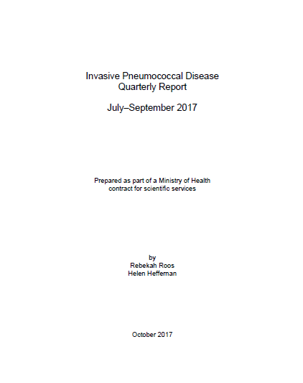
Invasive Pneumococcal Disease Quarterly Report July–Sep.2017
PCV Background Information
June.2008: PCV7
July 2011: Synflorix
July 2014: PCV13
July 2017: Synflorix
https://surv.esr.cri.nz/surveillance/IPD.php

Slide 46
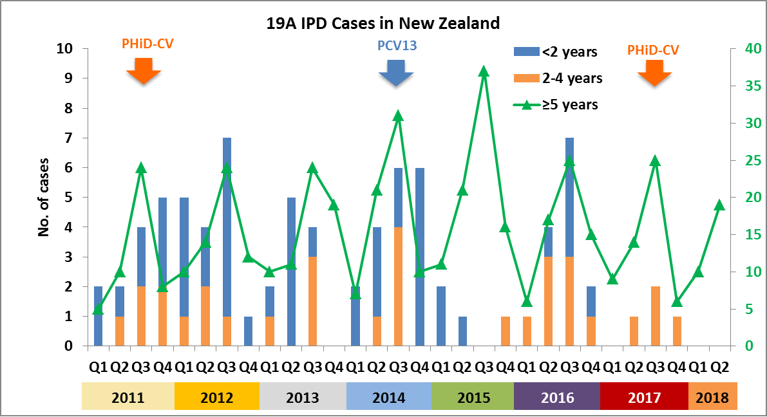
19A IPD in New Zealand is well controlled in the vaccinated groups
* Data based on quarterly reports
ESR IPD surveillance reports https://surv.esr.cri.nz/surveillance/IPD.php
Notes:
Since a PCV was introduced into the NZ NIS in 2008 there has been a significant 96% decrease in VT IPD, which is fantastic for NZ children as it means IPD is rarely seen now. Although we still see fluctuating low levels of 19A in the vaccinated groups irrespective of what vaccine is used, which is illustrated on the graph.
The coloured bars represent the years from 2008-2016 with 19A cases ranging from 2-12 per year in the <2yrs and under 10 cases a year in 2-4yrs age group. While in unvaccinated >5yr age group there is a high level of background 19A disease.
There is a real risk for us if 19A increases over the next 3yrs and PHARMAC will exercise a clause in the contract and revert back to PCV13 if an increased threshold of 19A cases is met during use. This is based on some feelings from EES that the cross protection against 19A from is not as good as the direct protection from PCV13
So let me explain the 3 keys actions to help mitigate this risk. 1) We are engaging closely with the MoH CD Team and they have agreed to share the 19A threshold model with us once it is finalised. 2) We are also engaging with ESR to ensure the commentary in the quarterly and annual IPD reports is balanced and fair, and 3) engaging with key EEs so potential small fluctuations in 19A are not taken out of context, and the value of overall disease reduction is emphasised which you will see coming through in the remainder of our presentation.

Slide 47
UMV /NIP Status

Slide 48
Disease burden and vaccine-preventable disease incidence (VPDI)

Slide 49
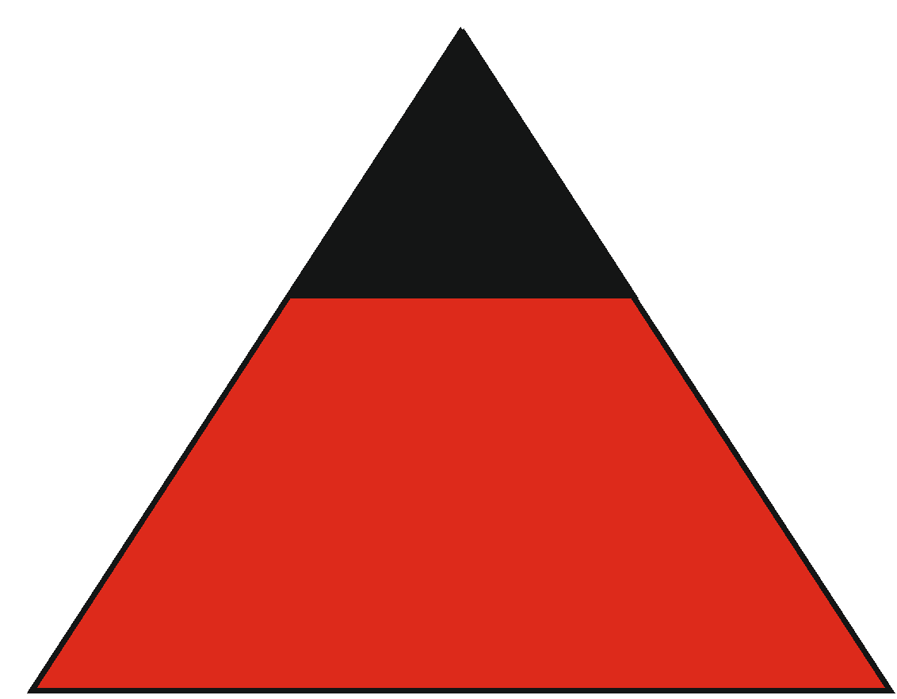
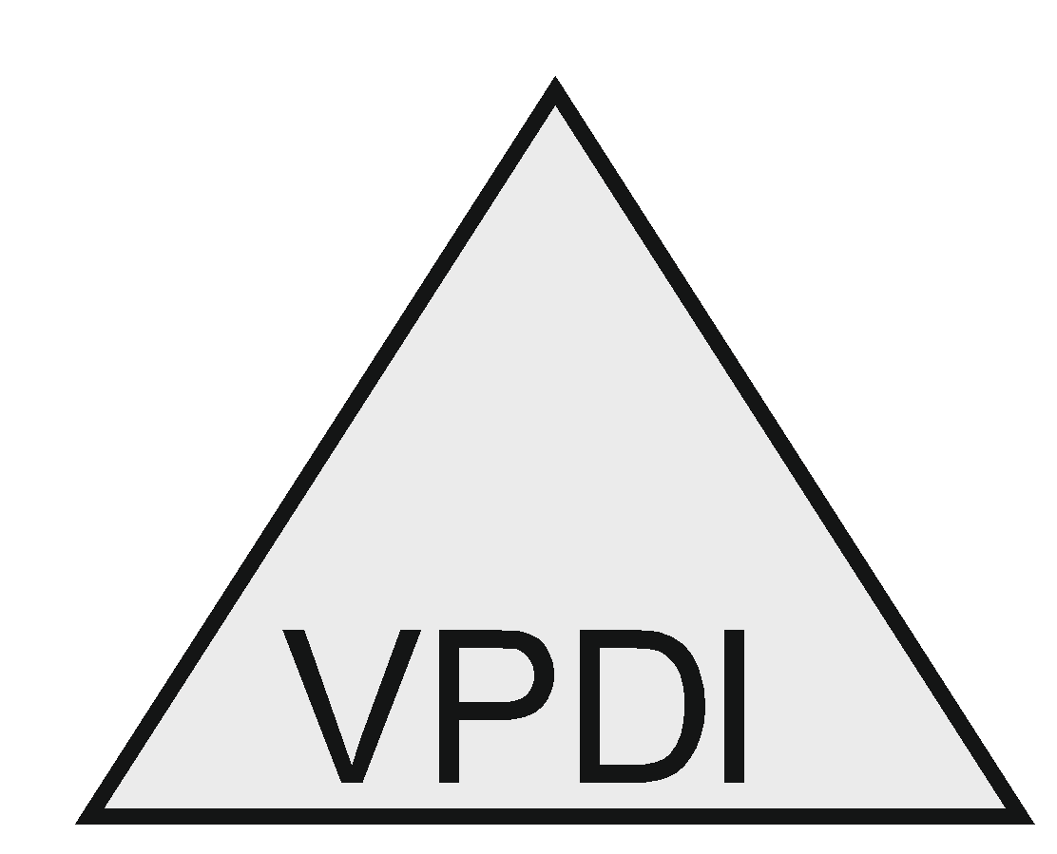
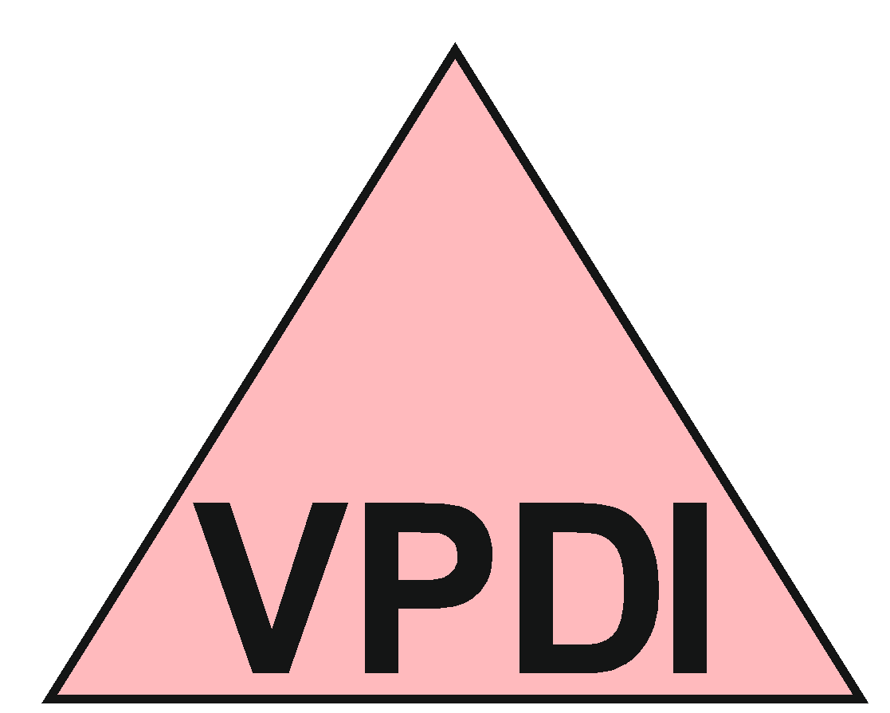
Disease burden and vaccine-preventable disease incidence (VPDI) in children vaccinated in infancy
Finland
FinIP
Laboratory-confirmed IPD
Non-laboratory-
confirmed IPD
Graphics based on true incidences
Adapted from Palmu et al, ESPID 2014, Dublin, Ireland (poster)

Slide 50
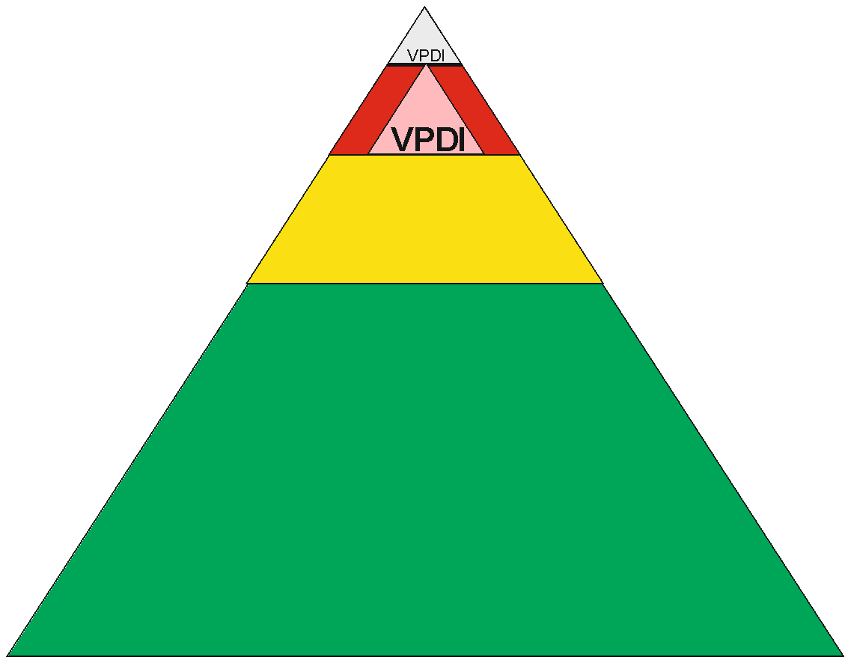
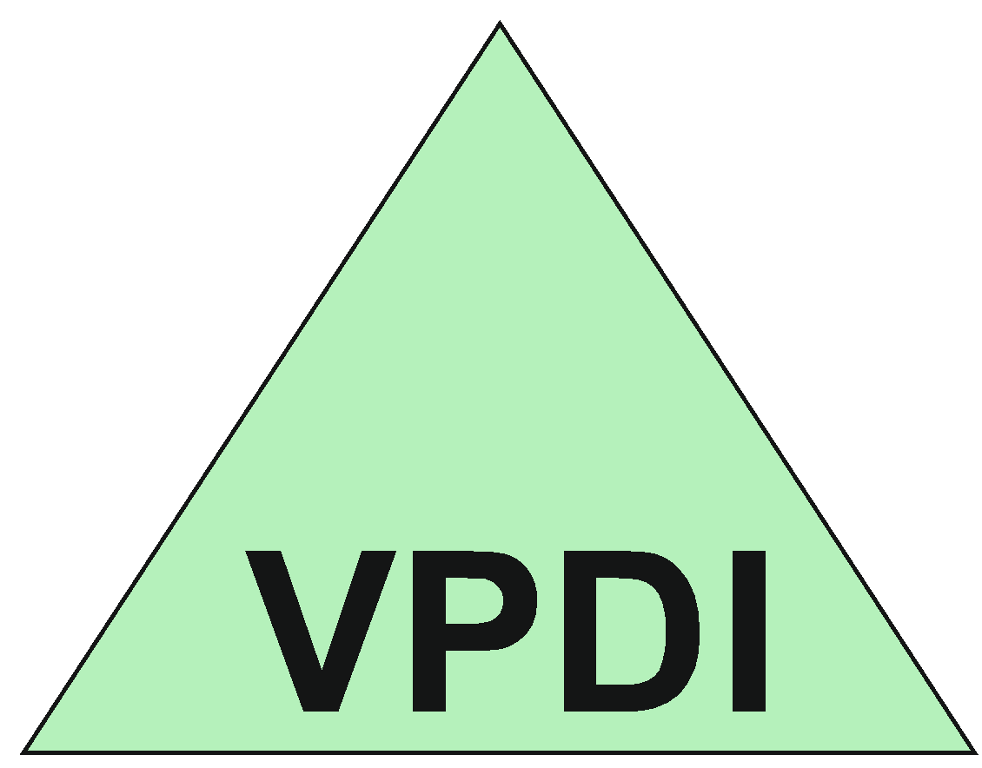
Disease burden and vaccine-preventable disease incidence (VPDI) in children vaccinated in infancy
FinIP
Laboratory confirmed IPD
Laboratory-confirmed IPD
Non-laboratory-confirmed IPD
Pneumonia
Non-laboratory-
confirmed IPD
Tympanostomy
tube placement
Graphics based on true incidences
Adapted from Palmu et al, ESPID 2014, Dublin, Ireland (poster)

Slide 51
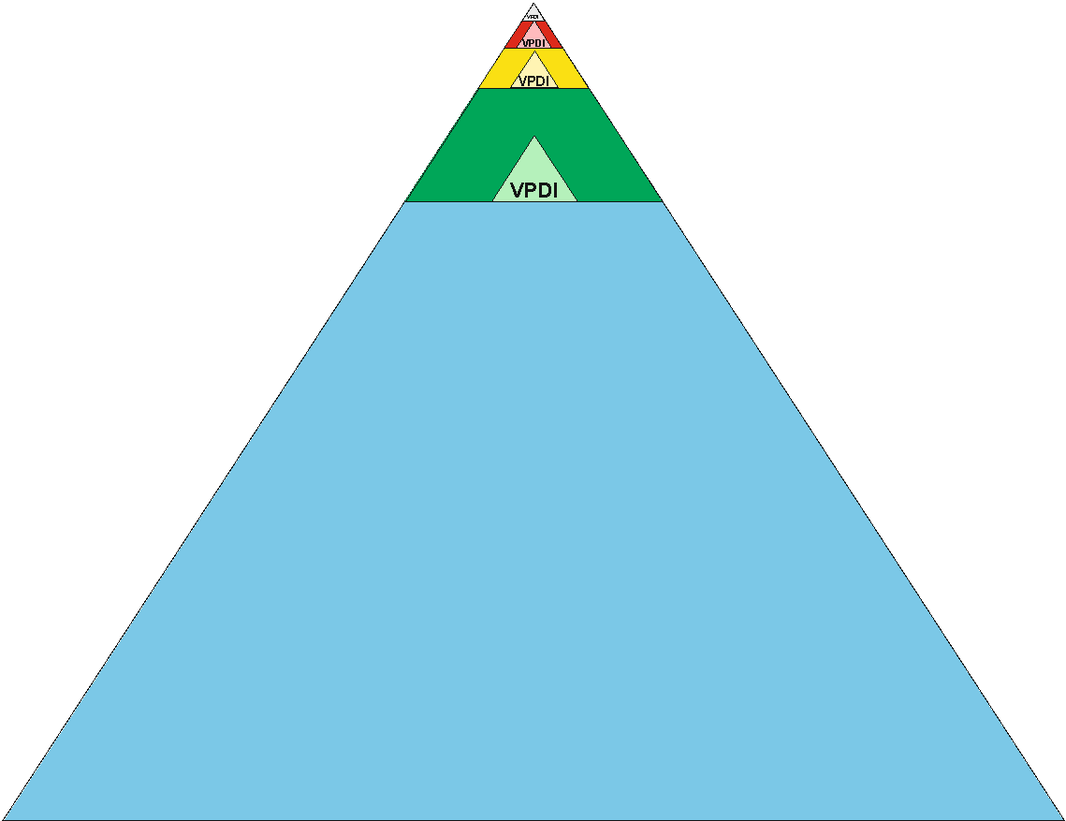
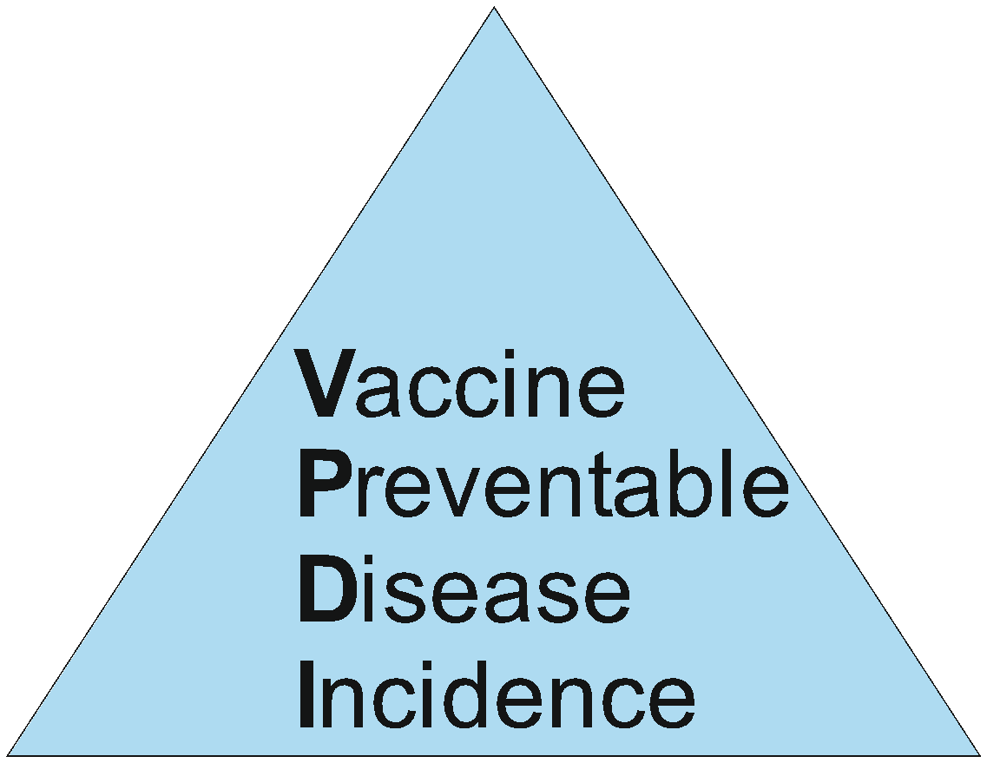
Disease burden and vaccine-preventable disease incidence (VPDI) in children vaccinated in infancy
FinIP
NNV = 667
NNV = 242
NNV = 147
NNV = 46 .
NNV = 5 .
NNV = 4 to prevent any outcome
Laboratory confirmed IPD
Non-laboratory-confirmed IPD
Pneumonia
Tympanostomy tube placement
19A IPD
Laboratory confirmed IPD
Non-laboratory-confirmed IPD
Pneumonia
Antimicrobial purchases
Tympanostomy
tube placement
Graphics based on true incidences
Adapted from Palmu et al, ESPID 2014, Dublin, Ireland (poster)

Slide 52
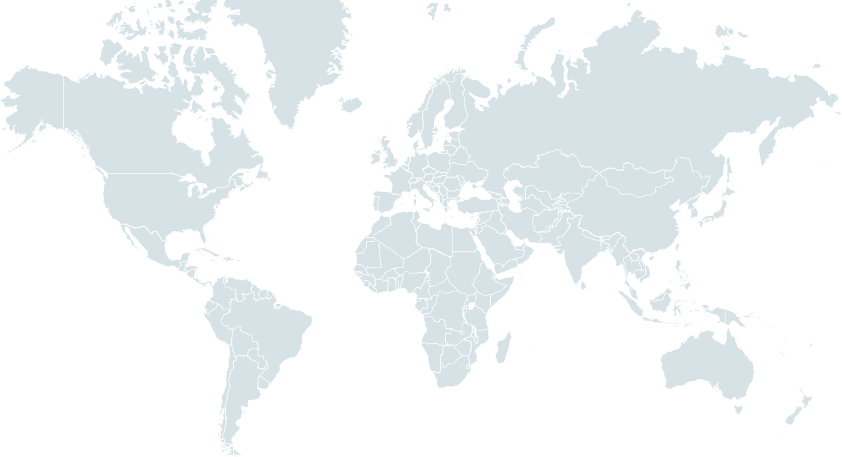
UMV/NIP programs: 39 countries included Synflorix in 2018¹
Europe
Albania
Austria
Belgium
Bulgaria
Cyprus
Czech Rep*
Dutch Antilles
Finland
Georgia
Iceland
Asia and Pacific
Bangladesh
Nepal
Pakistan
Fiji
South Korea*
New Zealand
The Americas
Brazil
Canada – Quebec
Colombia
Ecuador
El Salvador
Italy – Piedmont
Latvia
Lithuania
Macedonia†
Netherlands
Palestine
Poland
Serbia
Slovak Rep*
Slovenia
Sweden – multiple regions
Africa
Ethiopia
Kenya
Madagascar
Morocco
Nigeria
Uganda
Zambia
NIP, national immunization program; UMV, universal mass vaccination.
* Reimbursed; † Risk groups only – only a fraction of birth cohort is eligible for vaccination.
1. GSK Data on File 2018N371700_00.
Accurate as of May 2018

Slide 53
UMV/NIP programs in the European Union: 14 countries included Synflorix in 2018¹
14 Out of 27 countries in the European Union:
10 with Synflorix only (Austria, Belgium, Bulgaria, Cyprus, Finland, Latvia, Lithuania, Netherlands, Poland, Slovenia)
4 with both Synflorix and PCV13 (Czech Republic, Italy, Slovakia, Sweden)
3 with no PCV program (Croatia, Estonia, Malta)
10 with PCV13 only (Denmark, France, Germany, Greece, Hungary, Ireland, Luxembourg, Portugal, Romania, Spain)
Note: United Kingdom not counted as an EU country
Austria
Belgium
Bulgaria
Cyprus
Czech Rep*
Finland
Italy – Piedmont
Latvia
Lithuania
Netherlands
Poland
Slovak Rep*
Slovenia
Sweden – multiple regions
Accurate as of May 2018
NIP, national immunization program; UMV, universal mass vaccination.
* Reimbursed.
1. GSK Data on File 2018N371700_00.
Notes:
Status of UMV/NIP in the European Union (EU) in 2018.¹
Out of 27 countries:
10 with Synflorix only (Austria, Belgium, Bulgaria, Cyprus, Finland, Latvia, Lithuania, Netherlands, Poland, Slovenia)
4 with both Synflorix and PCV13 (Czech Republic, Italy, Slovakia, Sweden)
3 with no PCV program (Croatia, Estonia, Malta)
10 with PCV13 only (Denmark, France, Germany, Greece, Hungary, Ireland, Luxembourg, Portugal, Romania, Spain)
Note: United Kingdom not counted as an EU country
Reference:
GSK Data on File 2018N371700_00.

Slide 54
10 years of experience of use of PCVs in NIP
where are we now?
Experience in EU countries
Experience of countries which switch PCV in NIP

Slide 55
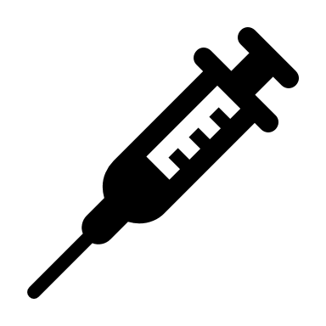
Infant PCV immunization in Belgium
Switch from PCV13 to PHiD-CV in several countries/regions, including Belgium
2007 | 2008 | 2009 | 2010 | 2011 |  | 2012 | 2013 | 2014 | 2015 |  | 2016 |  | 2017 | 2018
PCV7 (Jan 2007) |  |  |  |  | PCV13 (Jul/Oct 2011) |  |  |  |  |  |  | PHiD-CV
Switch in Flanders
(Jul 2015)
Switch in Wallonia
(May 2016)
2+1 schedule (at 2, 4 + 12 months of age)
Coverage for three doses:
94.9% (Flanders, 2016)
92.9% (Wallonia/Brussels, 2015)
Superior Health Council recommends
switch back to PCV13
Notes:
Data for vaccination coverage:
https://www.zorg-en-gezondheid.be/sites/default/files/atoms/files/Vaccinatiegraadstudie%202016.pdf, Tabel 1 (Pnc 3)
http://www.vaxinfopro.be/spip.php?article2000&lang=fr, Tableau 2 (4ème séance)
Introduction of PCVs (dates):
https://www.wiv-isp.be/pedisurv/AnnualReports/CurrentReport/jaarverslag_nl.pdf, p. 64-65
Recommendation on switch back to PCV13:
https://www.health.belgium.be/sites/default/files/uploads/fields/fpshealth_theme_file/hgr_9519_advies_vaccinatie_pneumokokken_kinderen_.pdf

Slide 56
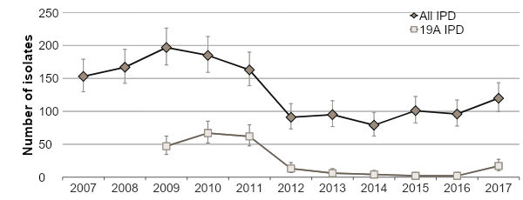
Increase in number of overall/19A IPD isolates 1–2 years after the switch
Number of IPD isolates from children <2 years of age sent to National Reference Center (NRC)
Could this be linked to the PCV13-to-PHiD-CV switch?
Sudden rise 1–2 years after switch in age group targeted for vaccination
Driven by 19A (included in PCV13, not in PHiD-CV)
Trend continuing:
Preliminary data for Jan–Sep 2018: 95 overall IPD and 23 19A IPD isolates in <2-year-olds
Full 2018 data to be presented by Desmet et al. in this session
Children <2 years old
120
96
17
2
PCV7 | PCV13 |  | PHiD-CV
Switch in Wallonia
Switch in Flanders
Streptococcus pneumoniae 2017 (NRC report)
Notes:
Streptococcus pneumoniae 2017 (NRC report), Table 3, Table 4
https://nrchm.wiv-isp.be/nl/ref_centra_labo/streptococcus_pneumoniae_invasive/Rapporten/Streptococcus%20pneumoniae%202017.pdf
Graphs prepared by Meheni: Data in Belgium_Graph_MK_03122018 for confidence intervals
Continuing trend:
Preliminary Jan-Sep 2018: https://www.health.belgium.be/sites/default/files/uploads/fields/fpshealth_theme_file/hgr_9519_advies_vaccinatie_pneumokokken_kinderen_.pdf
Desmet et al ESPID abstract: https://cmoffice.kenes.com/cmsearchableProgrammeV15/conferencemanager/programme/ESPID19/Chair#!abstractdetails/0000373550

Slide 57
Link between rise in IPD and PCV13-to-PHiD-CV switch?
Arguments questioning a link
Vaccination status not fully known; heterogeneity in administered vaccines
Children <2 years old
Vaccination status 19A cases
9 children with vaccination history available
9 PCV doses appropriate for age
6 received PHiD-CV only
3 received ≥1 PCV13 dose
120
96
17
2
PCV7 | PCV13 |  | PHiD-CV
Switch in Wallonia
Switch in Flanders
Streptococcus pneumoniae 2017 (NRC report); Desmet at al. Lancet Infect Dis. 2018 Sep;18:945-6
Notes:
Streptococcus pneumoniae 2017 (NRC report), Table 3, Table 4
https://nrchm.wiv-isp.be/nl/ref_centra_labo/streptococcus_pneumoniae_invasive/Rapporten/Streptococcus%20pneumoniae%202017.pdf
Graphs prepared by Meheni: Data in Belgium_Graph_MK_03122018 for confidence intervals
Vaccination status:
Lancet Infect Dis. 2018 Sep;18(9):945-946. doi: 10.1016/S1473-3099(18)30484-5.
https://www.thelancet.com/journals/laninf/article/PIIS1473-3099(18)30484-5/fulltext

Slide 58
Link between rise in IPD and PCV13-to-PHiD-CV switch?
Arguments questioning a link
Increasing trend in overall IPD isolates also seen between 2014 and 2015, before the switch
Children <2 years old
120
101
96
79
PCV7 | PCV13 |  | PHiD-CV
Switch in Wallonia
Switch in Flanders
Streptococcus pneumoniae 2017 (NRC report)
Notes:
Streptococcus pneumoniae 2017 (NRC report), Table 3, Table 4
https://nrchm.wiv-isp.be/nl/ref_centra_labo/streptococcus_pneumoniae_invasive/Rapporten/Streptococcus%20pneumoniae%202017.pdf
Graphs prepared by Meheni: Data in Belgium_Graph_MK_03122018 for confidence intervals

Slide 59
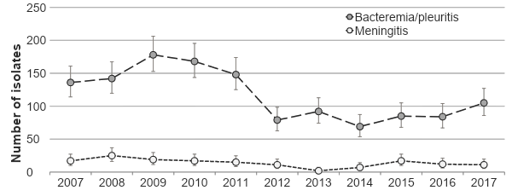
Link between rise in IPD and PCV13-to-PHiD-CV switch?
Arguments questioning a link
Increase in overall IPD isolates observed for bacteremia/pleuritis only, not for meningitis
Possible changes in non-meningitis case report patterns?
Children <2 years old
PCV7 | PCV13 |  | PHiD-CV
Switch in Wallonia
Switch in Flanders
Streptococcus pneumoniae 2017 (NRC report)
Notes:
Streptococcus pneumoniae 2017 (NRC report), Table 3, Table 4
https://nrchm.wiv-isp.be/nl/ref_centra_labo/streptococcus_pneumoniae_invasive/Rapporten/Streptococcus%20pneumoniae%202017.pdf
Graphs prepared by Meheni: Data in Belgium_Graph_MK_03122018 for confidence intervals

Slide 60
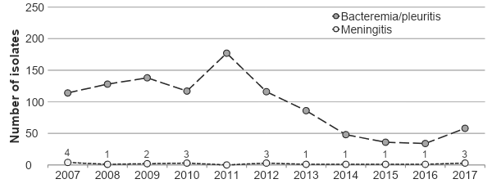
Link between rise in IPD and PCV13-to-PHiD-CV switch?
Arguments questioning a link
Increase in overall IPD also noted in children 2–4 years old
Children mostly vaccinated with PCV13 (before switch) or a combination of PCV13 and PHiD-CV
Children 2–4 years old
PCV7 | PCV13 |  | PHiD-CV
Switch in Wallonia
Switch in Flanders
Streptococcus pneumoniae 2017 (NRC report, additional table)
Notes:
https://nrchm.wiv-isp.be/nl/ref_centra_labo/streptococcus_pneumoniae_invasive/Rapporten/Report_table_IPD_cases_per_age_group_2007_2017.pdf

Slide 61
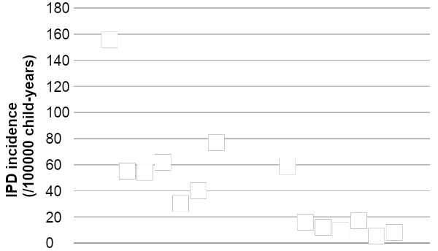
Link between rise in IPD and PCV13-to-PHiD-CV switch?
Arguments questioning a link
IPD incidence in Belgium: outlier compared to other European countries?
2002–2003:
156/100000
Belgium (2002–2003 vs 2015)
Denmark (2000–2007 vs 2011–2013)
England/Wales (2000/01–2005/06 vs 2013/14)
Finland (2004 vs 2015)
2015:
59/100000
France (2001–2002 vs 2012)
Netherlands (2004/05 vs 2013/14)
Norway (2005 vs 2012)
Pre-PCV period
PHiD-CV/PCV13 period
Notes:
Belgium: https://www.wiv-isp.be/pedisurv/AnnualReports/CurrentReport/jaarverslag_nl.pdf
Denmark: Harboe et al. Clin Infect Dis 2014
England/Wales: Miller et al. Lancet Infect Dis 2011; Waight et al. Lancet Infect Dis 2015
Finland: https://thl.fi/en/web/thlfi-en/research-and-expertwork/projects-and-programmes/monitoring-the-population-effectiveness-of-pneumococcal-conjugate-vaccination-in-the-finnish-national-vaccination-programme/incidence-of-invasive-pneumococcal-disease-in-finland
France: Lepoutre et al. Vaccine 2015
The Netherlands: Knol et al. Emerg Infect Dis 2015
Norway: Steens et al. Vaccine 2013

Slide 62
Link between rise in IPD and PCV13-to-PHiD-CV switch?
Arguments questioning a link
Effectiveness of PHiD-CV against 19A IPD has been demonstrated in well-designed studies¹⁻⁴
Although increases in overall IPD and fluctuations in 19A IPD incidences have been observed in other countries,⁵⁻⁹ epidemiological trends similar to those in Belgium have not been observed elsewhere regardless of which PCV is used.
Limited available data from other countries switching from PCV13 to PHiD-CV do not show increases in the overall/19A IPD incidence^{10,11}
1. Deceuninck et al. Vaccine. 2015;33:2684-9; 2. Domingues et al. Lancet Respir Med. 2014;2:464-71; 3. Jokinen et al. PLoS One. 2015;10:e0120290; 4. Verani et al. Vaccine. 2015;33:6145-8; 5. Collins et al. ISPPD-10; 6. Fry et al. ISPPD-10; 7. Corcoran et al. ISPPD-10; 8. Ladhani et al. Lancet Infect Dis. 2018;18:441-51; 9. Weinberger et al. Vaccine. 2018;36:572-7; 10. Diawara et al. Int J Infect Dis. 2015;40:95-101; 11. https://surv.esr.cri.nz/surveillance/IPD.php
Notes:
Note: temporary nature of effectiveness of PHiD-CV against 19A IPD – see: Rinta-Kokko H, Palmu AA, Auranen K et al. Long-term impact of 10-valent pneumococcal conjugate vaccination on invasive pneumococcal disease among children in Finland. Vaccine. 2018;36(15):1934-1940.

Slide 63
Conclusions
It is premature to infer a causal link between the PCV13-to-PHiD-CV switch in the Belgian infant immunization program and the rise in the number of overall/19A IPD isolates reported for children <2 years old in Belgium
Continued monitoring of IPD with robust methods is needed to assess the impact of the PCV immunization program
Data from 2018 (Desmet et al. ESPID 2019) confirms the need for follow-up to understand the Belgian epidemiology, as the increase in 19A IPD is mostly seen in one of the two main Belgian regions
WHO position paper: “There is currently insufficient evidence that the two vaccines differ in their impact on the overall pneumococcal disease burden”

Slide 64
National/regional infant immunization programs: 39 countries included Synflorix in 2018
Accurate as of May 2018
Europe
Albania
Austria
Belgium
Bulgaria
Cyprus
Czech Rep*
Dutch Antilles
Finland
Georgia
Iceland
Asia and Pacific
Bangladesh
Nepal
Pakistan
Fiji
South Korea*
New Zealand
The Americas
Brazil
Canada – Quebec
Colombia
Ecuador
El Salvador
Italy – Piedmont
Latvia
Lithuania
Macedonia†
Netherlands
Palestine
Poland
Serbia
Slovak Rep*
Slovenia
Sweden – multiple regions
Africa
Ethiopia
Kenya
Madagascar
Morocco
Nigeria
Uganda
Zambia
GSK Data on File 2018N371700_00
* Reimbursed; † Risk groups only – only a fraction of birth cohort is eligible for vaccination.
Prevenar is a registered trademark of Wyeth LLC; Prevenar 13 is a registered trademark of Pfizer Inc; Synflorix is a registered trademark of the GSK group of companies.
Notes:
We agree with the Belgian experts that to properly understand the Belgian epidemiology, further follow-up is needed.
What creates confidence in Synflorix is that >38 countries all over the world are using Synflorix in the NIP and no similar trends have been reported in any of this countries.

Slide 65
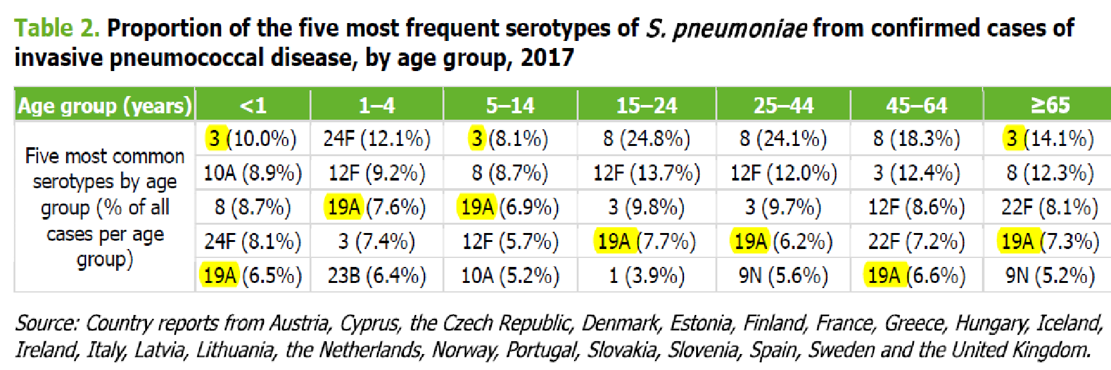
ECDC data 2017

Slide 66
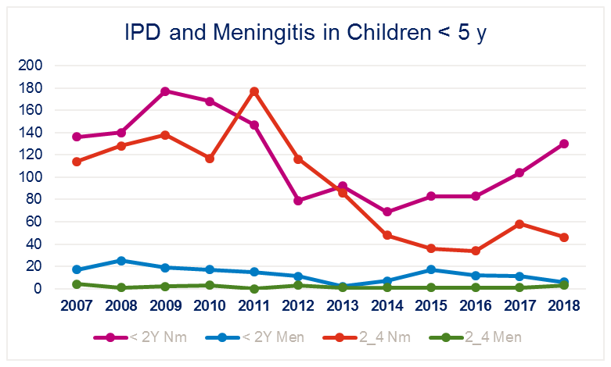
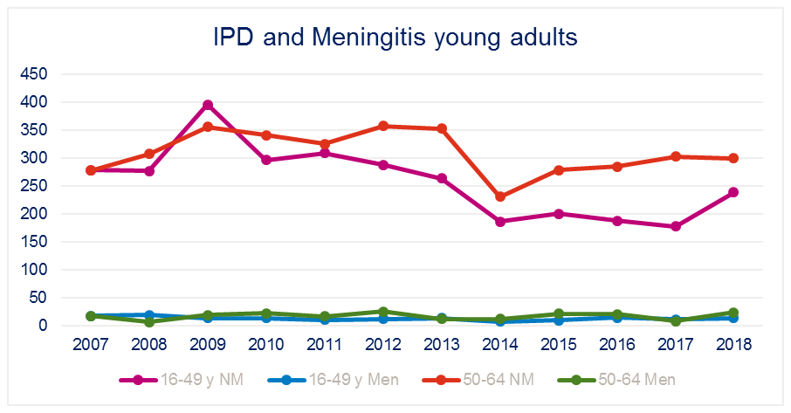
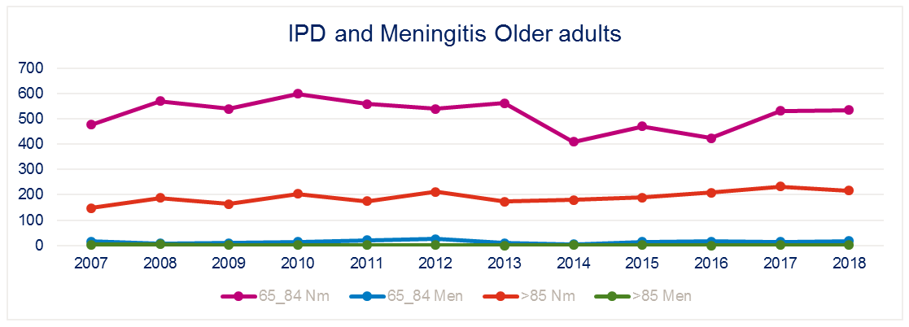
IPD and meningitis number of cases in Belgium up to 2018

