Slide 1
Medical Preparations of
Kidney Transplantation

Slide 2
Outline
Historical background of Transplantation
Timing of Kidney Tx
Donor Issues
Recipient Issues
Immunological work up
Immunosuppressive Meds
Recurrence
Graft Survival

Slide 3
Renal transplantation is generally regarded as the treatment of choice for end-stage renal disease (ESRD) in children and adolescents.
Dialysis therapy is generally considered as a bridge to renal transplantation for pediatric patients with ESRD.

Slide 4
Compared with chronic dialysis, renal transplantation offers survival advantage, improved linear growth, decreased hospitalization rate, and improved quality of life.
For these reasons, renal transplantation should be the goal for treatment of ESRD in childhood.
NAPRTCS Annual Report.
European best practice guidelines for renal transplantation.
Nephrol Dial Transplant 17 (Suppl 4):55.

Slide 5
Pre-emptive renal transplantation provides an opportunity for the child and the family to bypass dialysis altogether and remains a viable alternative for patients with a suitable donor.

Slide 6
1902 - The first successful experimental kidney transplants were performed at the Vienna Medical School in Austria with animals.
1909 - The first kidney transplant experiments were performed in humans in France using animal kidneys. Although “the immediate results were excellent” the child died about 2 weeks later.

Slide 7
1933 - The first human-to-human kidney transplant was performed , there were mismatches in donor and recipient blood groups and the donor kidney never functioned

Slide 8
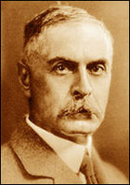
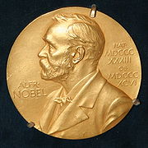
- Noted for his development in 1901 of the modern system of classification of blood groups
from his identification of the presence of agglutinins in the blood.
- In1930 he received the Nobel Prize in Physiology & Medicine
Karl Landsteiner (1868–1943)

Slide 9
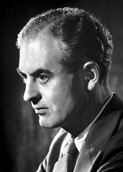
1943 -Nobel Prize for his work in tissue grafting , also for his discovery of acquired immunological tolerance
- Description of skin graft rejection as an immune process
Peter Brian Medawar
(1915 –1987)

Slide 10
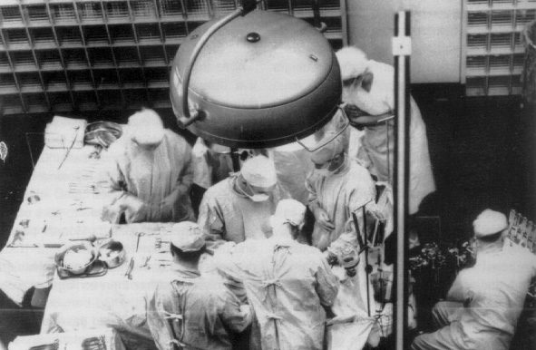
THE PERFECT MATCH
1954 - Joeseph E. Murray and his colleagues at Peter Bent Brigham Hospital in Boston performed the first truly successful kidney transplant from one twin to another. This was done without any immunosuppressive medication.

Slide 11
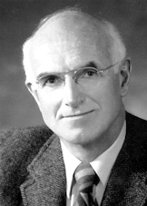
Murray won the Nobel Prize in Physiology & medicine in 1990 for his work on organ and cell transplant
Joseph Murray
Born in April 1919

Slide 12
Early 1950’s - Cortisone-like medications were used to suppress the human body’s self-defense system (immune system), resulting in some kidney transplant success.

Slide 13
1959 | Inhibition of antibody production in experiments with mercaptopurine
1960’s | Tissue typing advancements,better techniques for matching donor and recipient blood and tissue types, as well as improvements in preserving cadaveric kidneys,
1960 | Prolongation of survival of experimental kidney transplants by mercaptopurine
1961 | Prolongation of survival of experimental kidney transplants by azathioprine
1962 | Use of azathioprine and steroids in clinical renal transplants
1963 | First clinical liver transplant

Slide 14
1967 | First clinical heart transplant
1978 | Use of ciclosporin in clinical renal transplants
1981 | Use of monoclonal antibodies to lymphocytes in organ grafting
1989 | Use of tacrolimus in clinical organ grafts
1995 | Use of sirolimus in clinical organ grafts
1998 | Alemtuzumab induction and low-dose maintenance immunosuppression in clinical renal transplants

Slide 15
Time of kidney transplantation
Renal transplantation should be consider when renal replacement therapy is indicated .
In children, dialysis may be required before transplantation to optimize nutritional and metabolic conditions, to achieve an appropriate size in small children.
Many centers want a recipient to weight at least 12 kg, to minimize the risk for vascular thrombosis and accommodate an adult kidney size

Slide 16
Donors Issues

Slide 17
Source of the Graft
1- Living donation
Living donation is accepted by law, religion, and bioethics, provided that the donor is aware of the consequences of his/her act and makes the decision without outside pressure or commercialism .
The results of living kidney transplantation are superior to those of cadaveric renal transplantation, especially in the long term for both related and non-related donors .

Slide 18
Advantages of kidney transplantation from a living donor in comparison with a cadaveric kidney
Better ‘quality’ of kidney (GFR, renal blood flow, renal functional reserve)
No comorbidity (diabetes, atherosclerosis, hidden tumors, infection, etc.)
No hypotension (less DGF)
No over-regulation of cytokines and growth factors caused by intracranial hypertension.

Slide 19
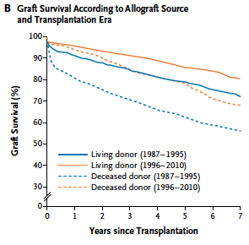

Slide 20
Requirements in considering a subject for potential living kidney donation
Voluntary offer
Aware of alternative therapies for the recipient
Aware of the risk for the donor and the recipient
Psychologically suitable
Psychological evaluation in doubtful cases
Fully informed consent

Slide 21
Contraindications for LKD:
Absolute
Cognitive deficit
Drug or alcohol abuse
Evidence of renal disease
Significant abnormal renal anatomy
Bilateral renal stone
HPN,DM ,prior ,MI mod. to sever lung disease,
chronic liver disease or chronic active infection
History of malignancy
Coagulation problems
Current pregnancy
Relative
ABO incompatibility
Age <18 or >65
Obesity BMI>35
Jehovah’s Witness

Slide 22
2- Deceased (Cadaveric ) Donor :
A - Current situation
The large majority of cadaver transplanted kidneys are removed from brain-dead donors with respiration and circulation are artificially maintained (Heart beating donor).
However, despite the legal and religious acceptance of brain death, many potential donors are not recognized, and some of the families refuse to donate !!!
Do we need to change this current situation ?

Slide 23
B- Presumed consent:
Under this system ,the organ of the deceased would be removed unless an objection had been registered in advance by the donor or by the family.
This approach spares families from having to consider organ donation at traumatic time and also increase the # of organs for transplantation !!!!!
C- Mandated Choice:
Under this system the individual would required to make choice in order to receive or renew the driver’s license or national ID

Slide 24
D- NHBD (DCD):
It rely on the use of irreversible cessation of circulation and respiratory functions, as opposed to irreversible cessation of brain function
There are several problems with this approach !!!!
Time until harvesting the donor ? 2 min or 10 min , religion ???

Slide 25
E – Financial incentive for LD :
I am in need of cash for my family needs ?
Is it legal to sell my own kidney ?
Is it safe for both donors and recipients ?

Slide 26
Due to the organ shortage, it had been the practice of many ESRD patients to seek the help of commercial centers that offered living non-related kidneys (LNR).
Several centers were offering such services.
The patients would be offered a kidney from a donor seeking financial gain and would receive a transplant without delay.

Slide 27
Pretransplant studies would be limited
Patients would usually be started on triple-therapy IM ,and would be shipped back to his country within 2 weeks of the procedure to arrive in the emergency rooms
Needless to say, the incidence of immunological, surgical, and infectious complications is much higher in these recipients
W. K. A1-Khudair, World J Urol 14:268-271

Slide 28
Unfortunately the medical information accompanying these patients usually poor or fair.
Education of the patients was lacking, and their compliance with medications, instructions, and follow-up visits also would be poor or fair
W. K. A1-Khudair, World J Urol 14:268-271

Slide 29
Recipients Issues

Slide 30
Evaluation of the recipient:
Hemostasis
Neuropsychiatric assessment
Non adherence issue
Pretransplant nephrectomy

Slide 31
Establishing the precise cause of ESRD

Slide 32
Etiology OF ESRD
The most common primary causes of kidney failure in young children are congenital or inherited disorders such as: Renal dysplasia Obstructive uropathies Reflux nephropathy
In older children acquired glomerular diseases such as FSGS and lupus nephritis

Slide 33
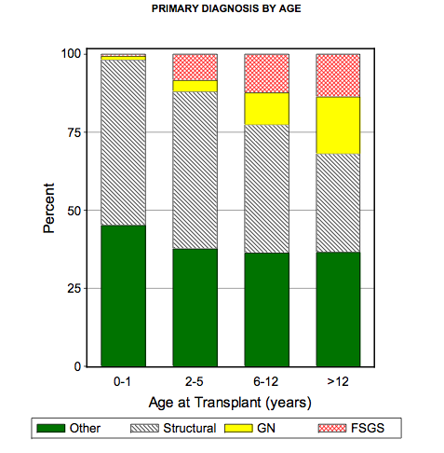
In contrast, the most common primary renal diseases that lead to end-stage kidney disease in adults are diabetic nephropathy, hypertension, and ADPK
NAPRTCS Annual Report.

Slide 34
Recurrence

Slide 35
Primary disease | Recurrence rate | Graft loss to recurrence
FSGS | 14-50% | 40-60%
Atypical HUS | 20-80-% | 10-83%
Typical HUS | 0-1% | 0-1%
MPGN type1 | 30-77% | 17-50%
MPGN type2(DDD) | 66-100% | 25-61%
SLE nephritis | 0-30% | 0-5%
IgA | 35-60% | 7-10%
HSP | 31-100% | 8-22%
Primary hyperoxalouria type1 | 90-100% | 80100%
Pediatr Nephrol (2009) 24:2097–2108

Slide 36
(i) Up to 30% of children and young adults with FSGS harbour mutations of genes encoding proteins of the podocyte, the slit diaphragm or the glomerular basement membrane.
(ii) These genetic FSGS almost never recur after transplantation.
(iii) The therapy of post-transplant FSGS recurrence ?

Slide 37
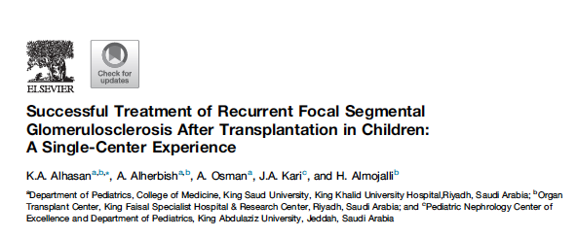

Slide 38
UROLOGIC ISSUES

Slide 39
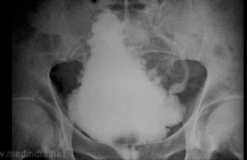
Surgical correction may be required for certain structural abnormalities before Tx
Neurogenic bladder (1^{ry} ^{or} 2^{ry} ) may lead to ESRD in children.
Children with neurogenic bladder with small bladder capacity likely will need bladder augmentation

Slide 40
In patients with PUV, an open vesicostomy may need to be performed early in life to decompress a dysfunctional bladder. An open vesicostomy may be kept in place for many months after transplantation.

Slide 41
Those children may will need lifelong antimicrobial prophylaxis to prevent UTI
Dharnidharka VR et al. Clin J Am Soc Nephrol 2007;2:100-6.

Slide 42
IMMUNIZATIONS

Slide 43
Vaccination strategies pre-KT:
Children require multiple vaccinations during early childhood to protect them from preventable infectious diseases.
Vigorous effort to immunize children completely before transplantation is critical

Slide 44
Although children with ESRD often have a suboptimal immune response and reduced duration of immunity, have better immune responses compared to patients after transplantation:
Higher initial doses or extra doses may be needed
Antibody titer monitoring with booster doses of vaccines may be needed.
Esposito S, et at,Vaccine 32:6601–6606

Slide 45
AST recommend that pediatric SOT candidates be immunized prior to transplantation using age appropriate guidelines
Children behind on vaccinations prior to transplantation can follow an expedited schedule according to the CDC’s catch-up schedule
Gangappa S,et al, Transpl Int 21:293–303

Slide 46
live vaccines are generally contraindicated post transplantation , so ensuring that all eligible vaccines are given before transplant surgery is critical

Slide 47
For live-attenuated vaccines: Waiting a minimum of 4 weeks between vaccine administration and transplantation is recommended

Slide 48
Recommended vaccines for KT C&R
Vaccine | Inactivated/live-attenuated | Recommended for candidates | Recommend. for recipients | Monitor V titers
Influenza | I | yes | yes | NO
Influenza | LA | NO | NO | NO
Hepatitis B | I | YES | YES | YES
Hepatitis A | I | YES | YES | YES
Pertussis | I | YES | YES | NO
Diphtheria | I | YES | YES | NO
Tetanus | I | YES | YES | YES
IPV | I | YES | YES | NO
H.infl. | I | YES | YES | YES
PCV13 | I | YES | YES | YES
PPSV23 | I | YES | YES | YES
Men ACWY | I | YES | YES | NO
HPV | I | YES | YES | NO
Thomas G. Fox,et al Pediatr Nephrol (2019) 34:579–591

Slide 49
Recommended vaccines for KT C&R
Vaccine | Inactivated/live-attenuated | Recommended for candidates | Recommend. for recipients | Monitor V titers
Varicella | LA | YES | NO | YES
Rotavirus | LA | YES | NO | NO
Measles | LA | YES | NO | YES
Mumps | LA | YES | NO | YES
Rubella | LA | YES | NO | YES
Thomas G. Fox,et al Pediatr Nephrol (2019) 34:579–591

Slide 50
How to vaccinate patients undergoing transplant and recently received immunosuppressive and/or IG therapies?

Slide 51
As a general recommendation, most sources suggest delaying vaccination for at least 6 months after rituximab in order to make the administration of inactivated vaccines effective and live vaccines safe
Cheng DR, et al the evidence to pediatric patients. Expert Rev Vaccines 15:1567–1574

Slide 52
Delaying live virus vaccines for at least 4 weeks in patients receiving 14 days or more of high-dose corticosteroids (≥2 mg/kg/day of prednisone or ≥ 20 mg/day in patients over10 kg) is generally recommended
American Academy of Pediatrics. Committee on Infectious Diseases (2015) Red book

Slide 53
MMR and varicella vaccines should be delayed at least 2 weeks before and up to 11 months after receipt of IG

Slide 54
Unfortunately, incompletely vaccinated children often receive transplants.
A survey of pediatric SOT centers in the USA reported that 82% of providers would list a child who was not vaccinated for medical reasons and 47% would list a child whose parents had refused vaccinations.
Ladd J, et al ,Pediatr Transplant 17:244–250

Slide 55
Vaccination strategies after KT:
Live vaccines is generally should be avoided
6 months after transplantation Injectable influenza vaccine should be given annually.

Slide 56
Immunologic Work-up of Donor and Recipient

Slide 57
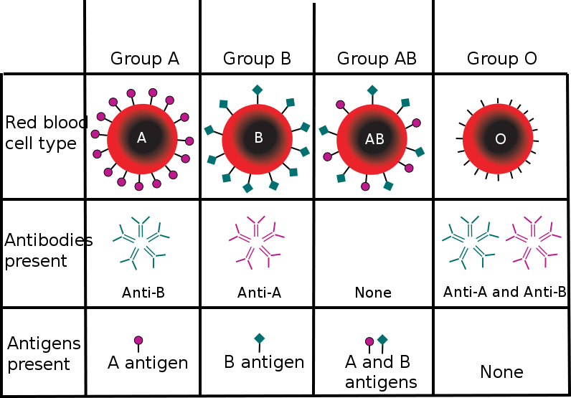
A-ABO blood grouping:
The ABO blood group should be determined.
The same criteria as used for blood transfusions may be adopted for renal transplants, with group O being the universal donor and group AB the universal recipient.

Slide 58
In cadaveric kidney transplantation, the donor should be ABO identical to the recipient, and ABO blood group compatibility should be discouraged.
This preserves the balance between demand and supply for different ABO phenotypes and counteracts the tendency for O patients to accumulate on waiting lists

Slide 59
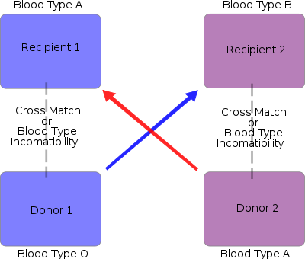
Paired Exchange Donation

Slide 60
(i) Paired donations allow to overcome ABO- and HLA incompatible
transplantation by swapping organ donors.
(ii) These paired donations programmes could include other parameters that influence graft outcome such as viral infections or age disparity.

Slide 61
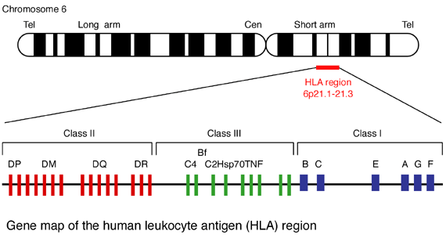
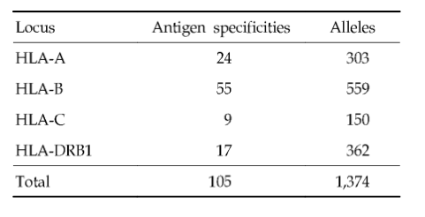
B- Histocompatibility testing:
Notes:
The human MHC calked HLA
HLA antigen are divided into class 1

Slide 62
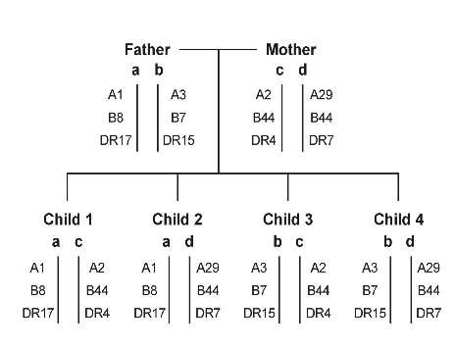
-MHC is inherited as HLA haplotype in Mendelian fashion from each parent
-2 sibling have 25% chance of being HLA identical,50% of being haploidentical
and 25% they share no HLA haplotype
Notes:
2 sibling have 25% chance of being HLA id,50% of being haploidentical and 25% they share no HLA haplotype

Slide 63
A- Tissue (HLA) Typing:
Serological typing
Molecular typing
Crossmatch:
CDC XM
CDC AHG XM
FCXM
ELISA
HLA antibodies screening :
PRA
Luminex

Slide 64
Immunosuppressive Medication

Slide 65
Class of agent | Options
Antibody induction | Lymphocyte depleting or non depleting
CNI | Cyclosporine,Tacrrolimus
Corticosteroid | Dose and regimen
Adjunctive agent | Azathioprine ,MMF, sirolimus
Supplementary agents | CCB, statins
Infection prophylaxis | Bactrim, Valgancylovir

Slide 66
Contraindications to renal transplantation in children
Absolute contraindication | Relative contraindication
HIV | Multiple congenital anomalies
Untreated malignancy | Sever mental retardation !!
Multi-organ failure | Poor compliance !!
Progressive neurological illness
Active infective state

Slide 67
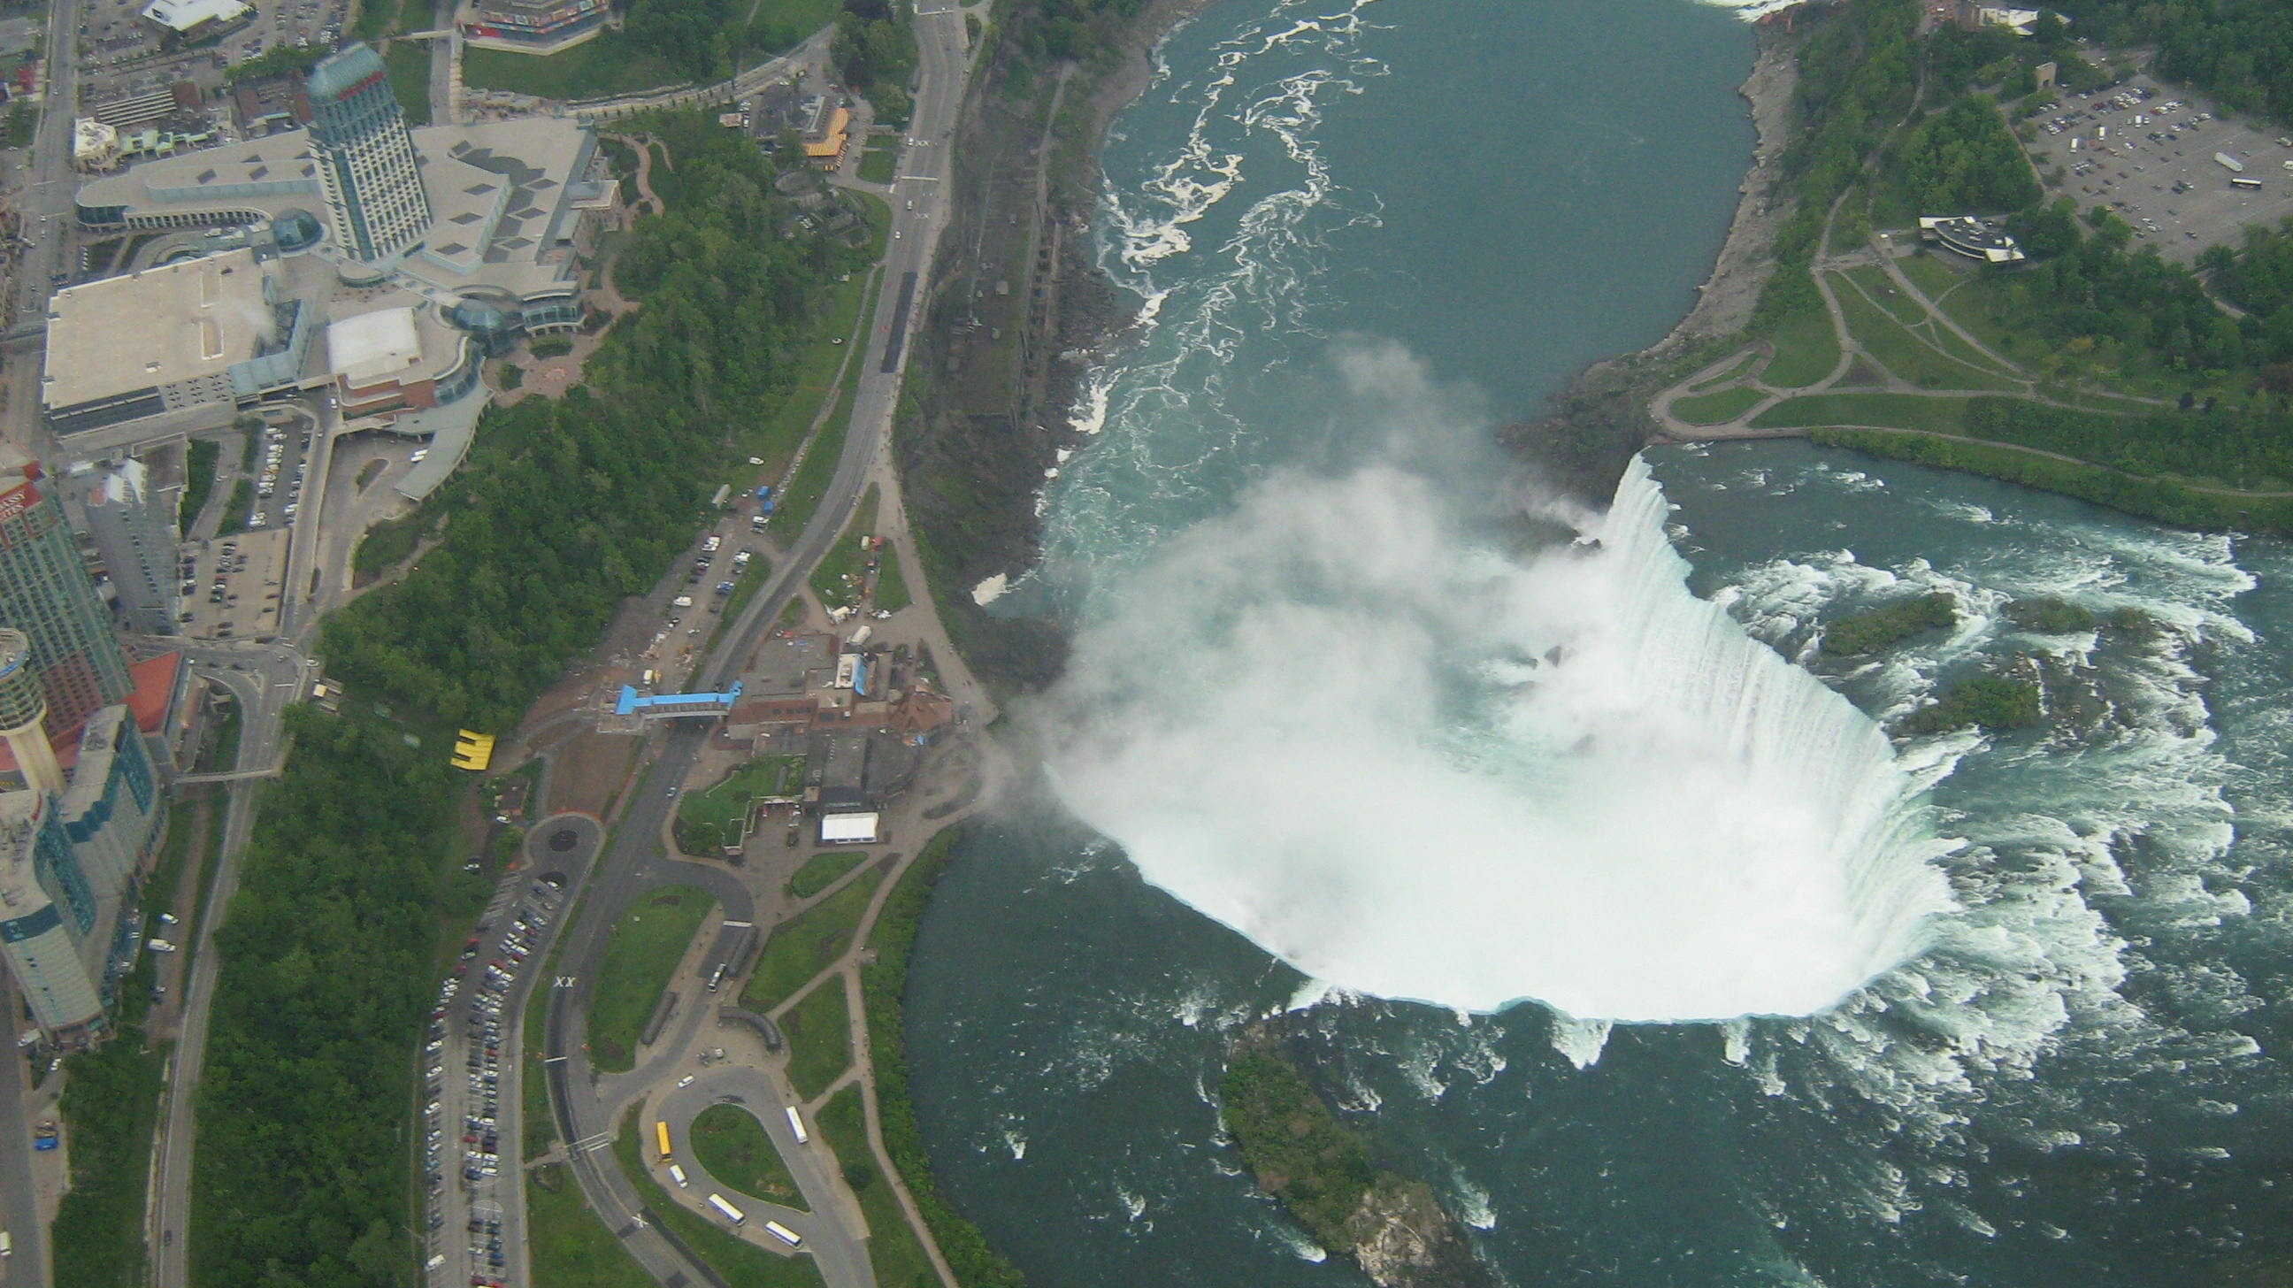
Thank You

