Slide 1
Approach to A Bleeding Child With Normal Initial Coagulation Profile
Mariam Fadlallah
Pediatric Hematology Oncology

Slide 2
Outline
Case Presentation 1
Case Presentation 2
Review of Hemostasis
Clinical Approach
Von Willebrand’s Disease
Glanzmann Thrombasthenia
Factor XIII Deficiency
Take Home message

Slide 3
Case 1
4 month-old boy was admitted for generalized tonico-clonic seizure of 5 minutes duration
He was admitted to ICN at 10 days of age for hemorrhagic shock due to severe umbilical bleeding, treated with FFPs and blood transfusion
He was readmitted at 2 months of age due to severe bleeding post circumcision. Platelet count, PT, aPTT were normal
No family history of bleeding disorders
1st degree consanguinity between parents

Slide 4
Case 1
Physical examination: pale, lethargic, tachycardic
Laboratory results:
CT brain showed diffuse bleeding with midline shift
Hb | MCV | WBC | platelet | PT | aPTT | fibrinogen
4 g/dL | 80 fL | 10 000/mm³ | 250 000/mm³ | 12 sec | 33 sec | 2 g/L

Slide 5
Case 1
4 month-old boy
Delayed Umbilical stump bleeding
Bleeding post circumcision
Normal:
Platelet count
PT
aPTT
Fibrinogen
R/O Bleeding disorder:
Factor XIII Deficiency
von Willebrand Disease
Inherited platelet function disorders
Intracranial bleeding
1st degree consanguinity

Slide 6
Case 1
4 month-old boy
Delayed Umbilical stump bleeding
Bleeding post circumcision
Normal:
Platelet count
PT
aPTT
Fibrinogen
vWF:Ag and vWF:RCo normal
Platelet function test normal
Factor XIII 2%
Intracranial bleeding
1st degree consanguinity

Slide 7
Case 1
4 month-old boy
Delayed Umbilical stump bleeding
Bleeding post circumcision
Normal:
Platelet count
PT
aPTT
Fibrinogen
Factor XIII Deficiency
Intracranial bleeding
1st degree consanguinity

Slide 8
Case 2
11 year-old girl with 3 weeks history of pallor and fatigue
She complains of heavy menses lasting for 10 days
She got her first menstrual period 4 months ago
She has a history of recurrent epistaxis that lasts for 10 to 15 minutes, well controlled at home
Family history: -maternal grandmother with hysterectomy at 40 years of age due to uterine bleeding
-mother with heavy menses, easy bruising and iron deficiency anemia
Non consanguineous parents

Slide 9
Case 2
Physical examination: pale , tachycardic
Laboratory results:
Hb | MCV | RDW | WBC | platelet | PT | aPTT | Fibrinogen
8.5 g/dL | 70 fL | 23% | 7 000/mm³ | 450 000/mm³ | 11 sec | 35 sec | 2.5 g/L

Slide 10
Case 2
11 year-old girl
Heavy menstrual bleeding
Normal:
Platelet count
PT
aPTT
Fibrinogen
R/O Bleeding disorder:
von Willebrand Disease
Inherited platelet function disorders
Factor XIII Deficiency
Recurrent epistaxis
Family history of mucocutaneous bleeding

Slide 11
Case 2
11 year-old girl
Heavy menstrual bleeding
vWF:Ag 20%
vWF:Rco 21%
Normal:
Platelet count
PT
aPTT
Fibrinogen
Recurrent epistaxis
Family history of mucocutaneous bleeding

Slide 12
Case 2
11 year-old girl
Heavy menstrual bleeding
Von Willbrand disease
Type I
Normal:
Platelet count
PT
aPTT
Fibrinogen
Recurrent epistaxis
Family history of mucocutaneous bleeding

Slide 13
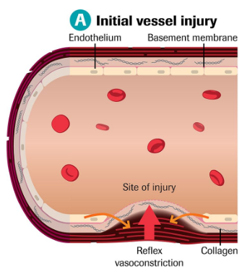
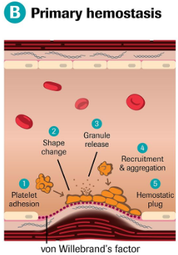
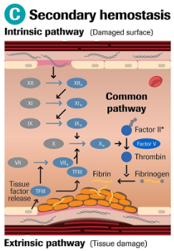
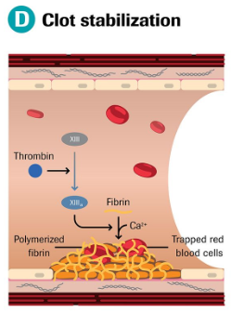
Hemostasis
Hemostasis is the physiologic response to vascular injury, resulting in a platelet-fibrin clot that prevents hemorrhage

Slide 14
Hemostasis
A defect in any of these phases of coagulation can result in a bleeding problem which may be inherited or acquired

Slide 15
Hemostasis
Mucocutaneous Bleeding
Deep Tissue Bleeding (muscles, joints…)

Slide 16
Hemostasis
Clinical history of bleeding: The initial screenings studies
▪CBCD with blood smear ▪PT ▪aPTT ▪Fibrinogen

Slide 17
Clinical history of bleeding:
Screening studies:
CBCD, PT, aPTT
No abnormalities
Thrombocytopenia
Prolonged PT
Prolonged aPTT
Von Willebrand disease (type I, some type II)
Platelet function Disorders
(Glanzmann Thrombasthenia)
Factor XIII deficiency
Non hematological causes:
Connective tissue disorders
Child abuse

Slide 18
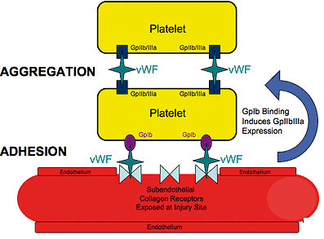
Von Willebrand Factor
vWF binds to both platelets and endothelial components, forming an adhesive bridge between platelets and vascular subendothelial structures and between adjacent platelets at sites of endothelial injury
vWF contributes to fibrin clot formation by acting as a carrier protein for factor VIII, which has a greatly shortened half-life unless it is bound to VWF

Slide 19
Von Willebrand Disease (vWD)
It is the most common inherited bleeding disorder
It is due to quantitative or qualitative defect in vWF
It is estimated to occur at a frequency of 1%, but it is symptomatic in only about 1 in 10 000 due to variable expression and incomplete penetrance of the disease
vWF levels are 20-25% lower in blood group O individuals
There are also rare acquired forms of the disease
Christopher Ng et al, Diagnostic approach to von Willebrand’s disease, Blood 2015,125:2029-2037

Slide 20
vWD :Classification
Type | Defect | Inheritance | Clinical Manifestations
Type 1 (≈75% of cases) | Partial quantitative deficiency | Autosomal dominant | Bleeding: None-severe
Type 2 (2A, 2B, 2M, 2N) | Qualitative defect | Autosomal dominant 2N Autosomal recessive | Bleeding: moderate-severe
Type 3 (<5% of cases) | complete deficiency | Autosomal recessive | Bleeding: severe (clinically similar to hemophilia A)
Christopher Ng et al, Diagnostic approach to von Willebrand’s disease, Blood 2015,125:2029-2037

Slide 21
vWD: Clinical Presentation
There is clinical genotypic and phenotypic heterogenity
Some patients remain asymptomatic
Patients can become symptomatic at any age
Mucocutaneous bleeding can range from mild to severe:
Easy bruising
Prolonged bleeding from mucosal surface:
▪ Heavy menstrual bleeding
▪ Epistaxis lasting more than 10 minutes
▪ Bleeding following dental procedures
Frank W.G Leebeek, Von Willebrand’s Disease, N Engl J Med 2016;375:2067-2080

Slide 22
vWD: Diagnosis
Normal platelet count (except 2B)
Normal PT
Normal aPTT (prolonged when vWF deficiency is severe)
Initial specific testing for vWD:
Plasma vWF antigen
Plasma vWF activity (Ristocetin cofactor activity/Collagen binding )
Factor VIII activity
Specialized assays:
vWF multimer
Ristocetin induced platelet aggregation (RIPA)

Slide 23
vWD: Treatment
Treatment is based on normalizing vWF and factor VIII in case of bleeding or before an intervention
Desmopressin( IV, SQ, or intranasal)
vWF:VIII concentrates
Recombinant vWF
Antifibrinolytic therapy (aminocaproic acid, tranexamic acid)
Topical agents (topical thrombin)
Recombinant VIIa
Frank W.G Leebeek, Von Willebrand’s Disease, N Engl J Med 2016;375:2067-2080

Slide 24
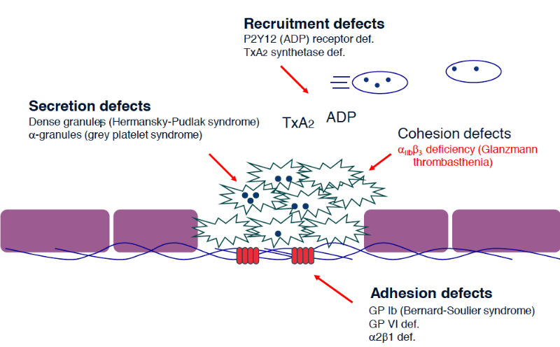
Inherited Platelet Function Disorders

Slide 25
Glanzmann Thrombasthenia
Autosomal recessive platelet surface receptor disorder of GPIIb/IIIa (αIIbβ3)
The incidence is about 1 in 1,000,000
Mucocutaneous bleeding can range from mild to severe and can lead to fatal bleeding episodes
Diagnosis:
-Platelet aggregation assays
-Platelet Function Analyzer (PFA-100)
-Flow cytometry
-DNA sequencing
Solh T. et al, Glanzmann’s thrombasthenia: pathogenesis, diagnosis, and current and emerging treatment options,
J Blood Med. 2015; 6: 219–227

Slide 26
Glanzmann Thrombasthenia:Treatment
Platelet transfusion( HLA-matched)
Recombinant FVIIa
Antifibrinolytic therapy (aminocaproic acid, tranexamic acid)
Topical agents (topical thrombin)
Solh T. et al, Glanzmann’s thrombasthenia: pathogenesis, diagnosis, and current and emerging treatment options,
J Blood Med. 2015; 6: 219–227

Slide 27
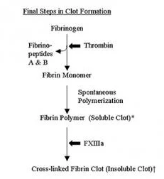
Factor XIII Deficiency
Autosomal recessive bleeding disorder
The incidence is about 1 in 2,000,000 people
Karimi M. et al, Factor XIII deficiency diagnosis: Challenges and tools,
International Journal of Laboratory Hematology. 2017;40,1

Slide 28
FXIII Deficiency: Clinical Manifestations
Bleedings can range from mild to life threatening hemorrhage
Umbilical stump bleeding (80% of patients)
Intracranial hemorrhage
(20-30% of patients)
Delayed bleeding (12-36 hrs) after trauma or surgery
Poor wound healing
Hemarthroses (20% of patients)
De Jager T. The burden and management of FXIII deficiency, Hemophilia, 2014;20:733-740

Slide 29
FXIII Deficiency: Diagnosis and treatment
Normal platelet count
Normal PT
Normal aPTT
Diagnosis:
Clot solubility test
Factor XIII activity assays
Molecular analysis
Treatment:
Factor XIII concentrate
FFPs, cryoprecipitate

Slide 30
Clinical history of bleeding:
Screening studies:
CBCD, PT, aPTT
No abnormalities
Thrombocytopenia
Prolonged PT
Prolonged aPTT
Von Willebrand disease (type I, some type II)
Platelet function Disorders
(Glanzmann Thrombasthenia)
Factor XIII deficiency
Non hematological causes:
▪ Connective tissue disorders
▪ Child abuse
▪ vWF antigen
▪ vWF activity
▪ FVIII activity
▪ Platelet aggregation assays
▪ PFA-100
▪ Flow cytometry
▪ DNA sequencing
▪ Clot solubility test
▪ Factor XIII activity assays
▪ Molecular analysis

Slide 31
Take Home Message
Bleeding disorders cannot be ruled out based on normal platelet count, PT, aPTT
Von Willbrand disease, inherited Platelet function Disorders, factor XIII deficiency should be in the differential diagnosis of a bleeding child with normal hemostasis tests
Early diagnosis is important to start early treatment and avoid devastating consequences

Slide 32
Thank you

