Slide 1
Condella et al, Western J Emerg Med 2018

Slide 2
Plint et al CJEM 2105

Slide 3
Korppi et al Acta Pediatr 2019

Slide 6
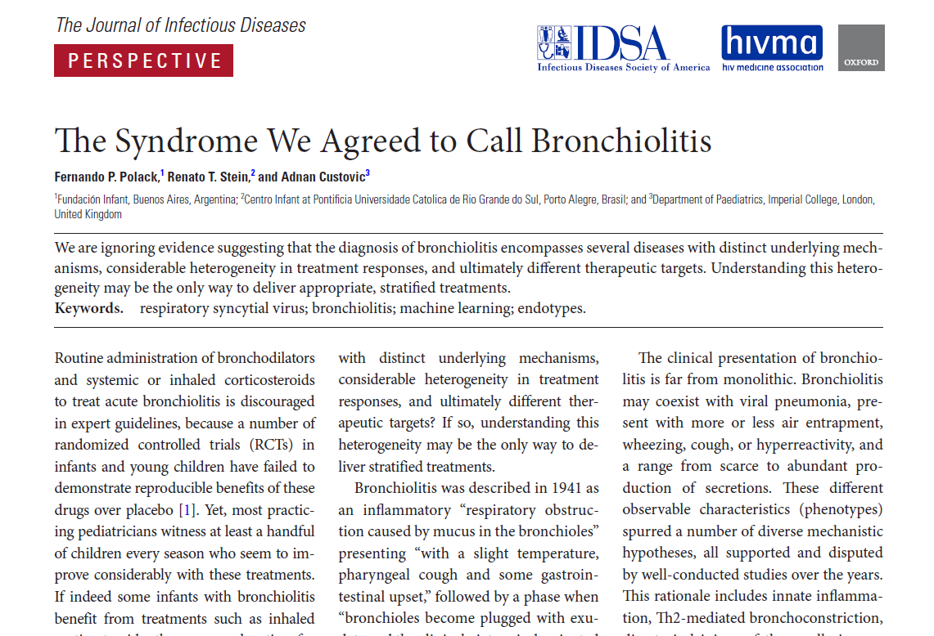

Slide 8
Definition
Bronchiolitis is a disorder commonly caused by viral lower respiratory tract infection in infants
Bronchiolitis is characterized by acute inflammation, edema, and necrosis of epithelial cells lining small airways, and increased mucus production
Signs and symptoms typically begin with rhinitis and cough, which may progress to tachypnea, wheezing, rales, use of accessory muscles, and/or nasal flaring
American Academy of Pediatrics, 2014

Slide 9
Bronchiolitis is a syndrome not a disease

Slide 10
Etiology
Virus | %
RSV | 76
Rhinovirus | 39
Influenza | 10
Metapneumovirus | 3
Coronavirus | 2
Parainfluenza | 1
Miller et al. Pediatr Infect Dis J 2013

Slide 11
Viral etiology
Relative to infants with RSV bronchiolitis, those with RV bronchiolitis have a shorter hospital stay, are more likely to be treated with systemic corticosteroids and have an increased risk of asthma

Slide 12
RSV genotypes
312 previously healthy term infants hospitalized for bronchiolitis over 12 epidemic seasons stratified according to genotypes NA1, ON1, and BA
NA1-infected infants were the youngest and had the most severe clinical course
BA infected infants had less severe symptoms and more frequently had eosinophilia and a family history of asthma
Infants with the ON1 genotype had a milder clinical course than those with NA1 and more risk factors for asthma
Midulla et al. J Infect Dis 2018

Slide 13
Causes of wheezing in infants
Asthma
Pneumonia
Chronic lung disease
Foreign body aspiration
Chronic aspiration
Congenital heart disease
Cystic fibrosis…

Slide 14
One treatment does not fit all

Slide 15
Much of the confusion about the management of bronchiolitis results from the fact that there are probably two groups of patients:
(1) those with obstructive disease resulting entirely from infection, thickening of the bronchiolar walls and intrabronchiolar secretions
(2) those with a predisposition to asthma who develop obstruction as a result of both inflammation and bronchospasm
Reynolds EO, Cook CD. J Pediatr 1963

Slide 16
Nowadays, there is increasing and convincing evidence showing that not all ‘‘viral bronchiolitis” corresponds to the same clinical condition, and that affected patients have high heterogeneity in their clinical presentation, immune responses, molecular immune signatures, and probably distinct response to different therapeutic options (phenotype-specific treatment strategies)
Rodríguez-Martínez et al Paediatr Respir Rev. 2019

Slide 17
Retrospective study of 320 children younger than 2 who presented with first episode of wheezing.
The primary outcome was need for hospitalization.
Al-Shawwa et al, Primary Care Respir J 2007

Slide 18
Al-Shawwa et al, Primary Care Respir J 2007

Slide 19
200 infants with bronchiolitis and eczema or family history of asthma were treated with Dexamethasone 1mg/kg, then 0.6 mg/kg for 4 days or placebo, in addition to Salbutamol
Primary outcome was readiness for discharge
Alansari et al, Pediatrics 2013

Slide 20
Alansari et al, Pediatrics 2013

Slide 21
How to assess response?

Slide 22
Clinical scores to assess bronchiolitis
Respiratory rate
Retractions
Wheezing
General appearance
Cyanosis
Other (SpO₂, oral intake, liver, spleen…)

Slide 23
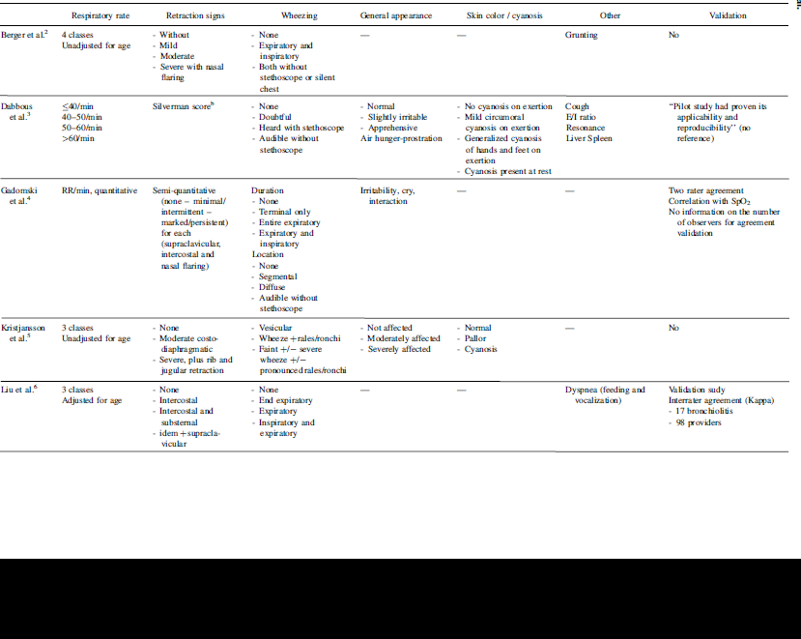
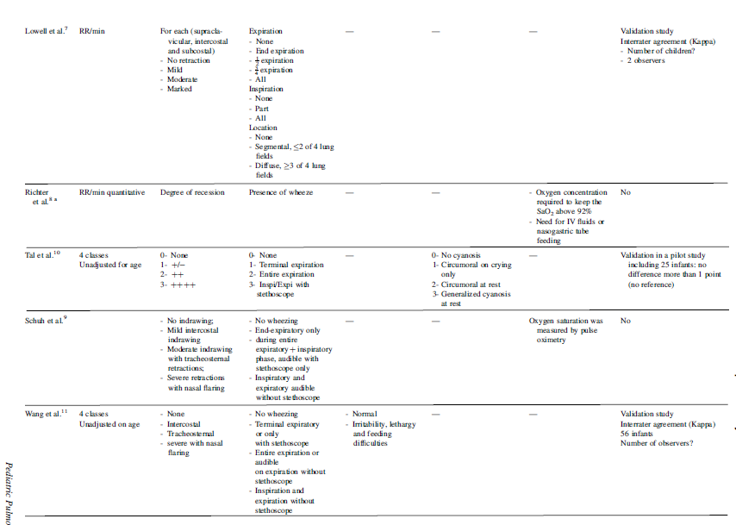

Slide 24
Drug delivery

Slide 25
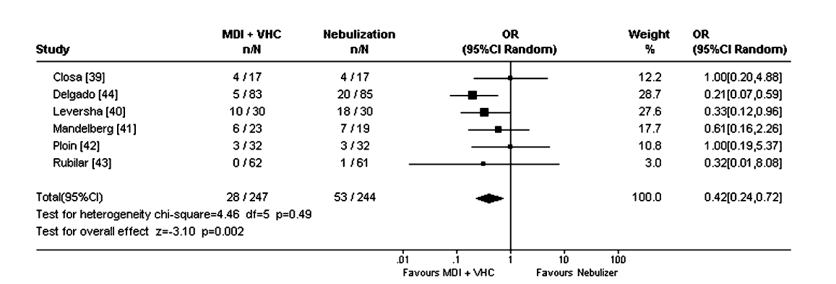
MDI vs. Nebulizer: Hospitalization
Castro-Rodriguez et al J Pediatr 2004

Slide 26
MDI vs. Nebulizer: Clinical Scores
Castro-Rodriguez et al J Pediatr 2004

Slide 27
Conclusion
Guidelines are meant to help deliver evidence-based, safe, cost effective care
However they do not necessarily apply to all patients
Consider alternatives if patients have atypical presentation, are sick or have specific risk factors
Give a therapeutic trial and assess the response

Slide 28
Candidate RSV vaccines
Mazur et al, Lancet Infect Dis 2108

Slide 29
Anti-RSV drugs
Nicholson et al, Clin Ther 2018

