Slide 1
Updates on Pediatric Pulmonology
Dr PH TORBEY

Slide 2
Can we diagnose asthma in children under the age of 5 years ?
C.L. Yang, J.M. Gaffin, D. Radhakrishnan
Paediatric Respiratory Reviews 29 (2019) 25–30

Slide 3
Can we diagnose asthma in children under the age of 5 years ?
Prevalence of asthma among children : 8.3%- 12.3%
80% of symptoms start before age 6 y
Preschoolers : 4 x more ER visits
10 x more hospitalizations than older age groups
Risk for irreversible airways obstruction in adulthood, pathologic remodeling develops between 1- 3 y
Some over-diagnosis of asthma
Morbidity relates to under-diagnosis and lack of initiation or adherence to therapies
Ability to diagnose asthma in preschool children is controversial

Slide 4
1- Symptoms that persist into childhood = true asthma
The Tucson Children’s Respiratory Study 🡪 3 groups of wheezing children based on whether wheeze was present at 3 and 6 years
transient early wheezers
persistent wheezers
late onset wheezers
Asthma predictive index API : positive predictive value of 26% and negative predictive value of 94%
Other predictive algorithms include factors such as
age at wheeze onset
frequency and timing of wheeze episodes
presence of personal or family history of atopy
skin prick tests
markers of allergic inflammation in blood, exhaled breath and sputum

Slide 5
Relying on such predictive indices 🡪 under-diagnosis of asthma in non-atopic wheezers
As non-atopic children comprise 60–75% of children with asthma in this age group 🡪 significant untreated morbidity
This assumes that individuals who eventually outgrow their symptoms do not have a response to asthma medications in their preschool years, which has not been shown in clinical trials

Slide 6
2- Multi-trigger wheeze = true asthma
Differentiation between multi-trigger and episodic viral wheeze EVW
A 2008 ERS Task Report recommended that
those with multi-trigger wheeze be treated with ICS
those with episodic viral wheeze be treated with LTRA
It was believed that EVW was a benign condition that did not respond to ICS and that it was synonymous with transient wheezing
Limitations to this approach are
phenotypes are not stable in individuals over time
those with EVW do not necessarily outgrow their symptoms
Frequency and severity of viral-triggered episodes was not a factor when deciding on a therapeutic plan
These factors have been shown to predict response to inhaled corticosteroids

Slide 7
3- Asthma symptoms that respond to asthma medication = asthma
Current asthma consensus statements advocate for a pragmatic approach and a trial of asthma therapy (bronchodilators and daily ICS or a short burst of OCS) in all children with clinical evidence of significant persistent or recurrent episodic reversible airflow obstruction
For those who improve, a diagnosis of asthma can be made
50–60% of patients with wheezing outgrow their symptoms by school age 🡪 diagnosis and treatment must be reassessed periodically

Slide 8
Treatment will decrease short term asthma-related morbidity
ICS do not have a disease modifying effect in this age group
Systematic reviews of ICS vs placebo show they decrease the symptoms of wheezing and asthma exacerbations with a RR= 0.59
LTRA have been largely studied in children with EVW, without evidence of benefit in a recent systematic review
Further studies showed benefit

Slide 9
Predictive factors for improvement with ICS
Markers of Th2 inflammation such as
serum eosinophils over 300 cells/ul
aeroallergen sensitization
elevated serum ECP
Demographic characteristics such as being
male gender
caucasian
having more severe disease : ER visit or hospitalization for asthma in the past year
being more symptomatic at baseline

Slide 10
Age 1-5 years presenting with
Current signs of airflow obstruction
>1 documented asthma-like exacerbation
AND
No red flags for alternative diagnosis
No current signs of airflow obstruction
>2 reported episodes of asthma-like symptoms
AND
No previously documented signs of airflow obstruction OR
No previously doc. improvement to asthma therapy
AND
No red flags for alternative diagnosis
Therapeutic trial
1
2

Slide 11
1
Current signs of airflow obstruction
≥1 documented asthma-like exacerbation
AND
No red flags for alternative diagnosis
Therapeutic trial
Mild exacerbation
SABA
Moderate or severe exacerbations
SABA and OCS
Clear improvement
No / unclear improvement
1st episode 🡪 Suspected asthma
≥ 2 episodes 🡪 Asthma
Unclear Diagnosis
Consider co-morbidity or alternative diagnosis
Watchful observation
Referral to an asthma specialist if persistent symptoms and/or moderate to severe exacerbations

Slide 12
Age 1-5 years presenting with
Current signs of airflow obstruction
≥1 documented asthma-like exacerbation
AND
No red flags for alternative diagnosis
No current signs of airflow obstruction
≥2 reported episodes of asthma-like symptoms
AND
No previously documented signs of airflow obstruction OR
No previously doc. improvement to asthma therapy
AND
No red flags for alternative diagnosis
Therapeutic trial
1
2

Slide 13
Frequent symptoms or 1≥ moderate to severe
asthma-like exacerbation ?
2
No
Yes
Monitor and reassess
When symptomatic
± 3 month therapeutic trial
+ as needed SABA
Therapeutic trial of
Medium dose of ICS for 3 months
+ as needed SABA
Reassess when symptomatic and at 3 months
Reassess at
6 wks and 3months
Documented signs of airflow obstruction AND
Convincing response to SABA
No / unclear improvement
Clear improvement
Yes
No
Yes
Mild infrequent symptoms and exacerbations
Asthma
Asthma
Stop trial
Yes
Deterioration
No
No
Unclear Diagnosis
Consider co-morbidity or alternative diagnosis
Watchful observation
Referral to an asthma specialist if persistent symptoms and/or moderate to severe exacerbations

Slide 14
Pertussis New preventive strategies for an old disease
Greta Di Mattia, Ambra Nicolai, Antonella Frassanito, Laura Petrarca, Raffaella Nenna, Fabio Midulla
Paediatric Respiratory Reviews 29 (2019) 68–73

Slide 15
WHO in 2016 reported
139,535 pertussis cases with
89,000 estimated deaths
95% of reported cases occurred in developing countries
Epidemics recently reported in Europe, US, Canada and Australia
In 2014 the highest notification rate among
infants <6 mo (51.6 cases per 100,000 population),
followed by the age group 10-14y

Slide 16
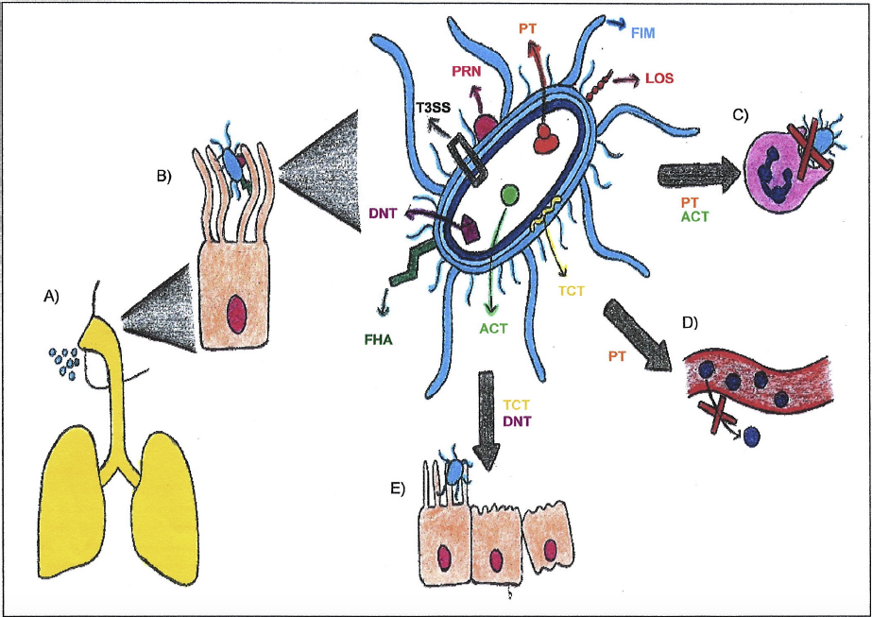
Pertussis pathogenesis virulence factors

Slide 17
Clinical presentation of pertussis in previously immunized or infected adolescents and adults is atypical and often asymptomatic, the main symptom being persistent cough
Neonates and infants < 6 mo can develop an atypical illness : cough and whooping may be absent.
Clinical picture dominated by recurrent episodes of gagging, apnoea, cyanosis and bradycardia
Pertussis can be difficult to diagnose in children under 1 y during the winter season
Symptoms can mimic RSV
B pertussis may cause bronchiolitis (o.6-20%)
Co infection with RSV (0.2-23%)

Slide 18
Diagnosis : greatest sensitivity when combining culture, PCR and serology
Treatment : Macrolide
eradicate B. pertussis in 97% of cases after 2–3 days and in 100% after 14–21 days
patient is no longer infectious after 5 days of treatment
do not improve the symptoms unless dx at 1st stage
Main preventive strategy is a vaccination scheme with 3 doses starting at 6 weeks, followed by 1 or more booster doses
Whole cell vaccine wP 🡪 78% efficacy but local side effects ~ 45%
Acellular vaccine aP 🡪 same efficacy, less side effects

Slide 19
Resurgence of pertussis
Increased awareness and more sensitive dx tests
New B pertussis strains with a selective advantage among vaccinated population
Novel allele ptxP3 of the PT promoter is replacing almost completely the classic allele ptxP1
Allelic variant of the fimbriae fim3B has been observed recently
B. pertussis strains lacking FHA and PRN are becoming predominant, escaping the aP immunity

Slide 20
Natural infection and vaccination do not give life-long immunity
serum levels of specific antibodies start declining within 9 mo and duration of immunity is about 4–12 years after vaccination and 4–20 years after infection
Natural infection and immunization with wP vaccines are associated with strong T helper (Th) 1/Th17-type responses, aP vaccines induce almost exclusively Th2 cells
Immunity induced from aP vaccine wanes rapidly after 2–3 years
In animal model the aP vaccine protected against the symptomatic disease but did not prevent from asymptomatic infection and transmission

Slide 21
Preventive strategies
Booster doses in adolescents and adults
CDC recommends routine vaccination with tetanus toxoid, a reduced diphtheria toxoid and aP (Tdap) for adolescents
Pertussis incidence in adolescents declined, but no relevant impact on infant disease
This may be caused by
insufficient vaccine coverage
incapacity of TdaP to prevent asymptomatic infection and transmission of B. pertussis
rapid decline of the protection, which leaves adults of child-bearing age susceptible
For these reasons, decennial boosting with TdaP is now recommended in several countries

Slide 22
Preventive strategies
Vaccination of pregnant women
pertussis antibodies efficiently pass the placenta, maternal levels are too low and rapidly decline in the infant serum, leaving newborns’ without protection
maternal vaccination is associated with significantly higher levels of pertussis antibodies at birth, both in the mothers and the infants
maternal antibodies against pertussis decrease after one year 🡪 it is recommended to repeat vaccination with repeated pregnancies
‘‘blunting”of vaccine response with low levels of anti-PT antibodies but no increased incidence of pertussis

Slide 23
Preventive strategies
Since 2012, ACIP recommends the use of Tdap vaccine during every pregnancy, regardless previous history of pertussis immunization, and optimally between 27 and 36 weeks gestation
Recent studies showed that early vaccination, between 13 and 25 gestational weeks, increased anti-pertussis antibody titres in the newborn and allowed even preterm infants to benefit
Higher levels of anti-PT IgA have been found in the breast milk of vaccinated comparing with non-vaccinated mothers. Role ?

Slide 24
The ‘‘cocooning” strategy
Parents are the source of infection in 50–55% of cases, grandparents 6–8% and siblings up to 20%
Cocooning strategy has been recommended in the US since 2006 and later in several other countries.
Transmission models predicted a reduction of more than 50% in the incidence of severe pertussis in young infants, but current data found a lower or absent impact
aP vaccine does not prevent colonization of B. pertussis and its transmission to infant
Adherence to this strategy is limited because
the parents have insufficient knowledge about pertussis and are under immunized
source of infection is unknown in up to 50% of cases and could be someone outside the household

Slide 25
Neonatal vaccination
Neonatal immunization with tetanus toxoid, diphtheria toxoid and aP (DTaP) vaccines results in elevated anti-B. pertussis antibody titers, demonstrating that neonates are able to mount immune responses to aP vaccines
Vaccination with DTaP at birth is associated with significant hypo-responsiveness and increased adverse events following booster doses of DTaP,
This was not demonstrated after monovalent aP administration
To date, a stand-alone aP vaccine is not available and data on neonatal vaccination safety are not sufficient

Slide 26
Development of new pertussis vaccines
Vaccines containing only aP antigens would permit more frequent pertussis booster doses and neonatal vaccination
Changes in the vaccine antigens: possible options include
modifying their content (increasing the PT dose),
replacing them with the antigens of the new circulating B. pertussis strains, or changing the PT detoxification method
Adding new antigens (ACT, BrkA...) to extend the antigenic coverage and the duration of protective immunity
Adjuvant modifications: the currently used aluminium promotes a Th2 response, while new adjuvants (Toll-like receptor (TLR) 2 activating lipoproteins, TLR7 agonists…) are associated with more effective Th1/Th17 responses

Slide 27
Different delivery system to stimulate a different type of immune response, especially mucosal immunity
Possible options are intranasal administration of a live attenuated B. pertussis strain,
Use of bacterial or viral effectors genetically engineered to produce B. pertussis antigens and alternative delivery vehicles
At the present time, vaccinating the mother during every pregnancy is the most cost-effective approach

Slide 28
What is New in Management of Pediatric Tuberculosis ?
Alkesh Kumar Khurana, Bhavna Dhingra
Indian Pediatrics, Vol 56; March 15, 2019

Slide 29
WHO estimates 2015
10.4 million new cases of TB worldwide, 1 million children
1.8 million people are estimated to have died from tuberculosis, of which 0.2 million were children
Case fatality ratio varies from 5% in developed countries to 20% in low and middle-income countries
In pediatric age group, MDR-TB is underestimated, and primary MDR-TB is reported as well
Cases of XDR-TB have been on the rise in the last few years

Slide 30
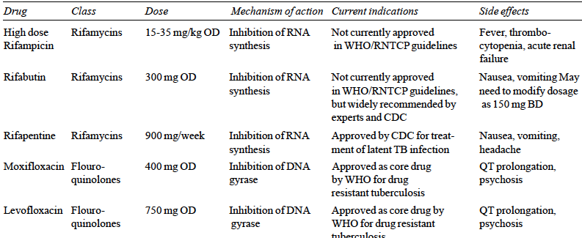
Newer Applications of Existing Drugs

Slide 31
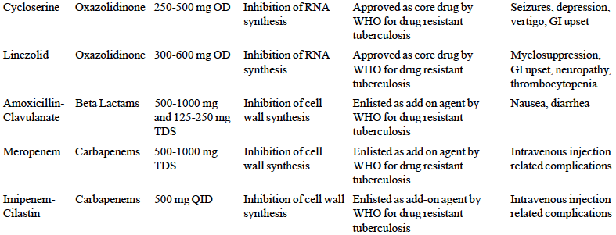

Slide 32
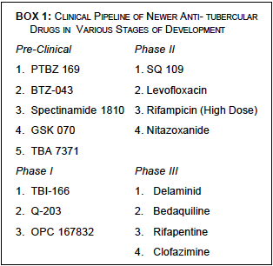

Slide 33
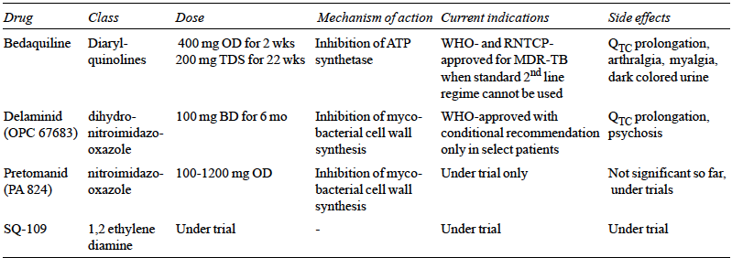
Newer Drugs for Treatment of TB

Slide 34
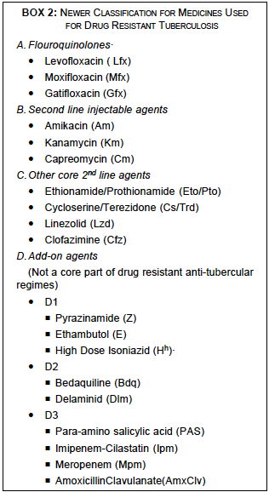

Slide 35
New Definitions
‘Presumptive Pulmonary TB’ refers to condition with any of :
cough and/or fever of >2 weeks,
significant weight loss, hemoptysis
any chest radiograph abnormality.
In pediatric patients, loss of body weight is defined as >5% weight loss in the last three months.
‘Presumptive Drug Resistant TB’ refers to
any patient who has failed treatment with first line ATT,
pediatric TB non-responders,
contacts of drug-resistance TB,
previously treated TB cases,
TB patients with HIV co-infection
TB patients found positive on follow-up examination during treatment with first line ATT.

Slide 36
Changes in Diagnostic Algorithms
For a presumptive pediatric pulmonary TB patient, Cartridge Based Nucleic Acid Assay CBNAAT should be performed
on sputum sample or
on gastric lavage if sputum is negative but chest radiograph is suggestive
If both these arms are not clinically relevant, further action should be based on the combination of chest radiograph and Mantoux test or IGRA

Slide 37
Treatment Recommendations
For new TB cases, Intensive phase now consists of
8 weeks of Isoniazid, Rifampicin, Pyrazinamide and Ethambutol*
followed by 16 weeks of two drugs Isoniazid and Rifampicin
For previously treated cases, intensive phase is recommended to be of
12 weeks where streptomycin is stopped after 8 weeks
4 drugs for another 4 weeks.
Continuation Phase (CP), pyrazinamide is stopped and rest of the three drugs are given for 20 weeks
In extra pulmonary tuberculosis, continuation phase can be extended for 3-6 months
* If suspicion of drug resistant TB

Slide 38
Changes in Follow-up
A clinical monthly follow-up should be done
In new guidelines, sputum smear examination is recommended only at the end of intensive phase and at the end of treatment
Long term follow-up is now recommended with evaluation at 6, 12, 18 and 24 months after completion of treatment, which was not recommended earlier

Slide 39
Management of Drug-resistant TB
No major change in treatment of MDRTB patients
6-9 months of intensive phase with Kanamycin, Levofloxacin, Ethambutol, Pyrazinamide, Ethionamide and Cycloserine,
and 18 months of continuation phase with Levofloxacin, Ethambutol, Ethionamide and Cycloserine
Bedaquiline recently introduced in TB programs in proven pulmonary MDR-TB patients >18 years

Slide 40
A systematic Cochrane Review of correctors for Cystic Fibrosis (specific therapies for class II CFTR mutations)
K.W. Southern ⇑, S. Patel, I.P. Sinha, S.J. Nevitt
Paediatric Respiratory Reviews 30 (2019) 25–26

Slide 41
Most common CFTR mutation that causes CF is F508del found in up to 80–90% of CF
Protein is transcribed, but recognized as misfolded by the cell and degraded before reaching the cell membrane
Severe mutation associated with no CFTR function
Correcting the basic CF defect may lead to
normalization of airway surface liquid
correction of mucociliary clearance
reduced susceptibility to airway infection
Even if drugs (correctors) successfully allow the F508del protein to reach the cell membrane, it may still have suboptimal function

Slide 43
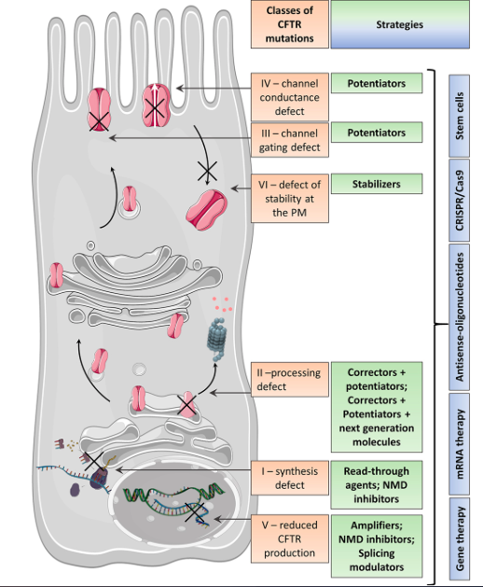

Slide 44
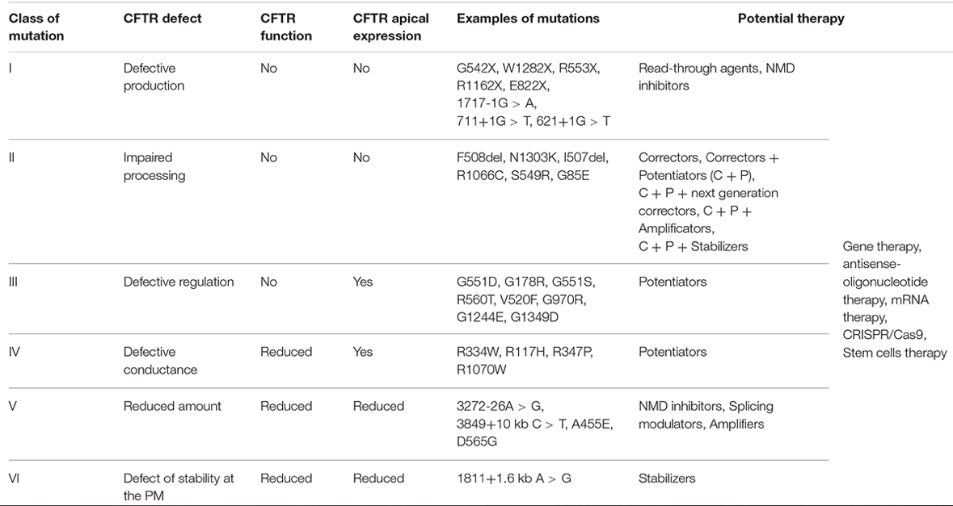

Slide 45
CFTR Modulator therapies
Trials assessing correctors include
lumacaftor and tezacaftor used alone
in combination with the potentiator ivacaftor
with other correctors
This Cochrane Review compares correctors used in people with class II mutations
Includes 13 RCTs (2215 participants), lasting 1 day - 24 weeks, with additional safety data from 1029 participants from a 96-week extension study of two lumacaftor-ivacaftor studies

Slide 46
Monotherapy vs placebo
No RCT reported any death or clinically relevant improvement in quality of life
Insufficient evidence to determine the effect of any of the correctors examined on lung function
No difference in mild, moderate or severe adverse effects
Difficult to assess the clinical relevance of these events with the variety of events and the small number of participants

Slide 47
Combination therapy versus placebo
Cystic Fibrosis Questionnaire (CFQ) scores improved by
2.62 points with lumacaftor (600 mg or 400 mg QD) combined with ivacaftor compared with placebo
2.5 points with lumacaftor 200mg BID + ivacaftor 250mg
5 points with tezcaftor 100mg BID + ivacaftor 150mg
Lung function (FEV1) increased by
5.21 % with lumacaftor QD + ivacaftor
2.4% with lumacaftor BID + ivacaftor
6.8% with tezacaftor + ivacaftor

Slide 48
Rate of pulmonary exacerbations decreased for participants receiving and additional therapies to ivacaftor
lumacaftor 600 mg hazard ratio (HR) 0.70
lumacaftor 400 mg, HR 0.61
and tezacaftor, HR 0.64
lumacaftor–ivacaftor combination reported early transient breathlessness, OR: 2.05
400 mg twice-daily dose of lumacaftor–ivacaftor experienced a rise in blood pressure over the 120-week total study period (5.1 / 4.1 mmHg)
Not reported in the tezacaftor–ivacaftor studies
* Drug price ~ 22000 USD / month

