Slide 1
Pediatric ARDS Review and Updates
Rami Sabouneh PGY VI
Pediatric Critical Care Fellow
Moderator: Dr Marianne Majdalani
American University of Beirut Medical Center

Slide 2
Outline
Epidemiology
Pathophysiology
Definition
Management Goals
Ventilator Management
Pulmonary Ancillary Therapies
Non-pulmonary therapies

Slide 3
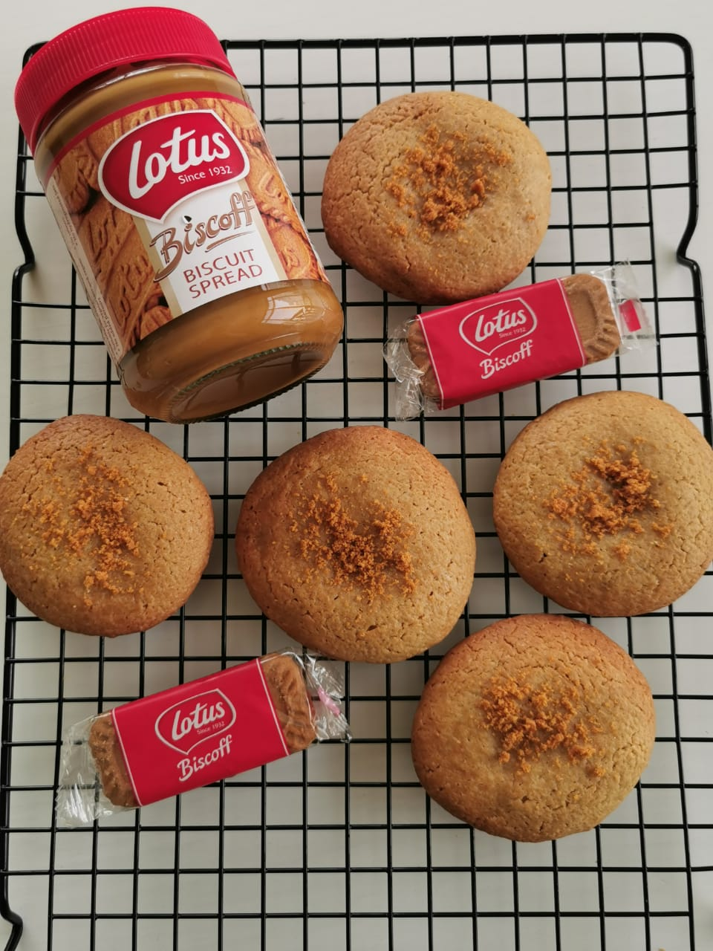

Before

Slide 4




Slide 5
Case Scenario
8 months old baby boy (weight = 7 kg) is admitted for bronchiolitis.
He is managed by High Flow Nasal Cannula for 72 hours then weaned to regular nasal cannula, with a smooth course

Slide 6
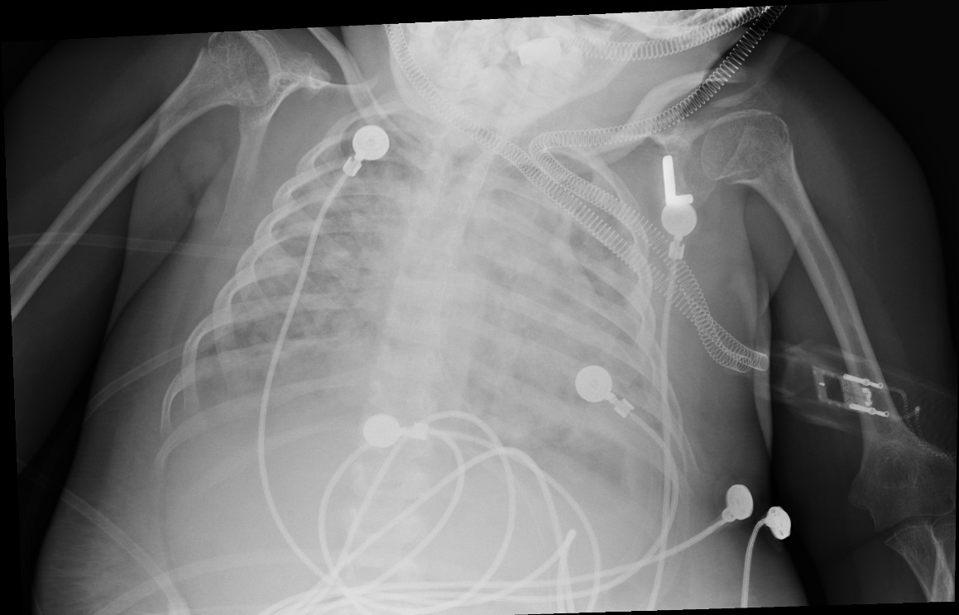
Case Scenario
48 hours later he develops high grade fever (40 °C) along with respiratory distress and desaturation
Trial of non-invasive ventilation
ABGs: 7.32/55/45/18/80

Slide 7
History
1940s through the 1960s: The terms wet lungs or shock lungs were used
1967: The first case series that named the findings of severe acute hypoxemic respiratory failure, poor lung compliance, and diffuse alveolar infiltrates on chest x-ray
  acute respiratory distress syndrome in adults, which they later called adult respiratory distress syndrome
1994: American-European Consensus Conference acknowledged that this process also occurred in children
Bernard GR, et al. The American-European Consensus Conference on ARDS. Definitions, mechanisms, relevant outcomes, and clinical trial coordination. Am J Respir Crit Care Med. 1994;818-824

Slide 8
Epidemiology
ALI in children that is between 2 and 16 per 100,000 person-years with an age-related increase
Mortality ranges between 18 and 27 %
Boys are more prone to develop ALI than girls
Presence of multiple organ failure also showed a trend towards higher mortality
Pediatric Acute Lung Injury Consensus Conference Group. Pediatric acute respiratory distress syndrome: consensus recommendations from the Pediatric Acute Lung Injury Consensus Conference. Pediatr Crit Care Med 2015;16(5):428-439

Slide 9
Pathophysiology
The primary etiologies were pneumonia (35%), aspiration (15%), sepsis (13%), near-drowning (9%), concomitant cardiac disease (7%), and other clinical conditions (21%)
It manifests as pulmonary inflammation, alveolar edema, and hypoxemic respiratory failure
Pediatric Acute Lung Injury Consensus Conference Group. Pediatric acute respiratory distress syndrome: consensus recommendations from the Pediatric Acute Lung Injury Consensus Conference. Pediatr Crit Care Med 2015;16(5):428-439

Slide 10
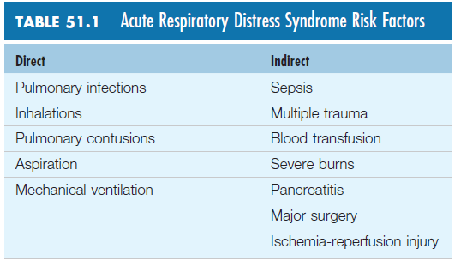
Pediatric Acute Respiratory Distress Syndrome Chapter 51

Slide 11
Pathophysiology
Rapid onset of respiratory failure in patients with severe pulmonary or systemic inflammation
  Restrictive lung disease
  pulmonary edema
  Atelectasis
  pulmonary consolidation
  surfactant dysfunction
  chest wall restriction
Pediatric Acute Lung Injury Consensus Conference Group. Pediatric acute respiratory distress syndrome: consensus recommendations from the Pediatric Acute Lung Injury Consensus Conference. Pediatr Crit Care Med 2015;16(5):428-439

Slide 12
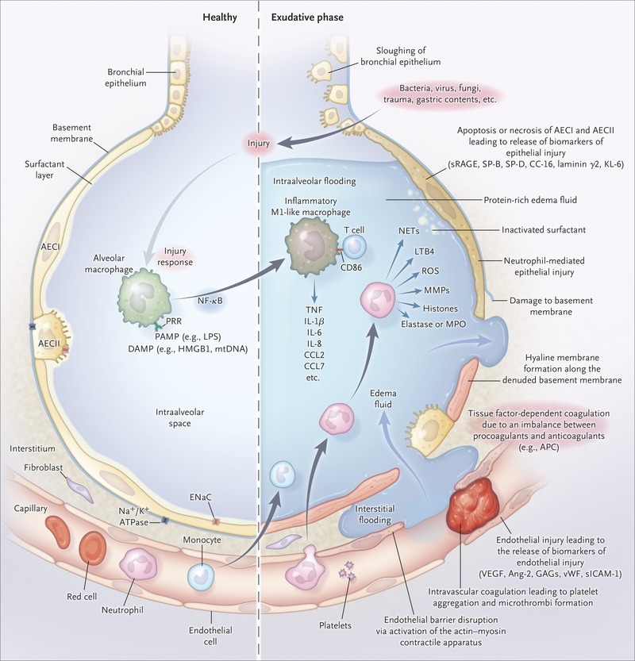
Pediatric Acute Lung Injury Consensus Conference Group. Pediatric acute respiratory distress syndrome: consensus recommendations from the Pediatric Acute Lung Injury Consensus Conference. Pediatr Crit Care Med 2015;16(5):428-439

Slide 13
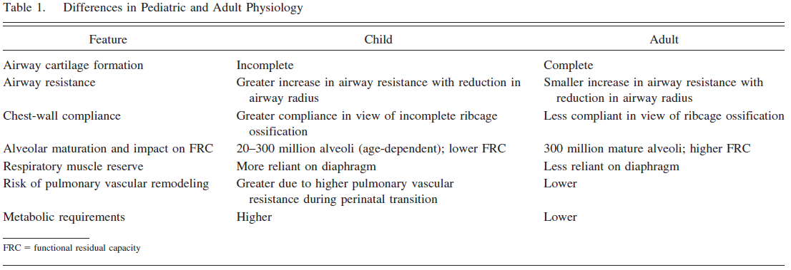
Pediatric vs Adult
Pediatric Acute Lung Injury Consensus Conference Group. Pediatric acute respiratory distress syndrome: consensus recommendations from the Pediatric Acute Lung Injury Consensus Conference. Pediatr Crit Care Med 2015;16(5):428-439

Slide 14
Definition
The Berlin Definition of ARDS in 2012
  limited by differences in the epidemiology and management of children
The Pediatric Acute Lung Injury Consensus Conference 2015
  First Pediatric Definition

Slide 15
Differences between the Berlin and PALICC
The PALICC definition:
  Does not require bilateral infiltrates on chest x-ray
  Allows substitution of SpO2 when PaO2 is not available to assess hypoxemia severity, providing SpO2 ≤97%
  Introduces the use of oxygenation index (OI) or oxygenation-saturation index (OSI) to stratify severity groups
  Identifies an at-risk group and criteria to identify PARDS patients with chronic lung disease, cyanotic heart disease, or left ventricular dysfunction

Slide 16
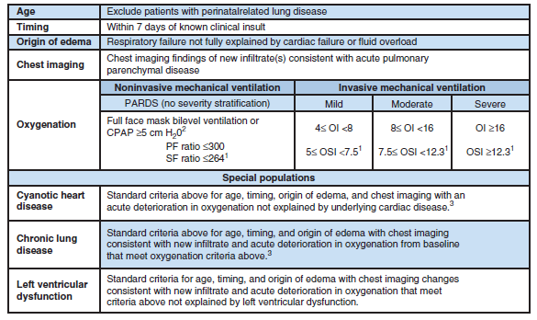
Pediatric Acute Lung Injury Consensus Conference Group. Pediatric acute respiratory distress syndrome: consensus recommendations from the Pediatric Acute Lung Injury Consensus Conference. Pediatr Crit Care Med 2015;16(5):428-439

Slide 17
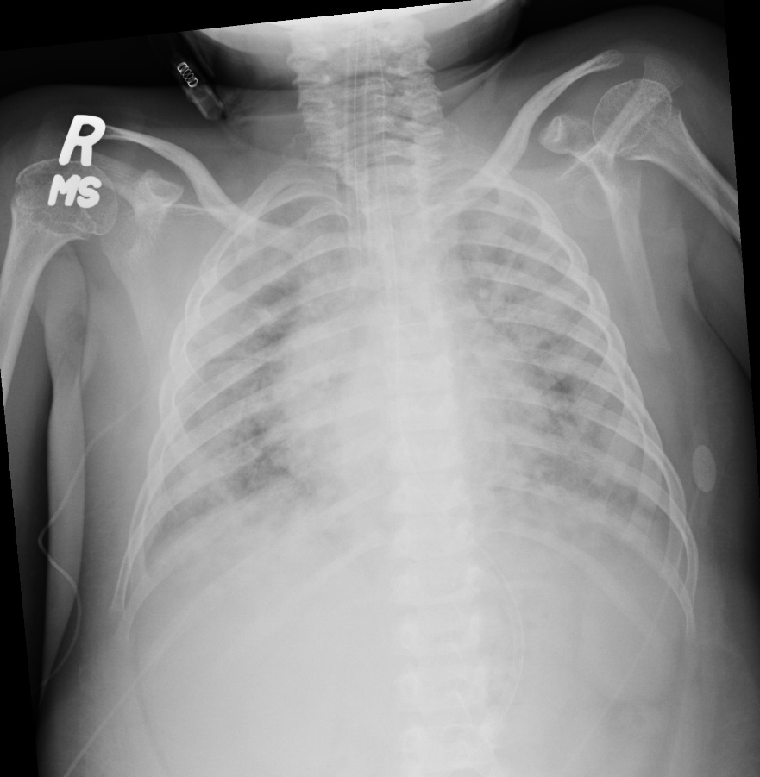
Case Scenario
He is intubated and resuscitated
Initial ventilator settings:
  RR 45
  PIP 39
  TV 8ml/kg
  PEEP 6
  FiO2 100%
ABGs: 7.37/48/50/20/83

Slide 18
Gas Exchange Goals

Slide 19
Gas Exchange Goals
Ventilatory approaches should provide adequate tissue/organ oxygenation while minimizing oxygen toxicity and ventilator induced lung injury
  Permissive Hypoxemia
  Permissive Hypercapnia

Slide 20
Permissive Hypoxemia
Permissive Hypoxemia: mild PARDS with PEEP < 10 cm H2O, the SpO2 goal should generally be 92–97%
  For those with more severe PARDS with PEEP > 10 cmH2O, the consensus conference recommended that SpO2 of 88–92%
Abdelsalam M, Cheifetz IM. Goal-directed therapy for severely hypoxic patients with acute respiratory distress syndrome: permissive hypoxemia. Respir Care 2010;55(11):1483-1490.
Acute Respiratory Distress Syndrome Network, Brower RG, Matthay MA, Morris A, Schoenfeld D, Thompson BT, Wheeler A. Ventilation with lower tidal volumes as compared with traditional tidal volumes for acute lung injury and the acute respiratory distress syndrome. N Engl J Med 2000;342(18):1301-1308.
Pediatric Acute Lung Injury Consensus Conference Group. Pediatric acute respiratory distress syndrome: consensus recommendations from the Pediatric Acute Lung Injury Consensus Conference. Pediatr Crit Care Med 2015;16(5):428-439

Slide 21
Permissive Hypercapnia
Permissive hypercapnia: pH range of 7.15–7.30 with pCO2 of 50-60s
Hickling KG, Walsh J, Henderson S, Jackson R. Low mortality rate in adult respiratory distress syndrome using low-volume, pressurelimited ventilation with permissive hypercapnia: a prospective study. Crit Care Med 1994;22(10):1568-1578.
Pediatric Acute Lung Injury Consensus Conference Group. Pediatric acute respiratory distress syndrome: consensus recommendations from the Pediatric Acute Lung Injury Consensus Conference. Pediatr Crit Care Med 2015;16(5):428-439

Slide 22
Conventional Mechanical Ventilation

Slide 23
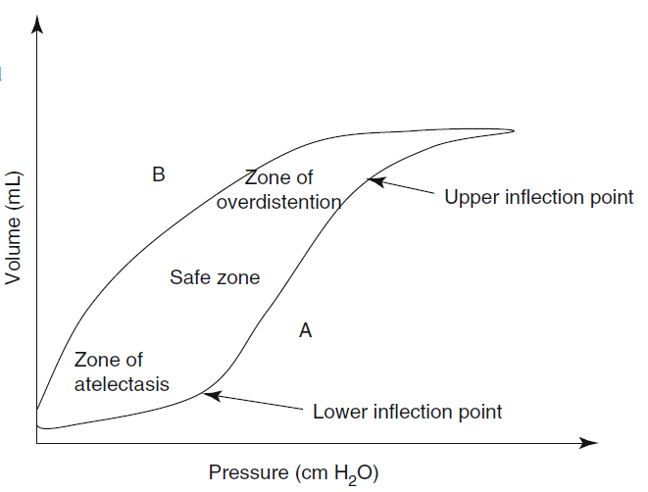
Dahlem P, van Aalderen WM, Bos AP (2007) Pediatric acute lung injury. Paediatr Respir Rev 8:348–362

Slide 24
Conventional Mechanical Ventilation
Tidal Volume
Peak Inspiratory Pressure
PEEP
Recruitment Maneuvers

Slide 25
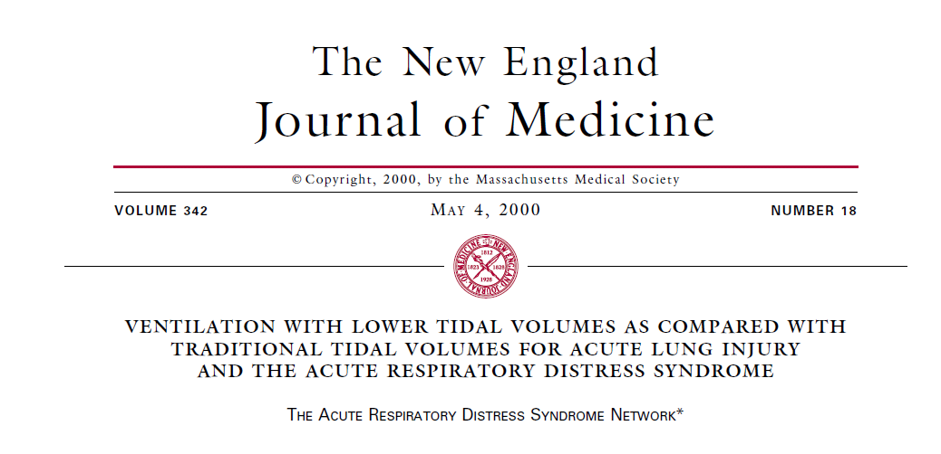
Tidal Volumes

Slide 26
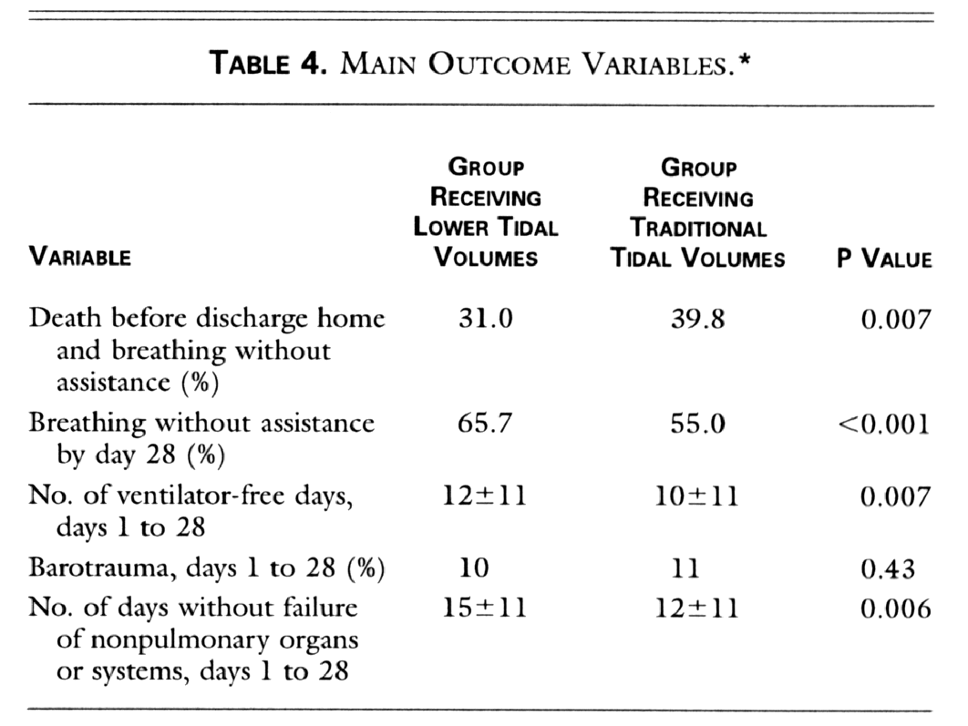
MORTALITY REDUCED BY 22%
861 patients: 12 ml/kg vs. 6 ml/kg

Slide 27
Tidal Volume
Tidal Volume: should be 3–6 mL/kg
Erickson S, Schibler A, Numa A, Nuthall G, Yung M, Pascoe E, et al. Acute lung injury in pediatric intensive care in Australia and New Zealand: a prospective, multicenter, observational study. Pediatr Crit Care Med 2007;8(4):317-323.
Khemani RG, Conti D, Alonzo TA, Bart RD 3rd, Newth CJ. Effect of tidal volume in children with acute hypoxemic respiratory failure. Intensive Care Med 2009;35(8):1428-1437
Demonstrated an inverse relationship between VT and mortality in children
BUT

Slide 28
PIP and P Plateau
Peak Inspiratory Pressure and Plateau Pressure: 28 cm H2O, allowing for slightly higher plateau pressures (29–32 cm H2O) for patients with increased chest wall compliance
Erickson S, Schibler A, Numa A, Nuthall G, Yung M, Pascoe E, et al. Acute lung injury in pediatric intensive care in Australia and New Zealand: a prospective, multicenter, observational study. Pediatr Crit Care Med 2007;8(4):317-323.
Khemani RG, Conti D, Alonzo TA, Bart RD 3rd, Newth CJ. Effect of tidal volume in children with acute hypoxemic respiratory failure. Intensive Care Med 2009;35(8):1428-1437

Slide 29
PEEP
PEEP: moderately elevated levels of PEEP (10–15 cm H2O) should be titrated in patients with severe PARDS to the observed oxygenation and hemodynamic response
Pediatric Acute Lung Injury Consensus Conference Group. Pediatric acute respiratory distress syndrome: consensus recommendations from the Pediatric Acute Lung Injury Consensus Conference. Pediatr Crit Care Med 2015;16(5):428-439

Slide 30
Brower RG, Lanken PN, MacIntyre N, Matthay MA, Morris A,
Ancukiewicz M, et al. National Heart, Lung, and Blood Institute
ARDS Clinical Trials Network. Higher versus lower positive endexpiratory
pressures in patients with the acute respiratory distress
syndrome. N Engl J Med 2004;351(4):327-336.

Slide 31
Recruitment Maneuvers
Application of recruitment maneuvers has been shown to improve oxygenation in adult ARDS (ie, predominantly inflammatory edema) in those without impairment of chest wall mechanics
PALICC recommended that careful recruitment maneuvers by slow incremental and decremental PEEP steps be formed in an attempt to improve severe oxygenation failure
Grasso S, Mascia L, Del Turco M, Malacarne P, Giunta F, Brochard
L, et al. Effects of recruiting maneuvers in patients with acute respiratory
distress syndrome ventilated with protective ventilatory
strategy. Anesthesiology 2002;96(4):795-802

Slide 32
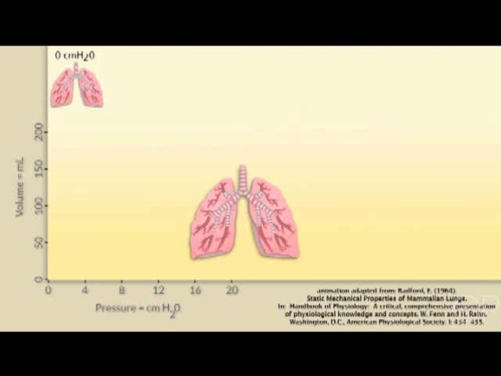

Slide 33




Slide 34
Case Scenario
Ventilator settings:
  RR 40
  PIP 30
  TV 5ml/kg
  PEEP 10
  FiO2 100%
ABGs: 7.29/63/60/21/90

Slide 35
Adjunct Approaches

Slide 36
Prone Positioning
Role of prone position for PARDS remains uncertain
Pediatric Acute Lung Injury Consensus Conference Group. Pediatric acute respiratory distress syndrome: consensus recommendations from the Pediatric Acute Lung Injury Consensus Conference. Pediatr Crit Care Med 2015;16(5):428-439

Slide 37
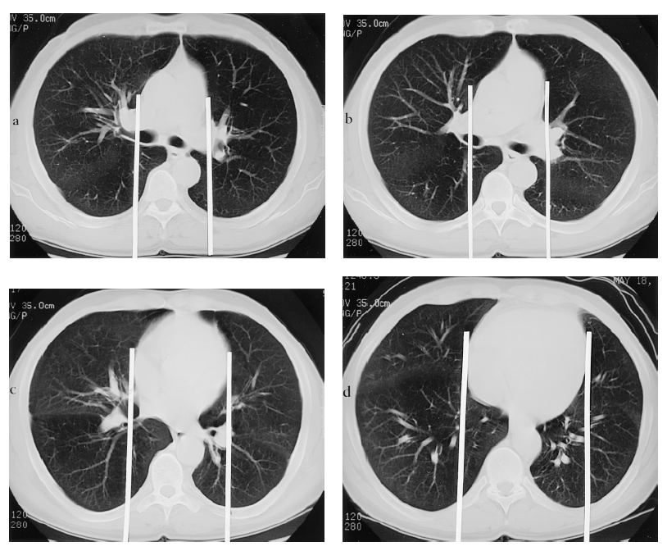
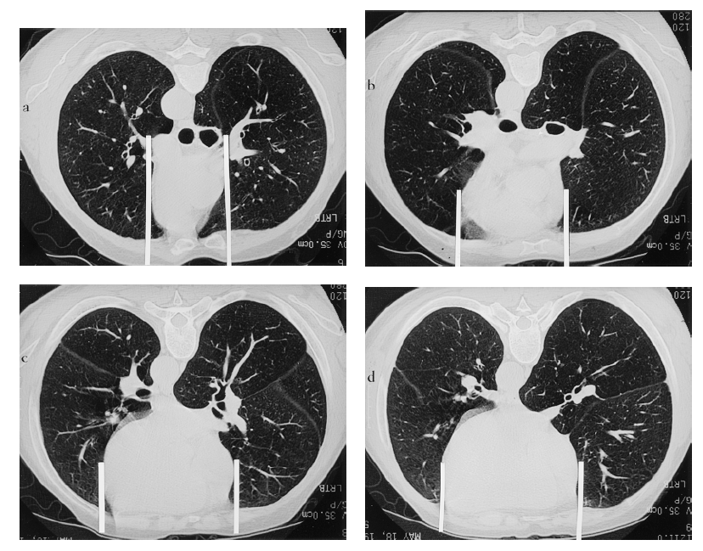
The Prone Position Eliminates Compression of the Lungs by the Heart
Albert, Hubmayr AJRCCM 2000; 161:1660-65
Supine CT
Prone CT

Slide 38
Prone Positioning
Curley et al (Pediatric)
  no differences in the primary outcome variable of ventilator-free days or any of the secondary outcome parameters were seen
  Subjects ranging from mild to severe lung injury
  mandated the use of HFOV as oxygenation worsened
PROSEVA (Adult)
  improved survival
  focused on severe ARDS.

Slide 39
Prone Positioning
Role of prone position for PARDS remains uncertain
Process of proning appeared safe
BUT how to do it and for how long?
Pediatric Acute Lung Injury Consensus Conference Group. Pediatric acute respiratory distress syndrome: consensus recommendations from the Pediatric Acute Lung Injury Consensus Conference. Pediatr Crit Care Med 2015;16(5):428-439

Slide 40
Case Scenario
Ventilator settings:
  RR 40
  PIP 30
  TV 5ml/kg
  PEEP 10
  FiO2 100%
ABGs: 7.28/65/61/21/90

Slide 41
Neuromuscular Blockade
adult population, neuromuscular blockade during the initial 48 h of ARDS demonstrated improved survival and time off the ventilator
if sedation alone is inadequate to achieve effective mechanical ventilation, neuromuscular blockade (NMB) should be considered
Pediatric Acute Lung Injury Consensus Conference Group. Pediatric acute respiratory distress syndrome: consensus recommendations from the Pediatric Acute Lung Injury Consensus Conference. Pediatr Crit Care Med 2015;16(5):428-439

Slide 42
Case Scenario
Ventilator settings:
  RR 40
  PIP 34
  TV 5ml/kg
  PEEP 11
  FiO2 100%
ABGs: 7.28/68/60/22/89

Slide 43
High-Frequency Oscillatory Ventilation

Slide 44
High-Frequency Oscillatory Ventilation
rescue modality for patients with refractory hypoxemic respiratory failure
Plateau airway pressures exceed 28 cm H2O
Pediatric Acute Lung Injury Consensus Conference Group. Pediatric acute respiratory distress syndrome: consensus recommendations from the Pediatric Acute Lung Injury Consensus Conference. Pediatr Crit Care Med 2015;16(5):428-439

Slide 45
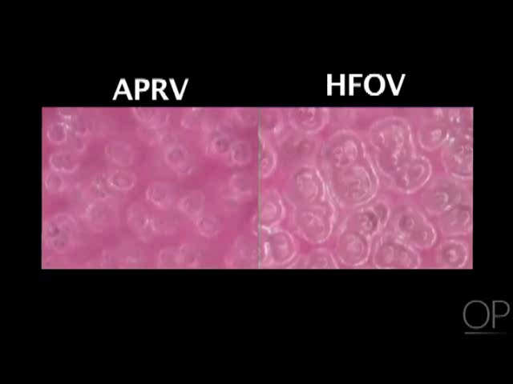

Slide 46
HFOV
RESTORE study:
Early application of HFOV was associated with a significantly longer duration of mechanical ventilation and greater use of sedation and pharmacologic paralysis
no mortality association was noted
No standard protocol for initiation and weaning
Curley MA, Wypij D, Watson RS, Grant MJ, Asaro LA, Cheifetz
IM, et al. Protocolized sedation vs usual care in pediatric patients
mechanically ventilated for acute respiratory failure: a randomized
clinical trial. JAMA 2015;313(4):379-389.

Slide 47
Case Scenario
Ventilator settings:
  MAP 28
  Delta P 55
  Frequency 20 Hz
  FiO2 90%
ABGs: 7.25/70/66/21/91
Why would HFOV fail?

Slide 48


Slide 49
Inhaled Nitric Oxide
INO does not improve outcome for PARDS, despite the expected short-term oxygenation benefit
Potential clinical exceptions in which INO may be indicated for ARDS include patients with documented pulmonary hypertension, as a bridge to ECMO cannulation, and in those with clinically important right-ventricular dysfunction
Pediatric Acute Lung Injury Consensus Conference Group. Pediatric acute respiratory distress syndrome: consensus recommendations from the Pediatric Acute Lung Injury Consensus Conference. Pediatr Crit Care Med 2015;16(5):428-439

Slide 50
Day RW, Allen EM, Witte MK. A randomized, controlled study of the 1-hour and 24-hour effects of inhaled nitric oxide therapy in children with acute hypoxemic respiratory failure. Chest 1997;112(5): 1324-1331.
Dobyns EL, Cornfield DN, Anas NG, Fortenberry JD, Tasker RC, Lynch A, et al. Multicenter randomized controlled trial of the effects of inhaled nitric oxide therapy on gas exchange in children with acute hypoxemic respiratory failure. J Pediatr 1999;134(4):406-412.
Ibrahim TS, El-Mohamady HS. Inhaled nitric oxide and prone position how far they can improve oxygenation in pediatric patients with acute respiratory distress syndrome? J Med Sci 2007;7(3):390-395.
Afshari A, Brok J, Møller AM, Wetterslev J. Inhaled nitric oxide for acute respiratory distress syndrome and acute lung injury in adults and children: a systematic review with meta-analysis and trial sequential analysis. Anesth Analg 2011;112(6):1411-1421.

Slide 51
Case Scenario
Ventilator settings:
  iNO: 20ppm
  RR 40
  PIP 34
  TV 5ml/kg
  PEEP 11
  FiO2 100%
ABGs: 7.28/65/67/21/92

Slide 52
Exogenous Surfactant
no significant decrease in the course of respiratory failure measured by duration of ventilator therapy, intensive care unit, or hospital stay was observed
Non sustained improvement in oxygenation
Mo¨ller JC, Schaible T, Roll C, Schiffmann JH, Bindl L, Schrod L, et
al. Treatment with bovine surfactant in severe acute respiratory distress
syndrome in children: a randomized multicenter study. Intensive
Care Med 2003;29(3):437-446.
Willson DF, Thomas NJ, Markovitz BP, Bauman LA, DiCarlo JV,
Pon S, et al. Effect of exogenous surfactant (calfactant) in pediatric
acute lung injury: a randomized controlled trial. JAMA 2005;293(4):
470-476

Slide 53
Exogenous Surfactant
Cannot be recommended as routine therapy
What is the proper dose and which preparation
What is the best mode of administration
What is the Optimum number of doses
Pediatric Acute Lung Injury Consensus Conference Group. Pediatric acute respiratory distress syndrome: consensus recommendations from the Pediatric Acute Lung Injury Consensus Conference. Pediatr Crit Care Med 2015;16(5):428-439

Slide 54
Corticosteroid
Corticosteroid administration is estimated at 20–60% of PARDS patients
No differences in mortality or duration of mechanical ventilation, ICU admission, and hospital stay
Not associated with increased incidence of hyperglycemia or nosocomial infections
But immunocomprimised patients were excluded from this study
Drago BB, Kimura D, Rovnaghi CR, Schwingshackl A, Rayburn M, Meduri GU, Kanwaljeet JS, Anand KJ. Double-blind, placebo-controlled pilot randomized trial of methylprednisolone infusion in pediatric acute respiratory distress syndrome. Pediatr Crit Care Med 2015;16(3):e74-e81.

Slide 55
Corticosteroid
exposure for 24 h was associated with:
  increased mortality
  fewer ventilator-free days (at 28 d)
  a longer length of ventilation in survivors
Yehya N, Servaes S, Thomas NJ, Nadkarni VM, Srinivasan V. Corticosteroid exposure in pediatric acute respiratory distress syndrome. Intensive Care Med 2015;41(9):1658-1666.

Slide 56
Corticosteroids
Cannot be recommended as routine therapy
IF used at what dose and for how long?
Pediatric Acute Lung Injury Consensus Conference Group. Pediatric acute respiratory distress syndrome: consensus recommendations from the Pediatric Acute Lung Injury Consensus Conference. Pediatr Crit Care Med 2015;16(5):428-439

Slide 57
Patient still not improving
What do you want to do next

Slide 58

Next Lunch

Slide 59
A few more details to optimize

Slide 60
Transfusion
hemoglobin concentration up to 7.0 g/dL be considered a trigger for RBC transfusion
Pediatric Acute Lung Injury Consensus Conference Group. Pediatric acute respiratory distress syndrome: consensus recommendations from the Pediatric Acute Lung Injury Consensus Conference. Pediatr Crit Care Med 2015;16(5):428-439

Slide 61
Nutrition
receive a nutrition plan to facilitate their recovery, maintain their growth, and meet their metabolic needs
enteral nutrition, when tolerated, should be used in preference to parenteral nutrition
Pediatric Acute Lung Injury Consensus Conference Group. Pediatric acute respiratory distress syndrome: consensus recommendations from the Pediatric Acute Lung Injury Consensus Conference. Pediatr Crit Care Med 2015;16(5):428-439

Slide 62
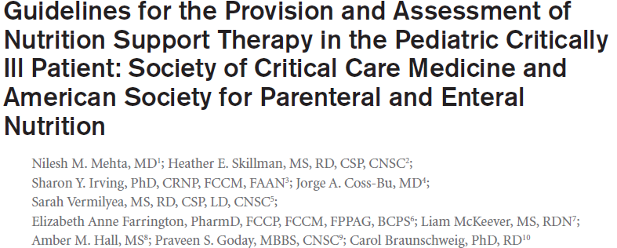
Nutrition
How do you decide the type of nutrition you give ? Parenteral or enteral?

Slide 63
Fluid Management
total fluids to maintain adequate intravascular volume, end-organ perfusion, and optimal delivery of oxygen
Fluid balance should be monitored and titrated to maintain adequate intravascular volume while aiming to prevent positive fluid balance
Pediatric Acute Lung Injury Consensus Conference Group. Pediatric acute respiratory distress syndrome: consensus recommendations from the Pediatric Acute Lung Injury Consensus Conference. Pediatr Crit Care Med 2015;16(5):428-439

Slide 64
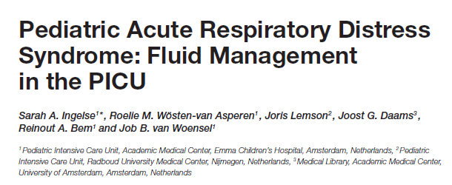
early fluid overload was found to be of main influence in less ventilator free days and worsening oxygenation
Ingelse SA, Wösten-van Asperen RM, Lemson J, Daams JG, Bem RA and van Woensel JB (2016) Pediatric Acute Respiratory Distress Syndrome: Fluid Management in the PICU. Front. Pediatr. 4:21. doi: 10.3389/fped.2016.00021

Slide 65
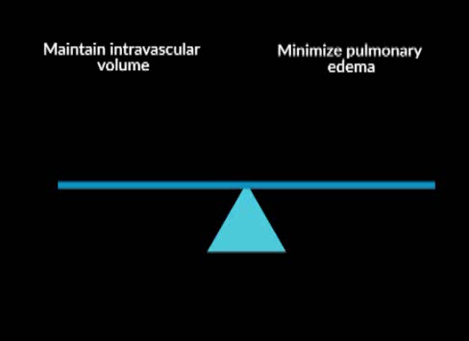

Slide 66
Extracorporeal Life Support

Slide 67
Extracorporeal Life Support
the optimal timing for cannulation remains uncertain and continues to be controversial
Survival rates 70% have been reported with venovenous ECMO for viral-induced ARDS
decisions to employ ECMO support
serial structured evaluations of clinical data, including evidence of improving or deteriorating trends
Pediatric Acute Lung Injury Consensus Conference Group. Pediatric acute respiratory distress syndrome: consensus recommendations from the Pediatric Acute Lung Injury Consensus Conference. Pediatr Crit Care Med 2015;16(5):428-439

Slide 68
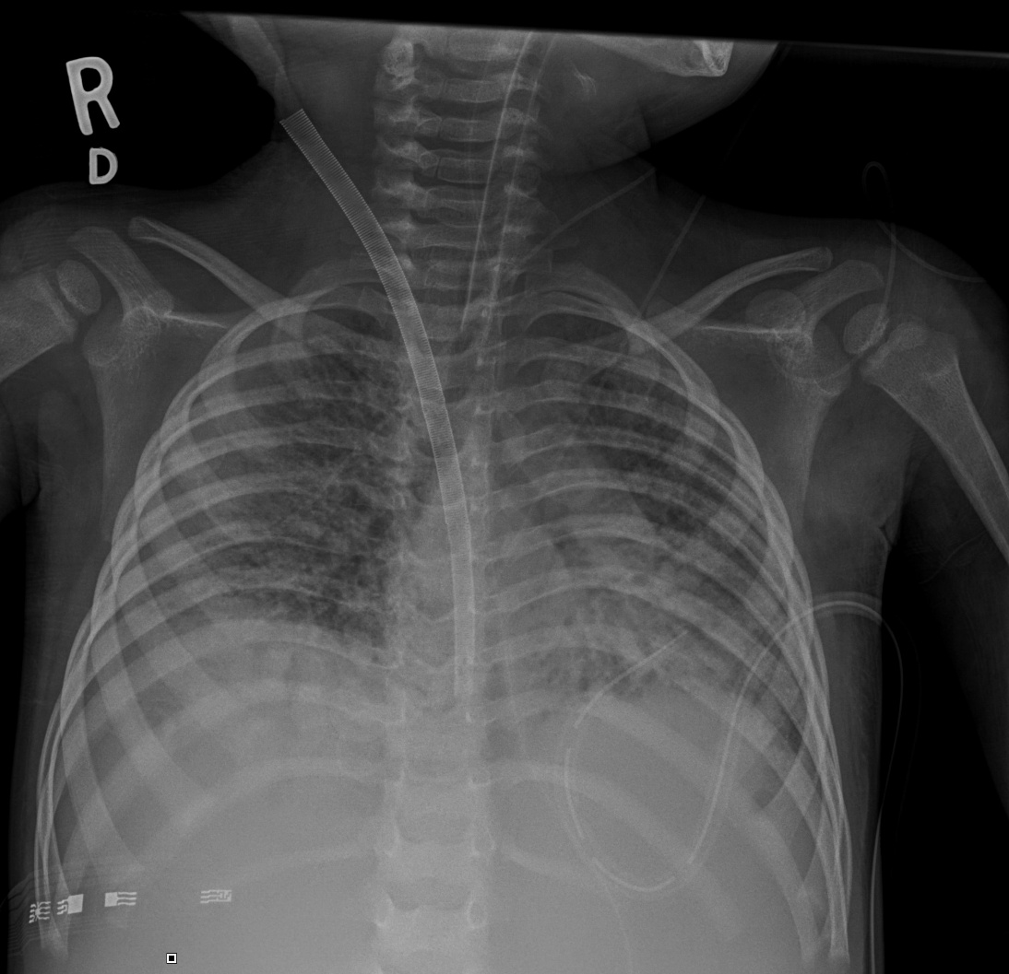

Slide 69
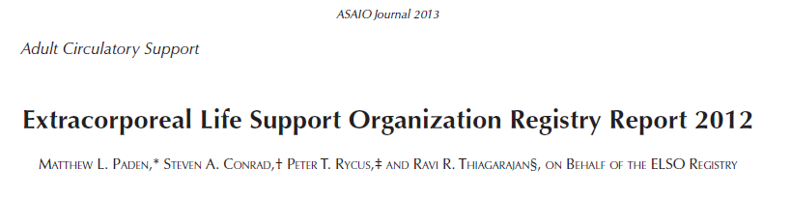
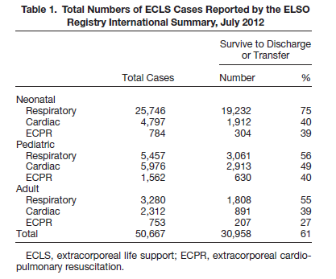
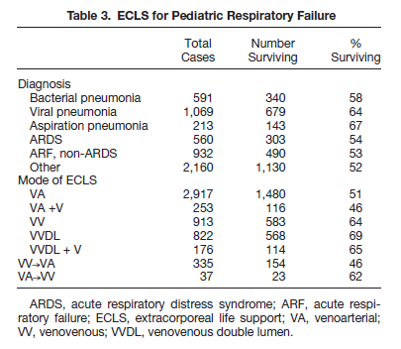

Slide 70


And Now Dessert

Slide 71


Thank you

