Slide 1
Neo Natal Screening for PID. 18 months later.
Raymond Mikhael.MD
September 2019

Slide 2
Talking on behalf of WOPID: Working Group on PID.
Group of Pediatricians specialized in Immunology, Infectious diseases, Hematology and few Adult Immuno-Allergologists as valued visitors.
Working under the LPS and LOP.

Slide 3
Primary Immunodeficiencies (PIDs)
Heterogeneous group of inherited disorders affecting the development and/or function of the immune system.
Patients with PID are more susceptible to life-threatening infections.
Non-infectious manifestations in PID patients might include: failure to thrive, allergy, lymphoproliferation and/or autoimmunity.
Notes:
In addition to high rates
of consanguinity, the large family size and the rapid population
growth all are factors responsible for the high prevalence of
rare genetic diseases in the MENA region

Slide 4
When to Suspect a PID
Recurrent infections within one year / persistent infections
Infections resistant to antibiotics
Infections affecting many organs
Infections with unusual pathogens
Autoimmune manifestations
Lymphoid organs hypoplasia
Lymphoproliferative manifestations
Family history of PID
Notes:
Des infections:
sévères
récidivantes
affectant plusieurs organes
résistantes aux antibiotiques
infections aux agents opportunistes ou inhabituels
Des manifestations auto-immunes
Une hypoplasie des organes lymphoïdes (ganglions, amygdales, thymus)
Autres manifestations: syndrome lymphoprolifératif (parfois lié à une infection à EBV), syndrome malformatif

Slide 5
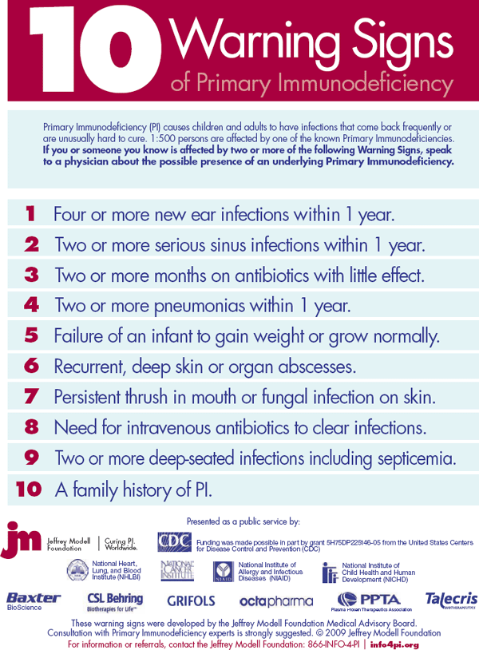

Slide 6
PIDs Prevalence
The real prevalence and incidence of PIDs remains unclear, but recent epidemiologic studies have suggested that PIDs are more common than generally thought.
Prevalence of PIDs worldwide:
5.38 per 100,000 inhabitants in France (2011)⁽¹⁾
5.6 per 100,000 in Australia (2007)⁽²⁾
1.94 per 100,000 in the UK (2011)⁽¹⁾
10.6 per 100 000 in Minnesota, USA (2009)⁽³⁾
0.81 – 30.5 per 100 000 in the MENA region(2017)⁽⁴⁾
ESID database statistics. In: European Society for Immunodeficiencies.2011.
Kirkpatrick P et al. J Clin Immunol. 2007;27:517–524.
Joshi AY et al. Mayo Clinic Proceedings. 2009;84:16-22.
Al-Mousa H et al. Frontiers in Immunology. 2017;8:678.
Al-Mousa H and Al-Saud B. Front. Immunol. 2017; 8:678.
Notes:
MENA: 1/3350 to 1/123500
SCIDs have a worldwide prevalence of approxi-mately 1:50,000 live births and are more common in male subjects, reflecting the over-representation of X-linked SCID ( chain mutation),
Previous to NSP, severe combined immunodeficiency (SCID) has been projected to happen at an incidence of 1/50,000-100,000 births

Slide 7
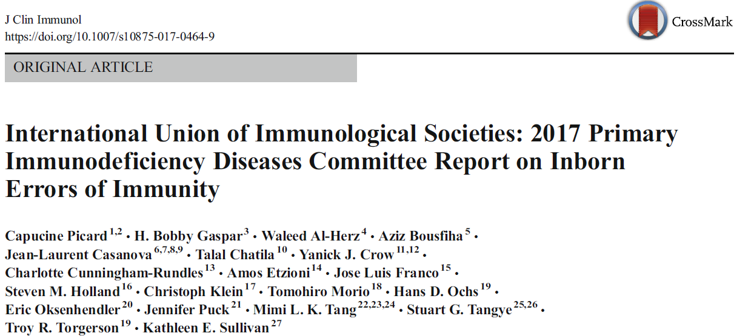
As of February 2017: 354 inborn errors of immunity with 344 different gene defects.

Slide 8
PID categories according to common phenotypes
Combined immunodeficiencies (SCID, CD40 and CD40L deficiencies, ZAP70 deficiency…)
Combined immunodeficiencies with syndromic features (Wiskott-Aldrich syndrome…)
Antibody deficiencies (X-linked Agammaglobulinemia…)
Diseases of immune dysregulation (LRBA deficiency, CTLA4 deficiency, ALPS…)
Defects of phagocyte number or function (congenital neutropenias, defects of motility…)
Defects in intrinsic and innate immunity (STAT1 and STAT2 deficiencies, IRAK4 deficiency…)
Autoinflammatory diseases (FMF, Muckle Wells syndrome…)
Complement deficiencies.
Notes:
EXAMPLES!!!!!!!!!!!!!!!

Slide 9
Severe Combined Immunodeficiencies SCID
Severe combined immunodeficiency, or SCID: a group of inherited disorders characterized by a lack of both humoral and cellular immunity (complete absence or extremely low level of T cells).
SCIDs have a worldwide prevalence of approximately 1:50,000 live births.
The average annual incidence rate for the period 2004-2014 of (S)CID in children in Kuwait was 13.01/100,000 children, with an estimated occurrence of 1/7500 live births⁽¹⁾.
⁽¹⁾ Al-Herz W et al. Clin. Immunol., 2015;161:170-173.
Notes:
Because children with SCID experience multiple infections, they fail to grow and gain weight as expected
, because they are protected for a few weeks by antibodies produced by the mother and then transferred into the baby's blood. In addition, newborns have not been exposed to infections.
Diagnosis and treatment before the onset of infections and the complications they cause in immune-compromised babies reduces costly hospitalizations and leads to better outcomes.

Slide 10
Severe Combined Immunodeficiencies SCID
Newborns with SCID generally appear healthy (maternal antibodies…)
Classic symptoms of SCID: increased susceptibility to a variety of infections (ear infections, pneumonia or bronchitis), oral thrush, diarrhea, failure to thrive.
SCID can lead to death in early infancy unless immune reconstitution is provided.
Early diagnosis of SCID should be considered a PEDIATRIC EMERGENCY.
Notes:
Because children with SCID experience multiple infections, they fail to grow and gain weight as expected
, because they are protected for a few weeks by antibodies produced by the mother and then transferred into the baby's blood. In addition, newborns have not been exposed to infections.
Diagnosis and treatment before the onset of infections and the complications they cause in immune-compromised babies reduces costly hospitalizations and leads to better outcomes.

Slide 11
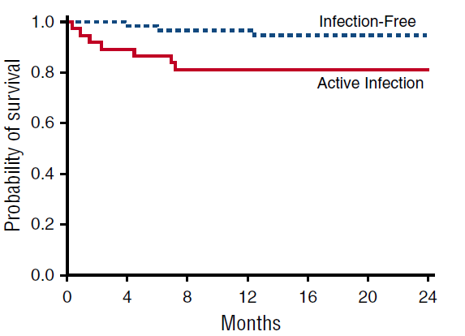
Transplantation outcomes for Severe Combined Immunodeficiency Active infection pretransplant adversely impacts survival
Data on all infants who had received a transplant for SCID at each of 25 centers between January 1, 2000, and December 31, 2009, were reviewed centrally (240 infants with classic SCID were included).
OS was significantly better in patients transplanted without infection (OS, 95%) compared with those with active infection at the time of transplant (OS, 81%; P 5.009).
Pai SY et al. N Engl J Med, 2014; 371:434-446
Notes:
Efficacy of Early Identification and Treatment. Research indicates that infants with SCID who receive hematopoietic stem-cell transplants from related donors in the first 3.5 months of life have approximately 95% chance of survival, compared with a survival rate of 76% for infants receiving this treatment after 3.5 months (27). Infants who received stem cell transplants during the first 28 days of life demonstrated higher levels of T-cell reconstitution and thymic output than did those who received a transplant later; updated survival estimates were 95% (N = 21/22) for infants receiving transplants during the first 28 days, compared with 74% (N = 71/96) for infants receiving transplants after the neonatal period (19). An analysis of registry data for 475 SCID patients from 37 centers in 18 European countries reported that long-term survival among patients who received stem-cell transplants has improved, probably because of more effective prevention of complications (106). Differences were identified by SCID phenotype, with poorer outcomes occurring among SCID patients without B cells than among those with B cells. Immune reconstitution using gene therapy in clinical trials has also been achieved for forms of SCID (14,17,18,20,52); however, as discussed previously, the unexpected complication of T-cell leukemia occurred among 2 of 10 children receiving therapy for IL2RG SCID (53--55). Similar types of therapy are promising for other immunodeficiencies (26).

Slide 12
Importance of early diagnosis.
If SCID is not detected until the infant is older, there is a much higher likelihood that death from live vaccines, graft-versus-host disease from non irradiated blood products or infection will occur before successful definitive therapy can be achieved.
Early diagnosis permits lifesaving HSCT, enzyme replacement or gene therapy.
Cost of therapy and outcome after treatment depend closely on early diagnosis and treatment.

Slide 13
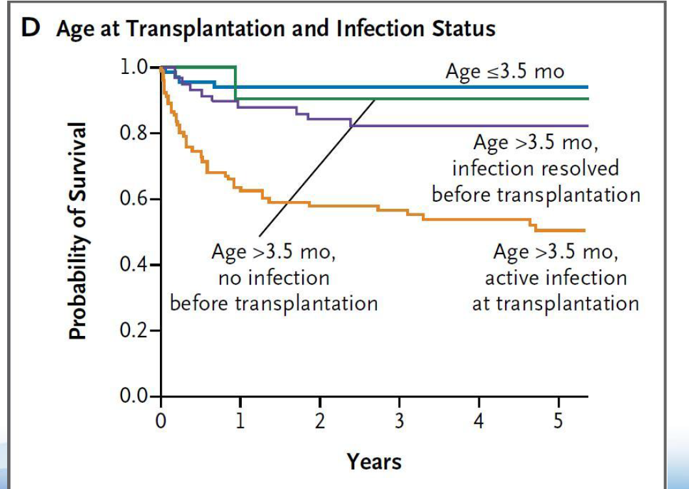
Age at the time of transplantation and infection status significantly affect survival
The survival rate was lowest for children who were older than 3.5 months of age and had active infection at the time of transplantation (50%)
Pai SY et al. N Engl J Med, 2014; 371:434-446

Slide 14
To screen or not to screen! Applying public health strategies to primary immunodeficiency diseases
SCID meets certain traditional criteria for newborn screening, as follows:
SCID is fatal during infancy without immune reconstitution.
A short asymptomatic period exists after birth.
Effective treatments are available.
Early intervention improves outcome and reduces the treatment cost.
Profound deficiencies of cellular and humoral immunity might be detectable with screening tests.
Centers for Disease Control and Prevention. MMWR, 2004;52:1-29
Notes:
The aim of any screening program in the newborn is the early detection of treatable genetic disorders having a high velocity of morbidity and mortality, like outlined by Wilson and Jungner
Wilson and jungner criteria:
Knowledge of the disorder and its natural history
Availability of, access to treatment
“simple” test
Follow up of “screen positive” newborns for confirmatory testing, introduction and monitoring of treatment
The principles as outlined earlier were acceptable to the consumer — the “target population”.

Slide 15
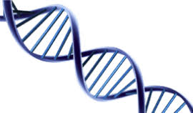
Test Technology
Notes:
Test developpe ou et puis ou

Slide 16
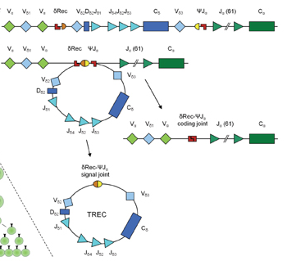
T-cell Receptor gene rearrangement
TCRD gene segments are interspersed within TCRA gene segments along chromosome 14q11 (TCRAD locus):
V(D)J recombination of the TCRD locus leads to the deletionof a segment by δREC–ψJα rearrangements.
This process gives rise to a δREC–ψJα signal joint on an excision circle (TREC) and a δREC–ψJα coding joint in the genome.
Chiarini M et al. J Public Health Res, 2013;2:9-16.

Slide 17
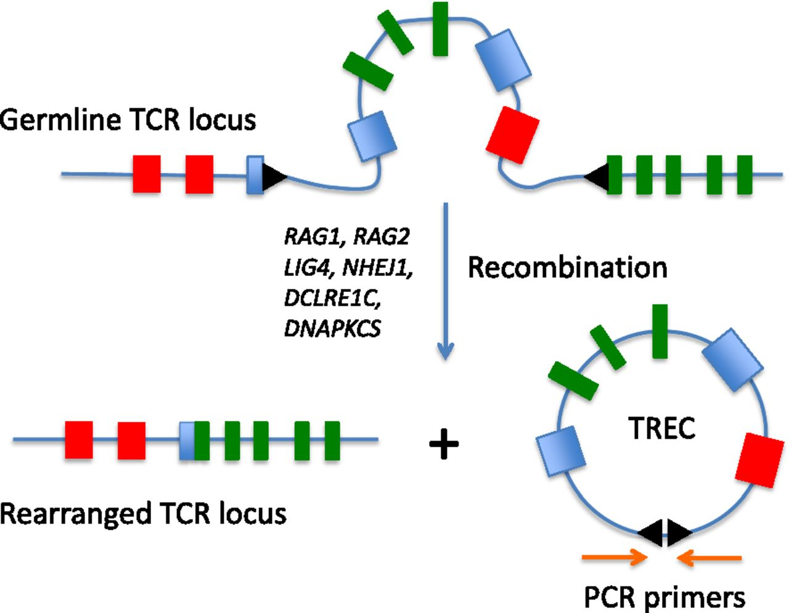
Quantification of T-cell Receptor Excision Circles (TRECs)

Slide 18
TREC test
Neonatal Screening for « SCID and T-cell lymphopenia conditions »
DNA Elution
Quantification of TRECs
PCR-based nucleic acid amplification and time-resolved fluorescence resonance energy transfer (TR-FRET) technology
(PerkinElmer)
1.5 mm punch
(Dried Blood Spot)
Notes:
Semi quantitative method
Add perkin slide technology!

Slide 19
Conditions detected by low or absent TRECs
Typical SCID
IL2RG, IL7R, JAK3, ADA, RAG1, RAG2, DCLRE1C (Artemis), LIG4, CD3 receptor chains, STAT5, PNP, Coronin-1A, and as yet unknown genes.
Leaky SCID
Conditions that are due to incomplete (hypomorphic) mutation in a typical SCID gene
Variant SCID
Conditions with no known gene defect and persistence of 300–1500 T cells/uL that have impaired function.
Puck J. Curr Opin Pediatr, 2011; 23: 667–673

Slide 20
Conditions detected by low or absent TRECs
Syndromes with variably affected cellular immunity
Complete DiGeorge syndrome, Partial DiGeorge syndrome with low T lymphocytes, CHARGE syndrome, Jacobsen syndrome, Trisomy 21, RAC2 dominant interfering mutation, DOCK8 deficient, hyper-IgE syndrome, Cartilage hair hypoplasia
Secondary T lymphocytopenia
Cardiac surgery with thymectomy, Neonatal leukemia, Gastroschesis, Third spacing, Extreme prematurity (resolves to normal with time), HIV
Puck J. Curr Opin Pediatr, 2011; 23: 667–673

Slide 21
TREC Test’s limitations
Although the TREC assay can identify many reasons for T-cell lymphopenia, physicians have to recognize the limitations of this test.
TREC test may not be a screening test for every PID.
There is a group of CID in which lymphopenia is not a finding, but the immune dysfunction is as severe as in typical SCID patients. Among these: chronic granulomatous disease, congenital neutropenia, toll-like receptor defects, ZAP-70 deficiency and MHC class II deficiency (Bare lymphocyte syndrome).
Any infant with unusual or serious infections should be assessed by an expert clinical immunologist.
Özdemir Ö. MOJ Immunol ,2016, 3: 00107
Notes:
TREC screening detects less than 50% of cases of ataxia telangiectasia.
Several rare disorders, such as Ora1, Stim1, or CD40 ligand deficiency, show an infectious phenotype similar to SCID but have normal numbers of T cells, and it is unknown whether the TREC assay can detect these disorders.
ZAP-70 defects similarly result in significant CD8 lymphopenia and a CID phenotype, but can have normal TREC levels. MHC class II deficiency results in severe CD4 lymphopenia and significant risk of infections similar to SCID. This syndrome is typically missed by the TREC assay because CD8 cells are present, so the assay can be within the normal range.
Recent reports also confirm that TREC assay is not effective in identifying a subset of rare but deadly immunodeficiencies. Therefore, it is vital that any infant with unusual or serious infections be assessed by an expert clinical immunologist.

Slide 22
Unité de Génétique Médicale – Faculté de Médecine de l’USJ
Metabolic Neonatal Screening was initiated in 1994.
Participation in the quality assurance program of CDC (Center for Disease prevention and Control) since 1999.
Samples are collected from 69 hospitals
April 2018: Neonatal Screening for SCID and T-cell lymphopenia conditions (TREC test) was added to the NBS panel.
Notes:
Metabolic screening:
La déficience en G6PD
La galactosémie congénitale, gc
Les troubles du métabolisme des acides aminés (8 maladies)
Les troubles du métablosime des acides gras (8 maladies)
Les troubles du métablosime des acides organiques (9 maladies)

Slide 23
“NBS should be available and accessible to all newborns!”
TREC test is recommended by the Ministry of public Health (MOH) to all newborns, as mandated by the decree 1/2128.
National Campaign (January 2018)
Ministry of Public Health
iFight PID
USJ
AUBMC

Slide 24
Facts in September 2019
25% of hospitals did not sign yet the contract with the labs wich is mandatory to lunch the screening in those hospitals.
During the last 18 months:
- 120 000 Lebanese births.
- Only 11 000 tests done. 9%
One DiGeorge found and many potential cases are retested.

Slide 25
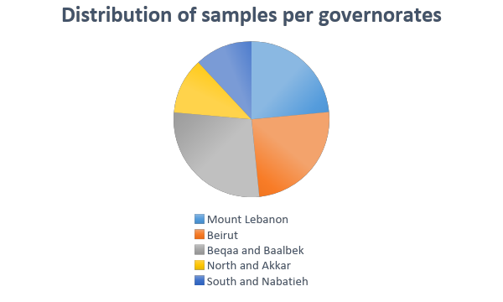
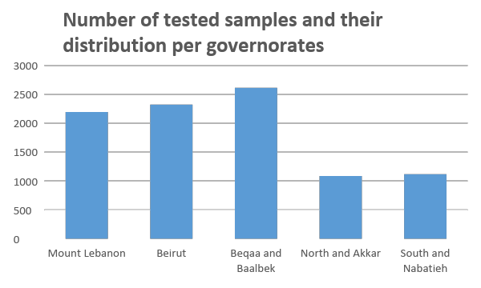
Test samples

Slide 26
The actual minister of health announced lately that this screening test is a requirement and asked all third party payers to cover it.
Mutual Fund of employees, all military and security forces, NSS, all agreed and memos will be issued soon.
Insurance companies will follow as they always do.

Slide 27
CASE 1
HF, male, born on 03/07/2018,at the Governmental Hospital, Nabatieh. TREC screening not done.
Third degree consanguineous parents.1 older sister in GH.
Well vaccinated, no BCG.
Lived in KSA, admitted 4 times to hospital for fever, pneumonia and failure to thrive.
Transferred to HDF in March 2019 for Infl A+, Coronavirus+ pneumonia
Severe lymphopenia, indetectable IgG in blood.
T- B+ NK- SCID on flux cytometry. Mutation in IL2RG gene.

Slide 28
HLA typing: father was a complete geno-identical donor.
Put on IVIG and prophylaxis.
Successful HSCT done at AUB. Discharged last week.
Lucky boy: survived till diagnosis.
Money spent till transplant ~ money for transplant.

Slide 29
CASE 2
Boy ,born on February 2019 at Cheikh Ragheb Hospital, consanguineous parents. TREC not proposed.
Three episodes of pneumonia with failure to thrive (actual
weight 2,7 kg)
Lab results: severe lymphopenia
no IgG in blood
T- B- NK+ SCID by flux cytometry
Treated by IV Ig
Search for a compatible donor in progress.

Slide 30
Challenges I- Logistics
Delays in sending Guthrie cards from hospitals.
Delays in performing tests in the labs due to paper work.
Many hospitals did not sign the contract yet.
Coverage of the test by third party payers.
The need for further confirmatory testing including a TREC repetition for all borderline and positive cases leading sometimes to additional detailed studies.
Huge work still needed in order to simplify procedures and optimize the circuit between hospitals and labs.
This work is done by us as WOPID in partnership with both labs, I fight PID and NaSPID

Slide 31
II- Awarness
The lack of awareness is really huge and present at multiple levels.
It is not about the neonatal screening concept but more about the PID screening. It explains most of the encountered problems:
- lack of compliance of hospitals.
- lack of compliance of nurses.
- lack of compliance of parents both in accepting to do the test and later in accepting to do confirmatory retesting and follow up when needed

Slide 32
The most surprising and challenging problem is the lack of compliance among pediatricians and obstetricians.
This program needs YOU to succeed

Slide 33
We need each one of you to act as a WOPID member in her or his institution to spread knowledge and convince all actors :
medical and administrative directors, obstetricians and nurses
to adopt this screening test.
We want to cooperate with you to organize awareness cessions in all regions of Lebanon especially in November when we are planning an awareness campaign in medias
We need you to do a catch up process in your clinics at the first visit.
We are open to your suggestions and comments.

Slide 34
THANK YOU

Slide 35
Merci
Cybel Mehawej

