Slide 1
Molecular Basis of Renal Tubulopathies
Sami a Sanjad

Slide 2
Outline
Solute transport across epithelial cell membranes
Generic classification of tubulopathies
Anatomic classification
Hereditary disorders of the Proximal Tubule
Hereditary disorders of the TALH
Hereditary disorders of the DCT
Hereditary disorders of the CD

Slide 3
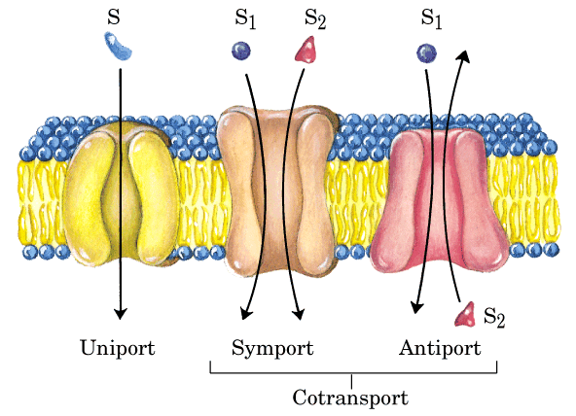
SOLUTE TRANSPORT: ACTIVE
Na⁺ Na-----Pi Na/K
AGAINST A CONCENTRATION GRADIENT

Slide 4
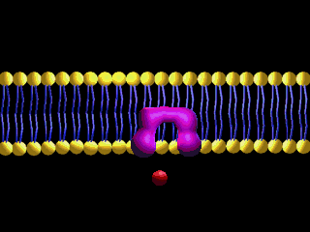
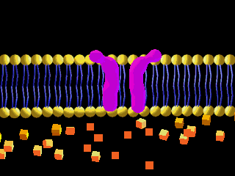
SOLUTE TRANSPORT: PASSIVE
BL Membrane
Lumen
CARRIER
CHANNEL
Down a concentration gradient

Slide 5
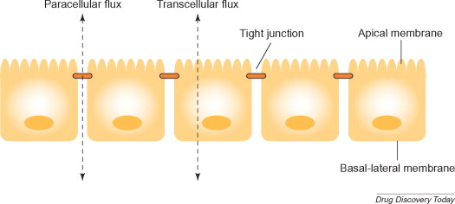
Transcellular Transport
Transfer of ions or non ionic solutes directly through the cell membrane, usually an active, energy requiring process
Paracellular Transport
Transfer of ions and solutes through tight junctions between epithelial cells from the luminal to the basolateral surface, usually a passive process, depending on an electrochemical gradient
ION TRANSPORT ACROSS EPITHELIAL MEMBRANES

Slide 6
Hereditary Tubulopathies
Absent or defective Na-S co-tx systems in P.T. cells
  Cystinuria
  Renal glycosuria
  HVDRR
  Proximal RTA
Notes:
2
2

Slide 7
Hereditary Tubulopathies (cont)
Altered gene affecting one or more tx systems (PT, DT)
  Adult Fanconi syndrome
  Gitelman’s Syndrome
  Bartter’s Syndrome
  Liddle’s Syndrome
  Distal RTA
  Nephrogenic D.I.
Notes:
3
3

Slide 8
Hereditary Tubulopathies (cont)
Mutant genes Endogenous tubulotoxic substances from extra renal sources
Cystinosis
Galactosemia
Tyrosinemia
Hereditary FI
Wilson’s Disease
Lowe’s Disease
Glycogen Storage Disease
Notes:
4
4

Slide 9
Hereditary Tubulopathies (cont)
Abnormal Solute Transport due to Structural Changes (CAKUT)
  Cystic Diseases
  Nephronophthisis
  Hydronephrosis
Notes:
5
5

Slide 10
1-Hereditary Disorders of the Proximal Tubule
Inherited Causes of the Fanconi Syndrome
1-Cystinosis-CTNS gene 17p
2-Galactosemia-GALT gene 9p
3-Tyrosinemia-FAH gene 15q
4-Hereditary Fructose Intolerance-Ald B gene 9q22
5-GSD (Type 11, 1)-GLUT2 gene 3q26, G6P gene 17q21

Slide 11
1-Hereditary Disorders of the Proximal Tubule
Inherited Causes of the Fanconi Syndrome (cont)
6-Wilson’s Disease-ATP7B gene 13q
7-Dent Disease-CLCN5 gene Xp11
8-Lowe’s Syndrome-OCRL gene Xq24-26
9- Mitochondrial Cytopathies –Several

Slide 12
1-Hereditary Disorders of the Proximal Tubule
Isolated Transport Defects:
Renal Glucosuria-SLC5A2 gene 16p11
Renal Hypouricemia-SLC22A12 gene 11q13
Cystinuria-SLC3A1, SLC7A9 2p, 19q
Imerslund-Grasbeck Syndrome LMW prot, B12
Hartnup Disease…SLC6A19 5p
Proximal RTA- AD-SLC9A3/NHE3 Costa Rica
AR-SLC4A4/NBC Ocular abnorm

Slide 13
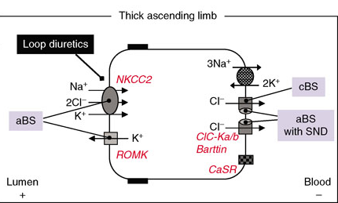
2-Hereditary Disorders of Thick ALH
A-Disorders of Transcellular Transport
Bartter’s Syndrome: Genotypes
BS1-NKC2
BS2- ROMK
BS3- CLCNKB
BS4- Barttin
BS5 - CaSR

Slide 14
2-Hereditary Disorders of Thick ALH
B-Disorders of Paracellular Transport
Familial Hypomagnesemia, Hypercalciuria, NC
Claudin-16 (Paracellin-1) 3q27
Claudin-19 1p34.2

Slide 15
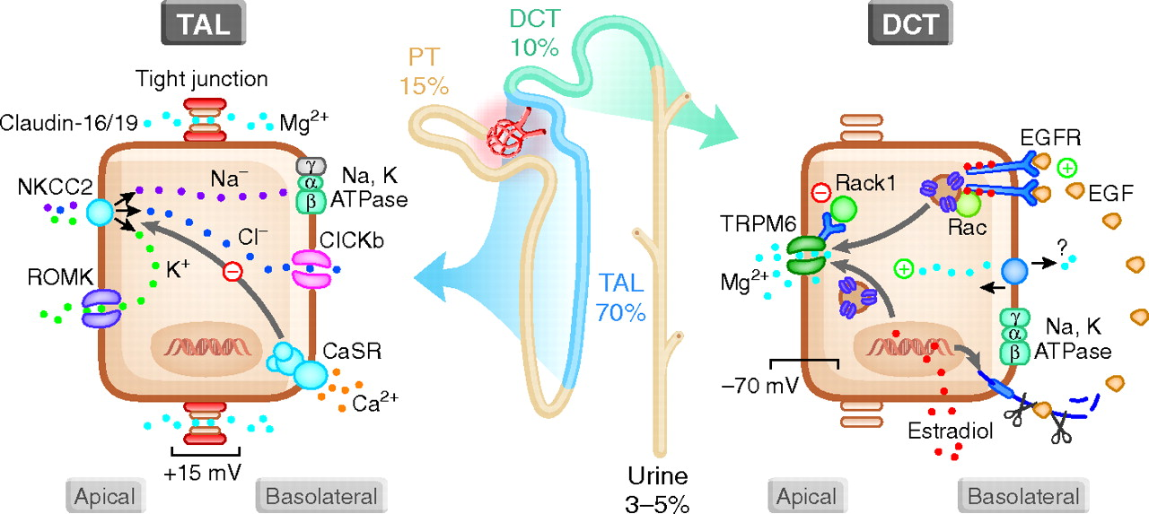
Renal Regulation of Mg2+ Homeostasis
, Ca²⁺
Paracellular Mg Reabsorption
Transcellular Mg Reabsorption
Alexander, R. T. et al. J Am Soc Nephrol 2008;19:1451-1458

Slide 16
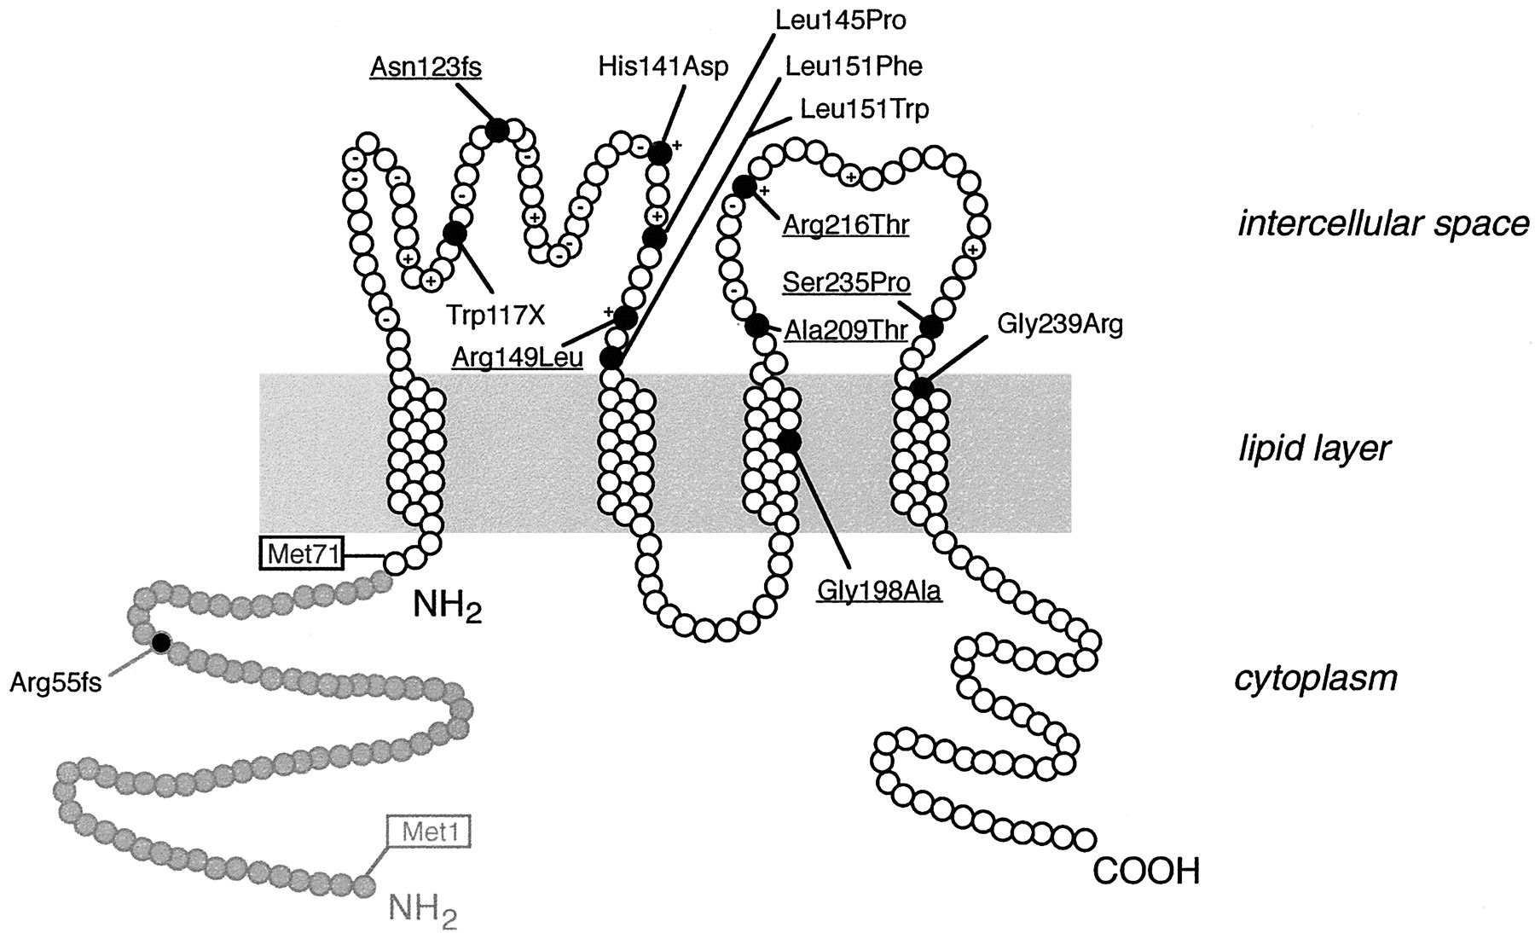
-5 net charge
Ser235Tyr
TM1
TM2
TM3
TM4
V 305
Cldn 16 Protein Model Deduced from Hydrophilicity Plots

Slide 17
3-Hereditary Disorders of the DCT
Transcellular Transport Defects
Gitelman Syndrome: NCCT
Gordon’s Syndrome PHAll: WNK 1,4 KLHL3,CUL3
EAST Syndrome: KCNJ10
Hypomagnesemia with 20 Hypocalcemia: TRPM6

Slide 18
4-Hereditary Disorders of the CD
Distal RTA: Alpha IC cell (ATP6B1, ATP6N1B, AEI)
Pseudohypoaldosteronism I: ENaC (a, b, g subunits)
Liddle’s Syndrome: ENaC (b, g subunits)
Nephrogenic DI: Principal cell (V2R, AQP2) XL
NSIAD “ “ “ XL
Others

Slide 19
Nephrogenic Diabetes Insipidus
1-Congenital-Hereditary Mutations
X-linked V2R 90%
Aut Recessive AQP2 7%
Dominant AQP2 3%

Slide 20
V2R Mutations
Over 200 identified
Class l Mutations: Defective synthesis of mRNA absent protein
Class ll Mutations: Fully translated but misfolded proteins
Class lll Mutations: Normal transport but defective activation or
regulation (i-c signaling)
Class lV Mutations: Normal trafficking but defective binding
Class V Mutations: None of the above but mistargeted to another
organelle in the cell

Slide 21
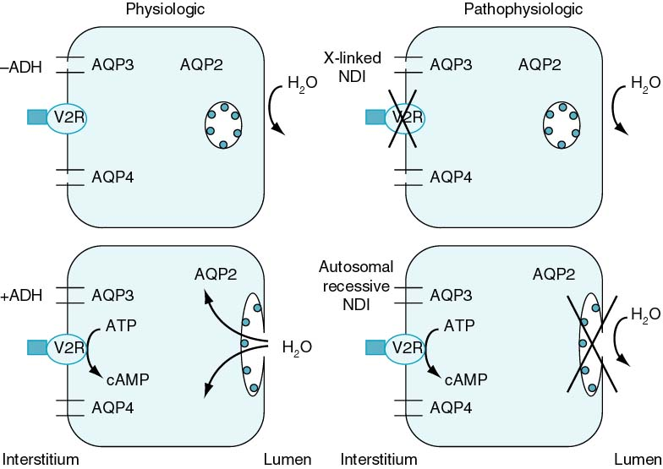
Pathophysiology of Nephrogenic DI
Lisa M. Guay-Woodford

Slide 22
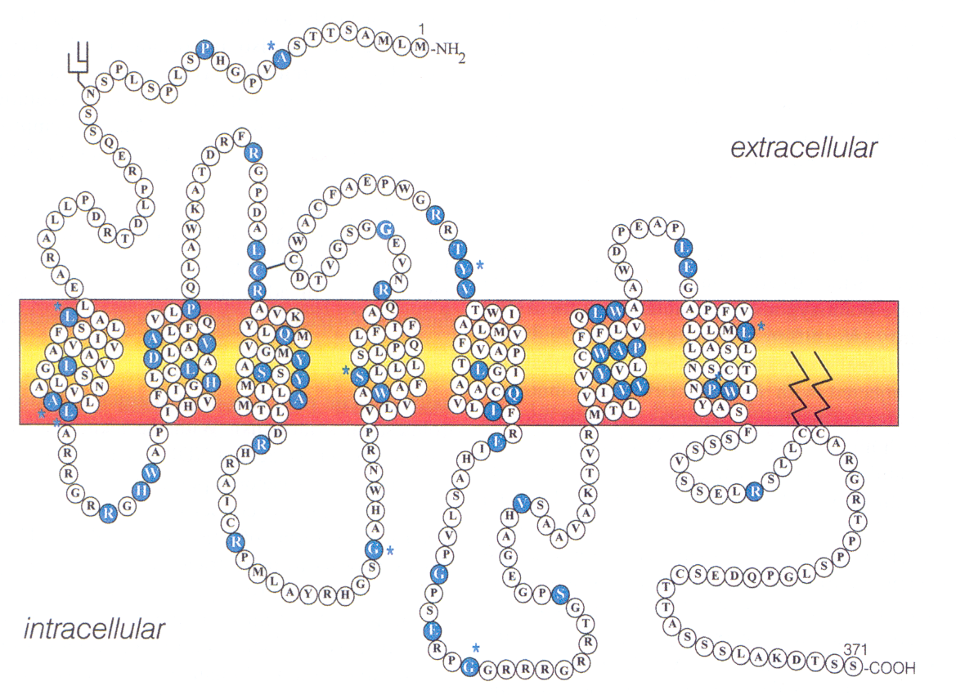
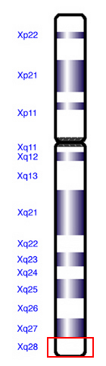
V2R Mutations in X-Linked NDI (Xq28)

Slide 23
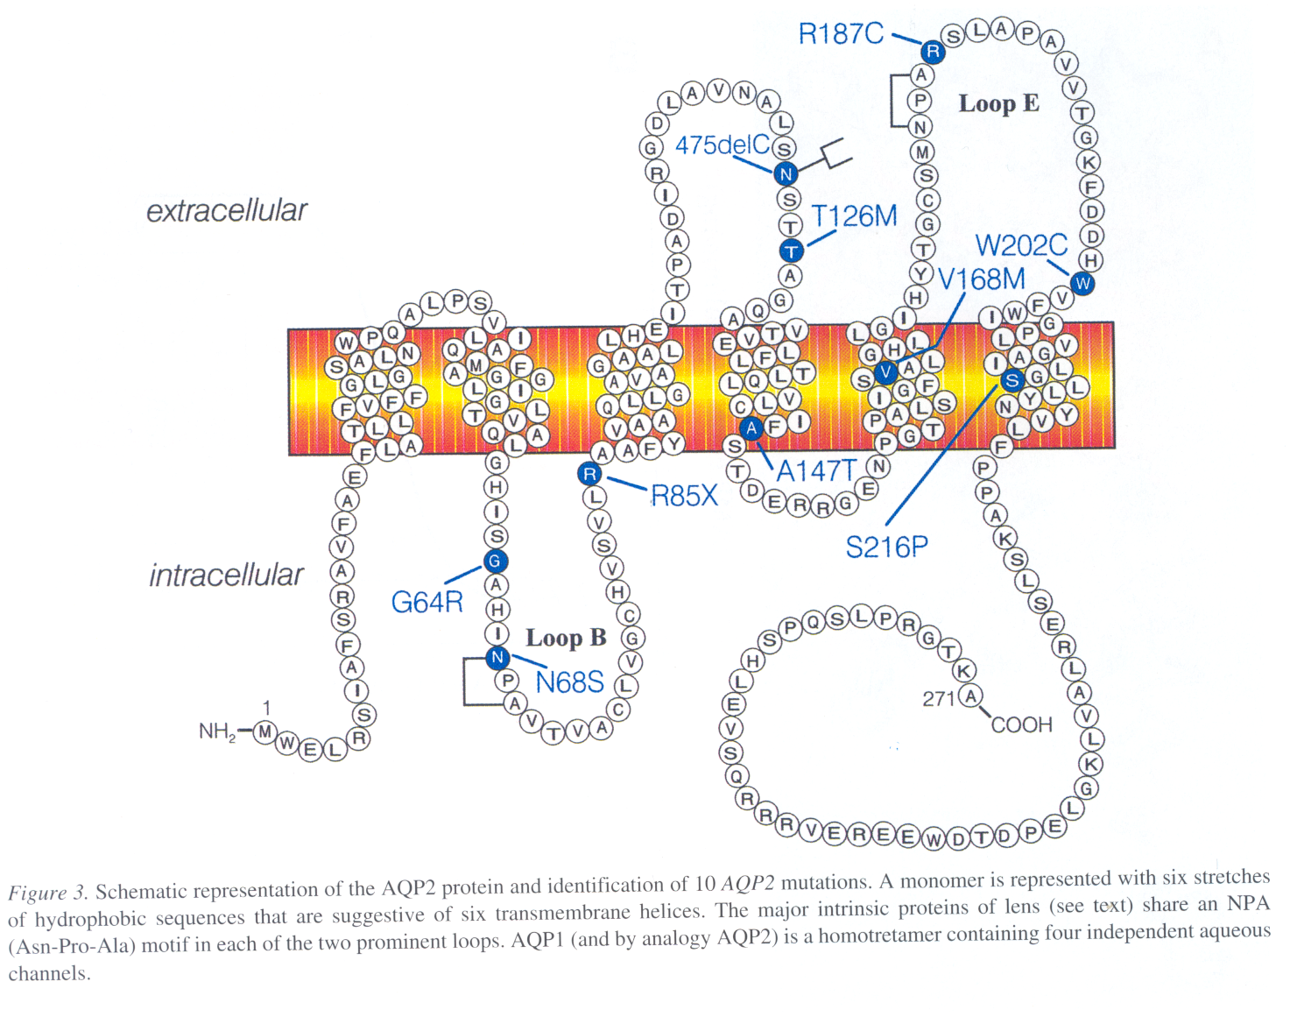
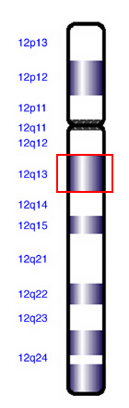
AQP2 Mutations in AR NDI (12q13)
Schematic representation of the AQP2 protein and
identification of 10 AQP2 mutations

Slide 24
Nephron Localization of Various Tubulopathies and Their Molecular Etiology: Summary
EAST Syndrome (KCNJ10)
Gitelman’s Syndrome
Gordon’s Syndrome (PHAll)
NCCT
WNK1,4
KLHL3,CUL3
3-DCT
1-PT- NHE3
NBC
Na S
Fanconi Syndrome
2-mTALH
5-CCD PC-ENaC
NKCC2
ROMK
ClCKb-a
Liddle’s Syndrome
Pseudohypoaldosteronism (PHAl)
Bartter’s
Syndrome
6-CD-AIC: ATP6B1, ATP6N1B, AEI
DRTA
Cldn 16, 19
FHHNC
7-CD-PC: V2R, AQP2
NDI
Notes:
7
7

Slide 25
Thank You

Slide 26
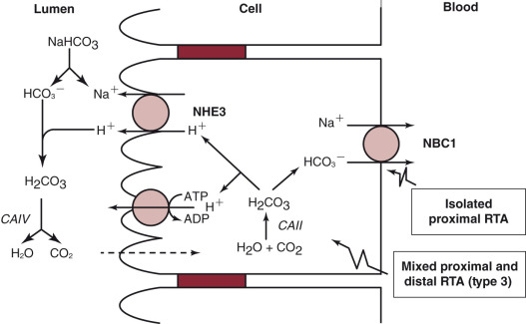
Transport mechanisms participating in acid–base handling in a proximal tubular cell.

Slide 27
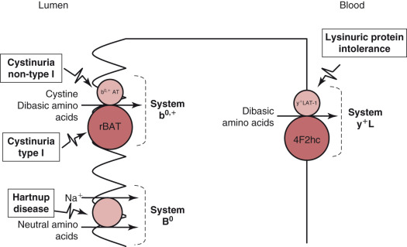
Transport pathways for several amino acids at the luminal and basolateral membranes of a proximal tubular cell

Slide 28
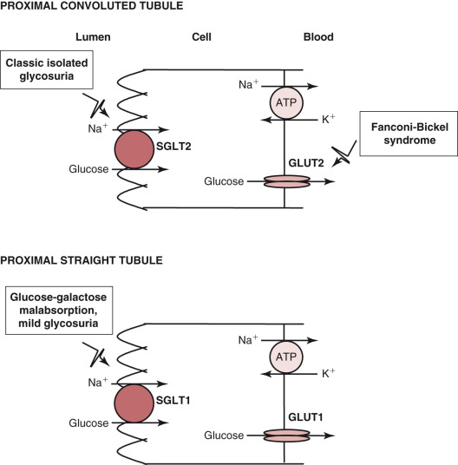
Glucose exit from cells in these two nephron segments occurs via the basolateral, facilitative Na⁺-independent glucose transporters GLUT2 and GLUT1, respectively
Glucose transport from lumen to cell in the proximal convoluted tubule and the proximal straight tubule is mediated by the luminal Na⁺-dependent glucose transporters SGLT2 and SGLT1, respectively.

Slide 29
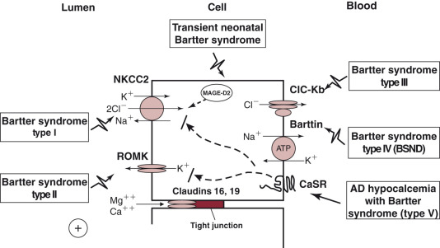
X-linked
FHHNC
Transcellular and paracellular transport pathways in the TALH. Cl⁻ reabsorption across the luminal membrane occurs via the Na⁺, K⁺, 2Cl⁻ cotransporter (NKCC2)

Slide 30
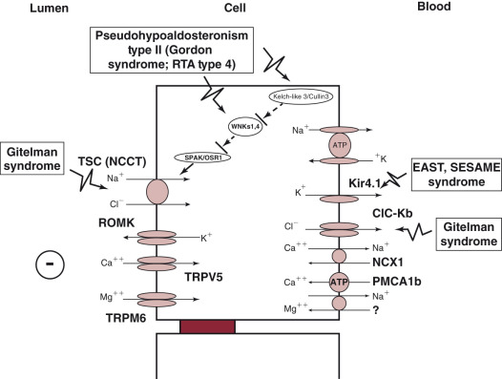
Transport mechanisms in the distal convoluted tubule. Na⁺ and Cl⁻ reabsorption occurs via the luminal, thiazide-sensitive NaCl cotransporter (TSC; NCCT).

Slide 31
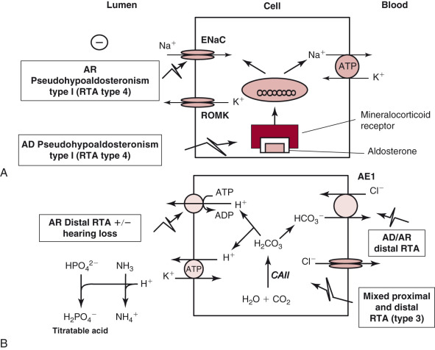
Transport mechanisms involved in electrolyte and acid–base handling in principal cell (A) and α-intercalated cell (B) of the cortical collecting duct.

Slide 32
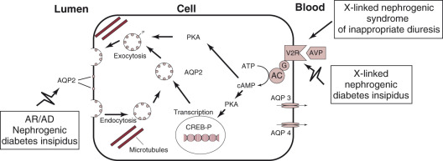
Regulation of aquaporin 2 (AQP2) recycling in a principal cell of the collecting duct. Binding of arginine vasopressin (AVP) to the G protein-coupled vasopressin type 2 receptor (V2R) at the basolateral membrane triggers a signaling cascade, which results in protein kinase A (PKA)-induced phosphorylation of AQP2 in intracellular vesicles.

Slide 33
1
Pathophysiology of Pseudohypoaldosteronism type 1 and Liddle’s syndrome

Slide 34
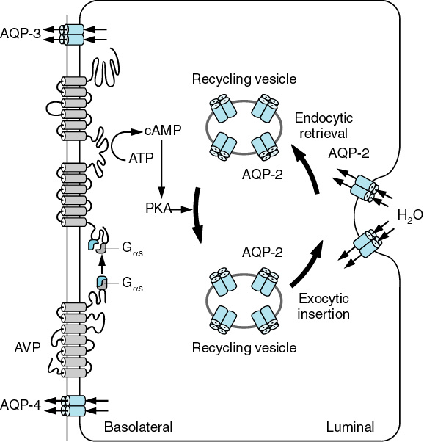
INTRACELLULAR ACTION OF ANTIDIURETIC HORMONE
7
6
AVP regulated transcellular water permeation of apical membrane of CD Principal Cell via AQP2 and constitutive
permeation of BL membrane via AQP3 and AQP4
3
6
2
3
4
4
1
V2R
5
7
5
7

Slide 35
Familial Hypomagnesemia, Hypercalciuria and Nephrocalcinosis
1972: Michelis et al
1978: Manz et al
1980s-1990s: Scattered case reports
Molecular characterization
1999: Claudin 16
2006: Claudin 19
By 2015 less than 80 families reported
Paracellin-1, a Renal Tight Junction Protein Required for Paracellular Mg2+ Resorption
David B. Simon, Yin Lu, Keith A. Choate, Heino Velazquez, Essam Al-Sabban, Manuel Praga, Giorgio Casari, Alberto Bettinelli, Giacomo Colussi, Juan Rodriguez-Soriano, David McCredie, David Milford, Sami Sanjad, Richard P. Lifton Science, 1999, 285: 103-106

Slide 36
Nephrogenic Diabetes Insipidus
2-Acquired: Causes /Mechanisms: Several Diseases
Disease State Med tonicity Def c-AMP Down regul of AQP2
Chr Renal Failure + + +
Hypokalemia + + +
Hypercalcemia + + +
S-S Disease +
Protein Malnutrition + +
Demeclocycline +
Lithium + +
Pregnancy Placental secretion of vasopressinase

Slide 37
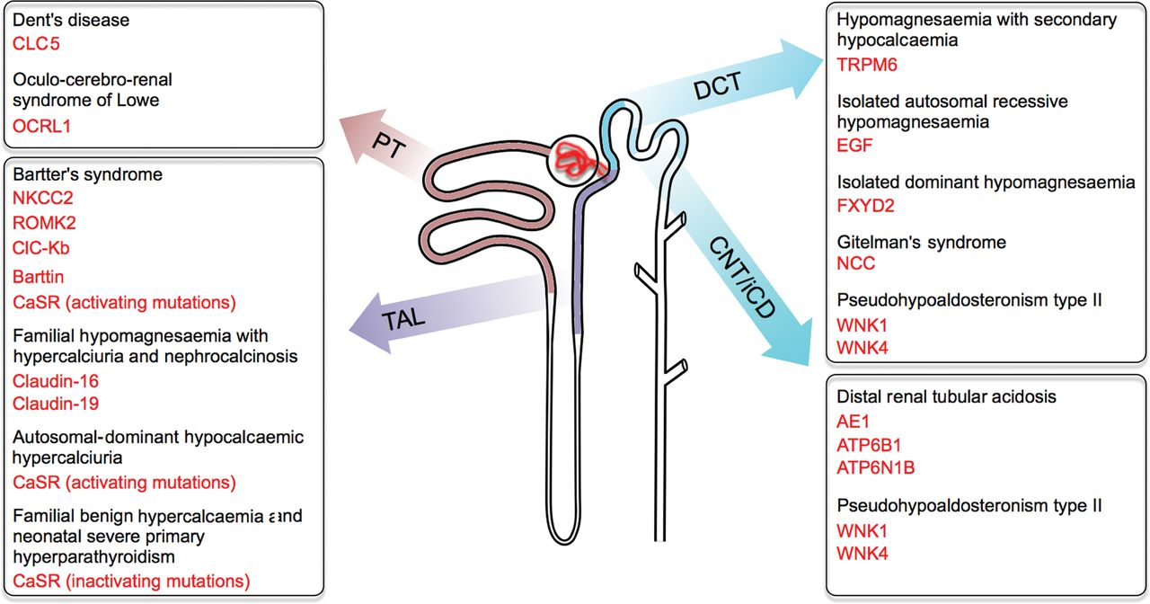
Fanconi Syndrome….

Slide 38
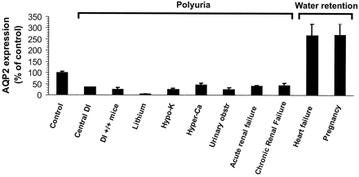
Changes in AQP2 expression with various water balance disorders JASN,10:647,1999

Slide 39
Bartter’s Syndrome: Phenotypes
BS 1 BS 2 BS 3 BS 4 BS 5
aBS aBS
cBS
aBS SND
AD
NB NB ANY NB NB
YES YES +/- YES YES
YES YES +/- YES +/-
AGE
POLYHYDR
PREMAT
SERUM K
SERUM Mg N N N/L N/L N/L
NEPHROCAL YES YES RARE YES +
U Ca CRF
aBS-antenatal Bartter’s, cBS-classical Bartter’s, SND-sensorineural deafness

Slide 40
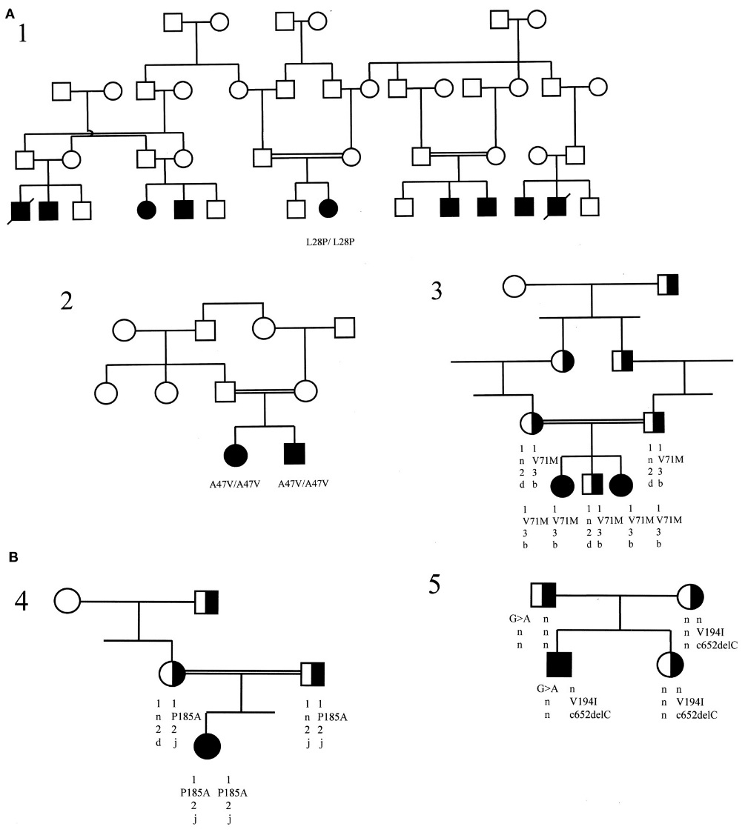
Segregation of NDI and AQP2 mutations in the studied families
Marr, N. et al. J Am Soc Nephrol 2002;13:2267-2277

Slide 41
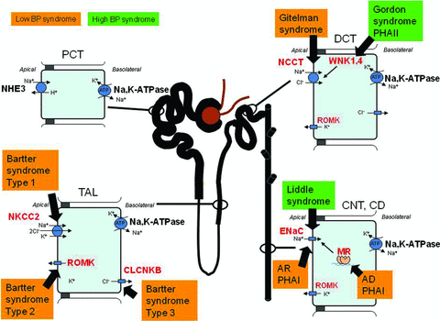
Hypertension, Dietary Salt Intake, and the Role of the Thiazide‐Sensitive Sodium Chloride Transporter NCCT
Cardiovascular Therapeutics Volume 29, Issue 1, pages 68-76, 19 DEC 2010
Notes:
Sodium transport along the nephron showing associated monogenic blood pressure syndromes. Schematic representation of a nephron showing the reabsorption of Na⁺ in the proximal tubules (PROX), the thick ascending loop of Henle (TAL), the distal convoluted tubule (DCT), the connecting tubule (CNT), the collecting duct (CD), and the monogenic syndromes associated with these segments. Abbreviations (molecular targets are bolded red): AD autosomal dominant; AR, autosomal recessive; ENaC, amiloride‐sensitive epithelial sodium channel; NCCT, thiazide‐sensitive Na⁺/Cl⁻ cotransporter; MR, mineralocorticoid receptor; PHAI and PHAII, pseudo‐hypoaldosteronism type 1 and type 2; NHE3, Na⁺/H⁺ exchanger isoform 3; NKCC2, Na⁺/K⁺/2Cl⁻ cotransporter; Na/K‐ATPase, sodium pump; ROMK, renal outer medulla potassium channel; CLCNKB, chloride channel; WNK1 and WNK4, “With No lysine (K)” kinase.
© This slide is made available for non-commercial use only. Please note that permission may be required for re-use of images in which the copyright is owned by a third party.

Slide 42
