Slide 1
INTRANASAL CORTICOSTEROIDS USE IN THE MANAGEMENT OF ALLERGIC RHINITIS
Patrick Snaifer, MD
ENT, Head and Neck Surgery
Pediatric ENT
zinc code: NE/FF/0004/18

Slide 2
Disclosures and Disclaimers
I have not received any payment for preparing or taking part in this presentation
The meeting is organized and funded by GSK
Prescribing information and adverse event reporting information are available at the end of this presentation and may be requested from GSK staff at this meeting

Slide 3
ARIA Guidelines: Classification of Allergic Rhinitis
Intermittent
<4 days per week or
<4 weeks
Persistent
4 days per week and
>4 weeks
Mild
Normal sleep and
No impairment of daily activities, sport, leisure
Normal function at school
No troublesome symptoms
Moderate-Severe
One or more items
Abnormal sleep
Impairment of daily activities, sport, leisure
Abnormal work and school
Troublesome symptoms
ARIA = Allergic Rhinitis and Its Impact on Asthma.
Bousquet et al. Allergy. 2002;57:841.

Slide 4
Treatment of Allergic Rhinitis According to ARIA
moderate
severe
persistent
mild
persistent
moderate
severe
intermittent
mild
intermittent
intranasal corticosteroid
Nasal wash, cromones
oral or local non-sedative H1-blocker
intra-nasal decongestant (<10 days) or oral decongestant
allergen and irritant avoidance
immunotherapy
Adapted from: Management of Allergic Rhinitis and Its Impact on Asthma Pocket Guide. Available at:
http://www.whiar.org/docs/ARIA_PG_08_View_WM.pdf.

Slide 5
Allergic Cascade
Early-Phase Reaction
Mast Cell Response
Late-Phase Reaction
Cellular Infiltration/Inflammation
Histamine
Proteases
Eosinophil
Degranulation
CysLTs, GM-CSF, TNF-α, IL-1, IL-3, PAF, ECP, MBP
Allergen
Basophil
Chemotactic factors
(CysLTs, PAF, IL-5)
Histamine, CysLTs, TNF-α, IL-4, IL-5, IL-6
Mast cell
CysLTs
Prostaglandins
PAF
Bradykinin
Interleukins
TNF-α
GM-CSF
Monocyte
Neosynthesis
CysLTs, TNF-α, PAF, IL-1
Lymphocyte
IL-4, IL-13, IL-5, IL-3, GM-CSF
Bascom et al. Am Rev Respir Dis. 1988;138:406.
Bascom et al. J Allergy Clin Immunol. 1988;81:580.
Pearlman. J Allergy Clin Immunol. 1999;104:S132.
Quraishi et al. J Am Osteopath Assoc. 2004;104(suppl 5):S7.
Notes:
Natural History of Allergic Rhinitis Early-Phase Reaction (EPR)
Following an initial sensitization step, the allergic response occurs upon subsequent exposure to the allergen. Allergen binding to the primed mast cells causes cross linking of IgE molecules on the cell surface, resulting in the opening of calcium channels and activation of the cells. Upon activation, the mast cells release granules (exocytosis) containing preformed mediators, including histamine and proteases such as chymase and tryptase.¹ Within minutes of exposure, the activated mast cells synthesize and release new mediators such as cysteinyl leukotrienes, prostaglandins, platelet activating factor (PAF), bradykinin, interleukins (IL-1–IL-6), tumor necrosis factor-alpha (TNF-α), and GM-CSF.¹
The late-phase reaction usually occurs between 2 and 4 hours after allergen exposure and is characterized by persistent symptoms, primarily nasal congestion and, to a lesser extent, rhinorrhoea and sneezing.¹ It is mediated by the infiltration of inflammatory cells (eosinophils, basophils, monocytes, and lymphocytes)^{2,3} and the release of mediators into the nasal mucosa. The late-phase reaction is initiated during the early-phase response when mast cells release leukotrienes, interleukins, and cytokines, which promote the inflammatory processes and the recruitment of inflammatory cells, particularly eosinophils. These inflammatory cells release additional chemical mediators during the late-phase response, leading to inflammation, including “priming” of nasal tissues to further allergic responses.⁴
Quraishi SA, Davies MD, Craig TJ. Inflammatory responses in allergic rhinitis: traditional approached and novel treatment strategies. J Am Osteopath Assoc 2004; 104(Suppl.5):S7-S15.
Bascom R, Pipkorn U, Lichtenstein LM, Naclerio RM. The influx of inflammatory cells into nasal washings during the late response to antigen challenge. Effect of systemic steroid pretreatment. Am Rev Respir Dis. 1988;138:406-412.
Bascom R, Wachs M, Naclerio RM, Pipkorn U, Galli SJ, Lichtenstein LM. Basophil influx occurs after nasal antigen challenge: effects of topical corticosteroid pretreatment. J Allergy Clin Immunol. 1988;81:580-589.
Pearlman DS. Pathophysiology of the inflammatory response. J Allergy Clin Immunol 1999; 104: S132-7.

Slide 6
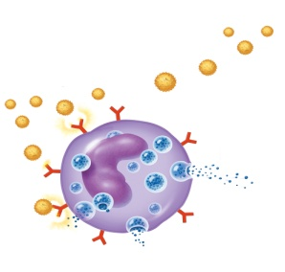
Nasal Inflammation: An Underlying Mechanism in Allergic Rhinitis
Early-Phase Response
Mast Cell
Late-Phase Response
Cellular Infiltration/Inflammation
Allergen
Histamine
Proteases
Eosinophil
Degranulation
Basophil
Chemotactic factors
Other Inflammatory Mediators
Neosynthesis
Monocyte
Mast cell
Other Inflam. mediators
Lymphocyte
Nasal Mucosa in Patients with PAR
Pearlman. J Allergy Clin Immunol. 1999;104:S132. Bascom et al. Am Rev Respir Dis. 1988;138:406. Bascom et al. J Allergy Clin Immunol. 1988;81:580. Quraishi et al. J Am Osteopath Assoc. 2004;104(suppl 5):S7. Minshall et al. Otolaryngol Head Neck Surg. 1998;118:648.
Notes:
Inflammatory Mediators of Nasal Congestion in Allergic Rhinitis
Following an initial sensitization step, the allergic response occurs upon subsequent exposure to the allergen. Allergen binding to the primed mast cells causes cross linking of IgE molecules on the cell surface, resulting in the opening of calcium channels and activation of the cells. Upon activation, the mast cells release granules (exocytosis) containing preformed mediators, including histamine and proteases such as chymase and tryptase.¹ Within minutes of exposure, the activated mast cells synthesize and release inflammatory mediators such as cysteinyl leukotrienes, prostaglandins, platelet activating factor (PAF), bradykinin, interleukins (IL-1–IL-6), tumor necrosis factor-alpha (TNF-α), and GM-CSF, that can cause congestion.¹
The late-phase reaction usually occurs between 2 and 4 hours after allergen exposure and is characterized by persistent symptoms, primarily nasal congestion and, to a lesser extent, rhinorrhoea and sneezing.¹ It is mediated by the infiltration of inflammatory cells (eosinophils, basophils, monocytes, and lymphocytes)^{2,3} and the release of mediators into the nasal mucosa. The late-phase reaction is initiated during the early-phase response when mast cells release leukotrienes, interleukins, and cytokines, which promote the inflammatory processes and the recruitment of inflammatory cells, particularly eosinophils. These inflammatory cells release additional chemical mediators during the late-phase response, leading to inflammation, including “priming” of nasal tissues to further allergic responses.⁴
Nasal inflammation with infiltration of eosinophils is a characteristic finding in patients with nasal allergies.⁵
Pearlman DS. Pathophysiology of the inflammatory response. J Allergy Clin Immunol. 1999; 104: S132.
Bascom R, Pipkorn U, Lichtenstein LM, Naclerio RM. The influx of inflammatory cells into nasal washings during the late response to antigen challenge. Effect of systemic steroid pretreatment. Am Rev Respir Dis. 1988;138:406.
Bascom R, Wachs M, Naclerio RM, Pipkorn U, Galli SJ, Lichtenstein LM. Basophil influx occurs after nasal antigen challenge: effects of topical corticosteroid pretreatment. J Allergy Clin Immunol. 1988;81:580-589.
Quraishi SA, Davies MD, Craig TJ. Inflammatory responses in allergic rhinitis: traditional approached and novel treatment strategies. J Am Osteopath Assoc. 2004; 104(Suppl.5):S7.
Minshall et al. Otolaryngol Head Neck Surg. 1998;118:648.

Slide 7
Nasal & Non Nasal
Symptoms of
Allergic Rhinitis

Slide 8
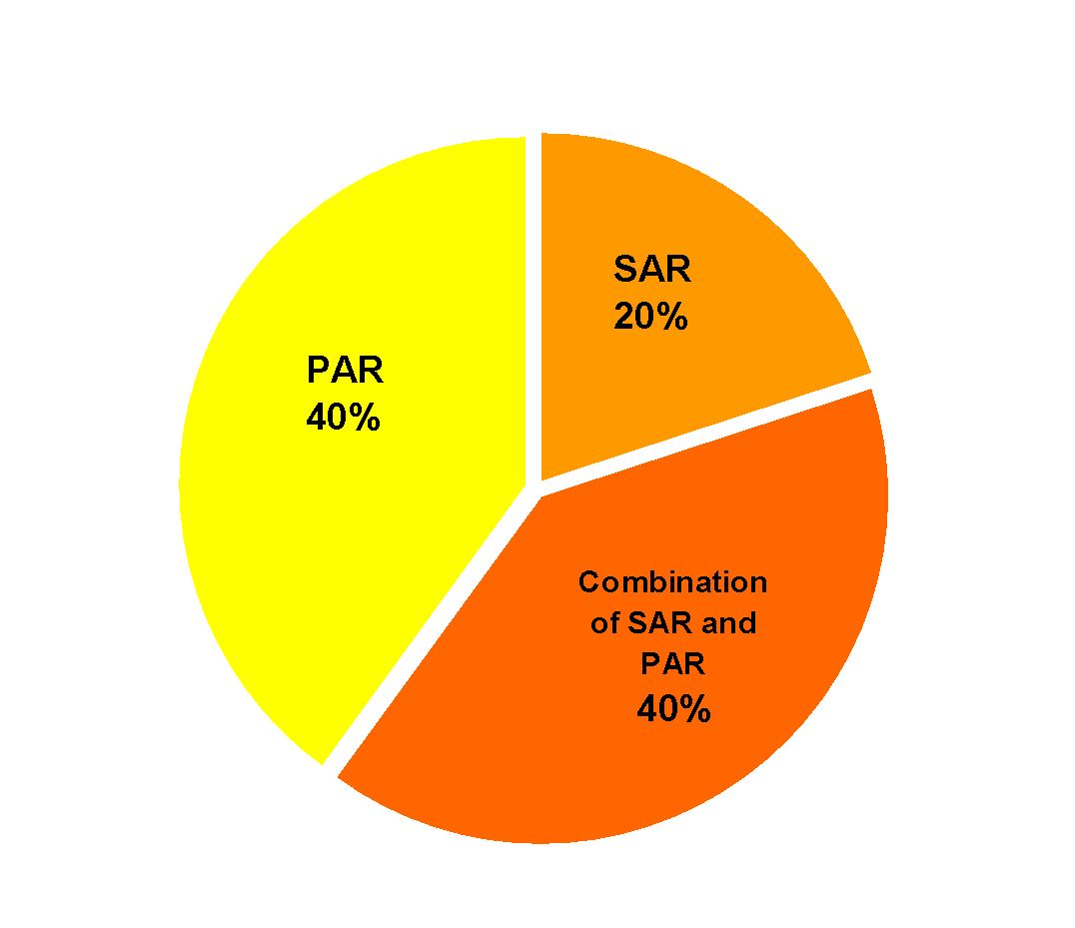
Prevalence of Seasonal and Perennial Allergic Rhinitis
SAR
Symptoms occur or increase at certain seasons and correlate with presence of seasonal allergens
PAR
Symptoms are intermittent or continuous throughout year
SAR = seasonal allergic rhinitis; PAR = perennial allergic rhinitis.
Mullarkey. J Allergy Clin Immunol. 1980;65:122. Skoner. J Allergy Clin Immunol. 2001;108(suppl):S2.
Notes:
Definition and Prevalence of Allergic Rhinitis (cont)
About 40% of all cases of allergic rhinitis are perennial allergic rhinitis (PAR), and another 40% are cases of PAR mixed with seasonal exacerbation. The remaining are seasonal allergic rhinitis (SAR). In contrast to SAR symptoms, the symptoms of PAR do not vary with the seasons; however, seasonal allergens can cause exacerbations.
1. Mullarkey MF. Allergic and nonallergic rhinitis: Their characterization with attention to the meaning of nasal eosinophilla. J Allergy Clin Immunol, 1980;65:122-126.
2. Skoner DP. Allergic rhinitis: definition, epidemiology, pathophysiology, detection, and diagnosis. J Allergy Clin Immunol. 2001; 108:S2-8.
3. Smith JM. Epidemiology and natural history of asthma, allergic rhinitis, and atopic dermatitis (eczema). In: Middleton E, Reed CE, Ellis EF, Adkinson NF, Yunginger JW, eds. Allergy: Principles and Practice. 3rd ed. St. Loui, Mo: CV Mosby Company; 1988;2:892-929.

Slide 9
Allergic Rhinitis: Comorbid Conditions
Asthma
Otitis media
Sinusitis
Eczema
Pharyngitis
Lymphoid hypertrophy
Obstructive sleep apnea
Speech impairment
Conjunctivitis
Bousquet et al. Allergy. 2002;57:841.
Notes:
Comorbid Conditions
Allergic rhinitis is associated with many comorbid conditions. In addition to other atopic disorders, such as asthma and eczema, the symptoms of allergic rhinitis may lead to the development of otitis media, sinusitis, conjunctivitis, and pharyngitis. In severe cases of allergic rhinitis, obstructed airways may cause breathing difficulties and lead to sleep apnea, speech impairment, and failure to thrive.
Appropriate diagnosis and treatment of allergic rhinitis may prevent the development of these disorders, or alleviate their symptoms.
Spector SL. Overview of comorbid associations of allergic rhinitis. J Allergy Clin Immunol. 1997;99:S773-S780

Slide 10
Complications of AR: More Than Just a Nuisance
Short-Term
-Acute sinusitis
-Eustachian Tube dysfunction🡪 Otitis Media.
-Sleep-Disordered breathing
-↓Cognitive functioning
-Aggravation of underlying asthma
Long-Term
-Chronic Sinusitis
-Aggravation of nasal polyps
-Permanent Hearing Impairment (as a results of chronic otitis)
-Sleep apnea & associated complications
-Craniofacial abnormalities
-↓Long Term Productivity
-⁭ Risk of developing persistent asthma
Bousquet et al. Allergy. 2002;57:841.

Slide 11
Inflammation Reduces Nasal Airflow in Allergic Rhinitis
800
r = -0.85
p<0.001
700
600
500
Nasal flow (ml/s)
400
300
200
100
0
0
5
10
15
20
Eosinophils
Ciprandi et al. Int Arch Allergy Immunol. 2004;134:34.

Slide 12
Allergic Rhinitis Leads to Increases Incidence of Sleep Apnea
P<0.001
Stuck et al. J Allergy Clin Immunol. 2004;113:663.

Slide 13
Features of the optimal medications for the treatment of Allergic Rhinitis
Affects the primary cause of the symptoms
Inflammation 🗹
Effective
Fast acting 🗹
24-hour coverage 🗹
No evidence of tachyphylaxis 🗹
Good short- and long-term safety and tolerability 🗹
Once daily dosing 🗹
Minimal side effects
Systemic 🗹
Little or no burning 🗹
No bad taste or aftertaste 🗹
Little or no drying 🗹
Lower volume of spray
Lower runout 🗹
Lower rundown 🗹
ARIA = Allergic Rhinitis and Its Impact on Asthma
Notes:
‹#›
Treatment considerations for medications used to treat allergic rhinitis are displayed on the current slide. If a product can be developed that is safe and effective (providing 24-hour coverage, with no evidence of tachyphylaxis), while treating the underlying cause of the disease.

Slide 14
Intranasal corticosteroids are the most effective treatment for allergic rhinitis
 | Symptom
Treatment | Sneezing | Itching | Congestion | Rhinorrhoea | Ocular
Oral antihistamine | ++ | ++ | +/– | ++ | ++
Nasal antihistamine | + | + | +/– | + | –
Intranasal corticosteroid | ++ | ++ | ++ | ++ | +
Oral decongestant | – | – | + | – | –
Intranasal decongestant | – | – | ++ | – | –
Intranasal mast cell stabilizer | + | + | + | + | –
Topical anticholinergic | – | – | – | ++ | –
– provides no benefit + provides modest benefit
+/– provides minimal benefit ++ provides substantial benefit
Scadding et al. Clin Exp Allergy 2008; 38:19–42

Slide 15
AIME Study Design
Population | Sampling Frame | Interview length
Adults diagnosed with nasal allergies or allergic rhinitis, symptomatic or being treated for nasal allergies in the past 12 months | Telephone* and in-person# screening of national or major city sample of households | Mean: 36.2 min.
AIME Countries | Number of Households Screened | Completed sample
Egypt Iran† Lebanon Saudi Arabia United Arab Emirates | 1,274# 2,313# 790# 1,639* 1,395* | 95 100 80 68 66
TOTAL: | 7,411 | 409
†In Iran, persons were screened, rather than households
Please note throughout this document, all claims made based on the survey results generalized to the “Middle East” refer to the following countries: Egypt, Iran, Lebanon, Saudi-Arabia, UAE
‹#›

Slide 16
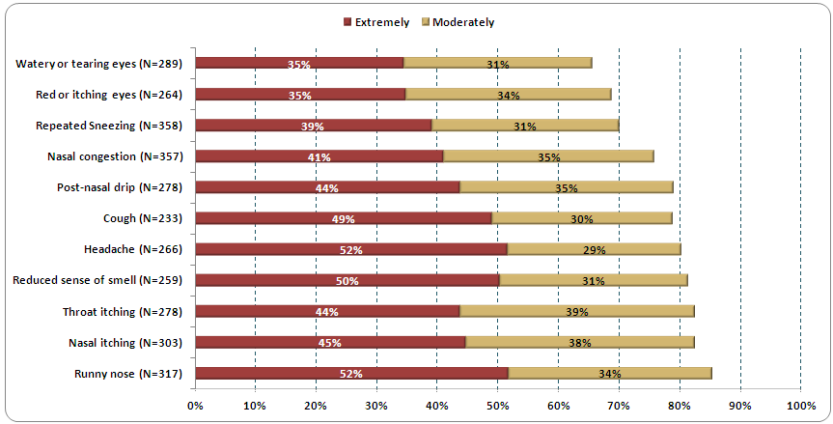
How Bothersome are Symptoms
Q18. When you have nasal allergy attacks, how bothersome are the following symptoms usually. Was the (symptom) extremely bothersome, moderately bothersome, slightly bothersome or not bothersome? Base: Had symptoms a few days a month or more often
‹#›
‹#›

Slide 17
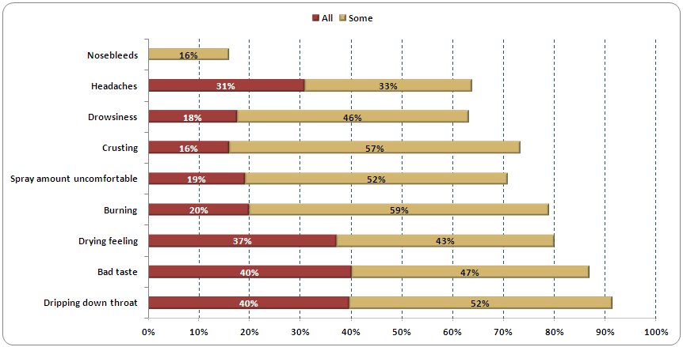
Commonly Reported Side Effects of Steroid Nasal Sprays
Q59. How many of the steroid nasal sprays that you have taken for nasal allergies had the following types of side effects – all, some or none?
Base: Have used steroid nasal spray, N=247
‹#›

Slide 18
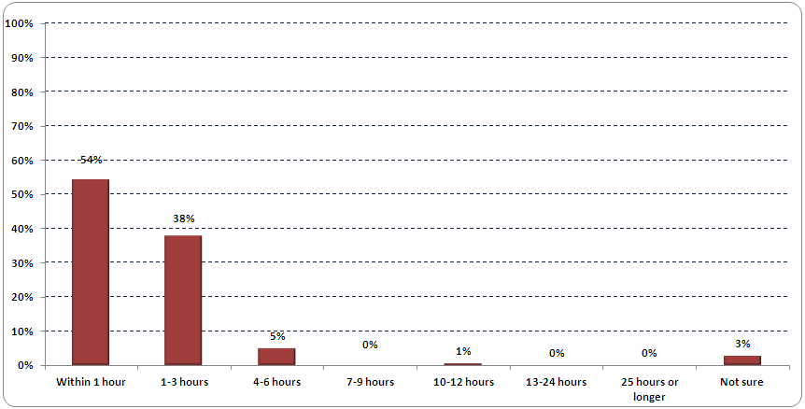
How Quickly Steroid Nasal Sprays Should Begin to Provide Relief
Q54. Based on your experience or what you have heard ……..How quickly are steroid nasal spray’s supposed to begin providing symptom relief for nasal allergies?
Base: Has heard of steroid nasal sprays, N=268
‹#›
‹#›

Slide 19
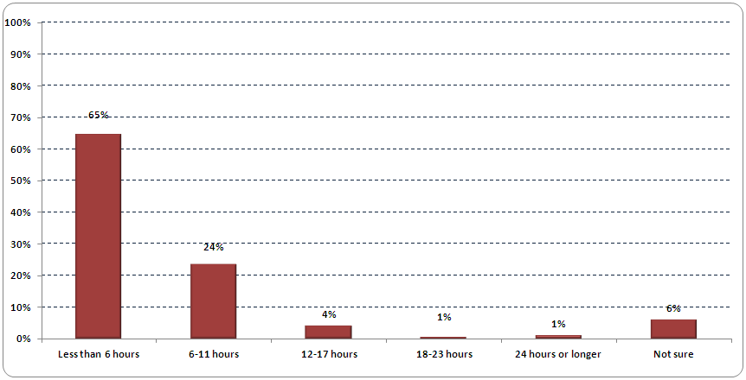
How Long Steroid Nasal Sprays are Supposed to Provide Symptom Relief
Q55. Based on your experience or what you have heard ……..How long are steroid nasal spray’s supposed to provide symptom relief for nasal allergies?
Base: Has heard of steroid nasal sprays, N=268
‹#›
‹#›

Slide 20
Safety profile of intranasal steroids
Absorption characteristics related to:
topical potency
lipid solubility
systemic bioavailability
ARIA = Allergic Rhinitis and Its Impact on Asthma

Slide 21
MECHANISM OF ACTION OF INTRANASAL STEROIDS

Slide 22
TOPICAL POTENCY
An article from Salter et al demonstrated that the newer generation agents, ﬂuticasone furoate and mometasone furoate, are more potent than other intranasal steroids.
A study using the method of quantifying the inhibitory power on IL and TNF generation demonstrated that ﬂuticasone furoate and mometasone furoate were equally effective at inhibiting cytokine release, and they also had greater inhibition than the other intranasal steroids studied (beclomethasone, triamcinolone, budes-onide, and betamethasone).

Slide 23
LIPID SOLUBILITY
The lipophilic nature of a compound refers to its lipid-partitioning properties. Thus, a highly lipophilic substance shows a higher and faster uptake by the nasal mucosa, greater retention within the tissue, and an enhanced glucocorticoid receptor binding.
The descending rank order of lipophilicity of the available topically active steroids is fluticasone furoate, mometasone furoate, ﬂuticasone propionate, budesonide, triamcinolone acetonide, and ﬂunisolide

Slide 24
SYSTEMIC BIOAVAILABILITY

Slide 25
Systemic bioavailability of fluticasone furoate
Study by Allen et al
THE GEOMETRIC MEAN OF THE ABSOLUTE BIOAVAILABILITY OF FLUTICASONE FUROATE IN A STUDY WHERE FF WAS DELIVERED INTRANASALY WAS LESS THAN 0.5%

Slide 26
AAAAI RECOMMENDATION
APRIL 2016

Slide 27
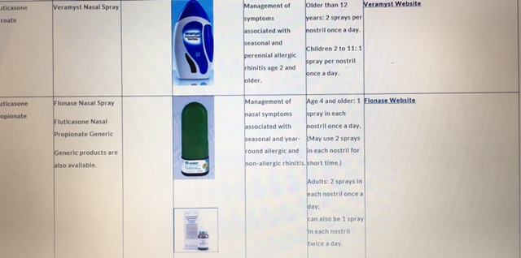

Slide 29
PATIENT PREFERENCE STUDY: Yanez et al. 2016
A patient preference study evaluating fluticasone furoate and mometasone furoate nasal sprays for allergic rhinitis
Anahi Yanez, Alex Dimitroff, Peter Bremner, Chae-Seo Rhee, Graham Luscombe, Barbara A. Prillaman, Neil Johnson
Yanez A, et al. Allergy Rhinol 7:1–6, 2016; doi: 10.2500/ar.2016.7.0185.
Yanez A, et al. Allergy Rhinol 7:1–6, 2016; doi: 10.2500/ar.2016.7.0185.

Slide 30
OVERALL AND IN TERMS OF SPECIFIC ATTRIBUTES, PATIENTS PREFERRED FFNS OVER MFNS
Significantly more patients preferred FFNS than MFNS for ‘less drip down throat’ (p < 0.001), ‘less run out of nose’ (p < 0.05), ‘more soothing’ (p < 0.05), and ‘less irritating’ (p < 0.001)
More patients responded in favor of FFNS versus MFNS for the immediate attributes, ‘run down the throat’ (p<0.001), and ‘run out of the nose’ (p<0.001)
There was little difference in preference for the treatments based on taste- or odour-related attributes

Slide 31
ARIA Guidelines for INS Use in Allergic Rhinitis: Duration of Therapy
ARIA guidelines do not provide specific recommendations regarding the duration of therapy with an INS
INSs may be more effective when given continuously

Slide 32
AAAAI/ACAAI Guidelines for INS Use in Allergic Rhinitis
INS may be considered for initial treatment of AR, because they provide significant symptom relief
INS alleviate ocular symptoms associated with AR
INS are particularly useful for the treatment of severe AR
INS use on as-needed (PRN) basis may not be as effective as continuous use

Slide 33
Impact of Pollution on Allergy

Slide 34
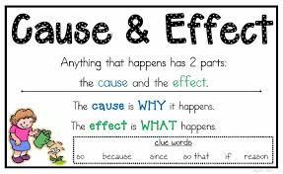
Impact of Pollution on Allergy
Pollution
Allergy
Genetic Predisposition
Enhancement of
Sensitization
Allergic Sensitisation
Enhancement of Organ
Hyper-responsiveness
Enhanced Pollen
Production
and Antigenicity
Organ Hyper-responsiveness
New onset allergies
Increased severity
Triggering Episodes
of Disease
Disease

Slide 35
Impact of Pollution on Allergy
Increased amount of pollen
Stronger allergenicity of pollen
Human activities
CO₂
Temperature
Increased germination rate
Altered plant/tree distribution
Earlier start to pollen season
Longer pollen season
Beggs PJ. Impacts of climate change on aeroallergens: past and future. Clin Exp Allergy 2004;34:1507-13.
Notes:
.Higher levels of CO2 in the atmosphere act as a fertilizer for plant growth
.Warmer temperatures and increased precipitation cause some plants to grow faster, bloom earlier, and produce more pollen
.may also increase fungal growth and spore release
. Climate change will allow certain allergen-producing plant species to move into new areas, and wind blown dust, carrying pollens and molds from outside of the United States, could expose people to allergens they had not previously contacted. Exposure to more potent concentrations of pollen and mold may make current non-sufferers more likely to develop allergic symptoms.
Sources:
(Bernard et al, 2001; CDC, 2012; U.S. EPA, 2008; Rogers et al, 2006)

Slide 36
PROPER SPRAYING TECHNIQUE

Slide 37
THANK YOU

