Slide 1
Acute Rejection in Kidney Transplantation
Valérie HAGE MD, MPH
Second IPNA Teaching course
Habtoor 2019

Slide 2
Introduction
Major cause of allograft dysfunction
Some kidneys do not regain function even with maximal antirejection therapy.
Can have a negative impact on long-term graft survival

Slide 3
Definitions
Acute deterioration in allograft + specific pathologic changes.
Two principal histologic forms:
- Active (acute) antibody-mediated rejection (ABMR)
- Acute T cell-mediated (cellular) rejection (TCMR)
Subclinical rejection = histologic evidence of acute rejection on biopsy without an elevation in the serum creatinine

Slide 4
ABMR | TCMR
Binding of circulating antibodies to donor alloantigens on graft endothelial cells (HLA/ ABO/ non HLA) | T cells that react to donor histocompatibility antigens
PRIMARY LESIONS | PRIMARY LESIONS
Severe vasculitis, glomerulitis with neutrophils in the GC and PTCs Presence of linear staining for C4d | Interstitial infiltration with mononuclear cells Tubulitis and interstitial mononuclear cell inflammation

Slide 5
ABMR
B. Nankivell: N Engl J Med, 2010

Slide 6
TCMR
B. Nankivell: N Engl J Med, 2010

Slide 7
Clinical features
Most episodes of acute rejection occur within the first six months after transplantation
Rejection >12 months
→ typically from noncompliance
→ overaggressive reduction in immunosuppression.
Most patients are asymptomatic
Occasionally: present with fever, oliguria, graft pain and/or tenderness

Slide 8
Radiographic manifestations
Nonspecific→ exclude other causes of acute kidney injury
Ultrasonography:
increased graft size
loss of corticomedullary junction
prominent hypoechoic pyramids
decreased echogenicity of the renal sinus
Renal Doppler studies: elevated resistance indices not specific
PET/CT: noninvasively distinguish non rejection from Acute rejection
Lovinfosse P:Am J Transplant, 2016

Slide 9
Laboratory manifestations
Acute rise in the serum creatinine
- late development in the course of a rejection
- significant histologic damage
Pyuria
New or worsening proteinuria

Slide 10
Investigational methods
Non invasive biomarker for the diagnosis of allograft rejection
Potential to improve the accuracy of diagnosis
Require validation in clinical trials
Several candidates biomarkers

Slide 11
Investigational methods
Molecular blood biomarkers:
- Kidney Solid Organ Response Test kSORT (mRNA)
Plasma levels of donor-derived cell-free DNA (dd-cfDNA) may be elevated (>1%) in patients with acute rejection
Blood cell function assays
- ELISPOT for IFN-gamma
Urine biomarkers: acute TCMR
mRNA (perforin, granzyme B, FOXP3, TIM-3)
miRNA
Immune-related proteins: CXCL9, CXCL10 (BK Virus)

Slide 12
Conclusions: Although increases in plasma ddcfDNA% are associated with graft injury, plasma ddcfDNA does not outperform the diagnostic capacity of the serum creatinine in the diagnosis of acute rejection.

Slide 13
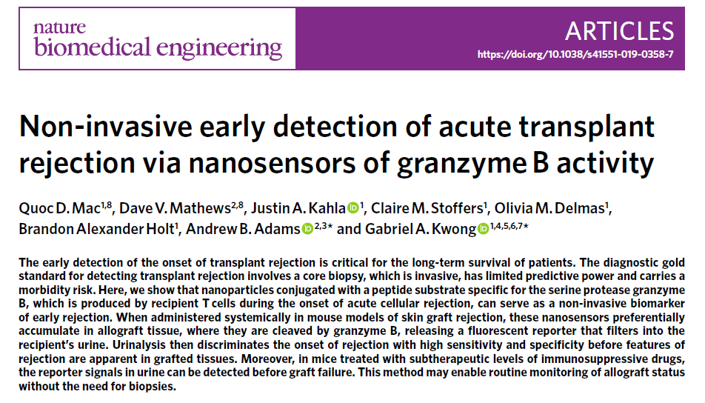

Slide 14
When to suspect acute rejection
>1 of the following:
New increase in serum creatinine of ≥25%
Worsening hypertension.
Proteinuria >1 g/day.

Slide 15
Increased risk for ABMR
Highly sensitized patients
ABO-incompatible renal allografts
Patients with Donor Specific Antibodies(DSAs)
Patients with inadequate immunosuppression
➔ Any incremental increase in serum creatinine should raise the suspicion for the possibility of acute rejection!!

Slide 16
The diagnosis of ABMR
Histologic evidence of acute tissue injury
Evidence of antibody interaction with vascular endothelium (eg, C4d staining in peritubular capillaries (PTCs)
Serologic evidence of DSAs

Slide 17
Confirming the diagnosis
Standard for the diagnosis → Renal Allograft Biopsy
Grade the severity of rejection
TCMR v/s ABMR
Degree of irreversible kidney damage [IF/TA]
Reveal other causes of renal inflammation and injury
CMV disease
BK nephropathy
interstitial nephritis
pyelonephritis
de novo or recurrent glomerular disease,
posttransplant lymphoproliferative disease (PTLD)

Slide 18
Molecular microscope
Molecular microscope diagnostic system: MMDx
Advanced tool
Provide more precise information
Smarter analysis
Can detect injury at the molecular level
Allow rapid target treatment

Slide 19
Molecular microscope
RNA extracted from the biopsy: microarray analysis is performed to measure mRNA levels
Predefined computer algorithms used to generate a report
Report= Molecular scores: reflect the probability that the biopsy sample has histologic features of TCMR, ABMR, rejection of any type, AKI , or IF/TA

Slide 21
The Banff classification of acute TCMR
Borderline – Mild interstitial inflammation (<25 percent of nonsclerotic cortical parenchyma; i0 or i1) plus any tubulitis (t1, t2, or t3) or significant interstitial inflammation (>25 percent of nonsclerotic cortical parenchyma; i2 or i3) plus foci of mild tubulitis (t1)
Type IA – Significant interstitial inflammation (>25 percent of nonsclerotic cortical parenchyma; i2 or i3) and foci of moderate tubulitis (t2)
Type IB – Significant interstitial inflammation (>25 percent of nonsclerotic cortical parenchyma; i2 or i3) and foci of severe tubulitis (t3)
Type IIA – Mild-to-moderate intimal arteritis (v1) with or without interstitial inflammation and tubulitis
Type IIB – Severe intimal arteritis comprising >25 percent of the luminal area (v2) with or without interstitial inflammation and tubulitis
Type III – Transmural arteritis and/or arterial fibrinoid change and necrosis of medial smooth muscle cells with accompanying lymphocytic inflammation (v3)

Slide 22
Treatment TCMR
Banff grade IA or IB
- inpatient admission
- pulse IV methylprednisolone at 3 to 5 mg/kg daily for 3 to 5 doses,
maximum daily dose of 500 mg
- oral glucocorticoids are tapered immediately to the maintenance dose
of oral prednisone the patient had been taking prior to the episode
Banff grade II or III rejection
- pulse IV methylprednisolone 3 to 5 mg/kg daily for three to five doses+
short tapered dose of oral prednisone.
- Daily rATG-Thymoglobulin at 1.5 to 3 mg/kg per dose for a total dose of 5
to 10 mg/kg. The total number of doses is determined by severity of
Banff grading.

Slide 23
Treatment ABMR
Primary aims :
Remove circulating donor-specific antibodies
Block their effects
Reduce their production
No therapeutics have received FDA approval for the treatment Mainstays of contemporary therapy:
Plasma exchange
Intravenous immune globulin
- Glucocorticoids
ClinTransplant 2015; 29: 118-23.

Slide 24
Treatment ABMR
Anti-CD20 monoclonal antibody: Rituximab
Proteasome inhibitor: Bortezomib
Two randomized, controlled trials
RITUX ERAH (Sautenet B: Transplantation, 2016)
BORTEJECT (Eskandary F: J Am Soc Nephrol, 2018)
→ neither trial showed clinical benefits!!!

Slide 25
Treatment ABMR
Anti-C5 monoclonal antibody : Eculizumab
reported to decrease the incidence of ABMR in HLA-sensitized renal-transplant recipients.
Stegal M: Am J Transplant, 2011
IgG-degrading enzyme of Streptococcus pyogenes (IdeS): Imlifidase
→ Cleaves Human IgG
Reduced/eliminated DSA before kidney transplantation HLA-incompatible
Jordan SC: N Engl J Med, 2017

Slide 26
A Loupy: N Engl J Med, 2018

Slide 27
THANK YOU

