Slide 1
SCREENING AND TREATMENT STRATEGIES OF HYPERCHOLESTEROLEMIA IN CHILDREN
WISSAM FAYAD MD

Slide 2
Familial hypercholesterolemia is one of the most common inherited metabolic diseases; the average worldwide prevalence of heterozygous familial hypercholesterolemia is about 1 in 500
It is the major risk factor for cardiovascular disease in adults

Slide 3
Nordestgaard et al. Eur Heart J 2013

Slide 4
In Lebanon:
High prevalence of FH
Numerous mutations of the LDL r
Homozygous familial hypercholesterolemia in Lebanon: a genotype/phenotype correlation.
Fahed et al Mol Genet Metab 2011 Feb;102(2):181-8.
The molecular basis of familial hypercholesterolemia in Lebanon: spectrum of LDLR mutations and role of PCSK9 as a modifier gene.
Abifadel et al Hum Metab 2009 Jul;30(7)

Slide 5
Simon Broome Register Diagnostic Criteria for Heterozygous Familial Hypercholesterolemia
Definite familial hypercholesterolemia is defined as:
• Total-C >6.7 mmol/l (260 mg/dL) or LDL cholesterol above 4.0 mmol/l (155 mg/dL) in a child <16 years or Total-C >7.5 mmol/l (290 mg/dL) or LDL cholesterol above 4.9 mmol/l (190 mg/dL) in an adult. (Levels either pre-treatment or highest on treatment).
PLUS
• Tendon xanthomas in patient, or in 1st degree relative (parent, sibling, child), or in 2nd degree relative (grandparent, uncle, aunt).
OR
• DNA-based evidence of an LDL receptor mutation or familial defective Apo B-100.

Slide 6
Simon Broome Register Diagnostic Criteria for Heterozygous Familial Hypercholesterolemia
Possible familial hypercholesterolemia is defined as:
• Total-C >6.7 mmol/l (260 mg/dL) or LDL cholesterol above 4.0 mmol/l (155 mg/dL) in a child <16 years or Total-C >7.5 mmol/l (290 mg/dL) or LDL cholesterol above 4.9 mmol/l (190 mg/dL) in an adult. (Levels either pre-treatment or highest on treatment).
And at least one of the following:
• Family history of MI below 50 years of age in 2nd degree relative or below 60 years of age in 1st degree relative.
• Family history of raised cholesterols >7.5 mmol/l (290 mg/dL) in adult 1st or 2nd degree relative or >6.7 mmol/l (260 mg/dL) in child or sibling under 16 years of age.

Slide 7
HC AS A RISK FACTOR FOR CVD FROM CHILDHOOD
Indirect studies: American soldiers in Vietnam an Korea
Bogalusa study: fatty streak formation directly proportional to LDL cholesterol (1,2)
Arterial mechanical changes and stiffness of the aortic wall(3,4,5)
1- Berenson et al: Am j Cardio 1992
2-Newman et al : NEJM 1994
3-Kroflach et al : Circul 2003
4- Morrisson et al : atheroscl 2010
5-KustersDM et al : Circ Res 2014

Slide 8
Carotid intima-media thickness in children with familial hypercholesterolemia
Kusters DM, et al :Circ Res. 2014 Jan 17
OBJECTIVE: As part of an ongoing trial to assess the efficacy and safety of rosuvastatin in children with FH aged 6 to 17 years, we report the differences in carotid intima-media thickness (cIMT) at baseline between children with FH and their unaffected siblings

Slide 9
Kusters DM, et al :Circ Res. 2014 Jan 17

Slide 10
CONCLUSIONS:
The difference in mean cIMT between children with FH and their unaffected siblings may be significant as early as age 8 years. This study confirms the need for early cholesterol lowering in this high-risk population.
Kusters DM, et al :Circ Res. 2014 Jan 17

Slide 11
SCREENING STRATEGIES
Universal screening is not recommended
AHA proposed a screening to high risk population:
1. A family history of parental or grand-parental vascular disease at less than 55 years of age. Vascular diseases cited include coronary artery disease, peripheral vascular disease, cerebrovascular disease, a coronary artery procedure, myocardial infarction, or sudden cardiac death;
2. A family history of increased total cholesterol(2G/L). The recommendation is that these children should be screened with fasting total cholesterol measurements;
3. Overweight or obesity. If hyperlipidemia is identified, these children should then also be screened for other elements of the metabolic syndrome.
McCrindle BW,, et al. Circulation. 2007;115(14): 1948–1967.

Slide 12
SCREENING STRATEGIES
AAP changed the recommendations in 2008:
Targeted screening for hyperlipidemia in children should be performed using a full fasting lipid profile every 3 to 5 years, beginning at age 2 years, using age and gender-specific norms for interpreting results (and considering results .95th percentile as abnormal). The triggers for initiating targeted screening include:
1. a positive family history of early atherosclerosis;
2. a positive family history of high cholesterol;
3. an unknown family history;
4. taking into consideration other risk factors individual to the child.
Daniels SR, Greer FR. Pediatrics. 2008;122(1):198–208.

Slide 13
SCREENING STRATEGIES
In some European countries a universal screening has been recently implanted as well as national registers
Universal Screening for Familial Hypercholesterolemia in Children
Gasper Klancar, et al journal of the American college of cardiology 2015
The UK Paediatric Familial Hypercholesterolaemia Register: preliminary data
Uma Ramaswami, et al Arch Dis child 2016

Slide 14
Treatment strategies
First intention treatment is based on DIET:
- Step 1: 30% fat, 10% saturated fat, 100 mg cholesterol/ 1000 calories
- Step 2: 7% saturated fat, 66 mg cholesterol/ 1000 calories
Need for vitamin supplement
Follow up of growth curve

Slide 15
Treatment strategies
Pharmacological agents : second step
Dietary supplements with phytosterols/stanols
Results of different studies show discrepancies:
Phytosterol capsules and serum cholesterol in hypercholesterolemia: A randomized controlled trial.
Ottestad I, Ose L, Wennersberg MH, Granlund L, Kirkhus B, Retterstøl K. Atherosclerosis. 2013 Jun;228(2):421-5.
Double-blinded, randomized, placebo-controlled crossover study
CONCLUSION: Daily intake of capsules containing 2 g phytosterols did not reduce total- or LDL-cholesterol significantly in a highly relevant target group for the use of phytosterol products.

Slide 16
Treatment strategies
Bile acid resins:
Cholesteramine, first used in FH
bad tolerability due to gritty taste and abdominal pain
Colesevelam: New BAS, has a better tolerability and may be used
Colesevelam hydrochloride: efficacy and safety in pediatric subjects with heterozygous familial hypercholesterolemia.
Stein EA, J Pediatr. 2010 Feb;156(2):231-6
RESULTS: At week 8, a significant difference from baseline in LDL-cholesterol was reported with colesevelam 1.875 g/d (-6.3%; P = .031) and colesevelam 3.75 g/d (-12.5%; P < .001) compared with placebo

Slide 17
Treatment strategies
“Hundred years ago, a wonderful new drug was discovered. If you put it on your teeth every day, you will still have teeth when you are eighty years old. You probably know that drug, it’s tooth-paste. Twenty five years ago, a tooth-paste for the vessels was invented. If you take that statin, it will brush your vessels clean and you will still have clean vessels when you are eighty years old”
Wiegman et al. Euro Heart J 2015

Slide 18
Treatment strategies
STATINS: THE DRUG OF CHOICE?
Numerous recent studies showed the efficacy and safety of different statins:

Slide 19
Treatment strategies
An Eight-Week Trial Investigating the Efficacy and Tolerability of Atorvastatin for Children and Adolescents With Heterozygous Familial Hypercholesterolemia
This study aimed to assess the efficacy and tolerability of atorvastatin in Tanner stage (TS) 1 patients ages 6 to 10 years and TS ≥ 2 patients ages 10 to <18 years with genetically confirmed heterozygous familial hypercholesterolemia
In this open-label, 8-week study , 15 TS 1 children were treated initially with atorvastatin 5 mg/day and 24 TS ≥ 2 children with 10 mg/day
RESULTS: After 8 weeks, the mean reduction in LDL-C was -40.7% ± 8.4 for the TS 1 children and -39.7% ± 10.3 for the TS ≥ 2 children.
Four patients experienced mild to moderate treatment-related AEs. No serious AEs or discontinuations were reported
Kuan Gandelman et al Pediatr Cardiol (2011) 32:433–44

Slide 20
Treatment strategies
Long-term follow-up of statin treatment in a cohort of children with familial hypercholesterolemia: efficacy and tolerability.
METHODS: Retrospective study on all medical files of young hypercholesterolemic patients referred to two specialized French centers. This population of 185 pravastatin-treated children with FH, with a mean baseline cholesterol level above 300 mg/dL, in most of whom genetic diagnosis was achieved, was followed-up for a mean duration of 2 years 2 months. The mean age for starting pravastatin was 11 years; in one of five children, treatment was started before the age of 8 years, mostly because of severe hypercholesterolemia or a family history of coronary heart disease.
RESULTS: A 16.9-19.2% decrease in total cholesterol level (21-24% for low-density lipoprotein cholesterol) was observed. Growth and puberty were not affected by statin treatment. A review of the medical files showed that 13% of children had side effects, most of which were minor; four of these children had muscular symptoms possibly related to the treatment. This frequency is lower than that observed in adults, and comparable to other studies in children.
Carreau V, et al. Paediatr Drugs 2011 Aug 1;13(4):267-75
Notes:
In this study, 185 children treated, 1/5 below 8 years simvastatin
Decreased LDL by 21-24%
Minor side effects in 13% , less than adults

Slide 21
Treatment strategies
Efficacy and safety of rosuvastatin therapy for children with familial hypercholesterolemia.
This study comprised a 12-week double-blind, randomized, placebo-controlled trial, followed by a 40-week open-label, titration-to-goal extension phase in 177 pubertal children, ages 10 to 17 years, with familial hypercholesterolemia. Participants were randomly assigned to placebo or rosuvastatin 5, 10, or 20 mg once daily.
RESULTS: Compared with placebo, rosuvastatin 5, 10, and 20 mg reduced LDL-C by 38%, 45%, and 50%, respectively (p < 0.001 for each group vs. placebo). With a maximum allowed dose of 20 mg, 40% achieved the treatment goal of <110 mg/dl during the open-label, titration-to-goal phase. Rosuvastatin was well tolerated, with no apparent adverse impact on growth or development.
Avis HJ et al J Am Coll Cardiol 2010 Mar 16;55(11):1121-6.

Slide 22
Treatment strategies
Familial hypercholesterolaemia in children and adolescents: gaining decades of life by optimizing detection and treatment
Wiegman et al, Eur Heart J, 2015

Slide 23
Wiegman et al, Eur Heart J, 2015

Slide 24
Treatment strategies
Conclusions:
Universal screening might be considered by age 10 years in countries where this is feasible, especially where founder effects with markedly increased frequency of FH are prevalent, such as Quebec in Canada, South Africa and Lebanon. Initiation of statin treatment at a young age is safe in both the short and mid-term, and significantly improves cardiovascular outcomes. Better education of young FH patients, together with frequent follow-up, are critical for adherence.
Wiegman et al, Eur Heart J, 2015

Slide 25
Treatment strategies
Statins for children with familial hypercholesterolemia
Vuorio A et al
Cochrane Database Syst Rev. 2017

Slide 26
Treatment strategies
Conclusions:
Statin treatment is an effective lipid-lowering therapy in children with heterozygous FH. No safety issues were identified in the short term up to two years. Since statin treatment in children with FH is not acutely or sub-acutely a life-saving treatment, it would be difficult to accept any clinically significant adverse events in this patient group. This treatment should be combined with regular pediatric follow-up and parents informed about potential side effects and interaction with concomitant medication.
Implications for research Much larger and longer-term randomized clinical trials are needed to ensure that statins are a safe therapy in the long term in children. Growth, neurological development, cognitive function and quality of life should be assessed during follow-up

Slide 27
Treatment strategies
A consensus has been established by AHA and endorsed by AAP and others European societies:
Statins are the drugs of choice
Start by age 10 in males (or Tanner II) and after menses in girls, but as soon as 8, if severe risk factors
Start when LDLc > 190mg/dl or >160 with increased CV risk
Objective: decrease LDLc at least by 30% to achieve level < 130
Watts GF, Int J Cardiol 2014
Nordestgaard BG, Eur Heart J 2013
Goldberg AC, J Clin Lipidol 2011
Wiegman et al, Eur Heart J, 2015

Slide 28
Treatment strategies New therapy
When the target is not achieved with statin, what are the option?
Ezetemibe
Anti CSPK-9 monoclonal antibodies

Slide 29
Treatment strategies
Ezetemibe:
Ezetimibe is a selective cholesterol absorption inhibitor
In adults, ezetimibe is most frequently used in combination with a statin where it provides an additional reduction of LDLC of approximately 17 % and appears to be safe and well tolerated
A small number of short-term studies have looked at the efficacy and safety of ezetimibe in children. Both coadministered with a statin or as monotherapy, ezetimibe appears to effectively lower LDL-C without any significant side effects. However, additional studies concerning long term safety and efficacy are needed
Kusters DM et al J Pediatr. 2015

Slide 30
EFC14643- Odyssey- FH Kids
Phase III Study
COMPOUND: Alirocumab
A randomized, double-blind, placebo-controlled study followed by an open label treatment period to evaluate the efficacy and safety of alirocumab in children and adolescents with HeFH
Amended Protocol 02 Date: 02-Jan-2019
Dr. Wissam Fayad, MD-Principal Investigator
Pediatric Endocrinology
12- 14 September-2019

Slide 31
EFC14643 - Study Selected countries/sites
Country | Country
Argentina | Mexico
Austria | Netherlands
Brazil | Norway
Bulgaria | Poland
Canada | Russia
Czech Republic | Slovenia
Denmark | South Africa
Finland | Spain
France | Sweden
Germany | Taiwan
Hungary | Turkey
Italy | USA
Lebanon
International, Multicenter Study
Total : 25 countries
Lebanon selected as Participating Country :
2 sites opened :
AUB
SGHUMC
Commitment = 5 patients (to enter treatment period)

Slide 32
EFC14643 - Study Rationale
Not all patients can achieve target LDL-C reductions with currently available LMTs
There is an “Identified unmet medical need” :
HeFH Dyslipidemic Kids treated with the optimal or tolerated stable dose of Statins* (+/- other LMT) and still uncontrolled (LDL≥ 130 mg/dl).
This group of Pediatric Patients can be addressed by adding alirocumab to their LDL-C lowering therapies through this R & D study.
*or other LMT in case of Intolerance to Statins

Slide 33
EFC14643 - Study objectives
Primary Objective:
Efficacy of alirocumab administered Q2W and Q4W versus placebo after 24 weeks of double-blind (DB) treatment on LDL-C levels in patients with HeFH 8 to 17 years of age on optimal stable daily dose of statin therapy ± other lipid modifying therapies (LMTs) or a stable dose of non-statin LMTs in case of intolerance to statins
Main secondary & other objectives:
-Safety and tolerability of alirocumab after 24 weeks of treatment in comparison with placebo. (besides some others Parameters of efficacy)
-Pharmacokinetics (PK) of alirocumab.

Slide 34
EFC14643 - Mode of Action of Alirocumab
Fully human monoclonal antibody anti-PCSK-9 (proprotein convertase subtilisin kexin type 9)
anti-PCSK-9 is highly expressed in the liver
Once PCSK9 is secreted into plasma it directly binds to the LDLR (LDL Receptor) and promotes its degradation.
The increased degradation of LDLRs leads to a reduced low density lipoprotein cholesterol (LDL-C) removal and, therefore higher LDL-C circulating levels.
Therefore, blocking PCSK9 binding to the LDL-R can potentially benefit patients with hypercholesterolemia by decreasing
their plasma LDL-C levels.

Slide 36
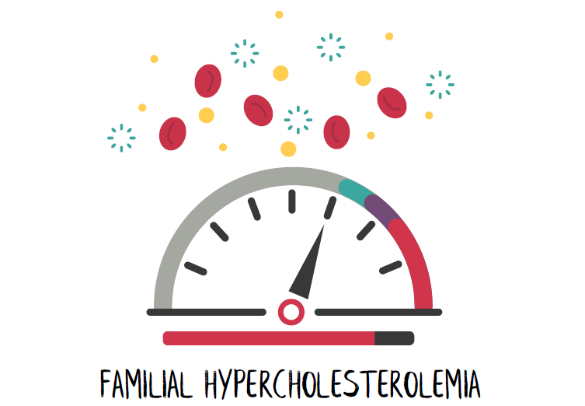
EFC14643 - Study Drug & Indication
Product : Alirocumab (Praluent®)
Sub-cutaneous Injection & 4 dosage possibilities : 40 mg, 75mg , 150mg and 300mg
Approved for adults:
- In the US, indicated for the treatment of adults with heterozygous familial hypercholesterolemia or clinical atherosclerotic cardiovascular disease.
-In the EU, for adults with primary hypercholesterolemia (heterozygous familial and non-familial) or mixed dyslipidemia.
ODYSSEY OUTCOMES : v/s placebo in patients with recent ACS (Acute Coronary Syndrome), alirocumab subcutaneous Q2W
Reduced ischemic events ( all cause mortality and MI)
Indication in Pediatric Expected :
FDA requested a pediatric placebo controlled study for Alirocumab

Slide 37
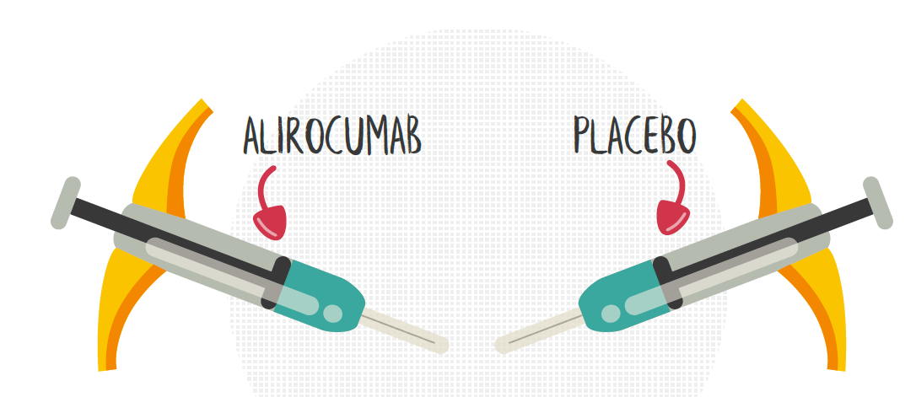
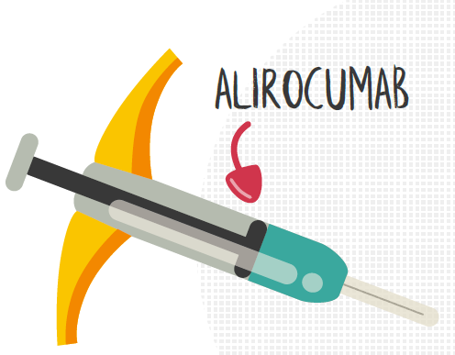
EFC14643 - Study Design
Phase III, randomized, 24-week DB treatment, placebo-controlled, parallel- group, multi-national, multi-center study followed by an OL treatment period of 80 weeks.
Weeks
Every 2 or 4 Weeks
Every 2 or 4 Weeks

Slide 38
EFC14643 - Patient Profile Inclusion criteria
Age between 8 -17 years old included
Diagnosed with Heterozygous Familial Hypercholesterolemia (HeFH)
Treated with optimal dose of statin with or without Lipid modifying therapies (LMTs), or non-statin LMTs, if statin intolerant, and at stable dose for at least 4 weeks.
N.B: Signed Informed Consent (Parental & Assent)

Slide 39
Patient Profile: Main Exclusion Criteria
LDL-C <130 mg/dL
BW less than 25 kg.
Age 8 to 9 years not at Tanner stage 1
Age 10 to 17 years not at least at Tanner stage 2
Secondary hyperlipidemia
Homozygous familial hypercholesterolemia.
Fasting triglycerides >350 mg/dL
Uncontrolled Medical conditions: in Diabetes, BP (hypertension), Thyroid disease and Severe Renal/Hepatic Impairment

Slide 40
EFC14643 - Study Risks
Alirocumab =Very good safety profile -> no label / Risk Management Plan updates required for safety since 1st Market Authorization
The most common side effects reported with alirocumab include:
injection site reactions (such as, but not limited to redness, itching, swelling and pain),
general itching,
and upper respiratory symptoms (such as pain in mouth/throat, excess mucous draining from nose and sneezing). None of these events occurred in more than about 6% of patients
Other adverse reactions:
Allergic Reactions:
Neurocognitive Events (for attention, visual Learning, Psychomotor and Executive Functions) : reported in 0.8% of patients treated with PRALUENT and 0.7% of patients treated with placebo .
Liver Enzyme Abnormalities
NEW! Flu-like illness is being added as an ADR to the Praluent labels based on post-marketing experience

Slide 41
EFC14643 - Study Benefits
The patient will benefit at no cost from all the following activities:
Closer medical observation,
Closer dietetic follow-up,
Medical treatment (alirocumab & background therapy)
Laboratory tests :Genetic and blood tests (Central Laboratory)
Patient transportation (per clinic visit)
Meal allowance (after blood draws)
N.B : VOLUNTARY PARTICIPATION / WITHDRAWAL

Slide 42
EFC14643 - Sites & Contacts
American University of Beirut Medical Center - AUBMC
John Kennedy Street, Abou Khater Building, Beirut, Lebanon.
Dr. Sami Azar (Endocrinologist)
Dr. Hala Tfayli (Pediatric Endocrinologist)
Phone #: 01-355500 (between 8 a.m. and 5 p.m.), Ms. Hanadi Beydoun (Research Coordinator).
Saint George Hospital University Medical Center -SGHUMC
Youssef Sursock Street, Achrafieh, Beirut, Lebanon
Dr. Wissam Fayad (Pediatric Endocrinologist) – 03/370655
Dr. Carole Saba (Pediatric Endocrinologist) – 03-114706

Slide 43
Take home message
FhHC is highly prevalent in Lebanon
Screening all children with familial history is mandatory as soon as 4 years of age
Statin is a effective and safe drug in childhood
Thank you

