Slide 1
Electrolyte Disorder
Rupesh Raina, MD, FAAP, FACP, FASN, FAcadTM and FNKF
Adult-Pediatric Kidney Disease/Hypertension
Associate Professor of Medicine
Director of Research Akron Nephrology Associates
AGMC, Cleveland Clinic, Cleveland, Ohio
Staff Medical Research, Rebecca D. Considine Research Institute
Staff at Akron Children's Hospital, Akron, Ohio
Council for Faculty of Internal Medicine - Northeast Ohio Medical University, Rootstown, Ohio
Faculty Staff at Case Western Reserve University School of Medicine, Cleveland, Ohio

Slide 2


1. Emergency management
2. Tailored management to likely cause
General Case Management Principles

Slide 3
General Principles: Prevention
CONDITION | MONITORING | PREVENTATIVE THERAPIES
AKI | ↑ if concurrent other therapies | Intake restrictions
CKD | ↑ if concurrent other therapies/illness | Intake restrictions, sick day plans
Post-obstructive diuresis | EUC – Na/H20 wasting | Isotonic fluids to maintain hydration
Rhabdomyolysis | EUC CMP | Isotonic Fluids to maintain high urine output. (Consider bicarbonate)
Tumor Lysis Syndrome | EUC CMP | -Isotonic Fluids to maintain high urine output -Hypouricemic agent: Rasburicase
Citrate - extracorporeal anticoagulation | Calcium | Calcium infusion/ oral calcium supplements
Drugs | Increase monitoring if associated diseases/risks | E.g. Bicarbonate Rx: correct calcium/K deficits first

Slide 4
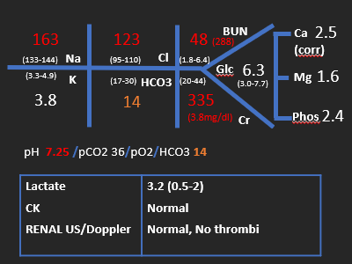
CASE 1: HYPERNATREMIA
2 year old with Trisomy 21
Oral aversion –PEG feeds
Past normal electrolytes/creatinine
Leaking PEG, diarrhoea, vomiting 4 days
Shocked, 16% loss of weight
Normal Saline Boluses 40ml/kg
Blood pressure & perfusion normalized
IDC – Some urine.
Dx: Acute Kidney Injury associated with severe hypernatremic dehydration

Slide 5
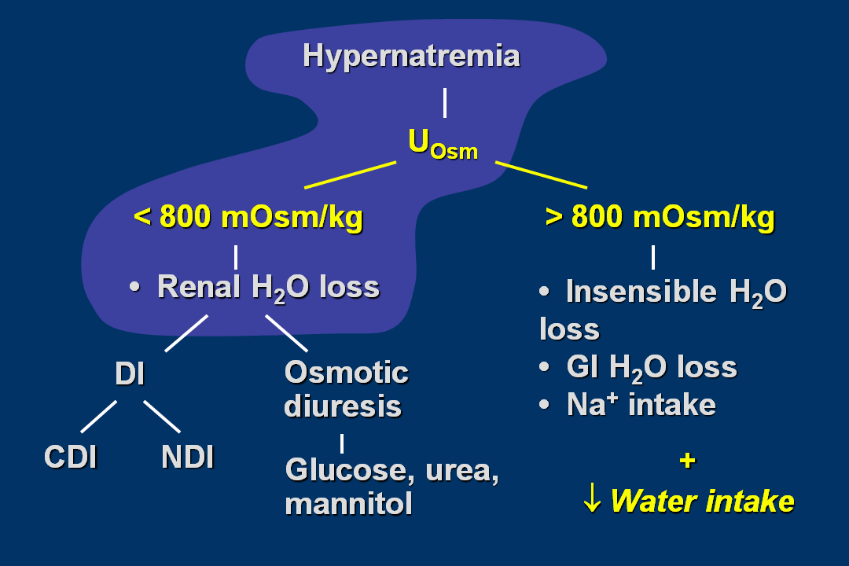

Slide 6
CASE 1: QUESTION
Your further management of this child would include :
A. 0.45% Saline – at urine output + other losses + replace remaining deficit
B. 0.9% Saline - at urine output + other losses + remaining deficit
C. Vascath & CVVHF
D. Replacement of deficit over 48hours
E. Replacement of deficit over 24 hours

Slide 7
CASE 1: Hyperosmolar state - Sodium & Urea
RISKS
AT PRESENTATION:
  Non-specific symptoms relate to intracellular dehydration - cerebral
  Risk of spontaneous cerebral hemorrhage, venous thromboses
  Total serum osmo> 335 or Na+ >160 - In this case osmolality 380
  Risk dependent on rate of change of osmolality
WITH TREATMENT:
  Rapid reduction in osmo or sodium may increase neurologic risks –cerebral edema
  Risk dependent on chronicity of hyperosmolar state

Slide 8
Case 1: Hypernatremia Work-Up
HYPERVOLEMIC
EUVOLEMIC
HYPOVOLEMIA
↑Total Body Water
↑ ↑ Total Body Sodium
↓ TBW
↔ TBNa
↓↓TBW
↓ ↔ TBNa
EXCESS NA INTAKE HYPERALDOSTERONISM
CUSHINGS SYNDROME
POOR H20 INTAKE
MILD DIABETES INSIPIDUS
GI LOSSES
DIABETES INSIPIDUS
DIURETICS
RENAL DISEASE
HYPERGLYCEMIA

Slide 9
HYPOVOLEMIC HYPERNATREMIA: WORK-UP
Urine Sodium & Urine osmolality if clinical scenario unclear
 | Uosm/UNa
GI LOSSES | ↑ / <20
DIABETES INSIPIDUS | ↓ / var
DIURETICS | ↓ / >20
RENAL DISEASE | ↓ / >20
HYPERGLYCEMIA | ↓ / >20

Slide 10
CASE 1: HYPERNATREMIA- MANAGEMENT
Early management must be TAILORED TO VOLUME STATE
Hypovolemic - 0.9% NaCl required to restore severe dehydration
  0.9% NaCl: 154mmol/L < serum Na – Sodium shouldn’t rise
Hypervolemic – Diuretics, Fluid restriction

Slide 11
CASE 1: HYPOVOLEMIC HYPERNATREMIA
PREVENTING THE 2nd EMERGENCY
TOTAL DEFICIT = Free water>isotonic ↓↓TOTAL BODY WATER/↓ ↔ TOTAL BODY Na |  | REPLACEMENT RATE Sodium > 160 - replace FWD over 48 hours Isotonic deficit – can replace over 24 hours
FREE WATER DEFICIT (FWD) = TBW x [(current Na⁺/140) – 1] | ISOTONIC DEFICIT = (% remaining dehydration x weight) - FWD = volume & mmol Na | TYPE OF FLUID Start with 0.45% & adjust acc to monitoring OR calculate: 1. FWD volume 2. Isotonic deficit volume 3. Isotonic Na mmol 4. Ongoing sodium/fluid needs
CALCULATE ONGOING FLUID/NA NEEDS urine output urine sodium insensible losses |  | MONITORING Rate of sodium correction <0.5mmol/L/hour

Slide 12



CASE 1: ANSWERS 1
A. 0.45% Saline – at urine output + other losses + replace remaining deficit
  Hypotonic with respect to plasma- likely to achieve a sodium drop
B. 0.9% Saline – at urine output + insensible losses + remaining deficit deficit
  Free water deficit will be very slow to replace
C. Replacement of deficit over 48hours
  Free water deficit should be replaced over 48 hours with Na>160 or high total osmo.
C. Replacement of deficit over 24 hours
  Isotonic deficit can be replaced over 24 hours, but not free water deficit
E. Vascath & CVVHF
  An option especially if poor urine output, deteriorating acidosis/uremia. Need to tailor sodium prescription in replacement fluid to allow slow rate of correction.

Slide 13
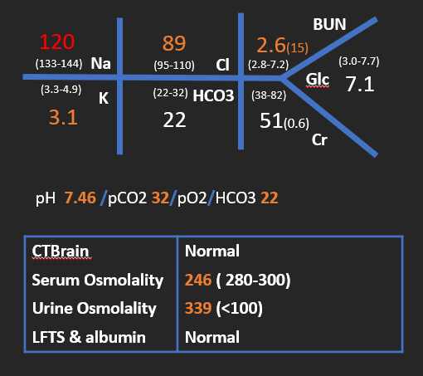
CASE 2: HYPONATREMIA
16 year old otherwise well
After soccer - vomited x1,
acute confusional state, lethargic,
Normotensive. Normal hydration state.
GCS 13 – disoriented.
Hyperreflexic, no focal signs
0.9% Saline + 40mmol KCL/L at “maintenance” charted
Dx: Symptomatic hyponatremia ? cause
Notes:
Had lowish- mg and phos- to check
Chase CTB

Slide 14
CASE 2: QUESTION
Your further management of this girl would include :
A. Continue maintenance 0.9% Saline
B. 3% Hypertonic Saline 1ml/kg over 1 hour
C. 3% Hypertonic Saline at ½ maintenance
D. Stop IV Fluids & restrict

Slide 15
CASE 2: Symptomatic Hyponatremia
RISKS
AT PRESENTATION:
  Acute reduction:
    <125mmol/L- non-specific symptoms (cerebral oedema)
    <120 – seizures, coma
  Chronic reduction: subtle symptoms
WITH TREATMENT:
  Chronic hyponatremia(days): rapid increase in osmo or sodium may increase neurologic risks – osmotic demyelination (central pontine myelinosis)
  Risk greatest Na<120

Slide 16
Case 2: Hyponatremia Work-Up
(True Hyponatremia- low plasma osmolality- exception hyponatremia with renal failure
Factitious- hyperlipidemia/Hyperglycemia)
HYPERVOLEMIC
EUVOLEMIC
HYPOVOLEMIC
↑↑ Total Body Water
↑ Total Body Sodium
↑ TBW
UNCHANGED TBNa
↓TBW
↓↓TBNa
GI LOSSES
DIURETICS
MINERALCORTICOID INSUFFICIENCY/resistance
SALT WASTING (nephropathy, cerebral)
RENAL FAILURE
LIVER FAILURE
HEART FAILURE NEPHROTIC SYNDROME
SIADH
POLYDIPSIA
DDAVP
HYPOTHYROID
GLUCOCORTIOCID DEFICIENCY

Slide 17
Case 2: Euvolemic Hyponatremic: Work-up
Urine Sodium & Urine osmolality if clinical scenario unclear
 | Uosm/UNa
SIADH | ↑ / >20
POLYDIPSIA | ↓/ >20
INAPPROPRIATE DDAVP | ↑ / >20
HYPOTHYROID | ↑ / >20
GLUCOCORTICOID DEFICIENCY | ↑ / >20
? Transient exercise associated hyponatremia

Slide 18
CASE 2: HYPONATREMIA- MANAGEMENT
SEVERE neurologic symptoms: coma/seizures
  3% (513mmol/L) Saline 1ml/kg/15 mins- may ↑ Na by 1mmol
  Aiming to improve neurologic symptoms
Hypovolemic Hyponatremia with Shock
  Fluid resuscitation to achieve hemodynamic stability - 0.9% Saline
  Known disease– CAH - hydrocortisone
Hypervolemic Hyponatremia with clear known cause – treat accordingly
  Known ESKD- dialysis
  Heart failure- diuretics

Slide 19
CASE 2: HYP0NATREMIA MANAGEMENT
EUVOLAEMIC HYPONATREMIA : SIAH/POLYDIPSIA
Negative balance: Restrict to 50% of “maintenance”
Wait for spontaneous diuresis
Treat underlying disease
Rate of correction/Monitoring
  Acute hyponatremia:
    Aim- 1mmol ↑ in sodium each 2 hours.
    If spontaneous diuresis raises more rapidly than this, unlikely to be a problem.
  Chronic hyponatremia: aim - <1mmol Na ↑ every 2 hours

Slide 20
CASE 2: ANSWERS
Continue maintenance 0.9% Saline
  May worsen hyponatremia if SIADH and urine osmolality fixed.
Bolus 10ml/kg 0.9% Saline
  Patient not hypovolaeamic, May worsen hyponatremia if SIADH and urine osmolality fixed.
C. 3% Hypertonic Saline 1ml/kg over 1 hour
  ? Justified with these symptoms
D. 3% Hypertonic Saline at ½ maintenance
  Will provide 614 mmol sodium over 24 hours! No evidence that child has sodium loss as cause of hyponatremia.
E. Fluid restrict
  She has euvolemic hyponatremia with water overload – fluid restriction will improve this regardless of cause – Polydipsia/SIADH/Hyperthyroidism/Glucocorticoid deficiency

Slide 21
Symptomatic Hyponatremia
Management
Estimate how much 1 L of fluid will raise the [Na] by the following equation:
Change in Na / 1 Liter fluid =
Fluid [Na] – Serum [Na]
TBW + 1
Then estimate infusion rate by dividing desired rise Na per hour by the above change/1L
NEJM 2000:342;21, 1581-1588

Slide 22
Symptomatic Hyponatremia
Management
Hot salt:
  3% NaCl, 513mEq Na/L
  100% extracellular distribution
  Results in large volume expansion
  Use for severe manifestations of hyponatremia (seizures, coma) or very low sodium levels
  Only use in ICU setting
  When given with lasix, hypotonic urine increase rate of free water excretion

Slide 23
Symptomatic Hyponatremia
Management
Normal Saline
  0.9% NaCl, 154 mEq Na/L
  100% extracellular distribution
  25% remains in vasculature
  Used when symptoms are milder, or when severe symptoms resolve, for slower correction of Na

Slide 24
Symptomatic Hyponatremia
Example
Option 1) Hot salt:
  According to the equation, 1 liter of 3% NaCl would raise the [Na] by 16.7mEq/L
    (513-112)/(23+1) = 16.7
  To raise Na 2mEq/L/hr in 4 hours, then 120cc/hr will need to be infused
    (2mEq/L/hr) * (1000cc/16.7mEq/L) = 120cc/hr for 4 hours
  Infusion started and symptoms resolve after 2 hours, repeat Na: 117mEq/L

Slide 25
Symptomatic Hyponatremia
Example
Option 2) Normal saline at the beginning:
  According to the equation, 1L NS will raise [Na] by 1.75mEq/L
    (154-112)/(23 + 1)
  To raise Na 2mEq/L/hr in 4 hours, then 1.14L/hr will need to be infused
    (2mEq/L/hr) * (1000cc/1.75mEq/L) = 1140cc/hr for 3 hours
  You can see how hot salts would help in life-threatening situations

Slide 26
Symptomatic Hyponatremia
Example
Option 3) No seizures or other symptoms
According to the equation, 1L NS will raise [Na] by 1.75mEq/L
  (154-112)/(23 + 1)
  To raise Na 10mEq/L/24hr (or 0.42mEq/L/hr), then 240cc/hr will need to be infused
If hot salt used, 1L will raise Na 16.7mEq/L
  To raise Na 10mEq/L/hr, then 25cc/hr needs to be infused

Slide 27
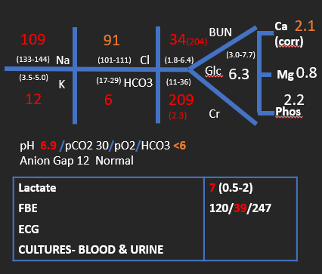
CASE 3: MIXED
6 month old
Poor feeding & vomiting 2-3 days
Increased work of breathing and blue
Cyanosed, floppy, poor perfusion
Hypotensive, Hypothermic
0.9% Saline 20ml/kg bolus via IO
Intubated, ventilated
Ceftriaxone/Flucloxacillin
Further 0.9% Saline 20ml/kg + inotropes
Dx: Hypovolemic/septic shock, Acute Kidney Injury, critical hyponatremia/hyperkalemia, Normal anion gap metabolic acidosis.

Slide 28
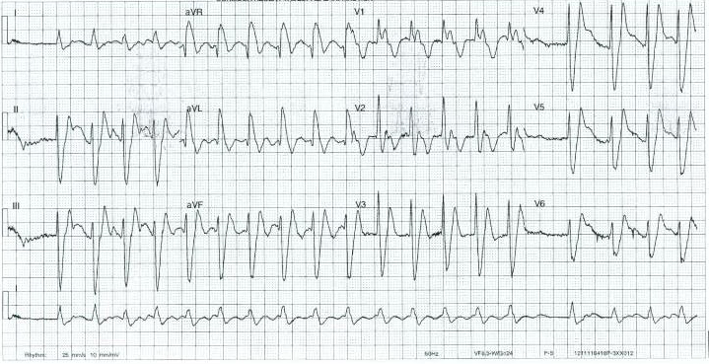
CASE 3: HYPERKALEMIA , HYPONATREMIA
RISKS
SODIUM:
Cerebral oedema
Rapid changes in osmo or sodium may increase neurologic risks
POTASSIUM:
Hyperkalemia- arrythmias
K>6.5 most likely to be associated with ECG changes
    ~6: peak T waves
    ~7: increased PR interval
    ~8-9: absent P wave, wide QRS
    Ventricular fibrillation
    Asystole

Slide 29
CASE 3: QUESTION
Your further management of this child would include :
Salbutamol nebuliser
Resonium
Bicarbonate
Calcium Gluconate
Vascath & CVVHF
Hydrocortisone
Fludrocortisone
Hypertonic Saline

Slide 30
CASE 1: HYPERKALEMIA MANAGEMENT
Cardiac Protection | Calcium gluconate: increases threshold potential → decrease cardiac cell excitability | Onset within minutes Lasts 30minutes | Calcium chloride –stronger alternative but risk of tissue necrosis.
Lower K⁺ acute but temporary: shift K to ICF | Insulin & dextrose Salbutamol nebulizer Sodium Bicarbonate | onset-15 minutes/Lasts 60min onset – 30mins onset- 1hour/Lasts 2-3 hours | Correct calcium if low first
Remove K+ | Kayexalate via feces ( may also remove Mg and Ca Furosemide via urine Hemodialysis/Hemofiltration/Peritoneal Dialysis | Onset 1-2 hours Onset - 2 hours | CI- bowel obstruction Avoid in neonates

Slide 31
CASE 3: HYPONATREMIA/HYPERKALEMIA WORK-UP
TURE HYPERKALEMIA
HYPONATREMIA
↑ INTAKE
↑ ICF RELEASE
↓EXRETION
HYPERVOLEMIC
EUVOLEMIC
HYPOVOLEMIA
IATROGENIC
BLOOD PRODUCTS
RENAL FAILURE
ADRENAL INSUFFICENCY
ALDOSTERONE RESISTANCE
↑↑Total Body Water
↑ Total Body Sodium
↑ TBW
↔ TBNa
↓ TBW
↓↓TBNa
METABOLIC
ACIDOSIS
TUMOR LYSIS
RHABDOMYOLYSIS
HEMOLYSIS
MASSIVE BURNS
DRUGS:
ACEI
K SPARING DIURETICS
B-BLOCKERS
SUCCINYLCHOLINE
RENAL FAILURE
LIVER FAILURE
HEART FAILURE
NEPHROTIC SYNDROME
POLYDIPSIA
SIADH
DDAVP
GLUCOCORTICOID DEFICIENCY
GI LOSSES
SALT WASTING (nephropathy, cerebral)
ADRENAL INSUFFICIENCY
ALDOSTERONE RESITANCE
DIURETICS

Slide 32
CASE 3: QUESTION
Your further management of this child would include :
Salbutamol nebuliser
Resonium
Bicarbonate
Calcium Gluconate
Vascath & CVVHF – lets just wait & see
Hydrocortisone
Fludrocortisone – volume/salt more important, won’t hurt but probably wont help
Hypertonic Saline – sodium is critical, but no clear symptoms, lets wait & see

Slide 33
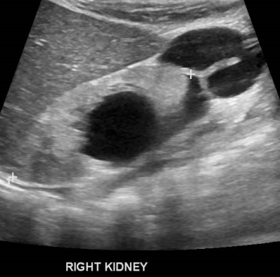
CASE 3:Continued
Further work-up :
Serum Osmolality | 289
Urine Osmolality | 245
Urine Sodium | 45
Acute Cortisol | 1500
Urine | Cloudy/ 3 ml/kg/hour
Dx: Salt wasting nephropathy,
Acute Kidney Injury, Urosepsis.
? Pseudohypoaldesteronism

Slide 36
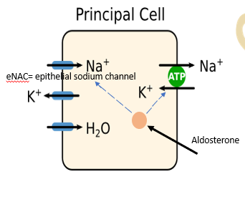
CASE 3: HYPERKALEMIA/HYP0NATREMIA
TYPE 4 RTA
Hypoaldosteronism:
  Salt-wasting Congenital Adrenal Hypoplasia
  Addison’s disease
Aldosterone resistance (pseudohypoaldosteronsim)
  Genetic (PH1)
  Acquired:
  drugs/tubular obstruction/pyelonephritis
Management: pseudohypoaldosteronism- hydronephrosis/UTI
Salt loading
Bypassing obstruction, restoring urine output, antibiotics

Slide 37
CASE 3: ONGOING MANAGEMENT
BUN
Repeat Bloods after 5 hours
Urine output: 2-3ml/kg/hour
Stable on low dose noradrenaline
HOW MUCH SALT TO GIVE?
HOW QUICKLY?
114 ↑
103
30 ↓
(133-144)
Na
(101-110)
Cl
(1.8-6.4)
(3.0-7.7)
Glc
(3.5-5.0)
K
(17-29)
HCO3
(11-36)
6.9 ↑
8 ↑
190 ↓
Cr

Slide 38
CASE 3:HYPONATREMIA: Mx NA WASTING
Preventing the 2nd emergency
TOTAL NA DEFICIT=Pure Na + Isotonic Na ↓TOTAL BODY WATER/↓ ↓TOTAL BODY Na |  | REPLACEMENT RATE Total Na deficit with fluid deficit over >48 hours
PURE NA DEFICIT(mmol) based on hyponatremia= (140-P_{Na} x TBW) mmol | ISOTONIC NA DEFICIT (mmol) = % remaining dehydration x weight x 140mmol/L | TYPE OF FLUID Intravenous: start with 0.9% Saline, additional Na with NaBicarb OR calculate: 1. Pure Na & Isotonic Na deficit 2. Isotonic deficit volume 3. Ongoing sodium/fluid needs
FLUID DEFICIT = % remaining dehydration x weight
CALCULATE ONGOING FLUID/NA NEEDS urine output urine sodium insensible losses |  | MONITORING Rate of sodium correction <0.5mmol/L/hour

Slide 39
Case:4
6 yr. old girl present to ED with 4hrs history's of nausea, vomiting, salivation, headache, blurred vision, and acidotic “Kussmaul” breathing
She severe mixed acidosis, metabolic and respiratory with high anion gap
The family gave us new information that the girl regularly took a drink called Kola Ingles. They stated that the patient had found a 250mL pink perfume bottle and that she had ingested 200mL of its contents, thinking it was the cola drink.

Slide 41
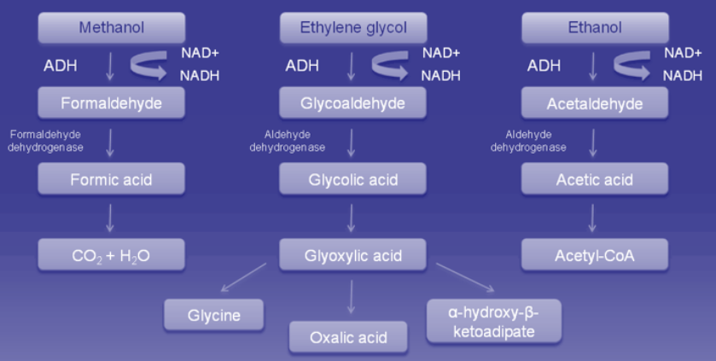
Metabolic Pathways for Ethylene Glycol, Ethanol and Methanol

Slide 42
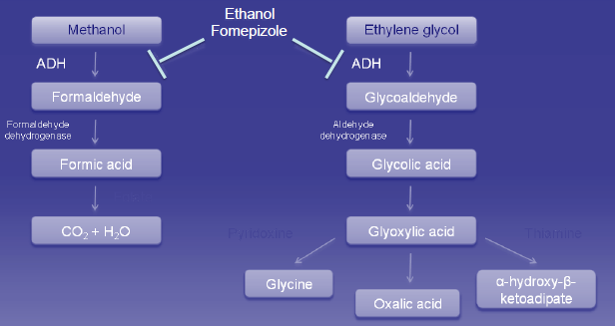
Treatment of Ethylene Glycol and Methanol Intoxications

Slide 43
Osmolal Gap and Its Application in Screening for Ethylene Glycol or Methanol Poisoning
Osmolal gap = measured serum osmolality − calculated serum osmolarity
Calculation of serum osmolarity (traditional units)Serum osmolarity = ([2 × sodium] + [BUN ÷ 2.8] + [glucose ÷ 18.1])
Osmolal gap = 355 mOsm/kg – 330 mOsm/liter = 25
Thus, 25 mOsm/liter are unaccounted for, so if the contribution of methanol to the osmolal gap is: methanol (mg/dl) ÷ 3.2, the value for methanol is 3.2 × 25 = 80 mg/dl
Ethanol ÷ 4.6, Ethylene glycol ÷ 6.2, and Methanol ÷ 3.2.

Slide 44
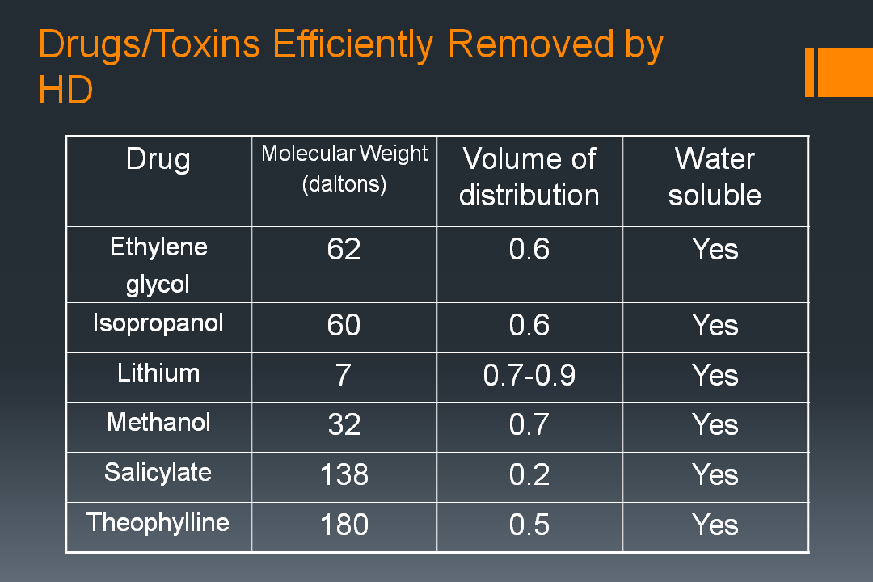

Slide 45
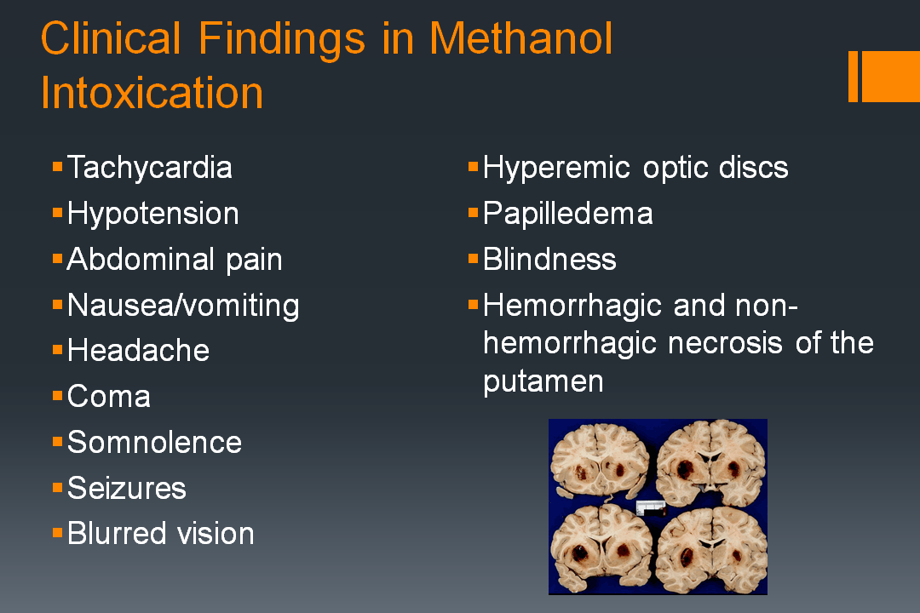

Slide 46
Methanol:Toxiderm
Absorption/metabolism
Absorbed rapidly via GI tract
Peak levels in 30-60 minutes
Latent period of ~ 24 hrs before development of symptoms or AGMA
75-85% metabolized via alcohol dehydrogenase in liver & 10-20% excreted unchanged by lungs
ADH metabolizes methanol to formaldehyde → oxidized to formic acid → AGMA & retinal toxicity

Slide 47
Management of Poisoning
Supportive care
  ABCs – intubation/vent & pressors if needed
Low index of suspicion in unexplained coma, ARF, or other metabolic disorders – do some quick screening:
  ABG
  Blood chemistries
  Figure out acid/base status
    pay close attention if resp alkalosis and met acidosis
  Calculate AG and osmolar gap
Prevent absorption & enhance elimination

Slide 48
General Measure
Fomepizole (4-methylpyrazole), Alcohol dehydrogenase was approved in 1997 for patients at least 12 years old with suspected or confirmed EG poisoning
Ld of 15 mg/kg with maint. doses of 10 mg/kg with total dose of 25 mg/kg
Fomepizole Treatment of Ethylene Glycol Poisoning in an Infant
Ethylene glycol – thiamine & pyridoxine
  Thiamine
  Shunts metabolism of glycolic acid towards non-toxic compound (alpha-hydroxy-beta- ketoadipic acid)
  Pyridoxine
    Shunts metabolism of glycolic acid towards glycine
Methanol – folate
    Enhance elimination of formic acid
Clin Toxicol (Phila) 2010 Jun;48(5):401-6); Pediatrics; Dec 2000. Vol 106-6

Slide 49
Indications for HD in Ethylene Glycol or Methanol Intoxication
Severe metabolic acidosis (pH 7.25 – 7.3)
Renal failure
Visual symptoms/signs
Deteriorating vital signs despite intensive supportive care
Ethylene glycol or methanol levels >50 mg/dl, unless fomepizole is being administered and patient is asymptomatic with a normal pH
Barceloux et al. J Toxicol Clin Toxicol 1999; 37; 537-560
Barceloux et al. J Toxicol Clin Toxicol 2002; 40; 415-446

Slide 50
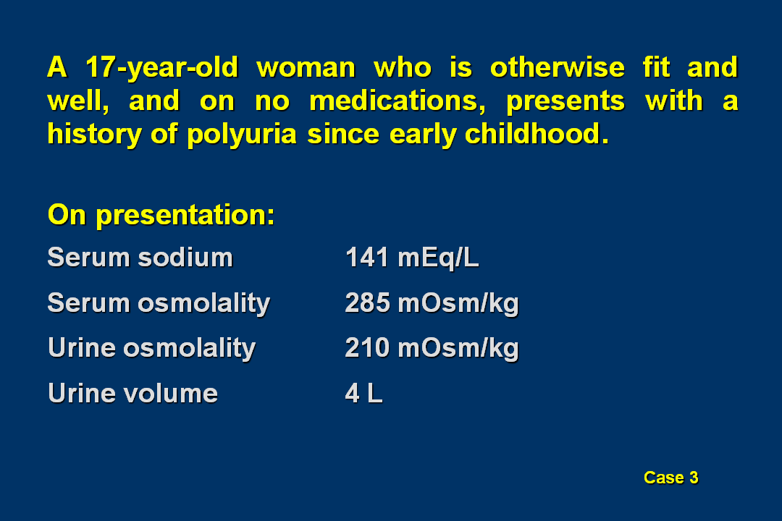
Case 5

Slide 51
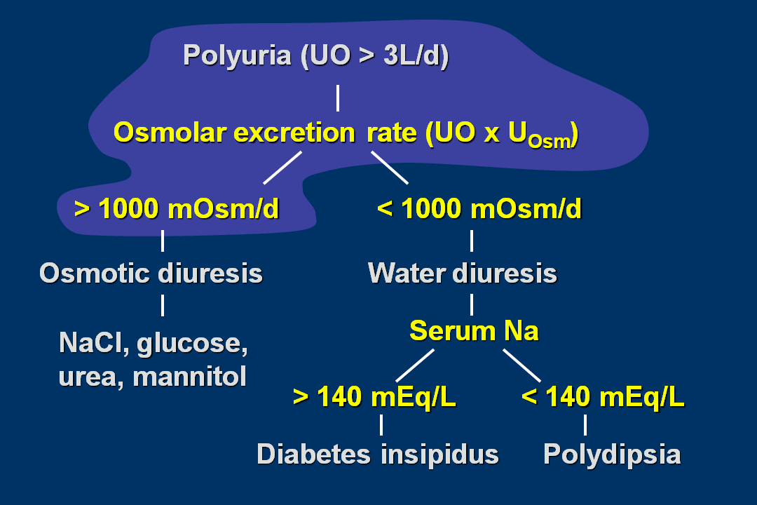

Slide 52
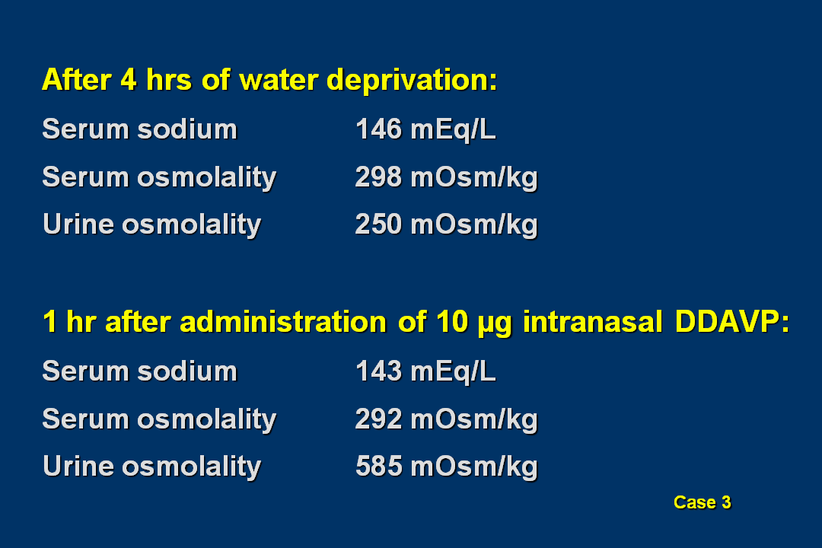

Slide 53
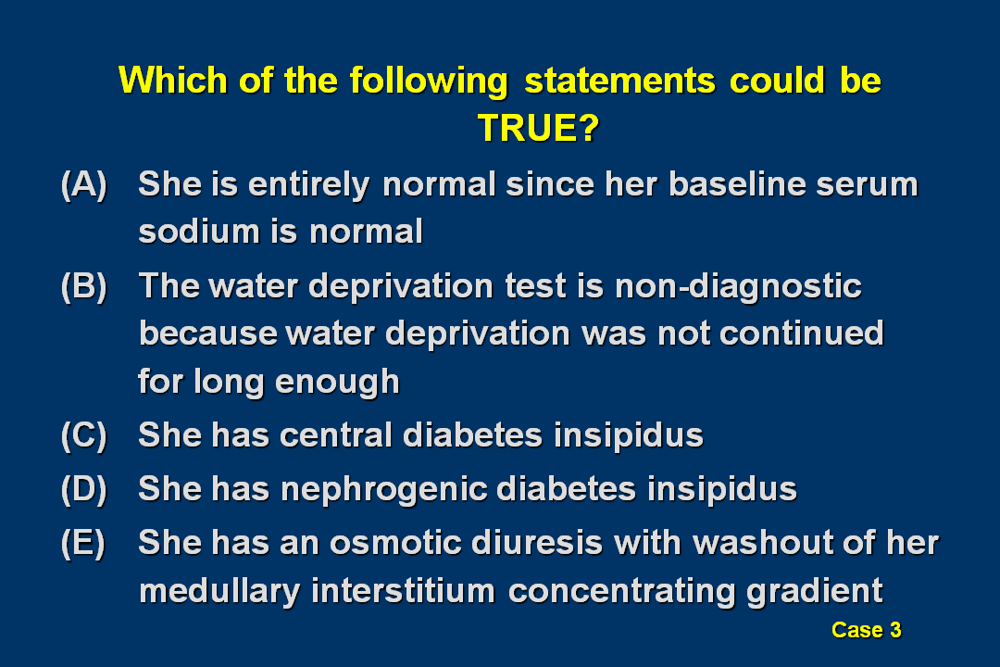

Slide 54
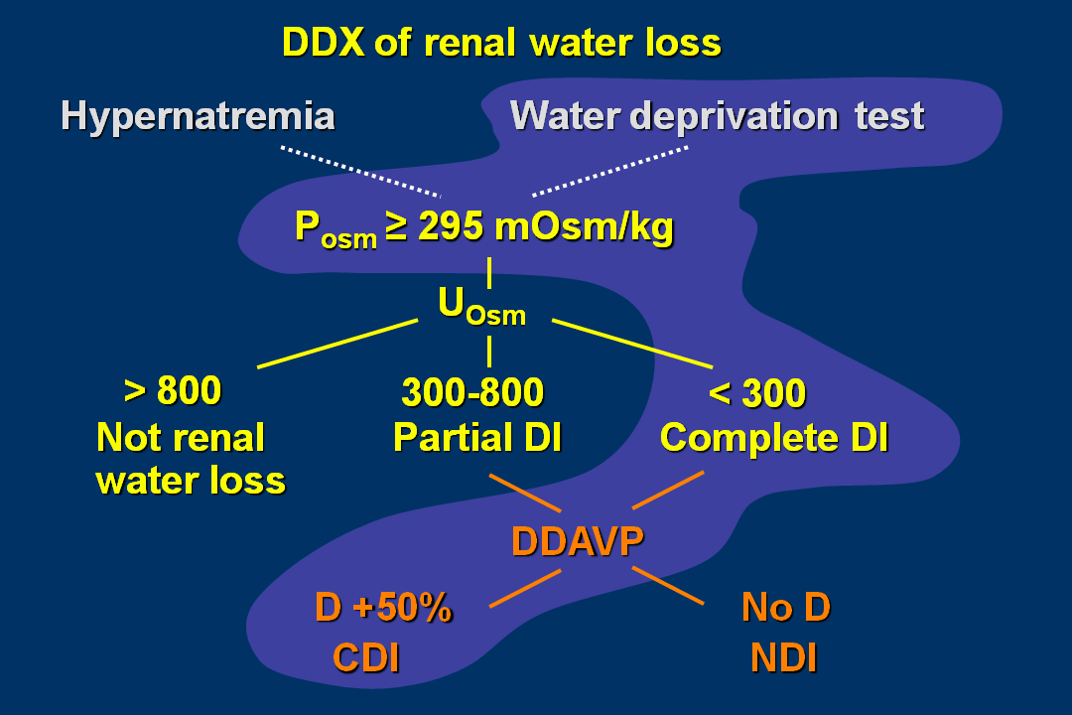

Slide 55
